Slide 1
Water-mind
The best way of saving-water

Slide 2
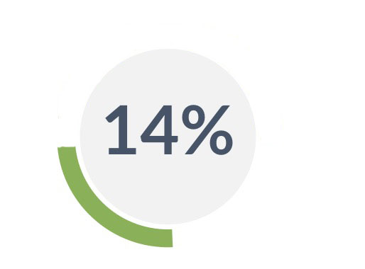
Let’s start at a little point of penetration…..
Average price of a bottle of water
why the water is much more valuable

Slide 3
Team member
柳煜辰
All members’ contributions can’t be calculated.
Because…
We are a team.
夏悦然
乌鑫亮
郁程
郭嘉茗

Slide 4

Here are we
POWER SAVED IS POWER PRODUCED

Slide 5
Did you notice …?
4.5 L
=
¥ 23.94
Notes:
As we can see

Slide 6
Transformation of HMW
The former
The latter
How to effectively attain the hot water
How to handle the cold water

Slide 7
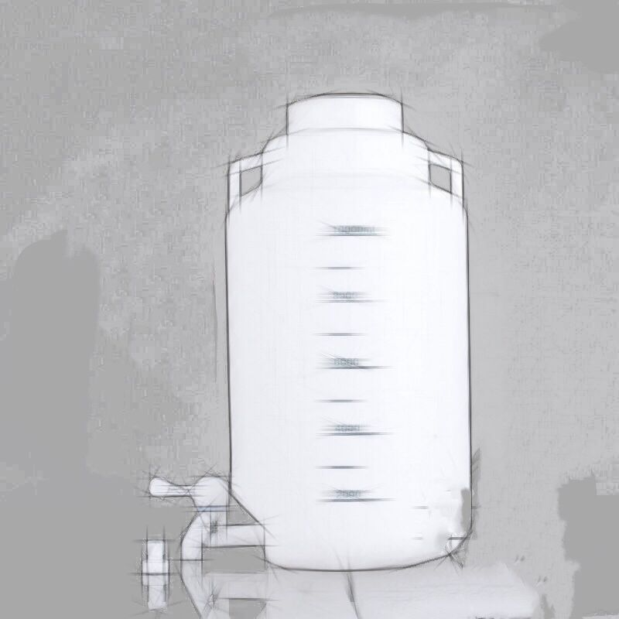
v1.0
Feasibility !
to Consumer
A Tap
A Tube
A bottle
¥ 19.90
Notes:
Eco-friendly

Slide 8
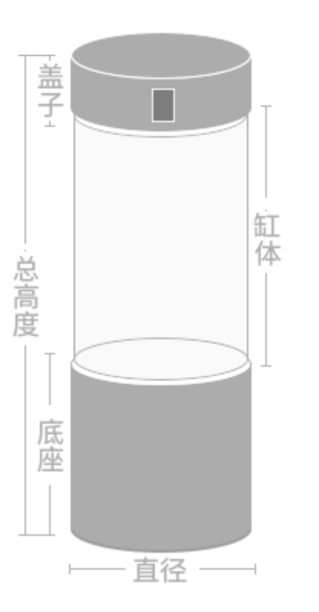
v2.0
to Consumer Pro
Art design
Light effect
IoT (Smart home)
¥ 400
Notes:
Original design

Slide 9
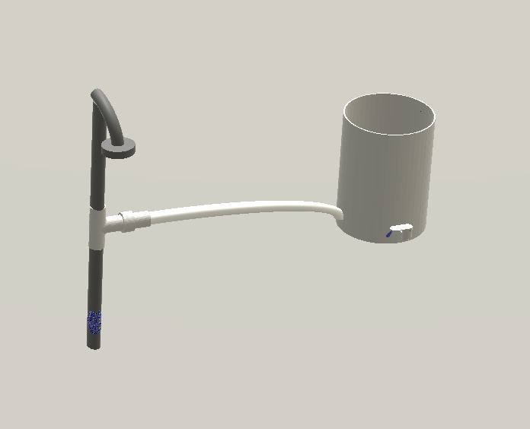
v1.1
Feasibility !
to Consumer
¥ 99.90
Notes:
Eco-friendly

Slide 10
v3.0
Divergence !
to Business
More decorative
UI support
Machine-learning
Excitation mechanism
Notes:
Decoration
To achieve the goal
Also we will
Moreover save water improve experience
No need to wo
What’s more

Slide 11
Our solution

Slide 12
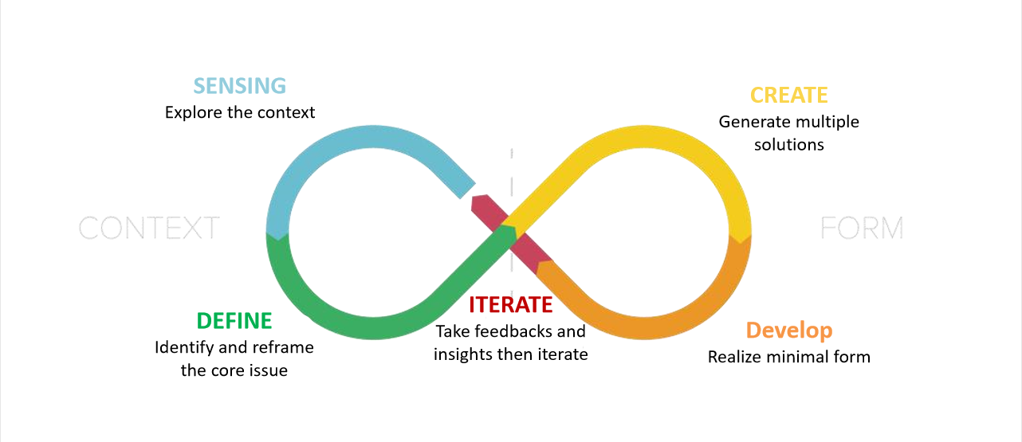
8. summarize
HMW and Solution

Slide 13
9. Recommendation and Close
Next step
Improve the product: more effective
more energy-saving;
Try to promote the product to the market
Future
For the sustainable development

Slide 14
Thank you
History
Our Team
Awards
Our Maps
Infographics
Portfolio

