Slide 1
DATACREW
FRAUD DETECTION FOR ONLINE PAYMENT PLATFORM
Sunday, 17th September 2023

Slide 2
Team DataCrew
Funsho-Akande Ifeoluwa
Maryam Habib
Ridwan Abdurahman

Slide 3
PROBLEM STATEMENT
An online payment platform processes millions of transactions daily, making it vulnerable to various types of fraudulent activities. These activities pose a significant threat to both the business and it’s customers. To safeguard the platform and enhance user experience, we aim to leverage the power of data science and machine learning to proactively detect and prevent fraudulent transactions.

Slide 4
OBJECTIVES
The primary aim is to enhance the security of the platform. By identifying fraudulent transactions early
To build an advanced machine learning model to predict whether a given transaction is potentially fraudulent or not
Provide accurate and efficient detection of fraudulent activities to assure users that their transactions are safe and secure.

Slide 5
FLOW PROCESS
DEFINE PROBLEM STATEMENT
DATA GATHERING & DATA CLEANING
DATA EXPLORATORY ANALYSIS
DATA PREPROCESSING
MODEL DEVELOPMENT & EVALUATION

Slide 6
THE DATASET
The Fraud Detection Dataset contains the following data
Transaction Data: Transaction ID, User ID, Transaction Amount, Transaction Date and Time, Merchant ID, Payment Method, Country Code, and Transaction Type.
User Data: User Age, User Gender, User Account Status, User's Transaction History, User's Credit Score, and User's Email Domain.
Merchant Data: Merchant Category and Merchant's Reputation Score.
Transaction Details: Transaction Status, Location Distance, Time Taken for Transaction, and Transaction Currency.
Device Information: Device Type, IP Address, Browser Type, and Operating System.
Additional Context: Transaction Purpose and User's Device Location.

Slide 7
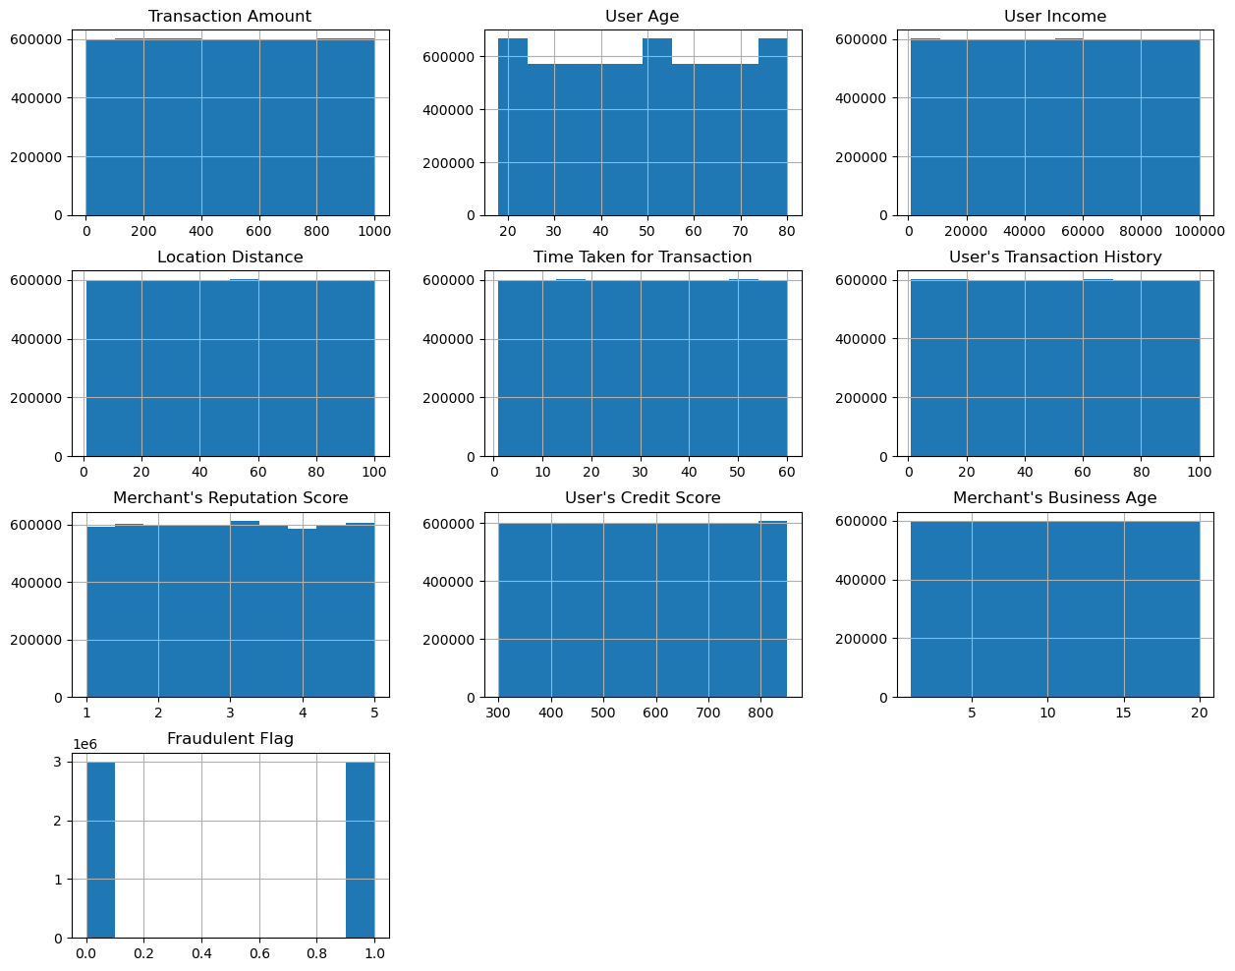
DATA CLEANING & DATA EXPLORATORY ANALYSIS
Datatypes were changed to suit each column
Certain columns were dropped to avoid data leakages
Checked for class imbalance

Slide 8
DATA PREPROCESSING
Data Transformation:
Data Splitting: The dataset was divided into training and testing sets using the train-test split method. This separation ensures the evaluation of models on unseen data to gauge their generalization capabilities.
Label Encoding: Label encoding was applied to the categorical columns, converting them into numerical representations

Slide 9
MODEL DEVELOPMENT
A Decision Tree Classifier model achieved on almost all metrics a 49%
A Gradient Boosting Classifier was used to find the most important features and best parameters to train the data on
The model was evaluated using both the test and validation set
Arriving at a model of that passed the 50% mark by a little on some of the evaluation metrics
precision recall f1-score support
0 0.50 0.59 0.54 599406
1 0.50 0.41 0.45 600594
accuracy 0.50 1200000
macro avg 0.50 0.50 0.50 1200000
weighted avg 0.50 0.50 0.50 1200000

Slide 10
LIMITATION
With such a large dataset, it proved difficult for the model to learn and limitations due to computational resources prevented the trial of other models

Slide 11
CONCLUSION
For the purpose of predicting the if a transaction is fraudulent or not , the gradient boosting classifier produced a better result than the decision tree classifier and might show further improvement with some hyperparameter tuning

Slide 12
THANK YOU

