Slide 1

Final Year Project: Smartly Hire
Project ID: BSSE-FYP-F25-059

Slide 2
Project Team
Hifza Khalid (SU92-BSSEM-F22-202)
Baqir Sultan (SU92-BSSEM-F22-201)
Muhammad Zubair (SU92-BSSEM-F22-196)
Supervisor: Mr. Sohail Irshad

Slide 3
Table of Content
Introduction & Background
Problem statement
Proposed Solution
Features & Scope
Requirements
Use Case Diagram
Functional & Non-Functional Requirements
System Design (Architecture, ERD, UML)
Challenges
Report Link

Slide 4
Introduction & Background
Background Remote hiring is now common, but it brings major issues:
Cheating attempts (~46%)
Inconsistent manual scoring (18–32%)
Proxy interviews (~22%)
Limited real-time monitoring (70% platforms)
High cost of proctoring tools (3×–6× higher)
These gaps demand a low-cost, AI-driven and secure hiring solution like Smartly Hire.

Slide 5
Problem statement
Traditional remote hiring faces major integrity challenges:
Impersonation or proxy interviews
Use of unauthorized devices (phone, notes, books)
Lack of real-time behavior analysis
Manual evaluation → biases
No automated report generation
No multi-modal monitoring system (face, emotion, head pose)
Smartly Hire solves these by providing AI-assisted proctoring + automated evaluation.

Slide 6
Solution
Smartly Hire is an AI-powered online interview platform providing:
✔ Secure authentication ✔ Real-time face detection & tracking ✔ Emotion recognition ✔ Head-pose monitoring ✔ Object detection (phone, book, paper) ✔ Violation logging & integrity scoring ✔ Automated report generation ✔ Job posting, applications, & interview workflows ✔ LLM-based evaluation (optional)

Slide 7
Features and Scope
Core Features
Admin dashboard
Job creation & management
Candidate applications
Proctored interview module
Live AI monitoring
Automated violation detection
PDF/JSON report generation
Integrity scoring engine
Emotion, distraction, and cheating analysis
Scope
Two user roles: Admin & Candidate
AI-based monitoring per 3–5 seconds
Scalable microservices architecture
Cloud-ready deployment

Slide 8
Requirements (Elicitation Techniques)
Interviews with recruiters/students
Market and literature review
System benchmarking of existing platforms
Wireframing & UI prototyping
SRS documentation
UML modeling

Slide 9
Requirements (User Types)
Admin / Recruiter:
Create jobs
Manage candidates
Monitor violations
View reports
Candidate:
Signup/login
Apply for jobs
Start interview
Answer questions
Receive evaluation

Slide 10
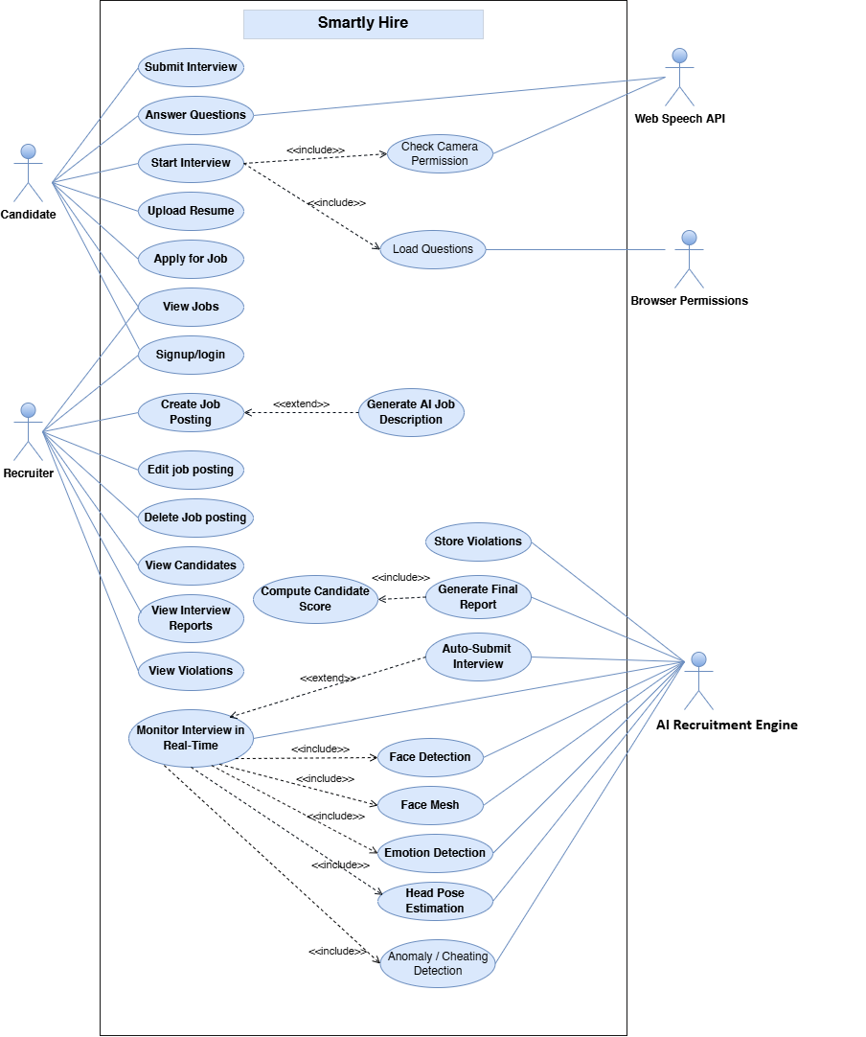
Use Case Diagram

Slide 11
Functional & Non Functional Requirements
Functional Requirements
User authentication
Job CRUD
Application submission
Interview question loading
Webcam access
AI proctoring (face, pose, objects)
Violation logging
Auto-submission
Report generation
Non-Functional Requirements
Performance (3–5 sec frame processing)
Security (JWT, HTTPS, DB encryption)
Usability (simple UI/UX)
Reliability (auto-save, resume session)
Maintainability (microservices, logs)
Scalability (50+ concurrent interviews)

Slide 12
System Design
Architecture Design
Entity Relationship Diagram
Class Diagram
Sequence Diagram
Activity Diagram

Slide 13
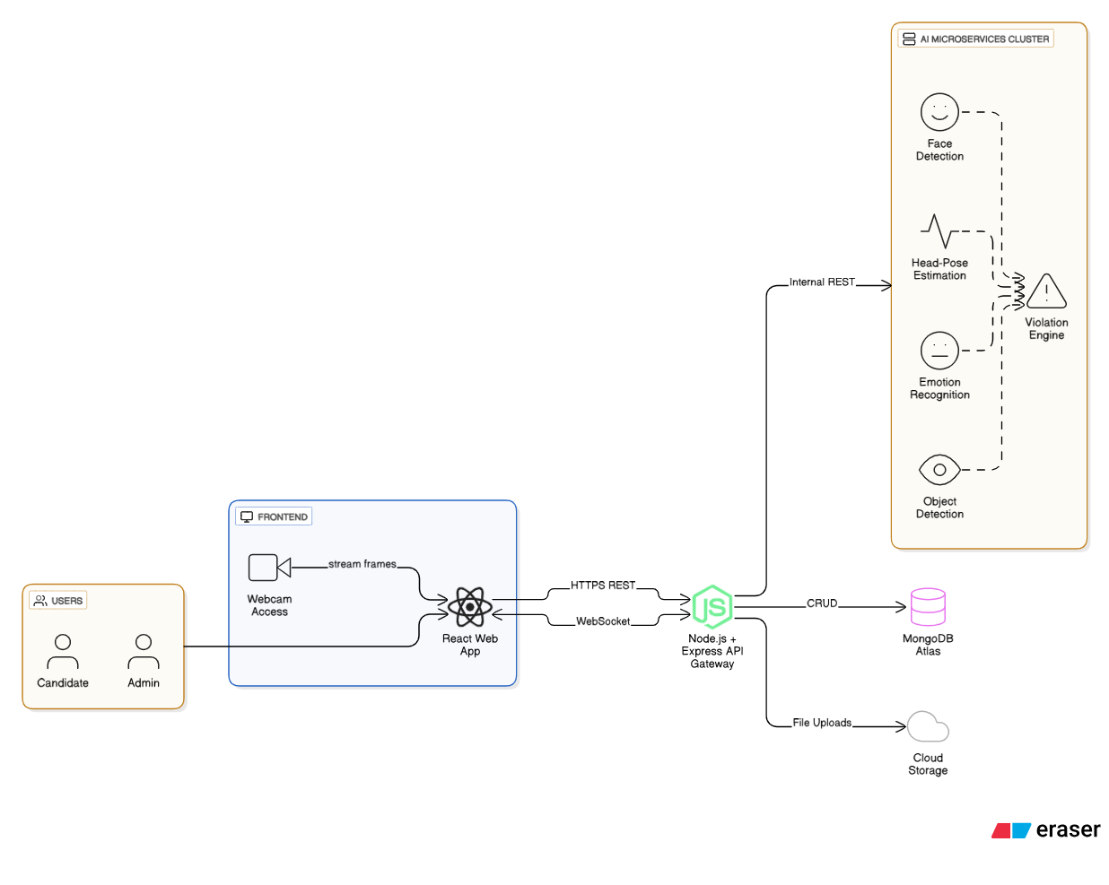
Architecture Design

Slide 14
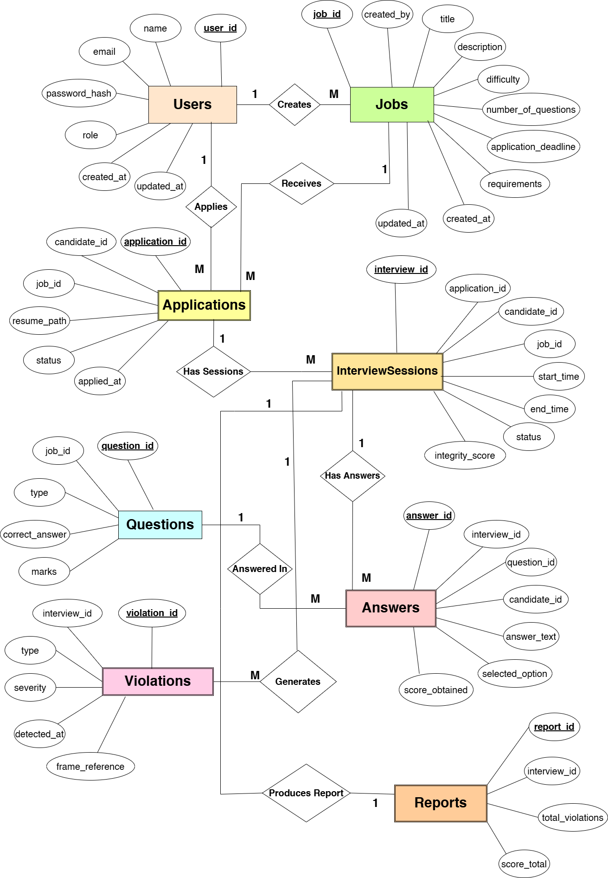
Entity Relationship Diagram

Slide 15
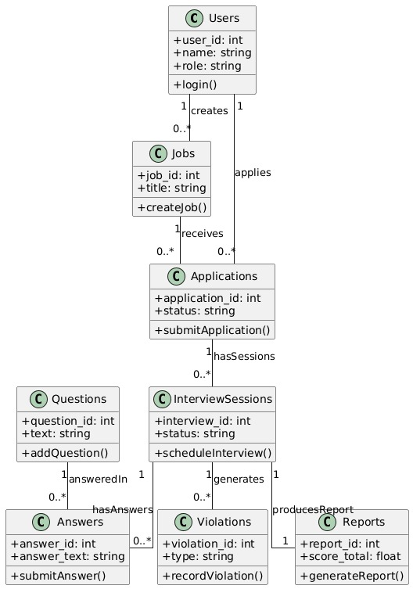
Class Diagram

Slide 16
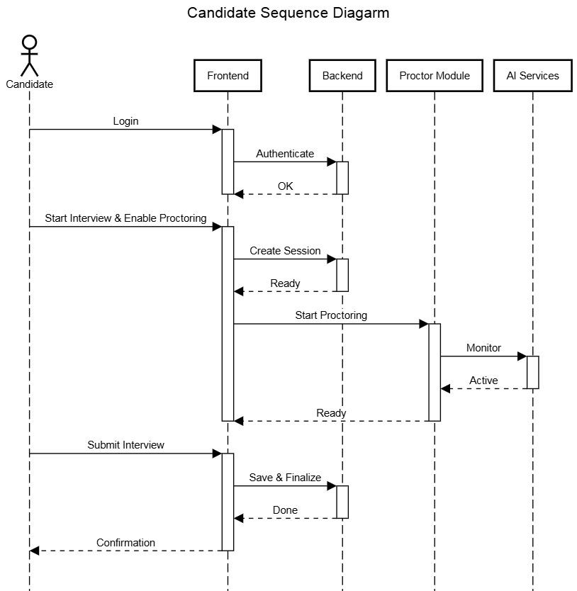
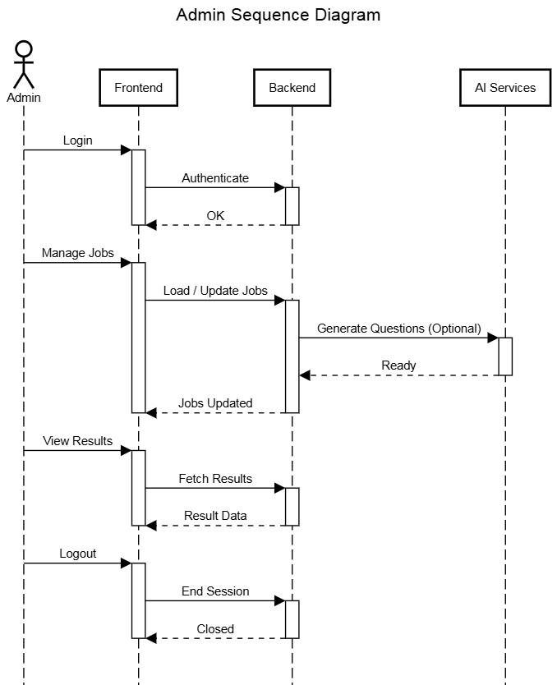
Sequence Diagram

Slide 17
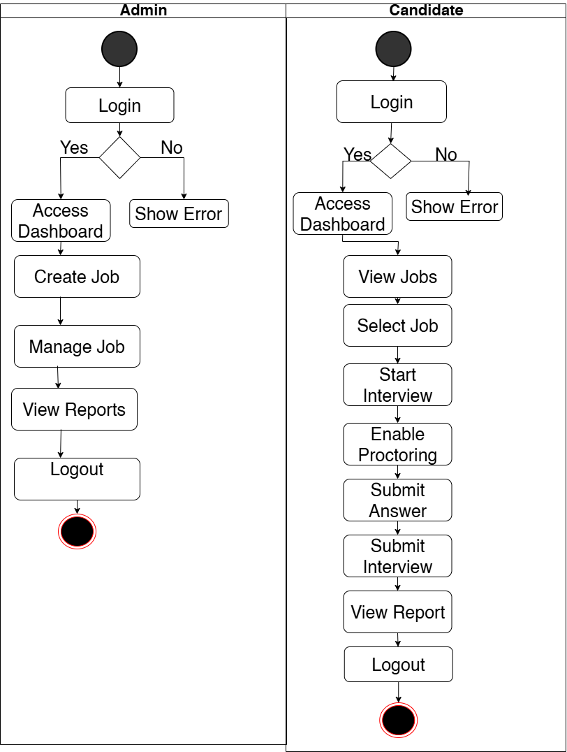
Activity Diagram

Slide 18
Challenges
Ensuring real-time AI detection with low latency
Processing video frames efficiently
Handling multiple AI models simultaneously
Synchronizing frontend-backend-AI pipelines
Managing sensitive data & privacy
Deploying ML services on cloud containers

Slide 19
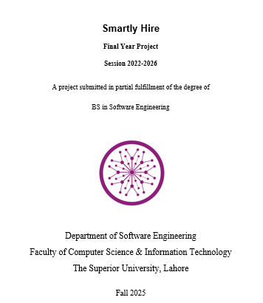
Report
Complete FYP Report:
https://github.com/Hifza-Khalid/Smartly-Hire-FYP/blob/main/FYP_Report_059.docx

