Slide 1
House Divided
A Thought Experiment

Slide 2
The Thought Experiment
Imagine that you are standing outside of the Senate Chamber, attempting to discover the outcome of a roll call vote. The vote has just taken place. You walk into the chamber and find that all 100 senators have just voted.
You are allowed to ask 1 senator of your choice how they voted, and they will respond truthfully. Then, you must guess the outcome of the vote -- passed or rejected.
So, who should you ask?
Notes:
Discuss n<100

Slide 3
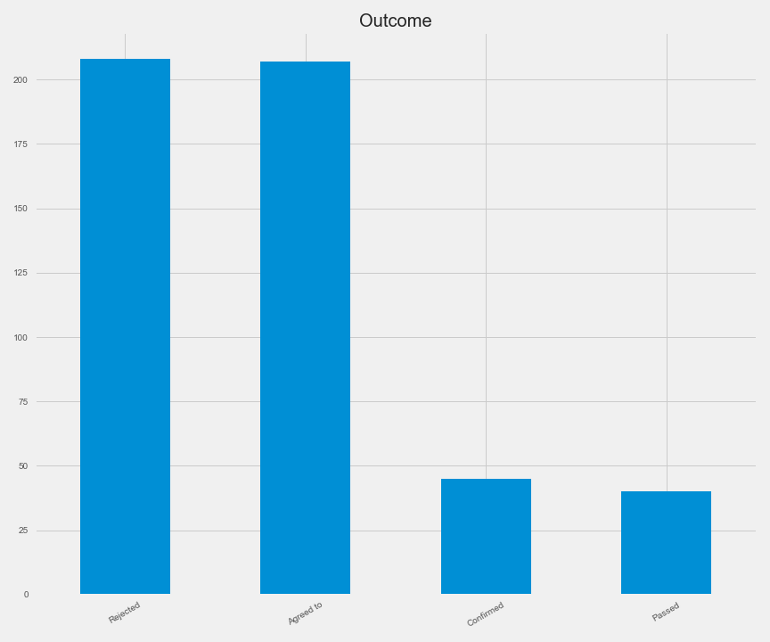
The Data: Outcomes

Slide 4
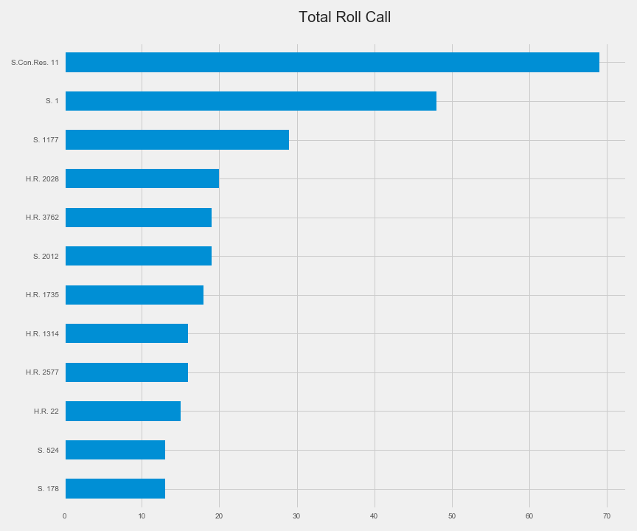
The Issues: Vote Share

Slide 5
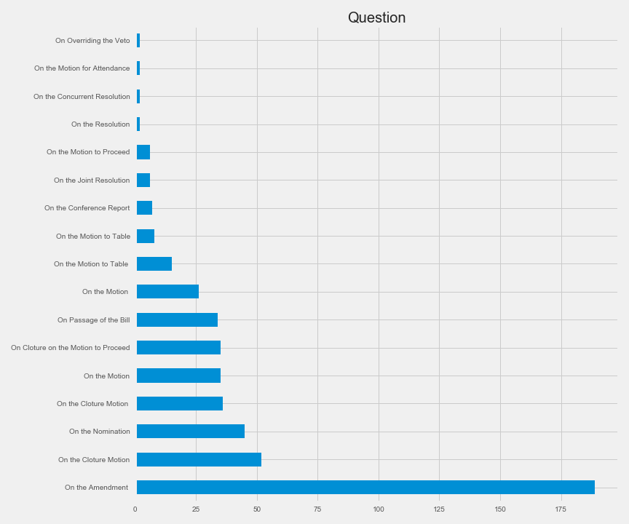
The Issues: Question

Slide 6
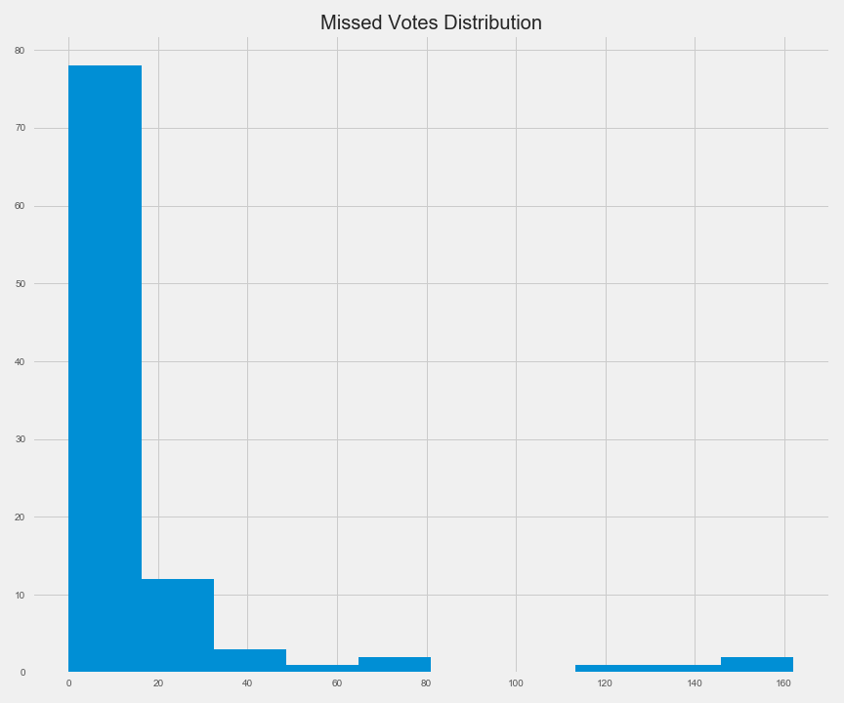
Missed Votes: Distribution

Slide 7
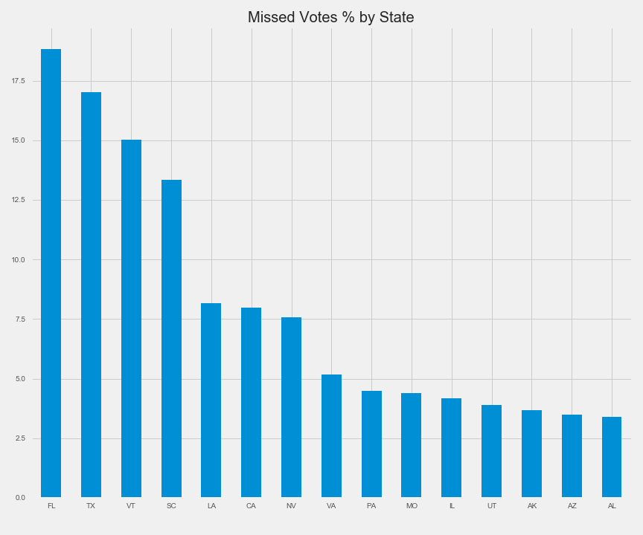
Missed Votes: States

Slide 8
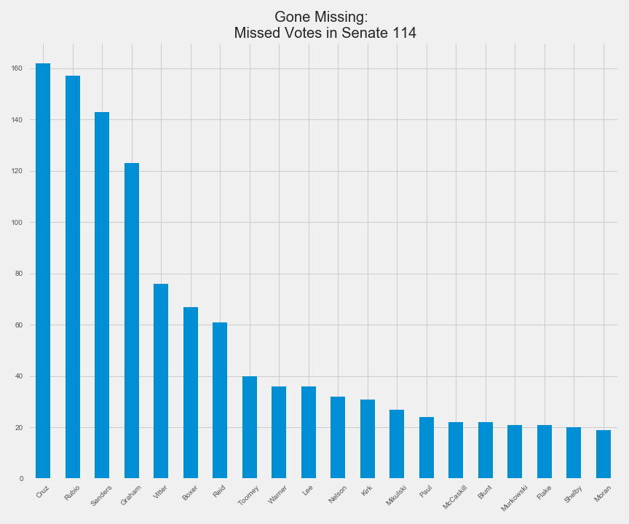
Missed Votes: Senator

Slide 9
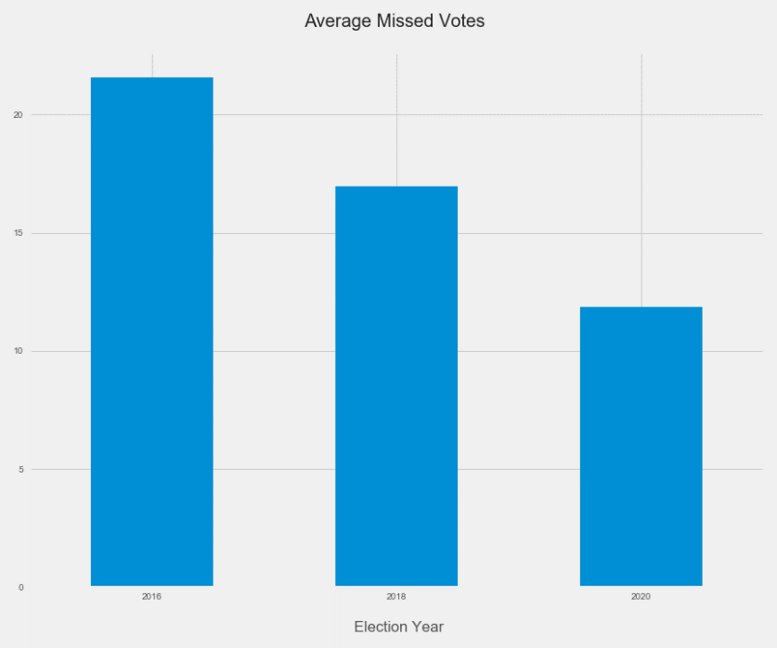
Missed Votes: Election Year
By Year

Slide 10
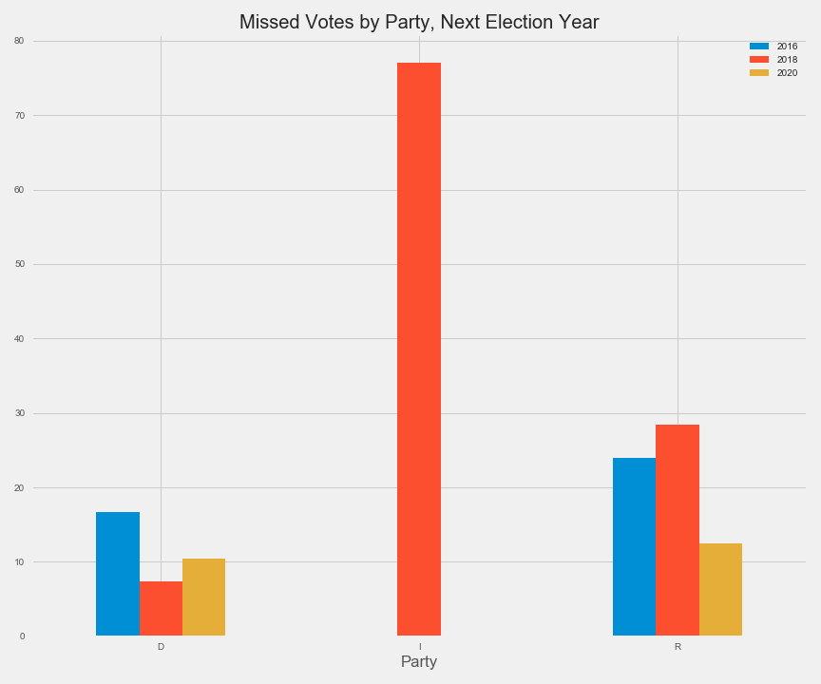
Missed Votes: Party, Election Year

Slide 11
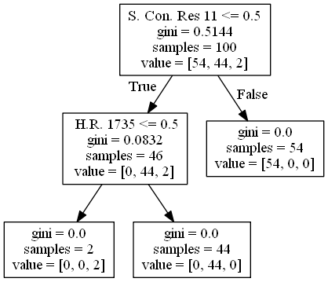
The Party Line: Easy Decisions

Slide 12
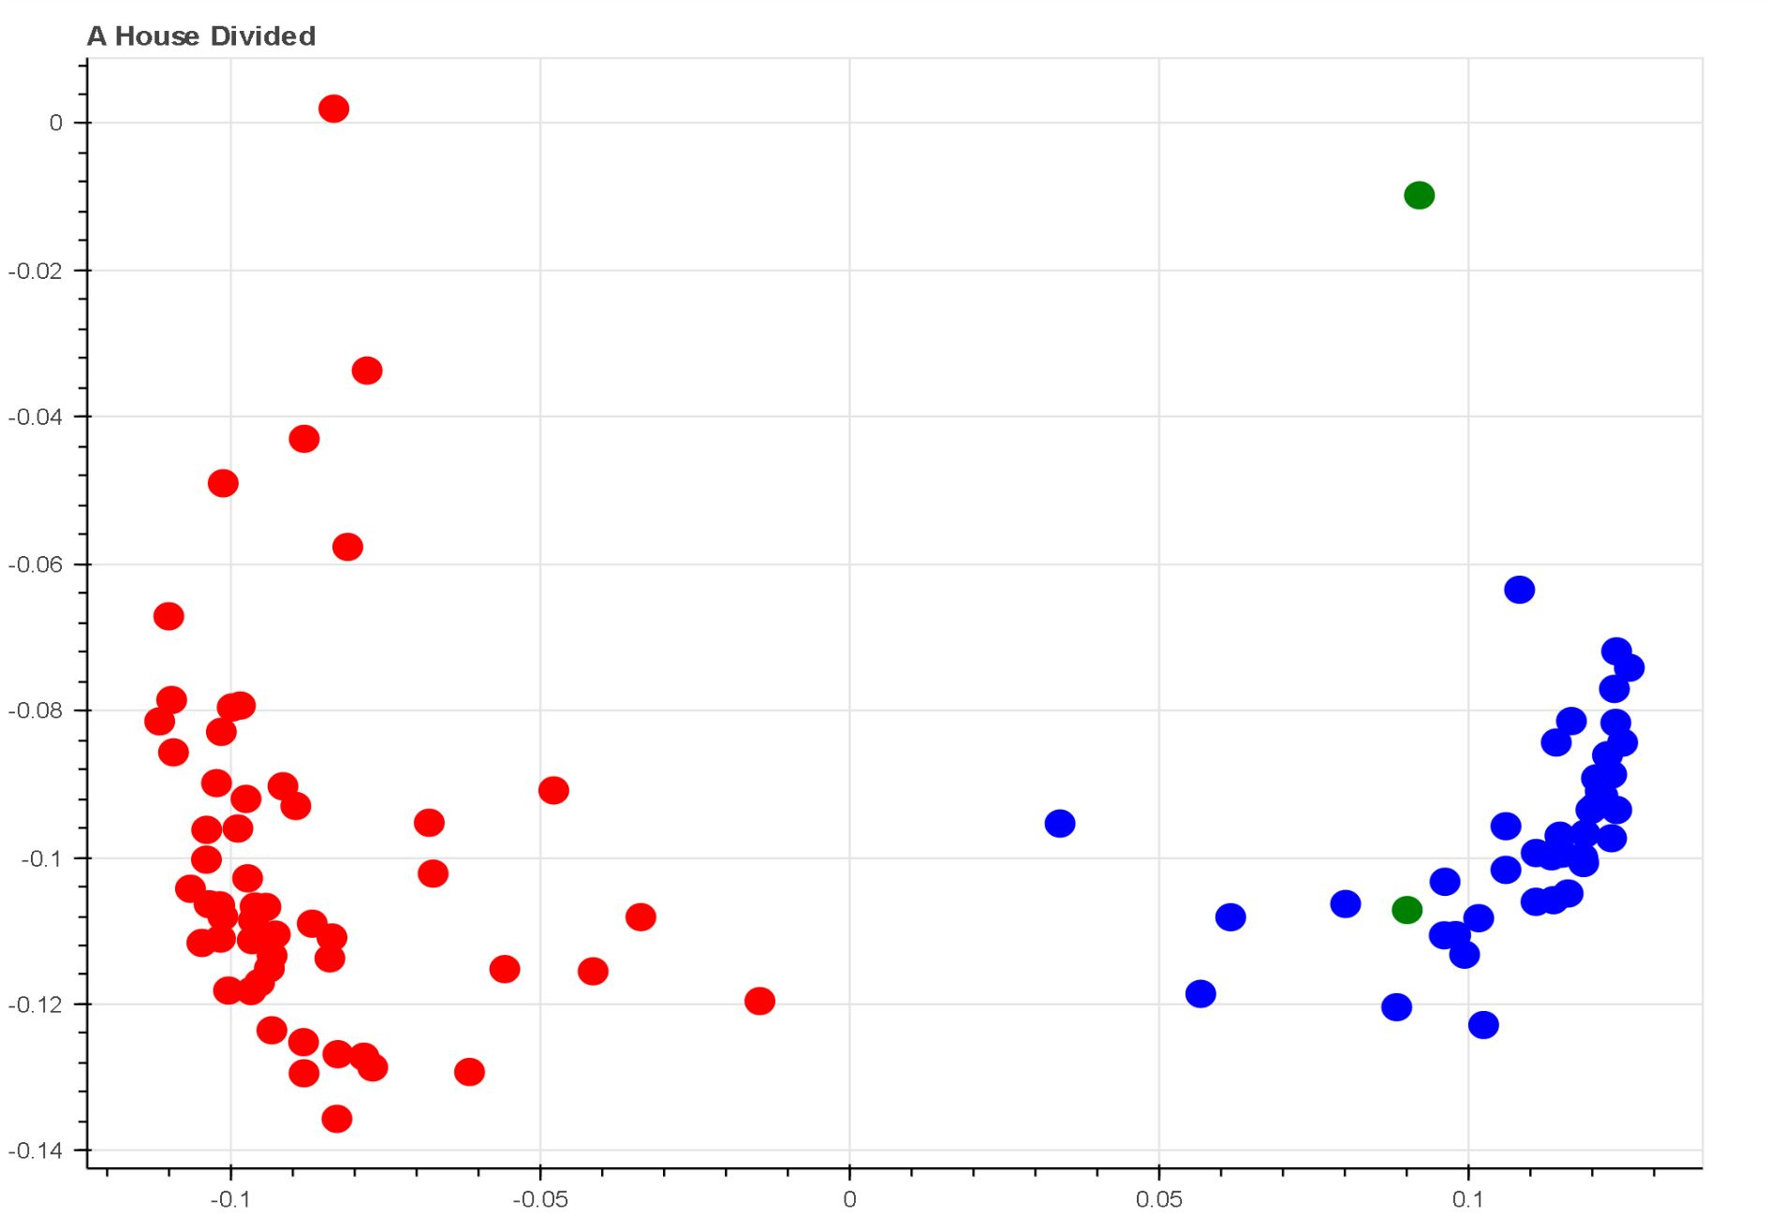
Clusters: A Who’s Who

Slide 13
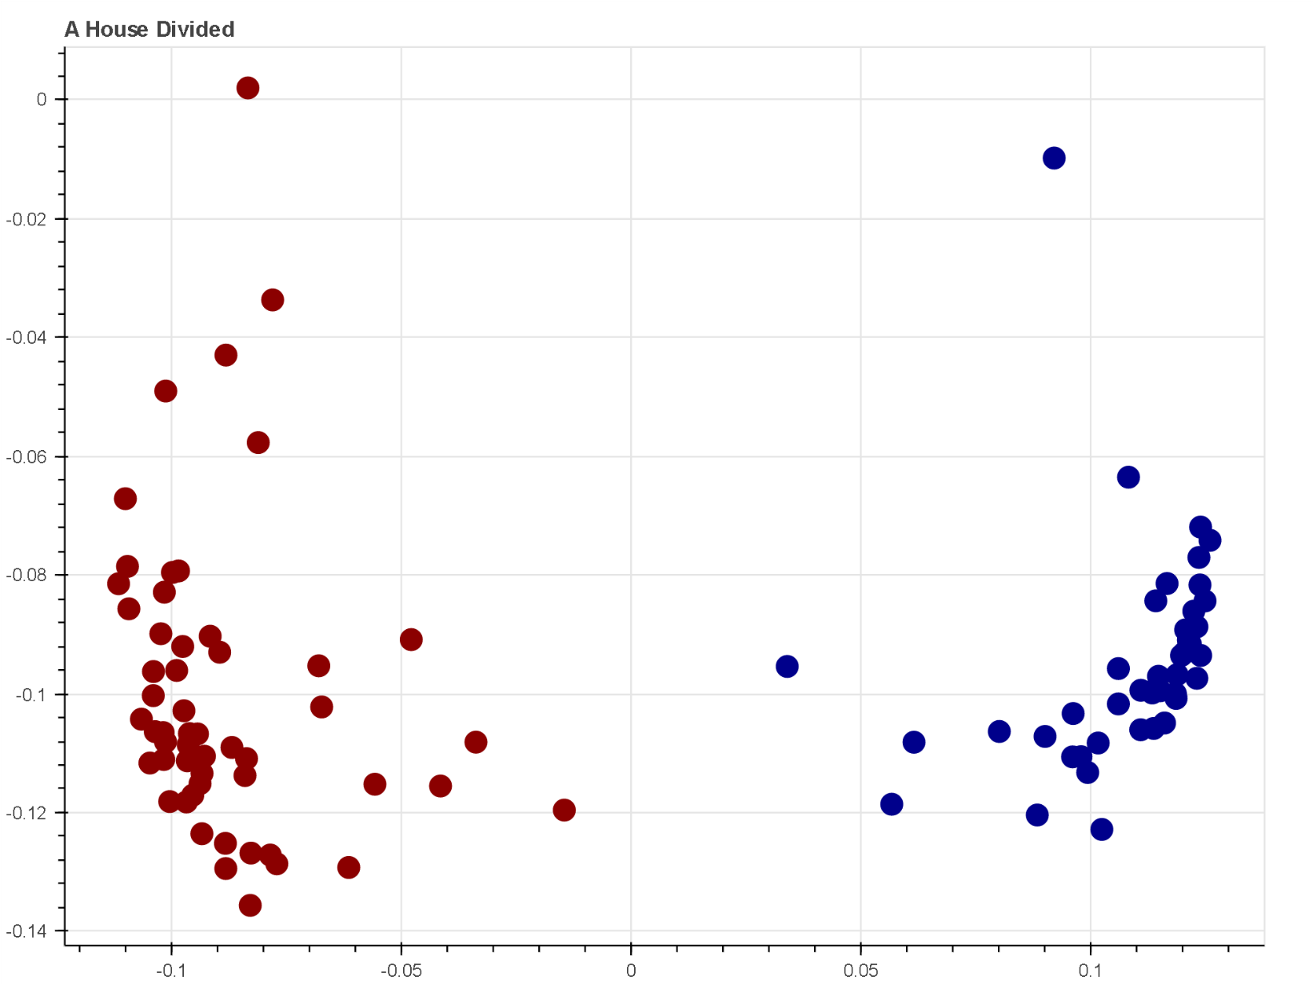
Clusters: Party Label Two

Slide 14
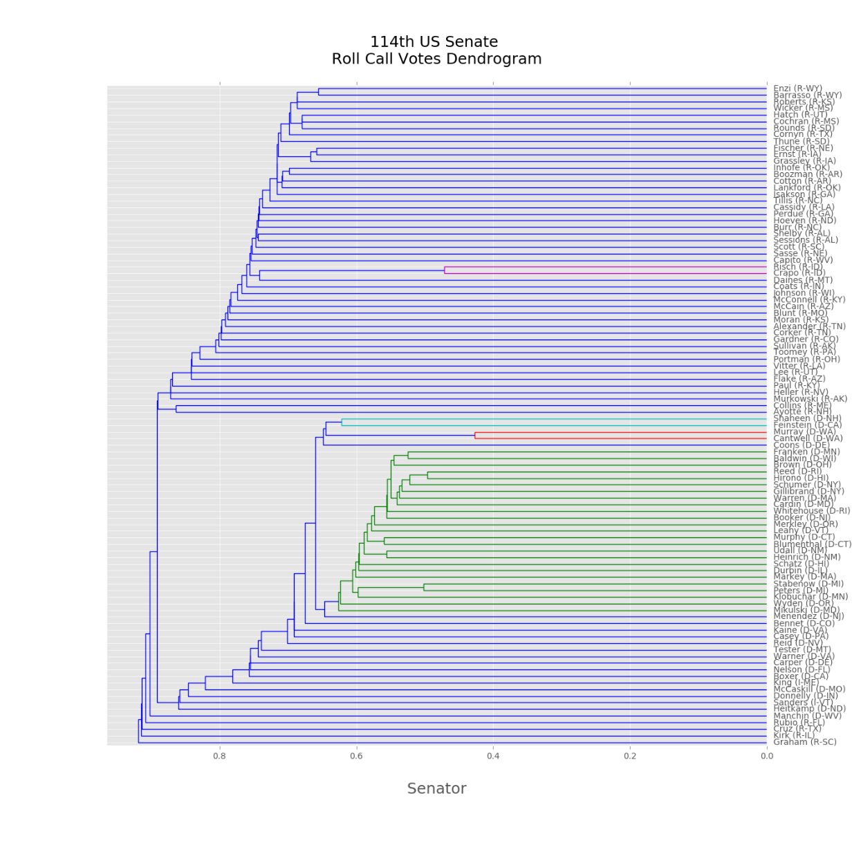
Clusters: Hierarchy
Notes:
Discuss distance metric

Slide 15
Measuring Influence
Mathematical model of influence
Entropy and Information
Notes:
Discuss the influence model, predictions

Slide 16
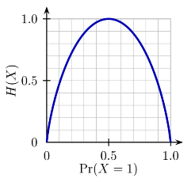
Entropy: The Fair Coin
Notes:
Wikipedia link

Slide 17
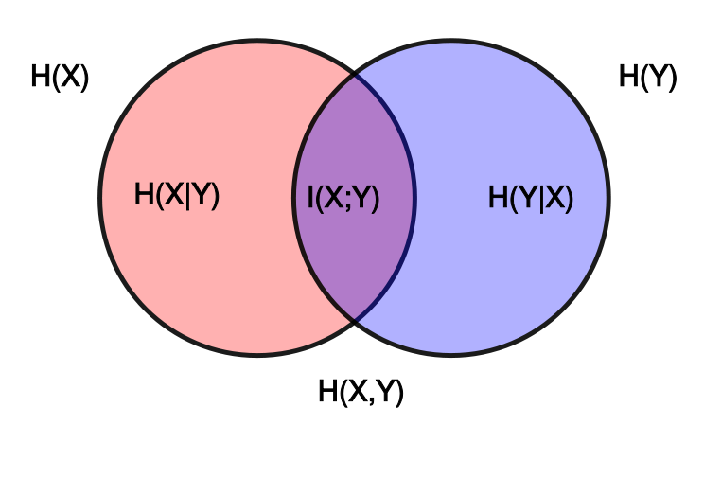
Entropy: Joint Entropy and Mutual Information
Notes:
Diagram showing additive and subtractive relationships for various information measures associated with correlated variables X and Y. The area contained by both circles is the joint entropy H(X,Y). The circle on the left (red and violet) is the individual entropy H(X), with the red being the conditional entropy H(X|Y). The circle on the right (blue and violet) is H(Y), with the blue being H(Y|X). The violet is the mutual information I(X;Y).

Slide 18
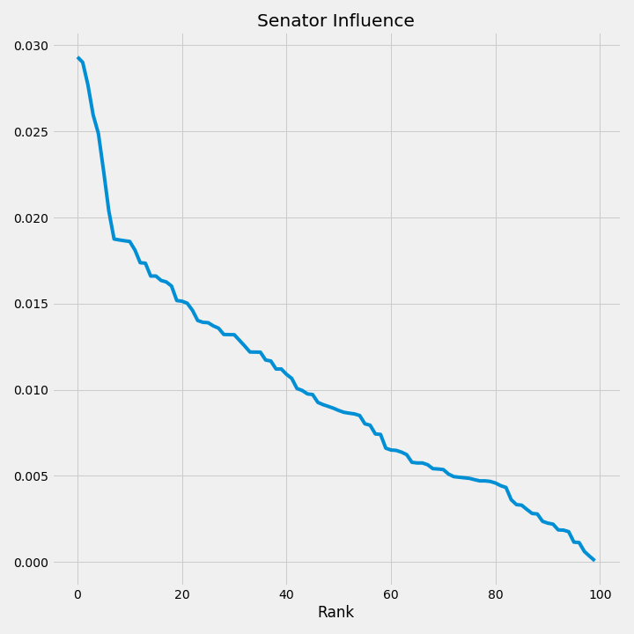
Influence: Rank Order
Notes:
Cochran (R-MS) 0.165132 McConnell (R-KY) 0.163380 Alexander (R-TN) 0.155987 Hatch (R-UT) 0.146168 Capito (R-WV) 0.140117 Rounds (R-SD) 0.127858 Ayotte (R-NH) 0.114744 Isakson (R-GA) 0.105607 Cornyn (R-TX) 0.105307

Slide 19
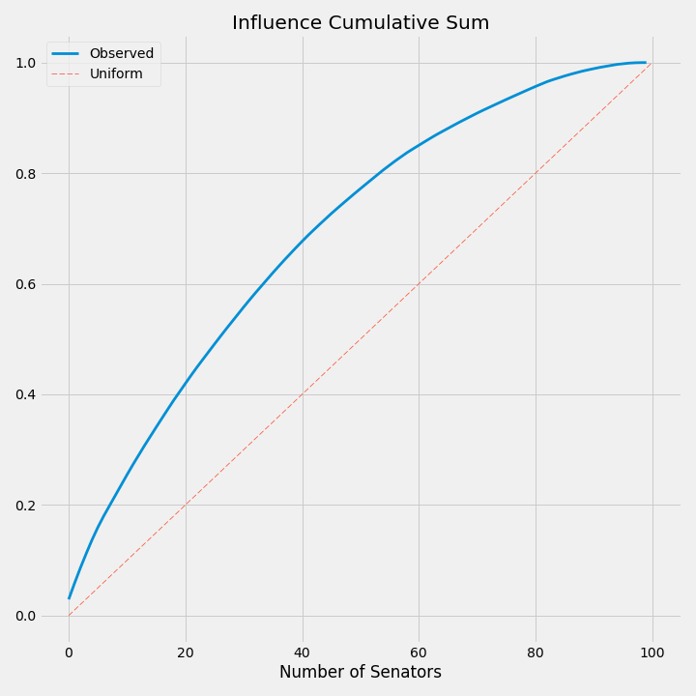
Influence: Distribution
Notes:
Talk about the distance metric.

Slide 20
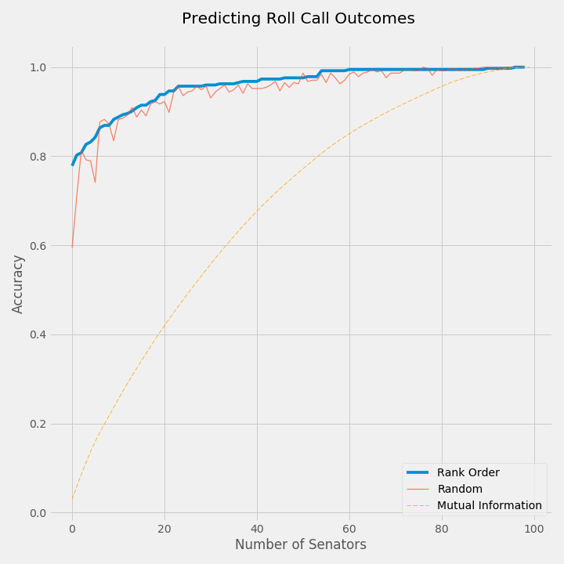
Predictions: First Look
Notes:
Describe the process, better than random

Slide 21
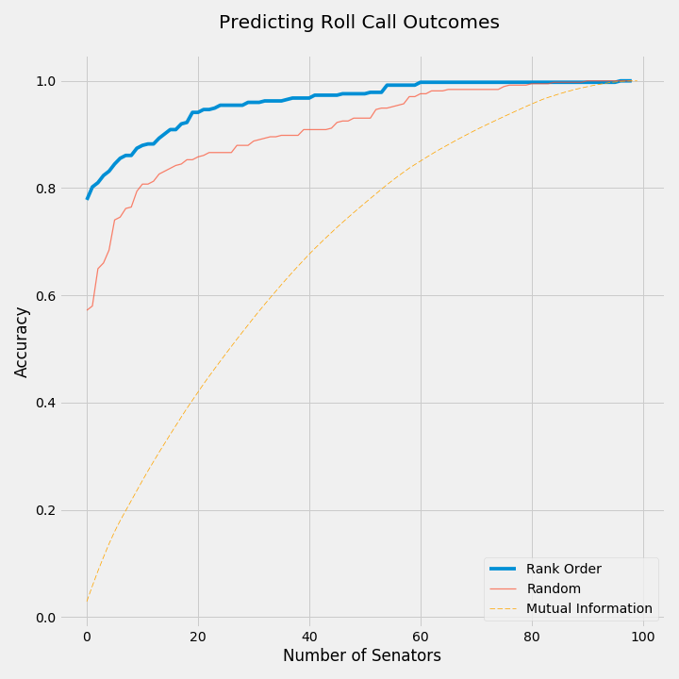
Predictions: 10,000 trials
Notes:
10,000 trails

Slide 22
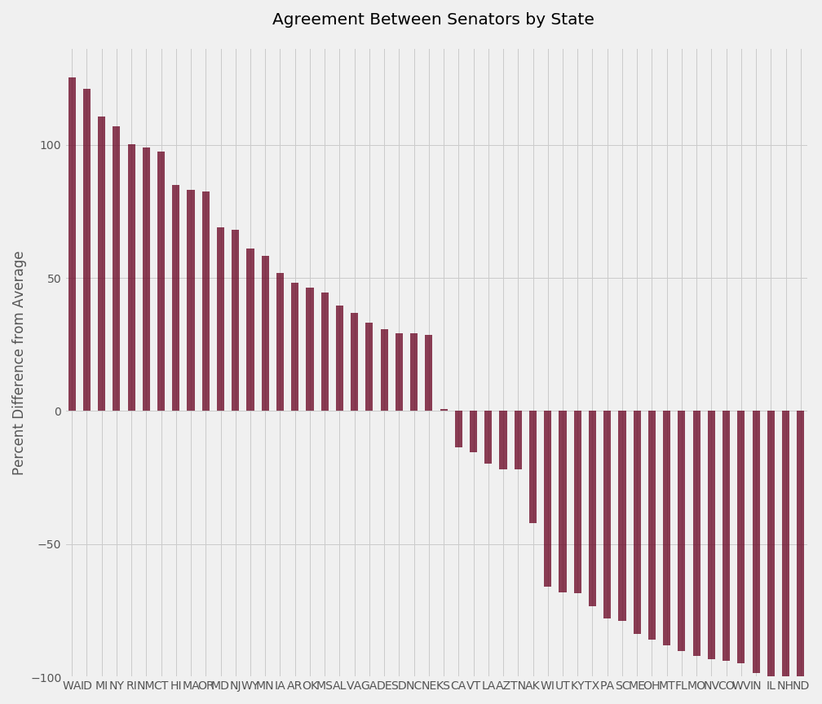
The States: Agreement

Slide 23
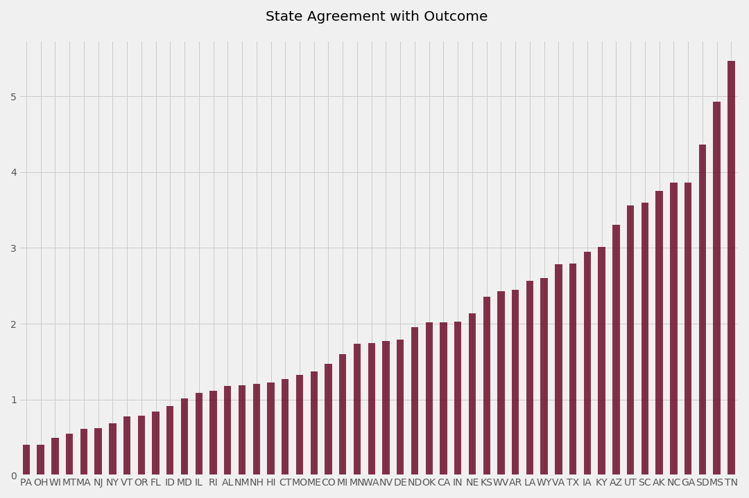
The States: Information Rank

