Slide 1
Deep Q for the Branin test problem

Slide 2
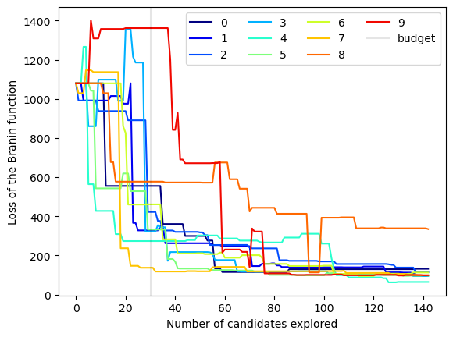
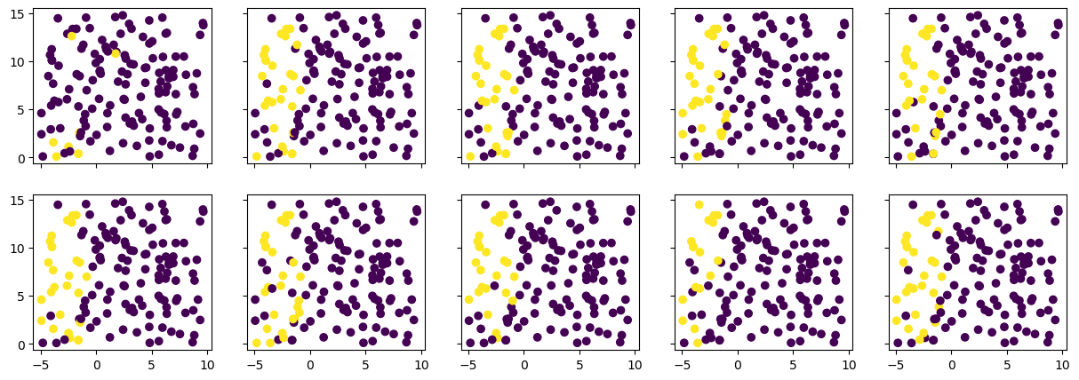
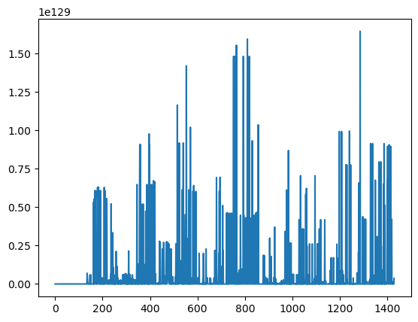
Implementation of a single layer learner
Again, defining the state as the coordinates of the point, the minimal distance in the plane and the distance of the prediction to the ground truths we train for 30 episodes.
We have a budget (points for which the function is evaluated and added to the data set) of 30 points.

