Slide 1


Matching Matrix Elements and Parton Showers
Peter Richardson
IPPP, Durham University

Slide 2
Summary
Matrix Element Corrections
MC@NLO
CKKW and MLM
Comments
Nason Method

Slide 3
Introduction
The parton shower is designed to simulate soft and collinear radiation.
While this is the bulk of the emission we are often interested in the radiation of a hard jet.
This is not something the parton shower should be able to do, although it often does better than we except.
If you are looking at hard radiation HERWIG and PYTHIA will often get it wrong.

Slide 4
Hard Jet Radiation
Given this failure of the approximations this is an obvious area to make improvements in the shower and has a long history.
You will often here this called
  Matrix Element matching.
  Matrix Element corrections.
  Merging matrix elements and parton shower
  MC@NLO
I will discuss all of these and where the different ideas are useful.

Slide 5
Hard Jet Radiation: General Idea
Parton Shower (PS) simulations use the soft/collinear approximation:
  Good for simulating the internal structure of a jet;
  Can’t produce high p_{T} jets.
Matrix Elements (ME) compute the exact result at fixed order:
  Good for simulating a few high p_{T} jets;
  Can’t give the structure of a jet.
We want to use both in a consistent way, i.e.
  ME gives hard emission
  PS gives soft/collinear emission
  Smooth matching between the two.
  No double counting of radiation.

Slide 6
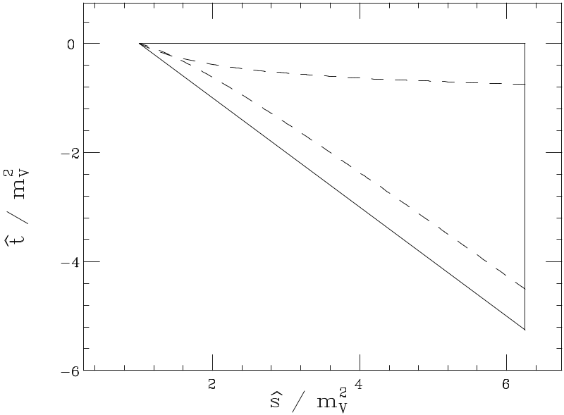
Matching Matrix Elements and Parton Shower
Parton Shower
The oldest approaches are usually called matching matrix elements and parton showers or the matrix element correction.
Slightly different for HERWIG and PYTHIA.
In HERWIG
HERWIG phase space for Drell-Yan
Dead Zone
  Use the leading order matrix element to fill the dead zone.
  Correct the parton shower to get the leading order matrix element in the already filled region.
PYTHIA fills the full phase space so only the second step is needed.

Slide 7
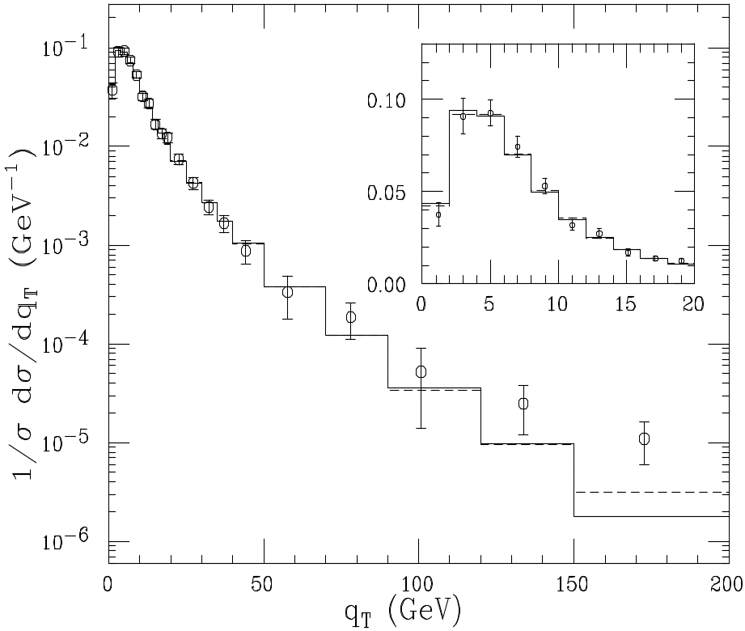
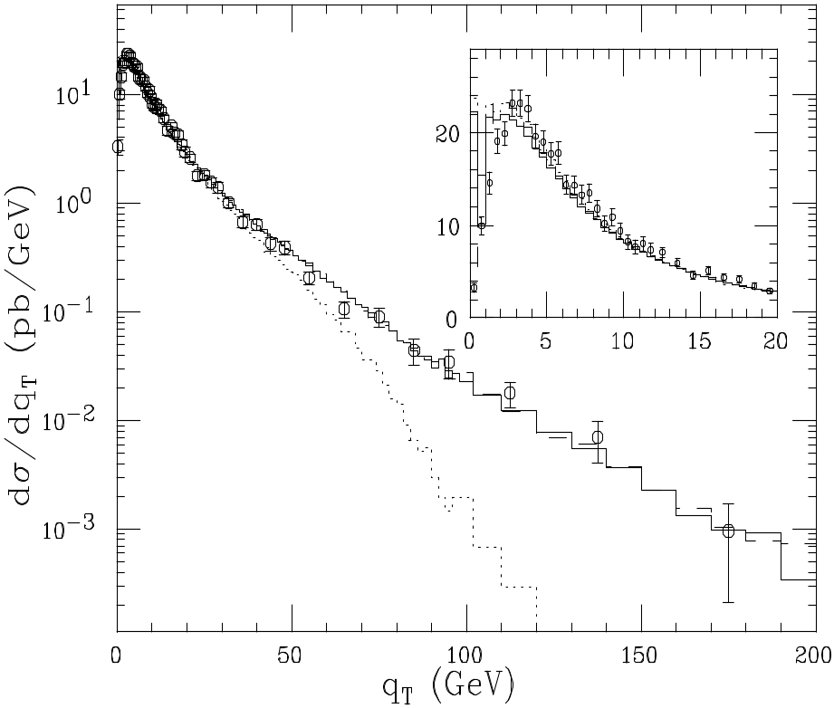
Matrix Element Corrections
W q_{T} distribution from D0
Z q_{T} distribution from CDF
G. Corcella and M. Seymour, Nucl.Phys.B565:227-244,2000.

Slide 8
Matrix Element Corrections
There was a lot of work for both HERWIG and PYTHIA. The corrections for
  e⁺e⁻ to hadrons
  DIS
  Drell-Yan
  Top Decay
  Higgs Production
were included.
There are problems with this
  Only the hardest emission was correctly described
  The leading order normalization was retained.

Slide 9
Recent Progress
In the last few years there has been a lot of work addressing both of these problems.
Two types of approach have emerged
NLO Simulation
  NLO normalization of the cross section
  Gets the hardest emission correct
Multi-Jet Leading Order
  Still leading order.
  Gets many hard emissions correct.

Slide 10
NLO Simulation
There has been a lot of work on NLO Monte Carlo simulations.
However apart from some early work by Dobbs the only Frixione, Nason and Webber have produced code which can be used to generate results.
I will therefore only talk about the work of Frixione, Nason and Webber.
Most of this is taken from Bryan Webber’s talk at the YETI meeting in Durham.

Slide 11
MC@NLO
S. Frixione and B.R. Webber JHEP 0206(2002) 029, hep-ph/0204244, hep-ph/0309186
S. Frixione, P. Nason and B.R. Webber, JHEP 0308(2003) 007, hep-ph/0305252.
http://www.hep.phy.cam.ac.uk/theory/webber/MCatNLO/

Slide 12
MC@NLO
MC@NLO was designed to have the following features.
  The output is a set of fully exclusive events.
  The total rate is accurate to NLO
  NLO results for observables are recovered when expanded in α_{s}.
  Hard emissions are treated as in NLO calculations.
  Soft/Collinear emission are treated as in the parton shower.
  The matching between hard emission and the parton shower is smooth.
  MC hadronization models are used.

Slide 13

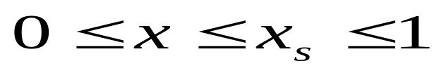
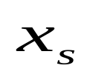
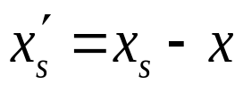
Toy Model
I will start with Bryan Webber’s toy model to explain MC@NLO to discuss the key features of NLO, MC and the matching.
Consider a system which can radiate photons with energy with energy with
where is the energy of the system before radiation.
After radiation the energy of the system
Further radiation is possible but photons don’t radiate.

Slide 14
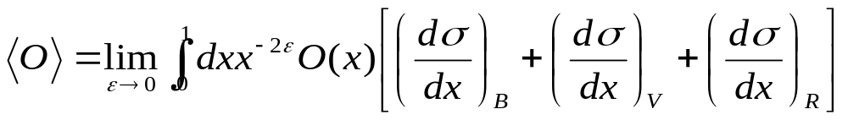
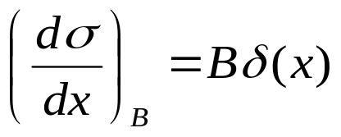
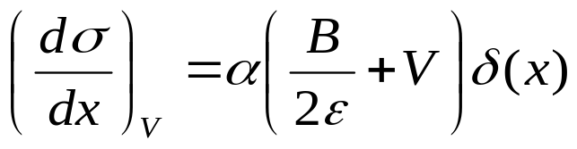
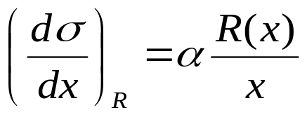
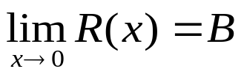
Toy Model
Calculating an observable at NLO gives
where the Born, Virtual and Real contributions are
α is the coupling constant and

Slide 15
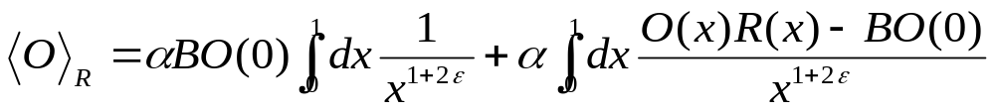

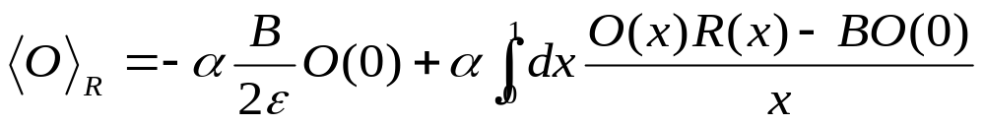
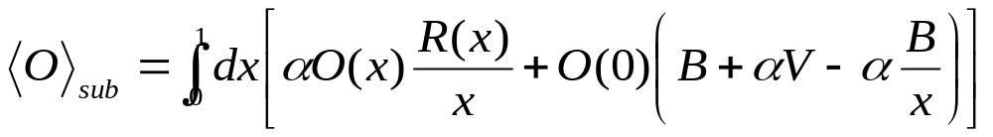
Toy Model
In a subtraction method the real contribution is written as
The second integral is finite so we can set
The NLO prediction is therefore

Slide 16
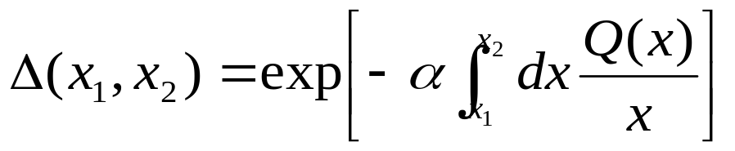


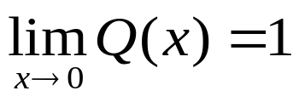
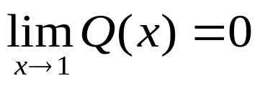



Toy Monte Carlo
In a MC treatment the system can emit many photons with the probability controlled by the Sudakov form factor, defined here as
  where is a monotonic function which has
is the probability that no photon can be emitted with energy such that .

Slide 17

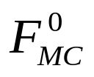

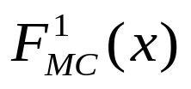
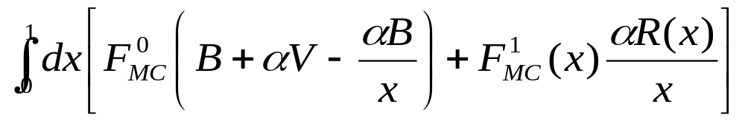
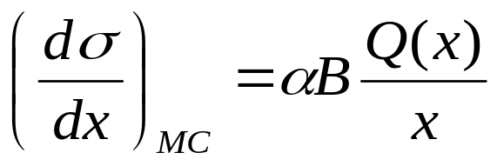
Toy MC@NLO
We want to interface NLO to MC. Naïve first try
  start MC with 0 real emissions:
  start MC with 1 real emission at x:
So that the overall generating functional is
This is wrong because MC with no emissions will generate emission with NLO distribution

Slide 18
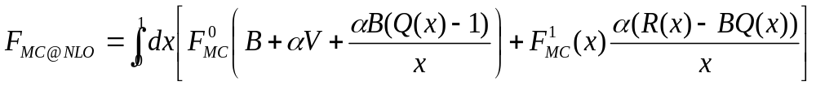

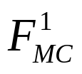
Toy MC@NLO
We must subtract this from the second term
This prescription has many good features:
  The added and subtracted terms are equal to
  The coefficients of and are separately finite.
  The resummation of large logs is the same as for the Monte Carlo renormalized to the correct NLO cross section.
  However some events may have negative weight.

Slide 19
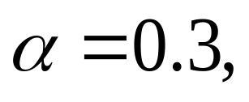
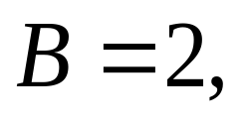
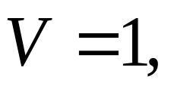
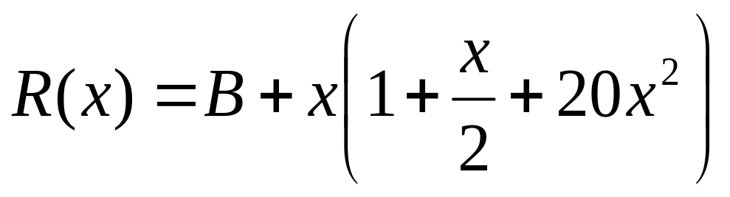
Toy MC@NLO Observables
As an example of an “exclusive” observable consider the energy y of the hardest photon in each event.
As an “inclusive” observable consider the fully inclusive distributions of photon energies, z
Toy model results shown are for

Slide 20
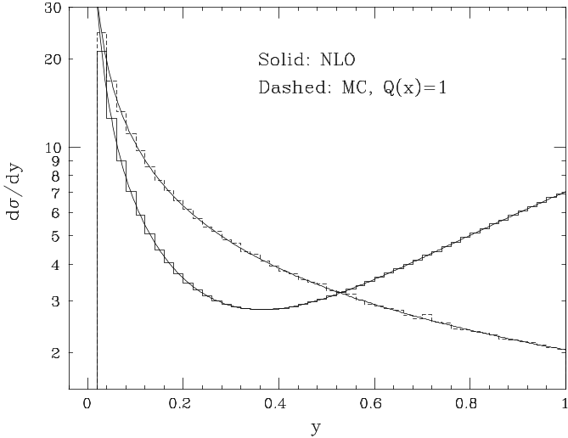
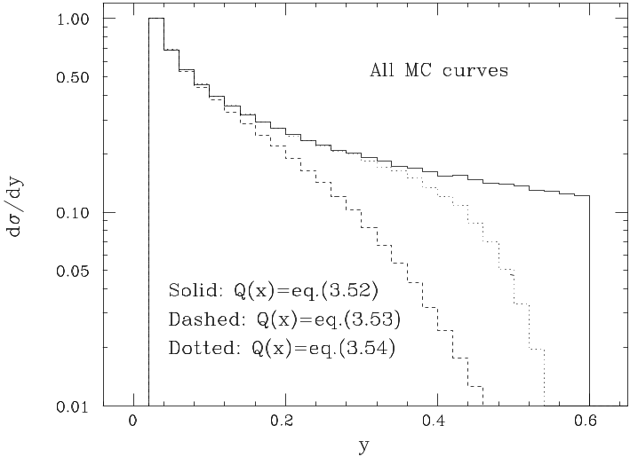
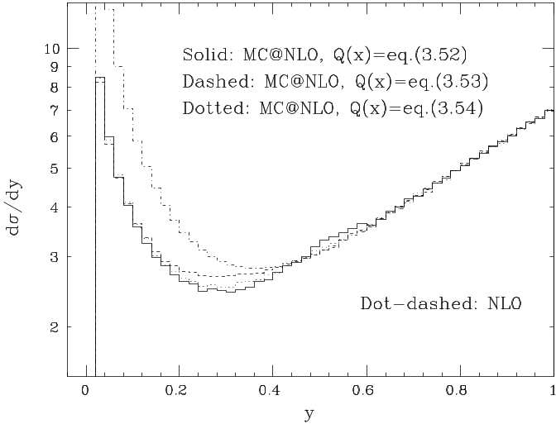
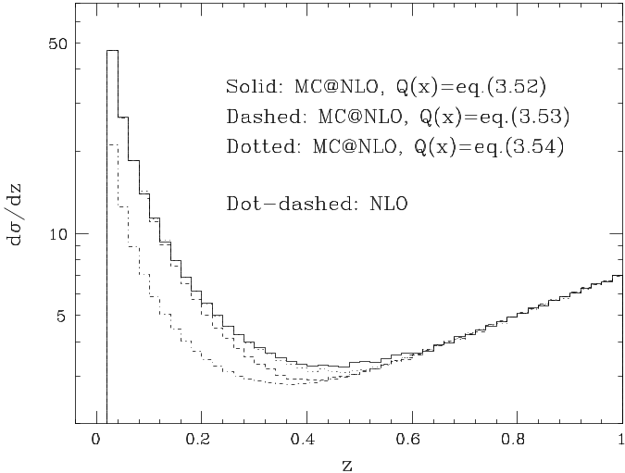
Toy MC@NLO Observables

Slide 21
Real QCD
For normal QCD the principle is the same we subtract the shower approximation to the real emission and add it to the virtual piece.
This cancels the singularities and avoids double counting.
It’s a lot more complicated.

Slide 22
Real QCD
For each new process the shower approximation must be worked out, which is often complicated.
While the general approach works for any shower it has to be worked out for a specific case.
So for MC@NLO only works with the HERWIG shower algorithm.
It could be worked out for PYTHIA or Herwig++ but this remains to be done.

Slide 23
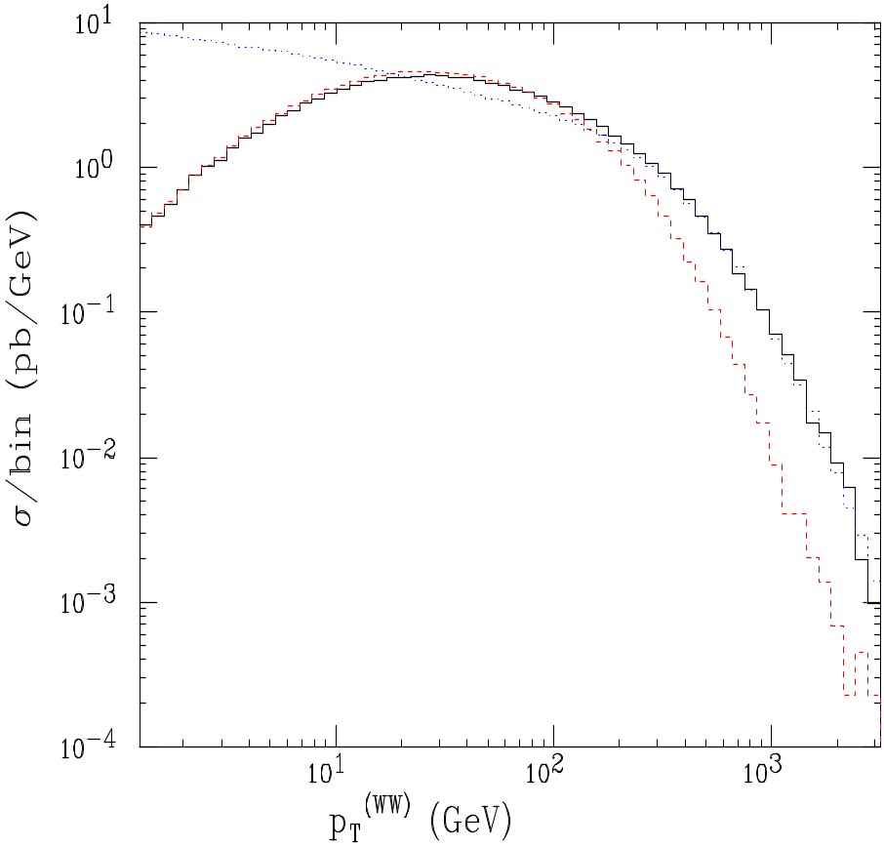
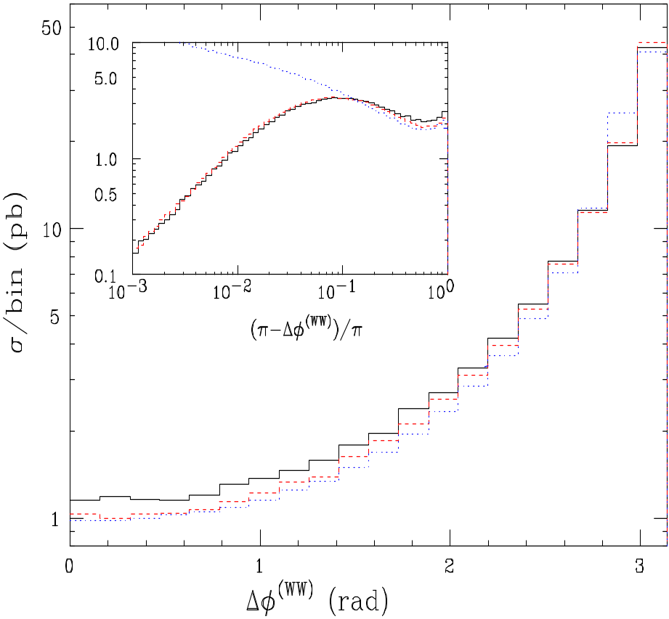
W⁺W⁻ Observables
P_{T} of W+W-
MC@NLO
HERWIG
Δϕ of W+W-
NLO
MC@NLO gives the correct high P_{T} result and soft resummation.
S. Frixione and B.R. Webber JHEP 0206(2002) 029, hep-ph/0204244, hep-ph/0309186

Slide 24
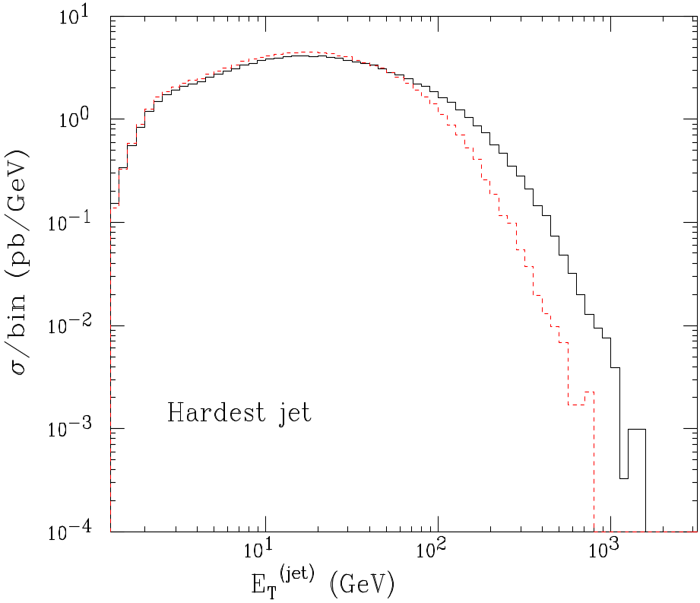
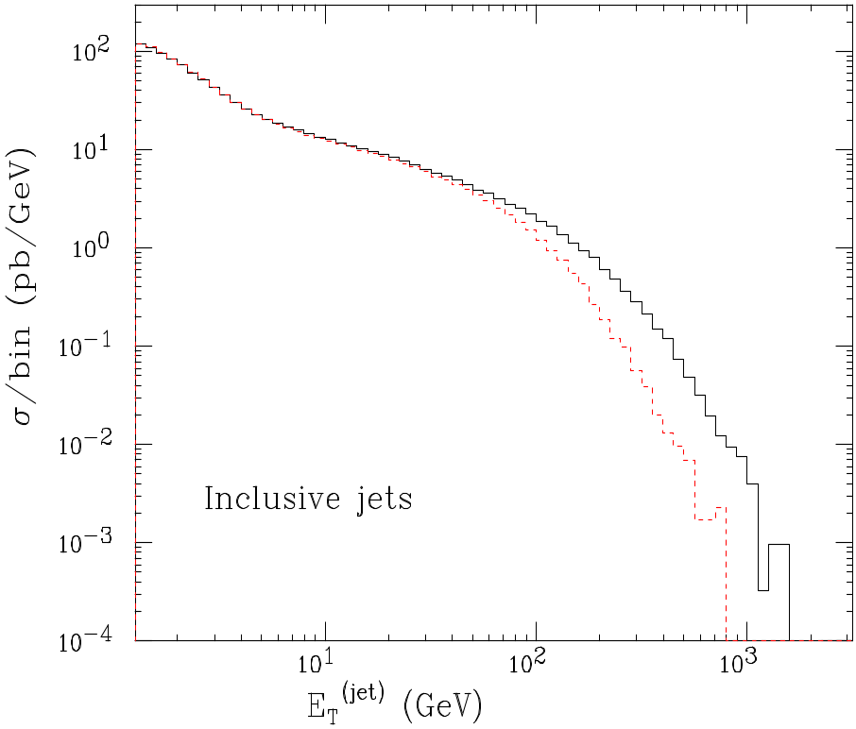
W⁺W⁻ Jet Observables
MC@NLO
HERWIG
NLO
S. Frixione and B.R. Webber JHEP 0206(2002) 029, hep-ph/0204244, hep-ph/0309186

Slide 25
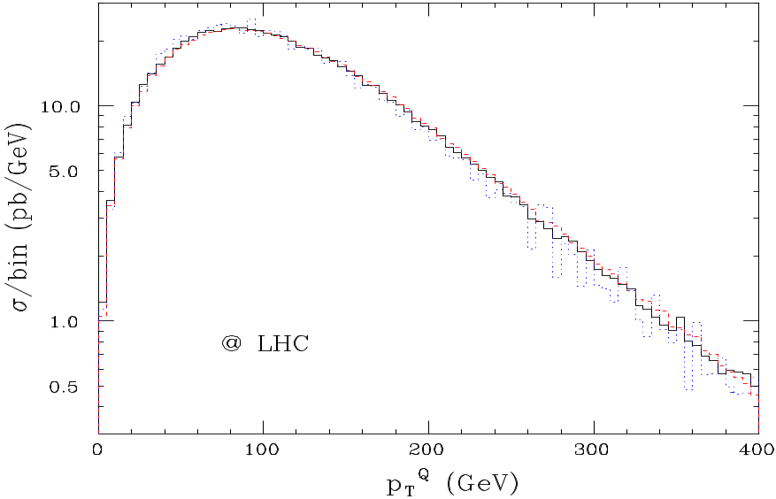
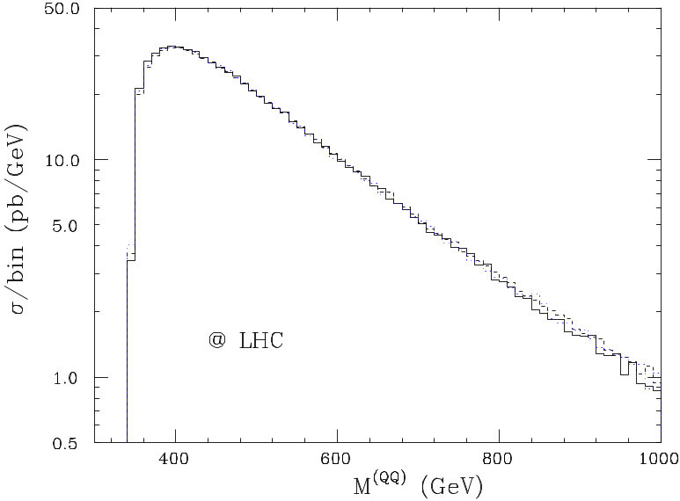
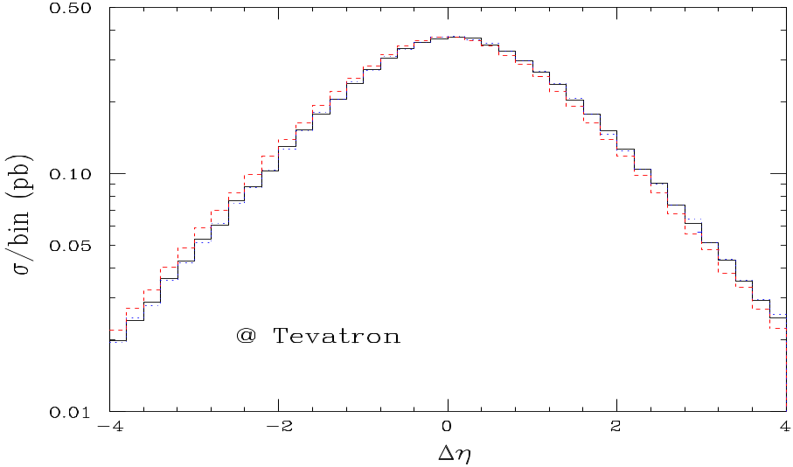
Top Production
MC@NLO
HERWIG
NLO
S. Frixione, P. Nason and B.R. Webber, JHEP 0308(2003) 007, hep-ph/0305252.

Slide 26
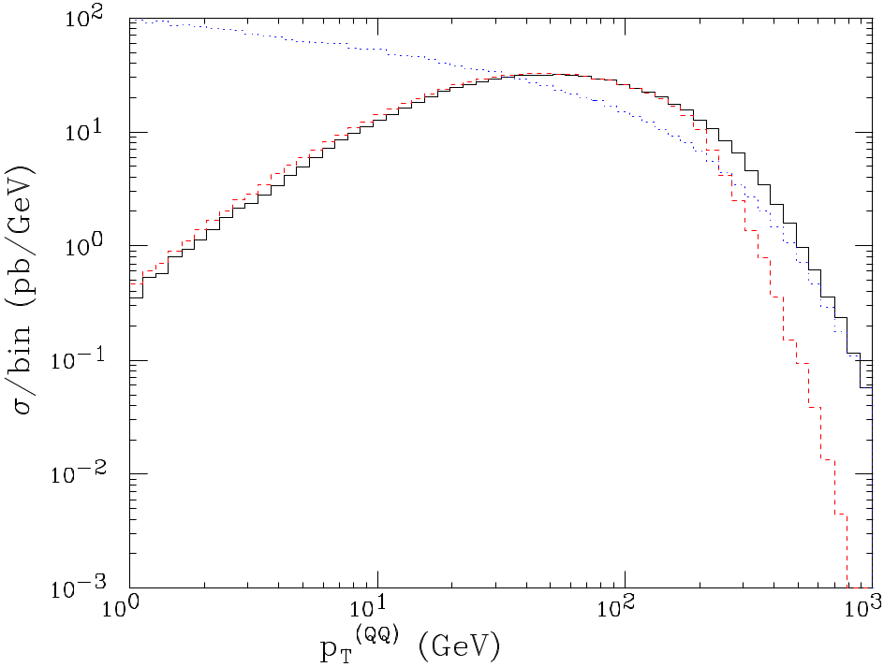
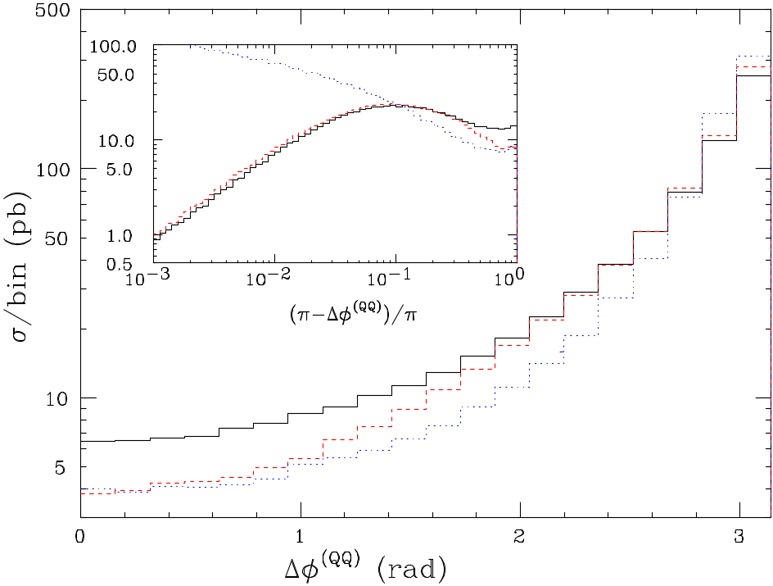
Top Production at the LHC
MC@NLO
HERWIG
NLO
S. Frixione, P. Nason and B.R. Webber, JHEP 0308(2003) 007, hep-ph/0305252.

Slide 27
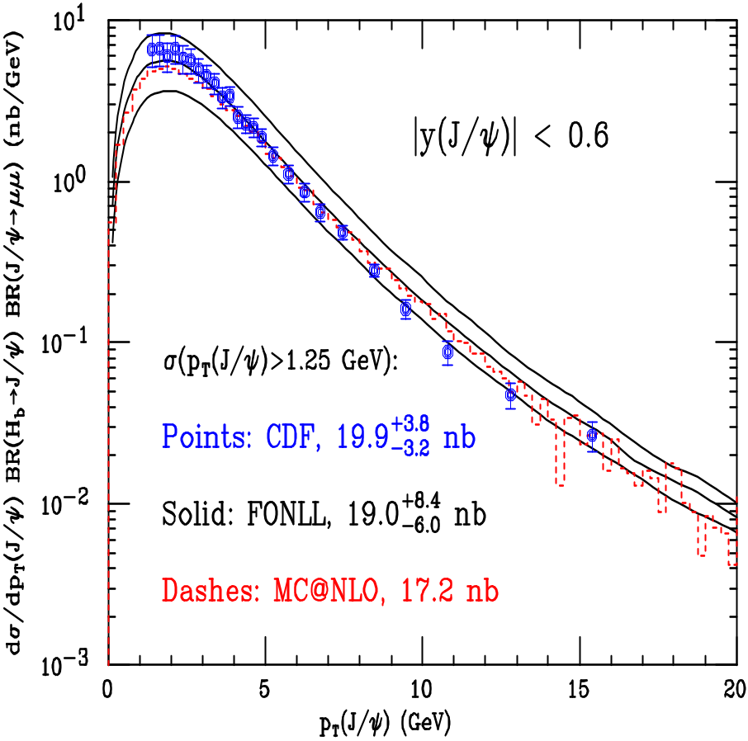
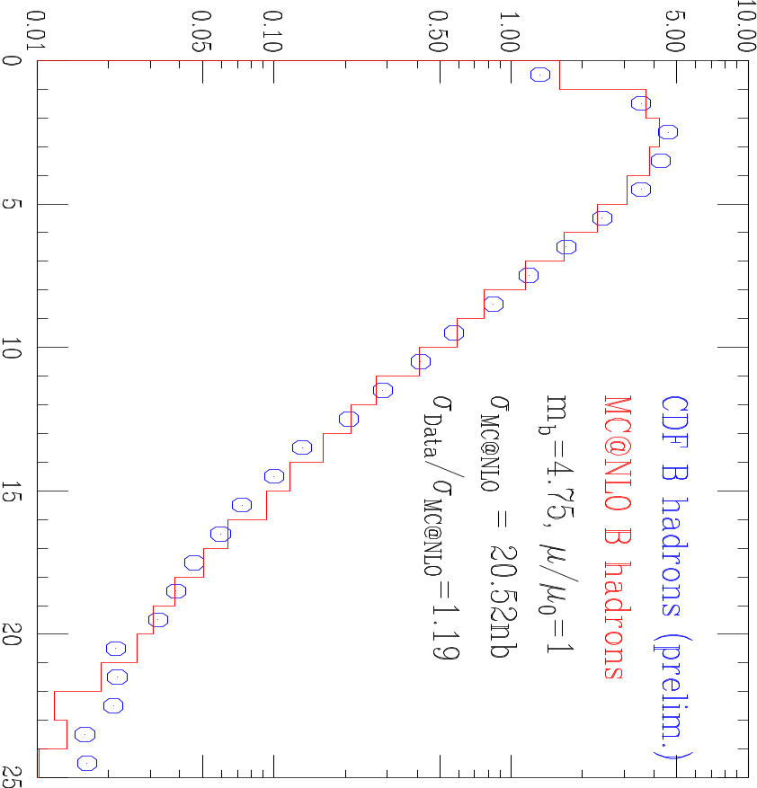
B Production at the Tevatron
S. Frixione, P. Nason and B.R. Webber, JHEP 0308(2003) 007, hep-ph/0305252.

Slide 28
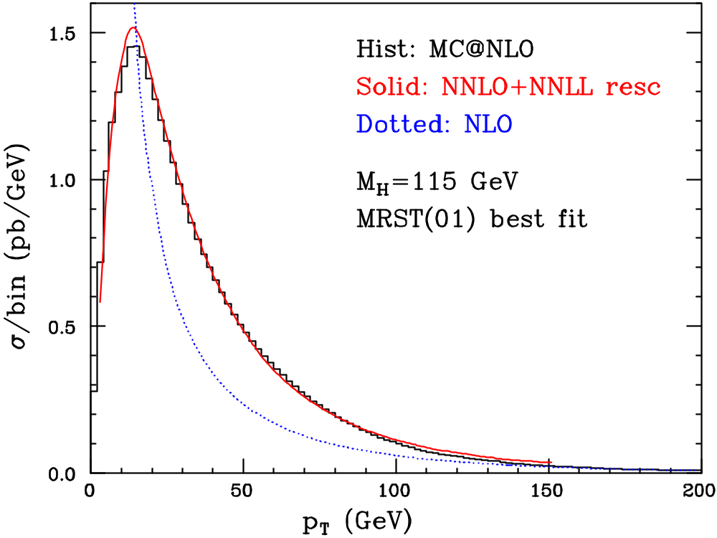
Higgs Production at LHC
S. Frixione and B.R. Webber JHEP 0206(2002) 029, hep-ph/0204244, hep-ph/0309186

Slide 29
NLO Simulation
So far MC@NLO is the only implementation of a NLO Monte Carlo simulation.
Recently there have been some ideas by Paulo Nason JHEP 0411:040,2004.
Here there would be no negative weights but more terms would be exponentiated beyond leading log.
This could be an improvement but we will need to see physical results.

Slide 30
Multi-Jet Leading Order
While the NLO approach is good for one hard additional jet and the overall normalization it cannot be used to give many jets.
Therefore to simulate these processes use matching at leading order to get many hard emissions correct.
I will briefly review the general idea behind this approach and then show some results.

Slide 31
CKKW Procedure
Catani, Krauss, Kuhn and Webber JHEP 0111:063,2001.
In order to match the ME and PS we need to separate the phase space:
One region contains the soft/collinear region and is filled by the PS;
The other is filled by the matrix element.
In these approaches the phase space is separated using in k_{T}-type jet algorithm.

Slide 32







Durham Jet Algorithm
For all final-state particles compute the resolution variables
The smallest of these is selected. If is the smallest the two particles are merged. If is the smallest the particle is merged with the beam.
This procedure is repeated until the minimum value is above some stopping parameter .
The remaining particles and pseudo-particles are then the hard jets.

Slide 33
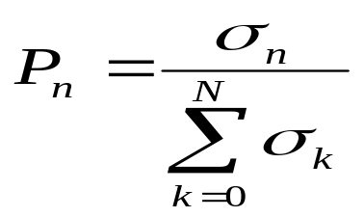


CKKW Procedure
Radiation above a cut-off value of the jet measure is simulated by the matrix element and radiation below the cut-off by the parton shower.
Select the jet multiplicity with probability
where is the n-jet matrix element evaluated at resolution using as the scale for the PDFs and α_{S}, n is the jet of jets
Distribute the jet momenta according the ME.

Slide 34
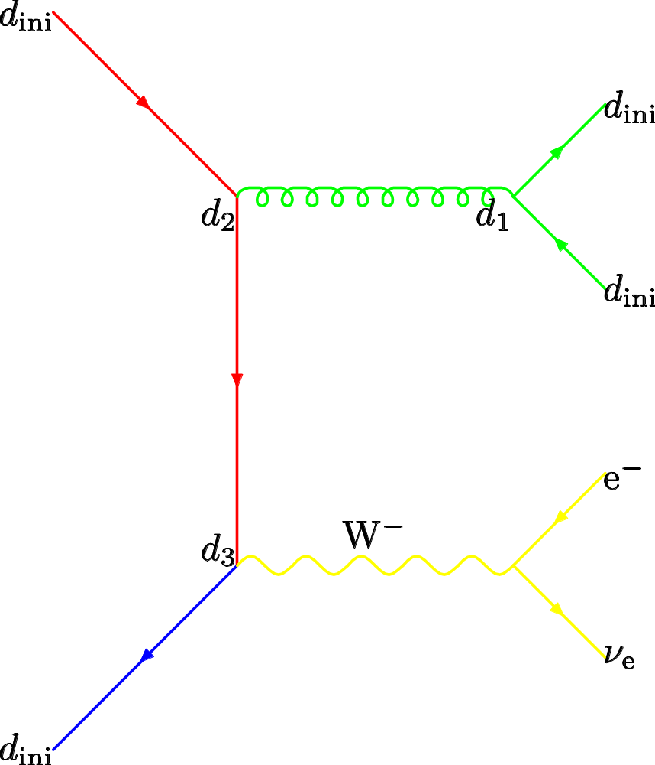
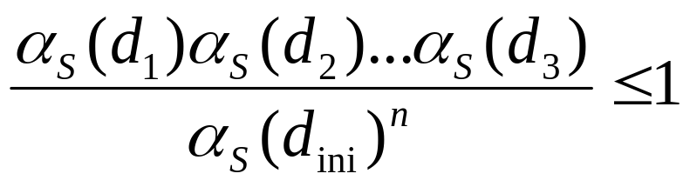
CKKW Procedure
Cluster the partons to determine the values at which 1,2,..n-jets are resolved. These give the nodal scales for a tree diagram.
Apply a coupling constant reweighting.

Slide 35
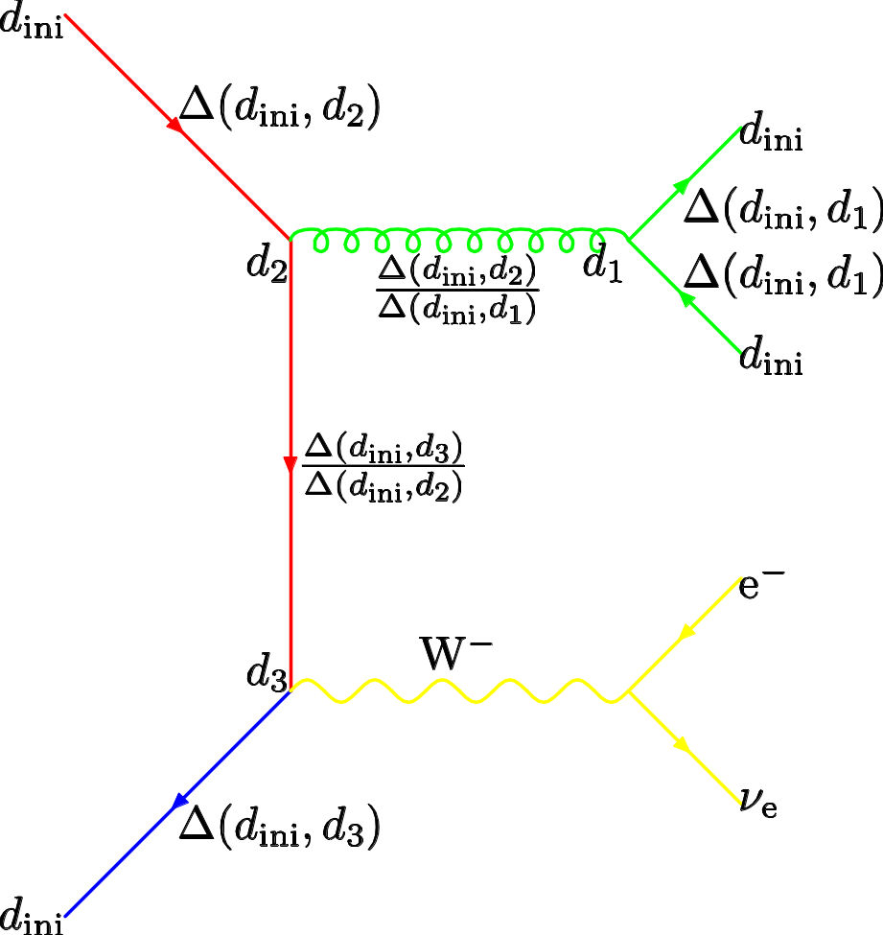
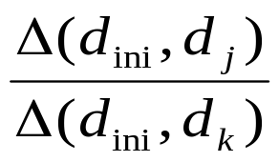

CKKW Procedure
Reweight the lines by a Sudakov factor
Accept the configuration if the product of the α_{S} and Sudakov weight is less than otherwise return to step 1.

Slide 36
CKKW Procedure
Generate the parton shower from the event starting the evolution of each parton at the scale at which it was created and vetoing emission above the scale .

Slide 37
CKKW Procedure
Although this procedure ensures smooth matching at the NLL log level are still choices to be made:
  Exact definition of the Sudakov form factors.
  Scales in the strong coupling and α_{S}.
  Treatment of the highest Multiplicity matrix element.
  Choice of the k_{T} algorithm.
In practice the problem is understanding what the shower is doing and treating the matrix element in the same way.

Slide 38
CKKW Procedure
A lot of work has been done mainly by
  Frank Krauss et. al. (SHERPA)
  Fabio Maltoni et. al. (MADGRAPH)
  Leif Lonnblad (ARIADNE)
  Steve Mrenna (PYTHIA)
  Peter Richardson (HERWIG)

Slide 39
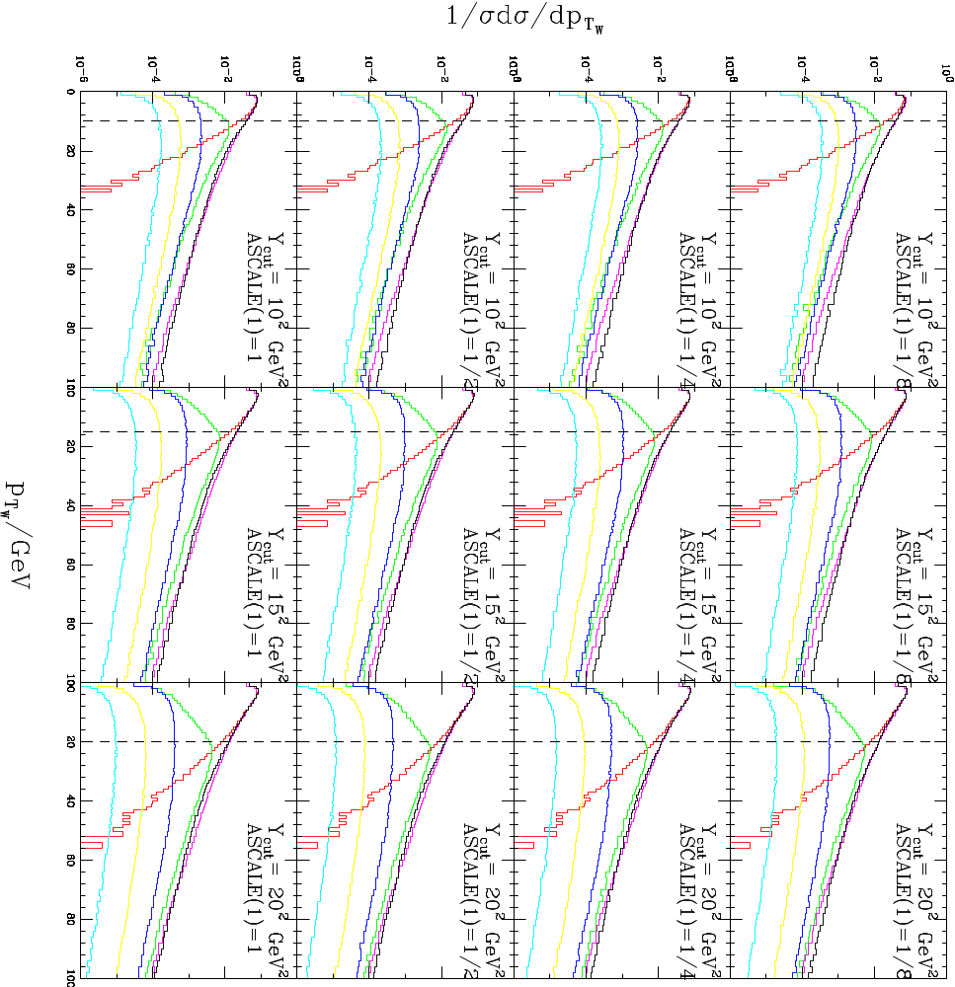
p_{T} of the W at the Tevatron
ME
HW
0 jets
1 jets
2 jets
3 jets
4 jets

Slide 40
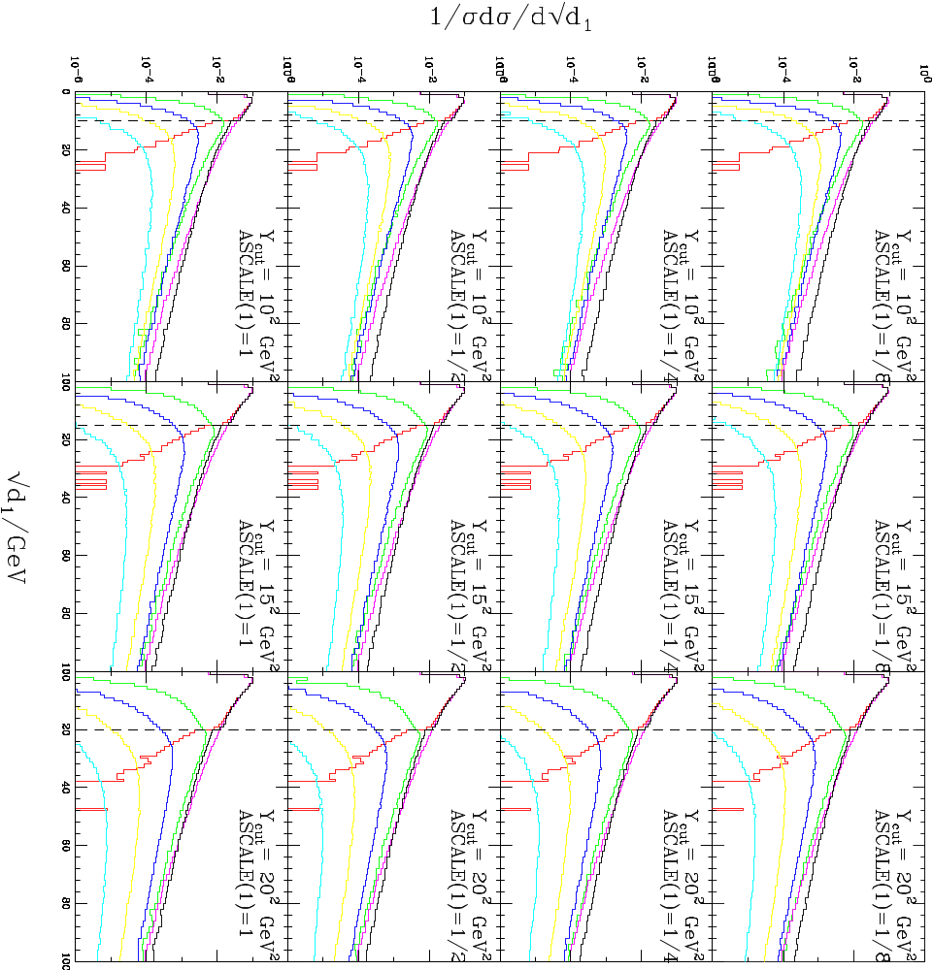
p_{T} of the hardest jet at the Tevatron
ME
HW
0 jets
1 jets
2 jets
3 jets
4 jets

Slide 41

Tevatron p_{T} of the 4th jet
ME
HW
0 jets
1 jets
2 jets
3 jets
4 jets

Slide 42

LHC pt of W
ME
HW
0 jets
1 jets
2 jets
3 jets
4 jets

Slide 43

LHC E_{T} of the 4th jet
ME
HW
0 jets
1 jets
2 jets
3 jets
4 jets

Slide 44
MLM
Simulate partonic N jet state.
Generate parton shower.
Require that all the jets above the matching scale after the shower have an associated pre-shower parton.
For each N the shower doesn’t add any more jets.
Rejection ensures that samples with different numbers of jets can be summed

Slide 45
MLM
The Sudakov form-factor is the probability of no resolvable emission above a cut-off scale.
Rejecting events which have jets above the matching scale which did not come from the matrix element is equivalent to applying the Sudakov factor and vetoing, essentially its calculating the Sudakov numerically.
The additional radiation which should have come from the internal lines is absent but in practice doesn’t seem to matter.

Slide 46


MLM Method for W+jets

Slide 47
Comments
In all of these approaches we need to understand in detail analytically what the shower is doing to either
  Subtract it from the NLO matrix elements
  Treat the matrix element like it for CKKW
The different shower algorithms use different evolution variables
  q² ( Sherpa, PYTHIA(old) )
  p_{T} ( Ariadne, PYTHIA(new) )
  Angular (HERWIG)
This also has various issues, as does the hadronization model used.

Slide 48
Nason Method
The Nason approach aims to deal with two issues
  Would prefer to have positively weighted events
  In angular ordered showers the hardest, highest p_{T}, emission is not generated first.
The first part of the method reorganises the angular-ordered parton shower so that the hardest emission is generated first.
The second generates the events with the correct NLO distributions.

