Slide 1
QCD Analysis and Fragmentation Functions in the BELLE Experiment
Patricia Francisconi

Slide 2
Introduction and Motivation
Most significant contribution to calculation of fragmentation functions and parton distribution functions: Single-inclusive annihilation: e⁺ + e⁻ → (γ,Z) → h^{+,-,0} X
Parton Distribution Functions: Initial Particle
Fragmenatation Functions: Final State in a scattering process
Those functions are “very sensitive to data” → non-perturbative objects → need Data input
Detailed look on nucleon substructure
Difficulty: disentangling favored and unfavored FFs
Advantages: process independence, insight in hadron structure and proton spin

Slide 3
final-state single-particle energy distribution in a hard scattering process
σ _{Hard Scattering}
FFs
Hadron
Production
PDFs

Slide 4
Previous Analysis:
Most Recent Work:
Marco Stratmann: (Phys. Rev. D 75, 094009 (2007))
first Analysis with uncertainties, included SIA and SIDIS Data
Stefan Kretzer (hep-ph0003177v2 (2000))
Kniel, Kramer, Pötter:
simple parametrizations and few sets of data
Kumano

Slide 5
QCD Framework
Cross sections of DIS and SIA decomposed into convolutions between pertubatively calculated components and two non perdupative components: FFs and PDFs
Perturbatively calculated: Coefficient Functions and Fragmentation Functions
Fragmentation

Slide 6
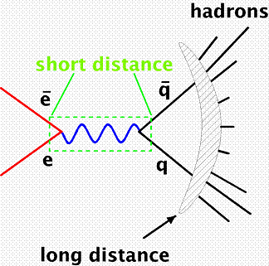
Fragmentation
e⁺e⁻ annihilation: e⁺ + e⁻ → (γ,Z) → H^{+,-,0} X
Fragmentation function: probability that a parton at a short distance 1/Q fragments into a hadron with fraction z of the parent momentum x

Slide 7
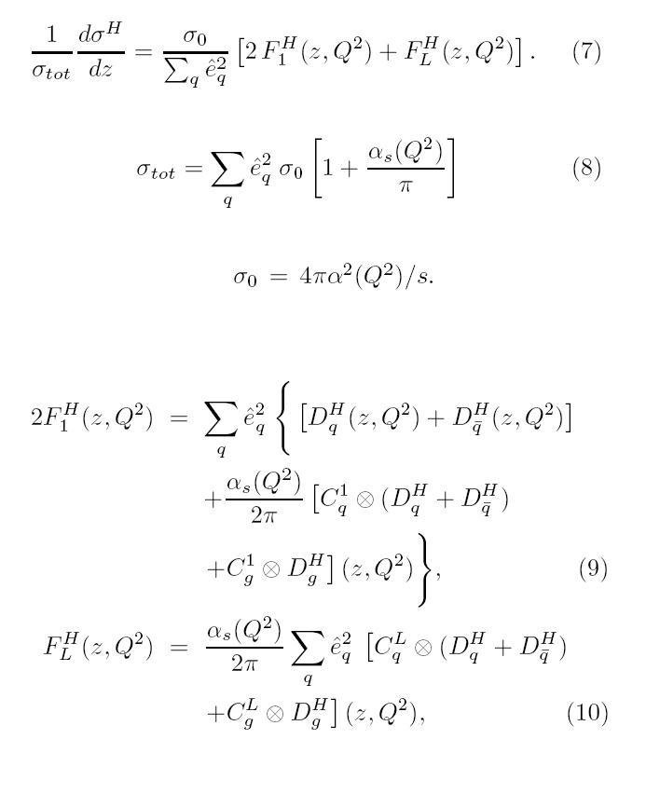
Cross section
Right side: total cross section
α_{S}: running coupling constant
z = 2 E_{H}/Q, with Q/2 = beam energy
C_{ij}s: Coefficient functions:
probability of creating a parton i with momentum fraction x of beam energy µ
(0 for gluons at lowest order)
(not tensor product but convolution)

Slide 8
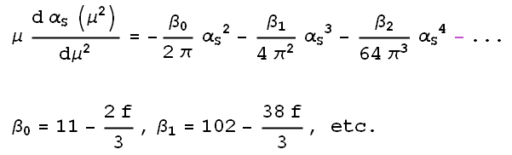
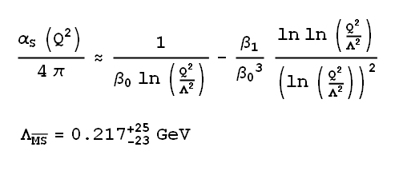
Asymptotic Freedom and Running Coupling Constant
Renormalized quantumchromodynamic coupling decreases with high energies
Scale dependence of QCD coupling is defined by β-function (possible negativity of β-function leads to asymptotic freedom)
Renormalization Group Equation:
Approxomate solution for Q² > m_{c} :

Slide 9
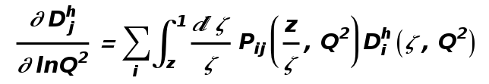
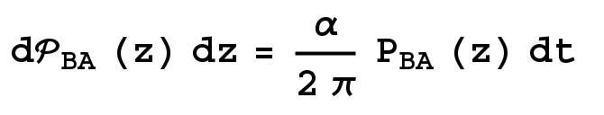
DGLAP Evolution
Use fragmentation function at different cms energies
Evolution with increasing energy scale: DGLAP Evolution equation
With D_{J}^{H} being the fragmentation function of the final parton, P_{ij} being splitting functions and D_{i}^{H} parametrization for the FF
Splitting functions: control the rate of change of parton distribution probability
When a quark radiates it splits into a quark with momentum fraction z
and a gluon with (z – 1)
Pij is the probability of finding a Particle B from a particle A with a fraction z of the longitudinal parent momentum

Slide 10
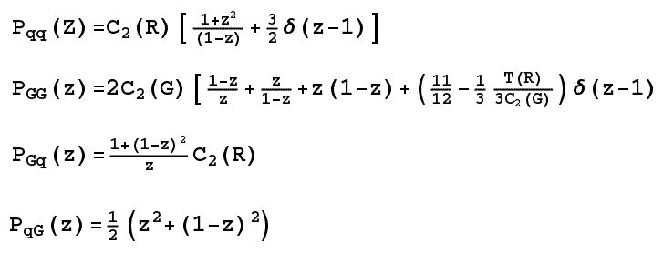
DGLAP Evolution
In LO P_{ij} in e⁺e⁻ the same as in DIS
Same probability for emitting a gluon, regardless of flavor
Equal probability for gluon creating a quark-antiquark pair for all flavors
P_{ij}s LO: Pijs NLO: can to be determined from connections between space-like Pijs (from DIS) and time-like ones (for e+e-)

Slide 11
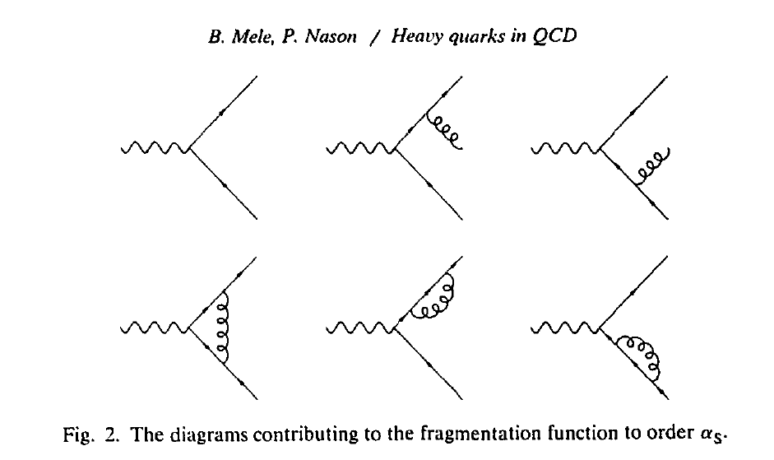
Contributions to Fragmentation Function

Slide 12
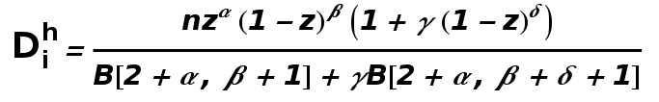

Mellin Space
Short Recap:
convolution with P_{ij}s = D_{J}^{H}
Cross section: convolution of D_{J}^{H} and C_{ij}s
Numerically very long and difficult
Transformation into Mellin Space: convolutions become multiplications
Mellin Transform:
Disadvantage: all complex values of j need to be known for inversion

Slide 13
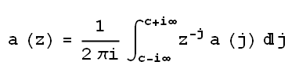
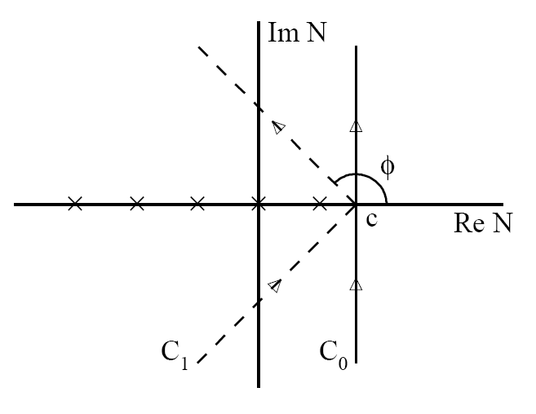
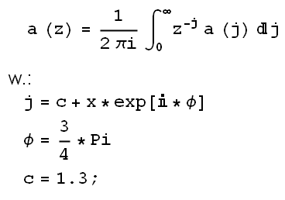
Mellin Space
Inverse Mellin Transform:
Contour c has to be right
of rightmost singularity
c can be tilted by Φ
Solving of integral through numerical methods (Trapezoidal Integration)

Slide 14
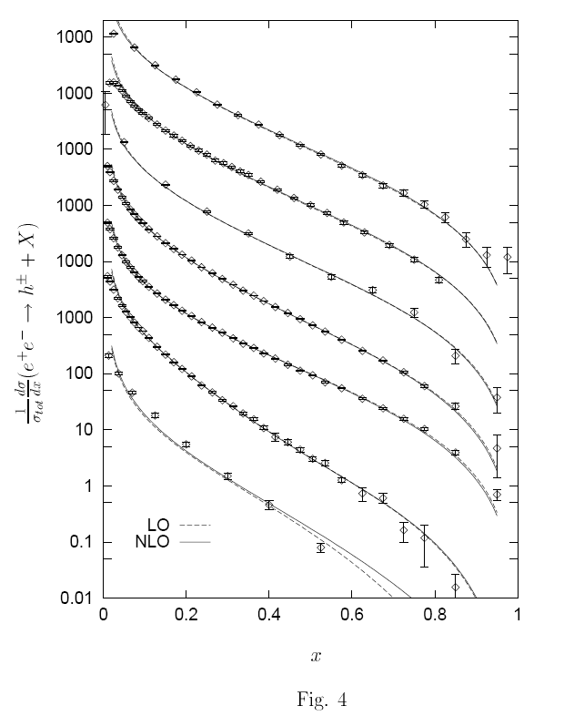
Data
SIA data from OPAL: e⁺ + e⁻ → (γ, Z) → h+X
Energy: 91.5 GeV
SIA Data from BELLE: e+ + e- → (γ, Z) → h+X
Energy: 10 GeV
Example from OPAL
Theoretical calculations compared with data
Differential coss section of inclusive hadron production in LO (dashed line)
Differential cross section if inclustive hadron production in NLO (solid line)
Lower 4 curves for Q of 91.5 GeV

Slide 15
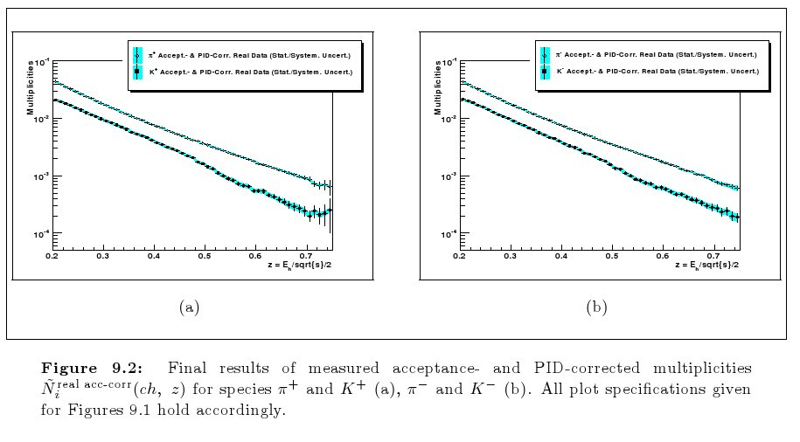
Data
Preliminary Electron-Positron Annihilation from BELLE (taken from the Masters Thesis of Martin Leitgab)
Energy: 10 GeV

Slide 16
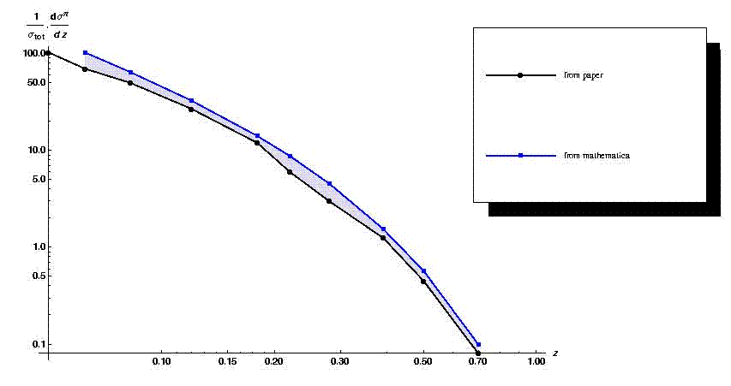
Preliminary Fit Results
Comparing my current results to previous ones from an earlier paper

Slide 17
Symmetry Assumptions
isospin symmetry for {u,ū,d,đ} → ⁺ :
  D_{u}^{+} = D_{d}^{+}, D_{s}^{+} = D_{ś}^{+}
slightly different normalizations for q + anti q :
  N D_{u+ū}^{+} = D_{d+đ}^{+}, D_{s}^{+} = D_{ś}^{+} = N' D_{ū}^{+}
if you assume N = N' = 1 → only SIA allows to distinguish between favored and unfavored
  D_{s+ś}^{K+} and D_{u+ū}^{K+} are fitted independently
Flavor Symmetry for unfavored: data are unable to distinguish between flavors
  D_{ū}^{K+} = D_{s}^{K+} = D_{d}^{K+} = D_{đ}^{K+}
same functional form for b and c quark only γ = 0

Slide 18
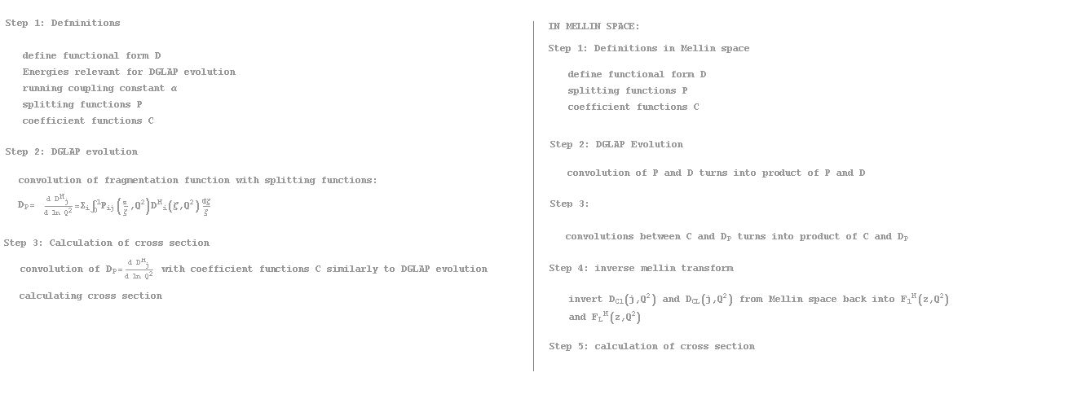
Program

Slide 19
Summary
NLO DGLAP Evolution performed in Mellin Space
Calculation of cross section
Fit code Setup
Fit of BELLE data ongoing

Slide 20
References
[1] Greiner, Schramm, Stein;
Quantum Chromodynamics 2nd Edition;(2002)
[2] M.Leitgab;
Master's Thesis: Precision Measurement of Pion and Kaon
Multiplicities in e+e Annihilation at ps = 10:52 GeV;
UIUC, University of Vienna, (July 2008)
[3] M. Glueck, E. Reya, M. Stratmann and W. Vogelsang;
Models for the Polarized Parton Distributions of the Nucleon;
Phys. Rev. D63, 094005 (2001)
[4] D. de Florian, R. Sassot, M. Stratmann;
Global Analysis of Fragmentation Functions for Pions and
Kaons and Their Uncertainties;
Phys. Rev. D 75, 094009 (2007)
[5] S. Kretzer;
Fragmentation Functions from Flavour-inclusive and Flavour-
tagged e+e Annihilations;
hep-ph0003177v2 (2000)
[6] O. Biebel, P. Nason, B.R. Webber;
Jet fragmentation in e+e annihilation;
hep-ph0109282 (2001)
[7] M. Hirai, S. Kumano, T.-H. Nagai, K. Sudoh;
Determination of fragmentation functions and their
uncertainties;
Phys. Rev. D 75, 114010 (2007)
[8] C. Amsler et al.;
The Review of Particle Physics; Physics Letters B 667, 1 (2008)
[9] A.Ariapetian, et al
The HERMES Collaboration
Multiplicity of charged neutral pions in deep-inelasitc scattering of
27.5 GeV positrons on hydrogen
Eur. Phys. J. C 21, 599-606 (2001)
[10] S.S.Adler et al.,
PHENIX Collaboration Mid-Rapidity Neutral Pion Production in
Proton-Proton Collisions at \sqrt{s}=200 GeV
hep-ex\ 0304038v2 (2003)
[11] J.Binnewies, et al.,
Pion and Kaon Production in e⁺e⁻ and ep Collisions at Next-
to-Leading Order
hep-ph\ 9503464v1 (1995)
[12] A.Vogt
Efficient Evolution of unpolarized and polarized distributions with
QCD-PEGASUS
hep-ph/0408244 (2004)

