Slide 1

Monte Carlo Event Generators
Durham University
Lecture 2: Parton Showers and Perturbative QCD
Peter Richardson
IPPP, Durham University

Slide 2
Plan
Lecture 1: Introduction
  Basic principles of event generation
  Monte Carlo integration techniques
  Matrix Elements
Lecture 2: Parton Showers
  Parton Shower Approach
  Recent advances, CKKW and MC@NLO
Lecture 3: Hadronization and Underlying Event
  Hadronization Models
  Underlying Event Modelling

Slide 3
Lecture 2
Today we will cover
The Standard Parton Shower approach
  Final-state showers
  Initial-state showers.
Merging Matrix Elements with Parton Showers
  Traditional Approach
  CKKW
  MC@NLO
  Where Next?

Slide 4
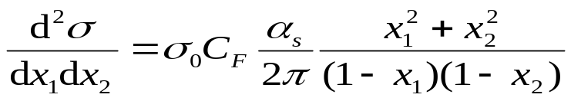

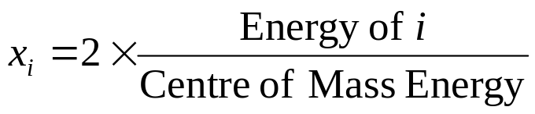


e⁺e⁻ Annihilation to Jets
In order to consider the basic idea of the parton shower let’s start with the cross section for e⁺e⁻ annihilation into three jets.
The cross section can be written as
where x₁ and x₂ are the momentum fractions of the quark and antiquark
Singular as x₁1 or x₂1.
Energy Conservation requires
Singular
1
0
1

Slide 5



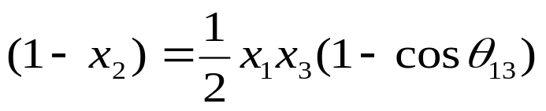
e⁺e⁻ Annihilation to Jets
So the matrix element is singular as x₁1, x₂1 or both.
What does this mean physically?
So x₂1 means that 1 and 3 are collinear.
Also x₁+x₂+x₃=2 means that x₁1 and x₂1 implies x_{g}0, soft

Slide 6
QCD Radiation
It is impossible to calculate and integrate the matrix elements for large numbers of partons.
Instead we treat the regions where the emission of QCD radiation is enhanced.
This is soft and collinear radiation.

Slide 7
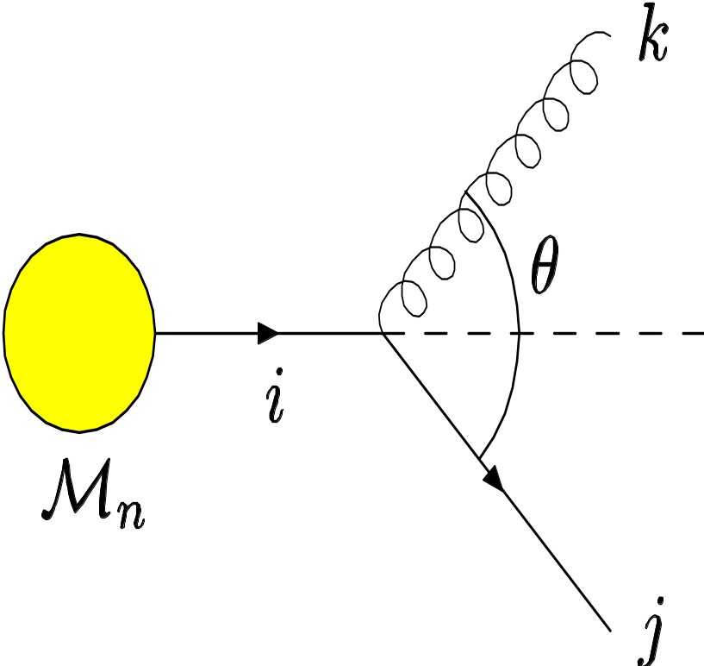
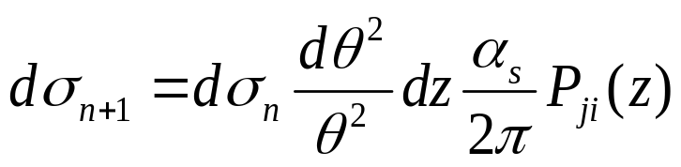
Collinear Singularities
In the collinear limit the cross section for a process factorizes
  P_{ji}(z) is the DGLAP splitting function.
The splitting function only depends on the spin and flavours of the particles

Slide 8
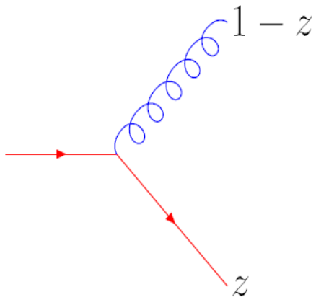
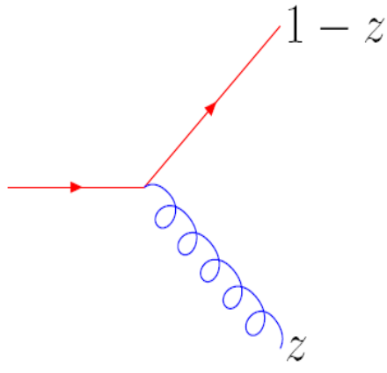
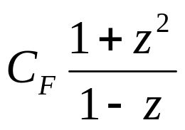
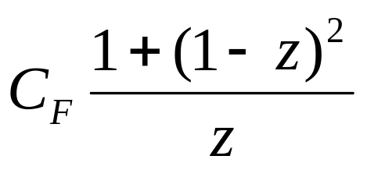
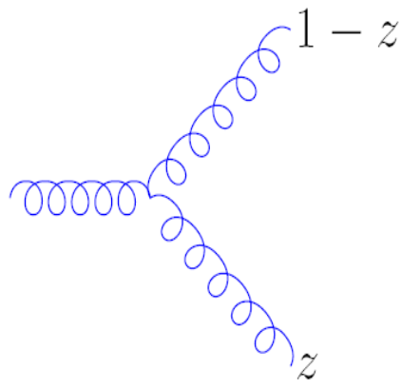
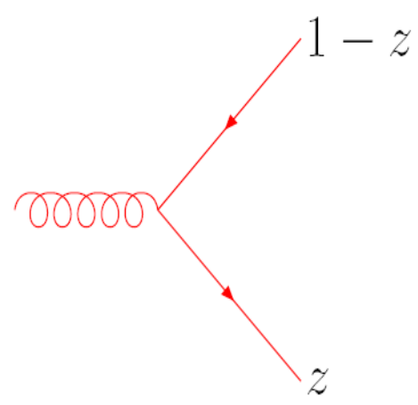
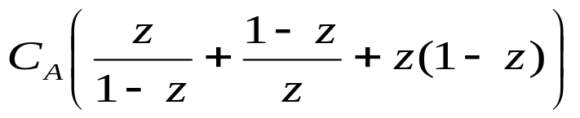
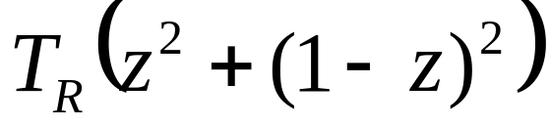
Splitting Functions

Slide 9

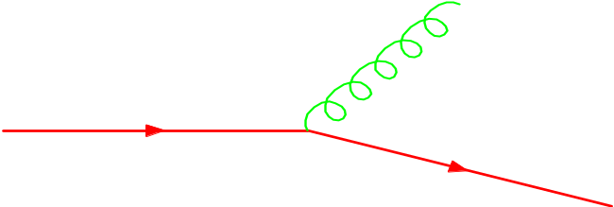
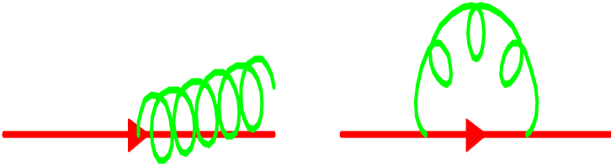
Collinear Singularities
This expression is singular as θ0.
What is a parton? (or what is the difference between a collinear pair and a parton)
Introduce a resolution criterion, e.g.
Combine the virtual corrections and unresolvable emission
Resolvable Emission
Finite
Unresolvable Emission
Finite
Unitarity: Unresolved + Resolved =1

Slide 10
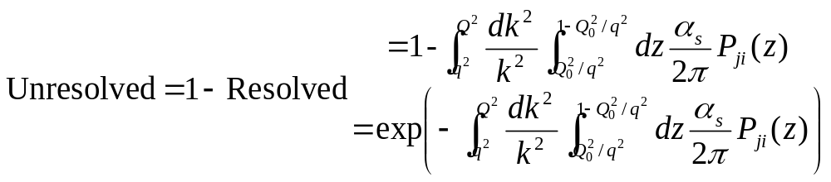
Monte Carlo Procedure
Using this approach we can exponentiate the real emission piece.
This gives the Sudakov form factor which is the probability of evolving between two scales and emitting no resolvable radiation.
More strictly it is the probability of evolving from a high scale to the cut-off with no resolvable emission.

Slide 11



Numerical Procedure
Radioactive Decay
Parton Shower
Start with an isotope
Work out when it decays by generating a random number and solving
where τ is its lifetime
Generate another random number and use the branching ratios to find the decay mode.
Generate the decay using the masses of the decay products and phase space.
Repeat the process for any unstable decay products.
This algorithm is actually used in Monte Carlo event generators to simulate particle decays.
Start with a parton at a high virtuality, Q, typical of the hard collision.
Work out the scale of the next branching by generating a random number and solving
where q is the scale of the next branching
If there’s no solution for q bigger than the cut-off stop.
Otherwise workout the type of branching.
Generate the momenta of the decay products using the splitting functions.
Repeat the process for the partons produced in the branching.

Slide 12
Monte Carlo Procedure
The key difference between the different Monte Carlo simulations is in the choice of the evolution variable.
Evolution Scale
  Virtuality, q²
  Transverse Momentum, k_{T}.
  Angle, θ.
  ….
Energy fraction, z
  Energy fraction
  Light-cone momentum fraction
  ….
All are the same in the collinear limit.

Slide 13
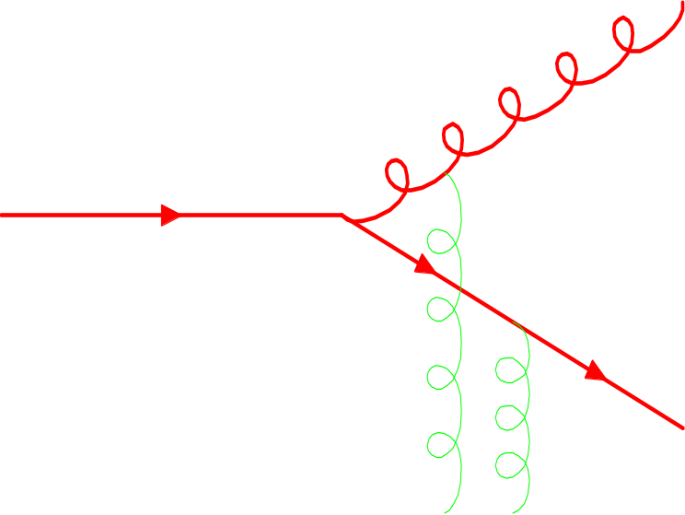
Soft Emission
We have only considered collinear emission. What about soft emission?
In the soft limit the matrix element factorizes but at the amplitude level.
Soft gluons come from all over the event.
There is quantum interference between them.
Does this spoil the parton shower picture?

Slide 14
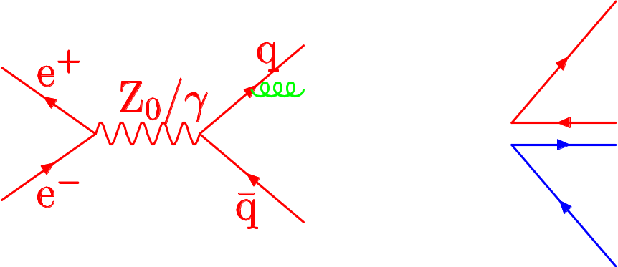
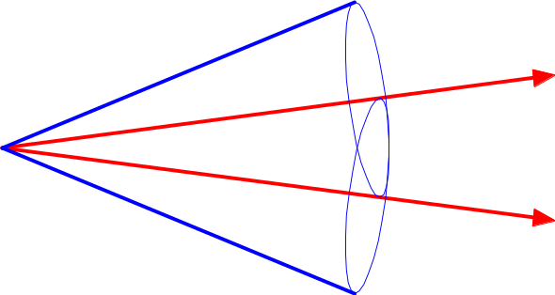
Angular Ordering
Colour Flow
There is a remarkable result that if we take the large number of colours limit much of the interference is destructive.
In particular if we consider the colour flow in an event.
QCD radiation only occurs in a cone up to the direction of the colour partner.
The best choice of evolution variable is therefore an angular one.
Emitter
Colour Partner

Slide 15
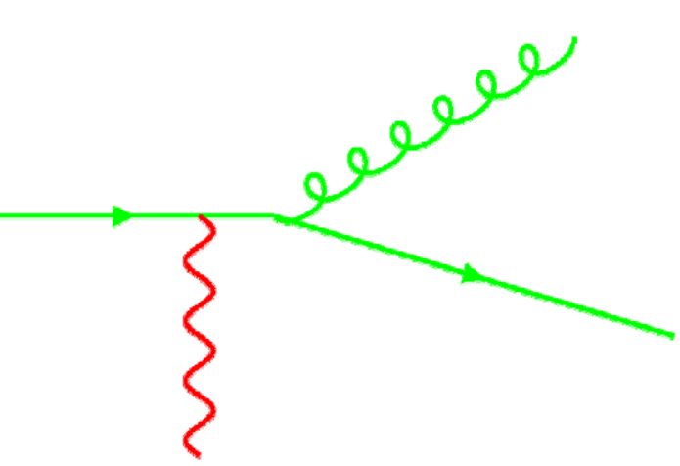
Colour Coherence
Angular Ordering and Colour Coherence are often used interchangeably in talks etc..
However there is a difference.
Colour Coherence is the phenomena that a soft gluon can’t resolve a small angle pair of particles and so only sees the colour charge of the pair.
Angular Ordering is a way of implementing colour coherence in parton shower simulations.

Slide 16
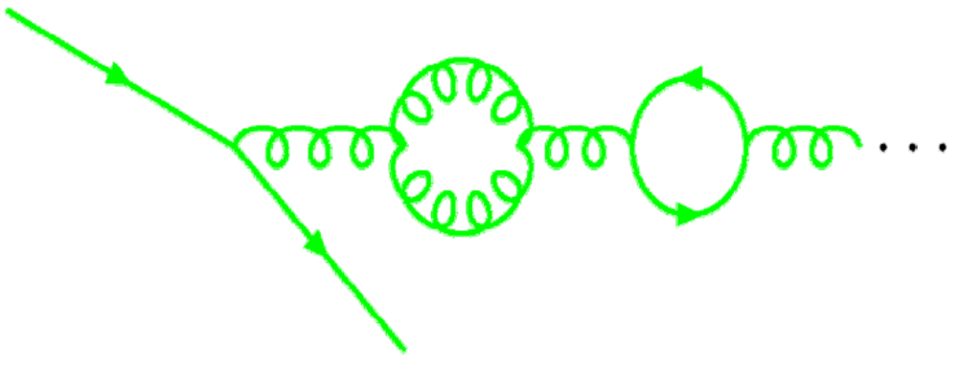
Running Coupling
It is often said that Monte Carlo event generators are leading-log.
However they include many effects beyond leading log, e.g.
Momentum Conservation
Running Coupling Effects
  Effect of summing higher orders is absorbed by replacing α_{s} with α_{s}(k_{T}²).
  Gives more soft gluons, but must avoid the Landau pole which makes the cut-off a physical parameter.

Slide 17
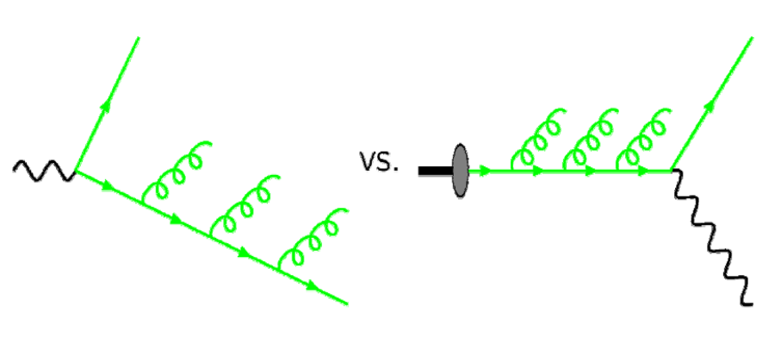
Initial-State Radiation
In principle this is similar to final-state radiation.
However in practice there is a complication
For final-state radiation
  One end of the evolution fixed, the scale of the hard collision.
For initial-state radiation
  Both ends of the evolution fixed, the hard collision and the incoming hadron
Use a different approach based on the evolution equations.

Slide 18
Initial-State Radiation
There are two options for the initial-state shower
Forward Evolution
  Start at the hadron with the distribution of partons given by the PDF.
  Use the parton shower to evolve to the hard collision.
  Reproduces the PDF by a Monte Carlo procedure.
  Unlikely to give an interesting event at the end, so highly inefficient.
Backward Evolution
  Start at the hard collision and evolve backwards to the proton guided by the PDF.
  Much more efficient in practice.

Slide 19
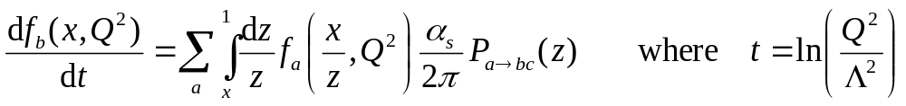
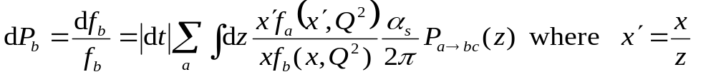
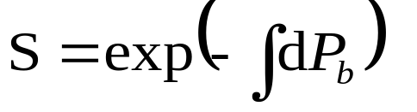
Initial-State Radiation
The evolution equation for the PDF can be written as
Or
This can be written as a Sudakov form-factor for evolving backwards in time, i.e from the hard collision at high Q² to lower with

Slide 20
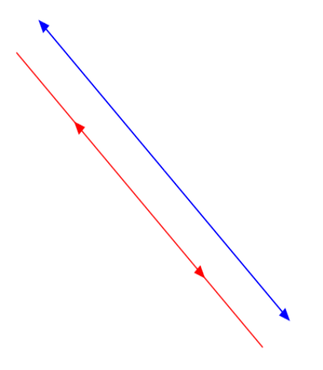
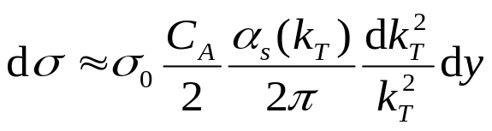
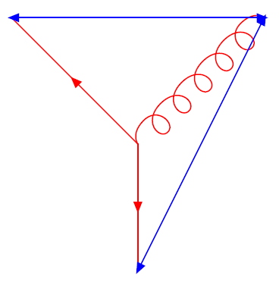
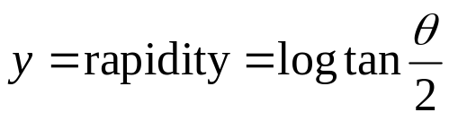
The Colour Dipole Model
The standard parton shower approach starts from the collinear limit and makes changes to include soft gluon coherence.
The Colour Dipole Model starts from the soft limit.
Emission of soft gluons from the colour-anticolour dipole is universal.
After emitting a gluon, the colour dipole splits into two new dipoles


Slide 21
Parton Shower
ISAJET uses the original parton shower algorithm which only resums collinear logarithms.
PYTHIA uses the collinear algorithm with an angular veto to try to reproduce the effect of the angular ordered shower.
HERWIG uses the angular ordered parton shower algorithm which resums both soft and collinear singularities.
SHERPA uses the PYTHIA algorithm.
ARIADNE uses the colour dipole model.

Slide 22
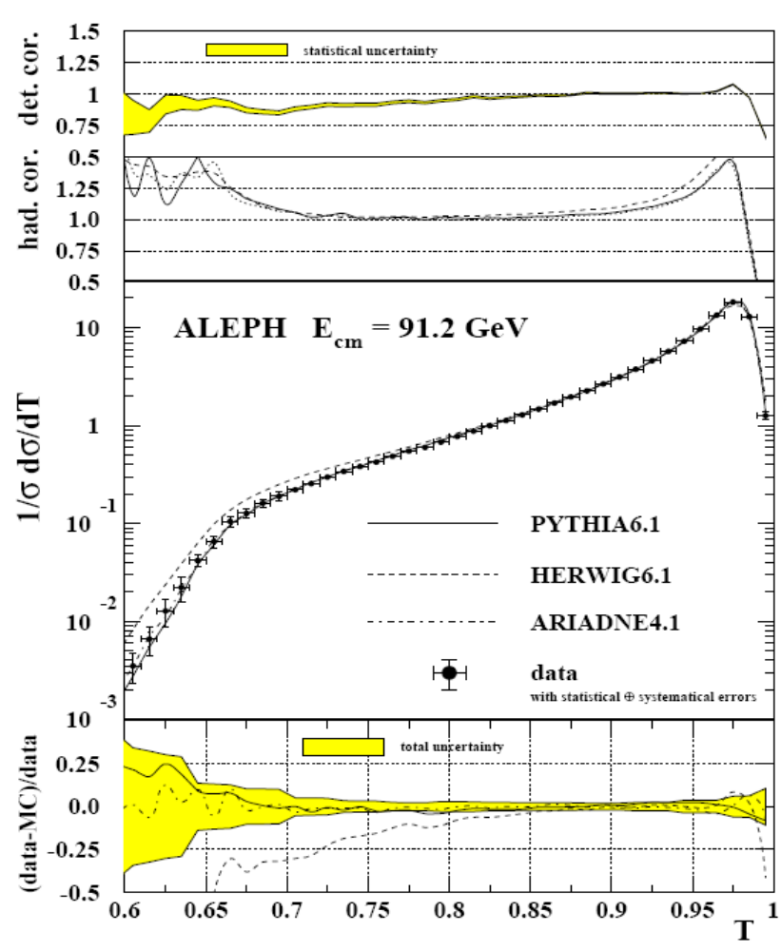
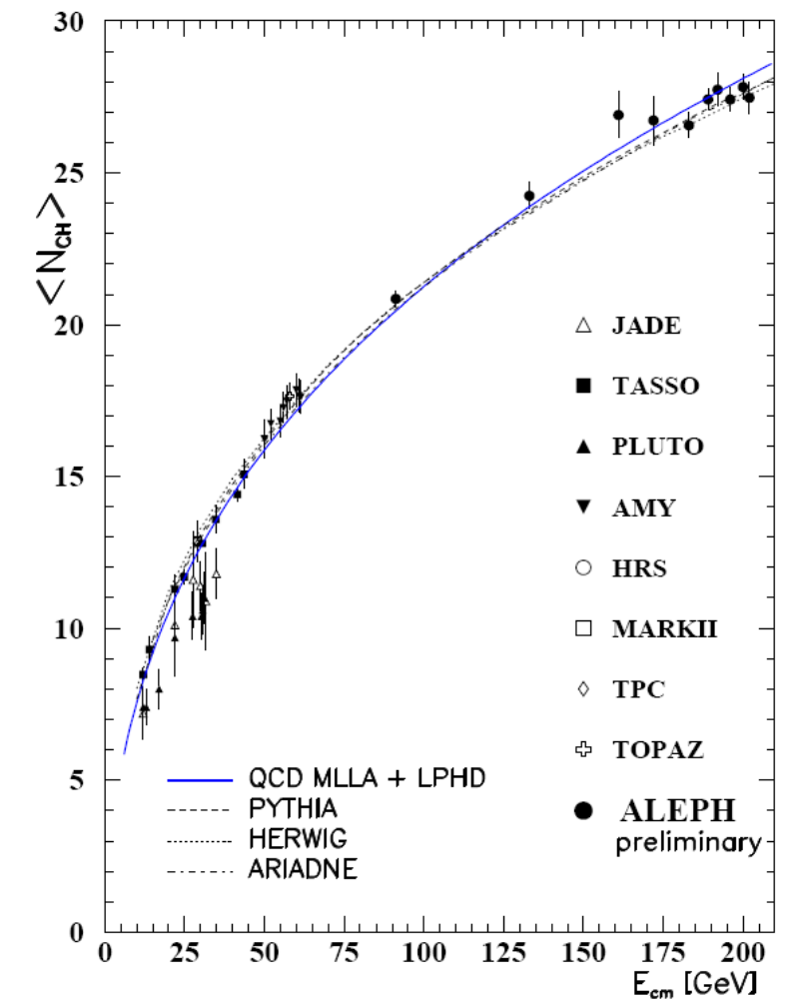
LEP Event Shapes

Slide 23
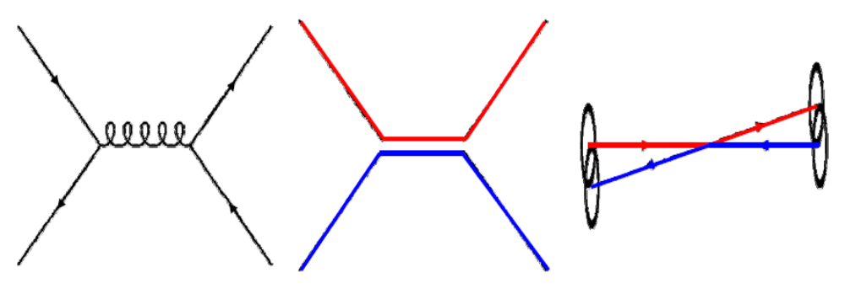
Hadron Collisions
The hard scattering sets up the initial conditions for the parton shower.
Colour coherence is important here too.
Each parton can only emit in a cone stretching to its colour partner.
Essential to fit the Tevatron data.

Slide 24
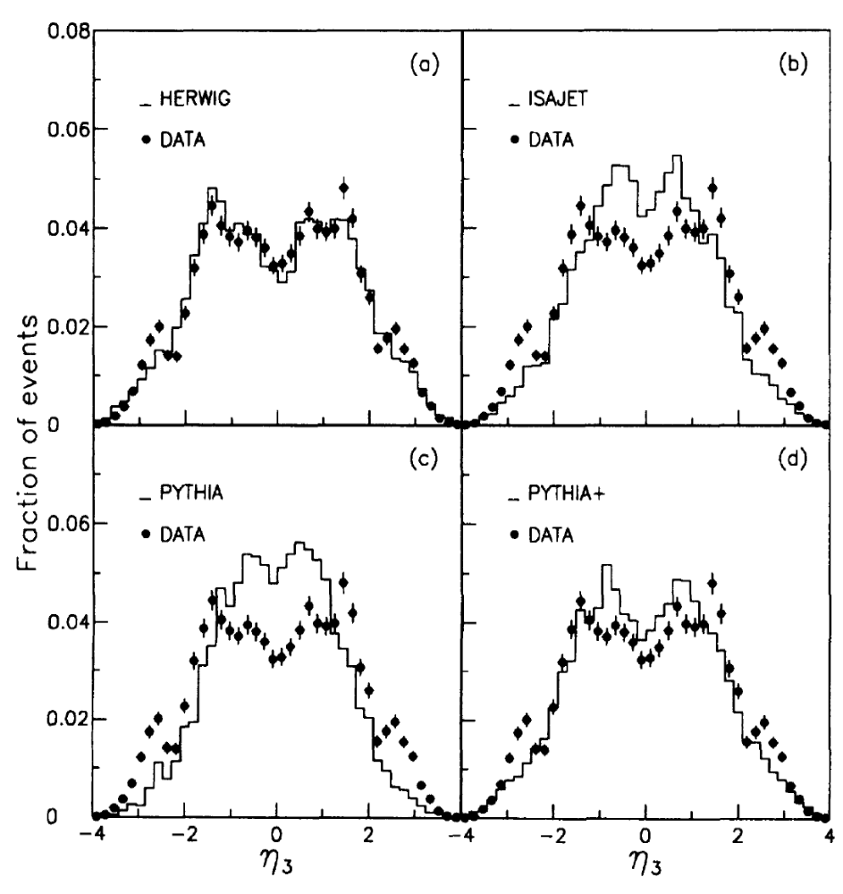
Hadron Collisions
Distributions of the pseudorapidity of the third jet.
Only described by
  HERWIG which has complete treatment of colour coherence.
  PYTHIA+ has partial
PRD50, 5562, CDF (1994)

Slide 25
Recent Progress
In the parton shower per se there have been two recent advances.
New Herwig++ shower
  Based on massive splitting functions.
  Better treatment of radiation from heavy quarks.
  More Lorentz invariant.
New PYTHIA p_{T} ordered shower
  Order shower in p_{T}, should be coherent.
  Easier to include new underlying event models.
  Easier to match to matrix elements

Slide 26
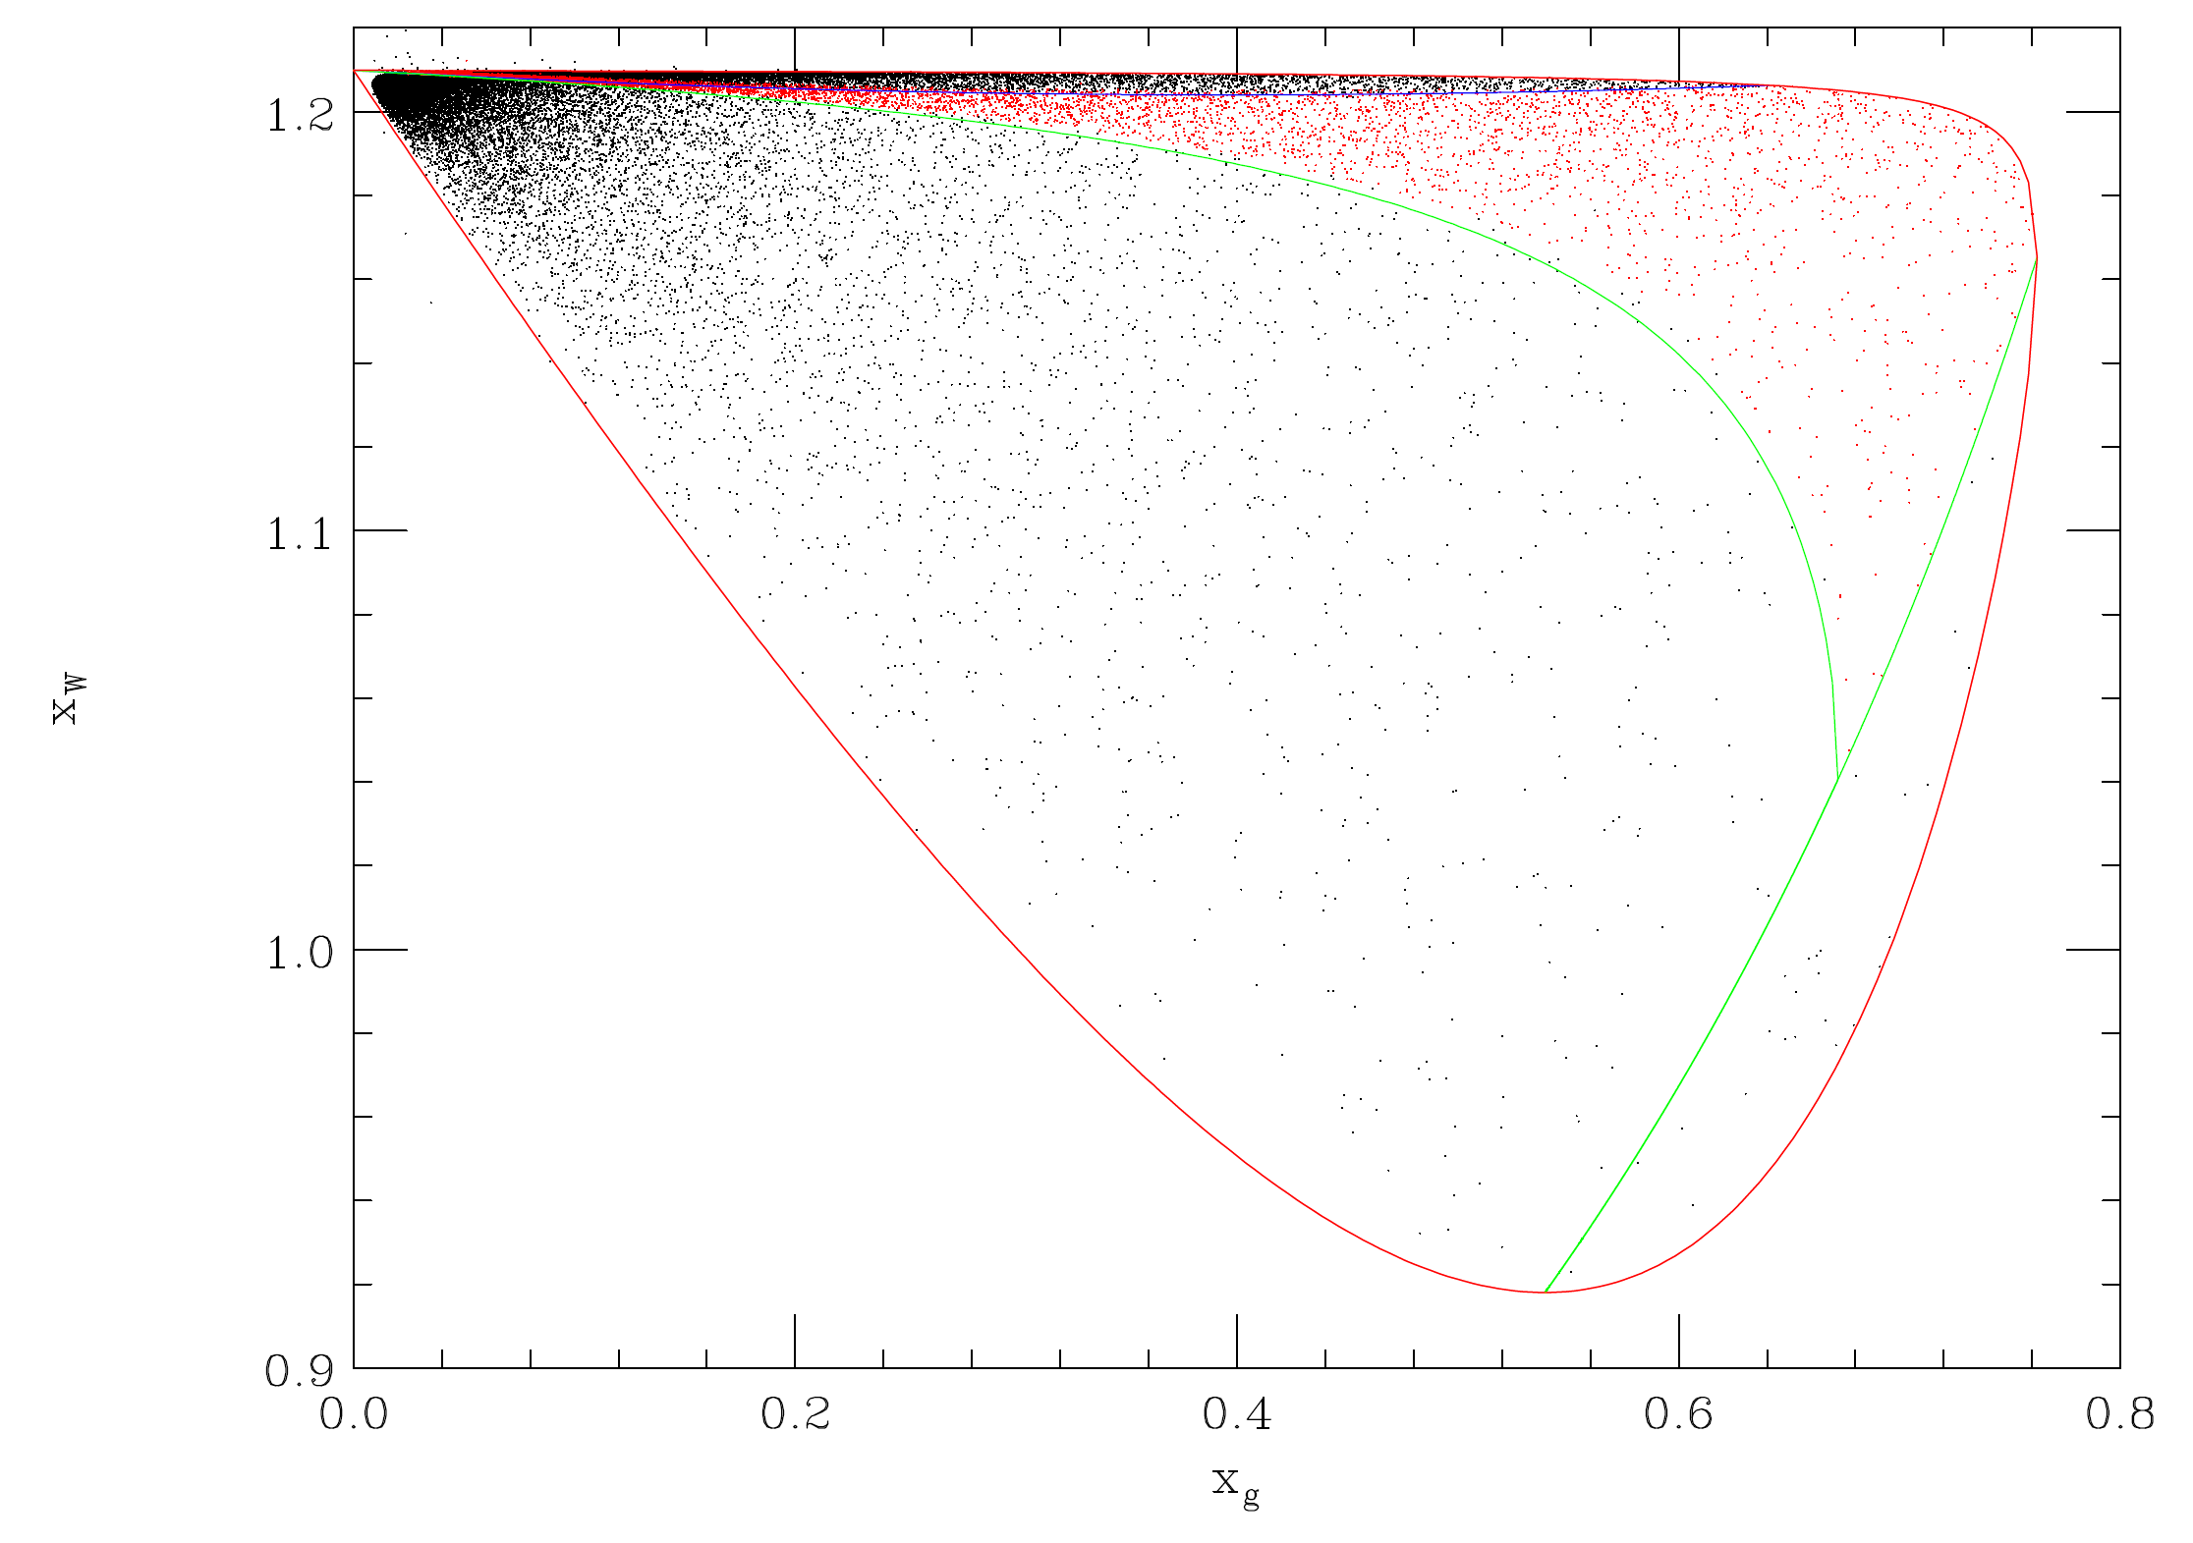
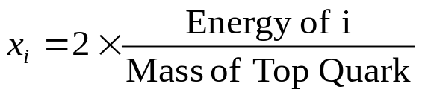
Herwig++ for tbW⁺g
Based on the formalism of S. Gieseke, P. Stephens and B.R. Webber, JHEP 0312:045,2003.
Improvement on the previous FORTRAN version.

Slide 27
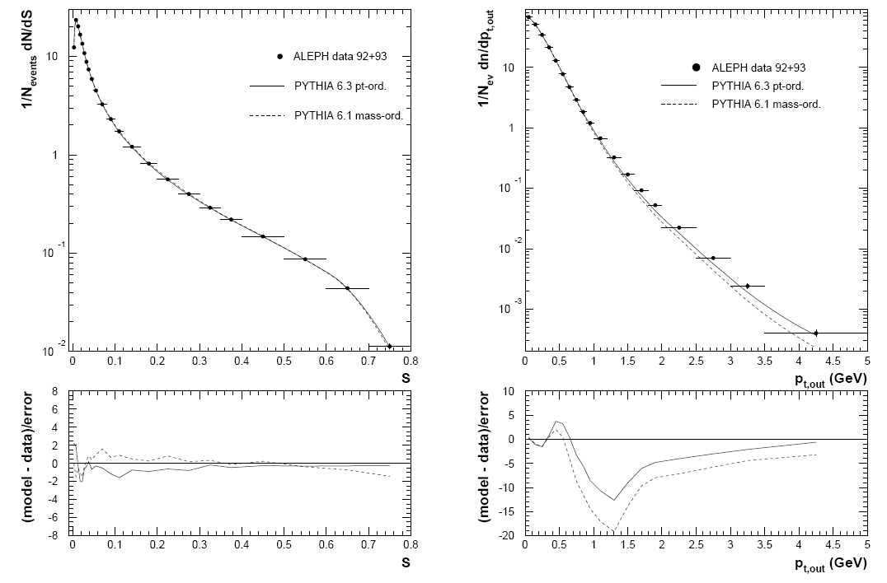
PYTHIA p_{T} ordered Shower

Slide 28
Hard Jet Radiation
The parton shower is designed to simulate soft and collinear radiation.
While this is the bulk of the emission we are often interested in the radiation of a hard jet.
This is not something the parton shower should be able to do, although it often does better than we except.
If you are looking at hard radiation HERWIG/PYTHIA will often get it wrong.

Slide 29
Hard Jet Radiation
Given this failure of the approximations this is an obvious area to make improvements in the shower and has a long history.
You will often here this called
  Matrix Element matching.
  Matrix Element corrections.
  Merging matrix elements and parton shower
  MC@NLO
I will discuss all of these and where the different ideas are useful.

Slide 30
Hard Jet Radiation: General Idea
Parton Shower (PS) simulations use the soft/collinear approximation:
  Good for simulating the internal structure of a jet;
  Can’t produce high p_{T} jets.
Matrix Elements (ME) compute the exact result at fixed order:
  Good for simulating a few high p_{T} jets;
  Can’t give the structure of a jet.
We want to use both in a consistent way, i.e.
  ME gives hard emission
  PS gives soft/collinear emission
  Smooth matching between the two.
  No double counting of radiation.

Slide 31
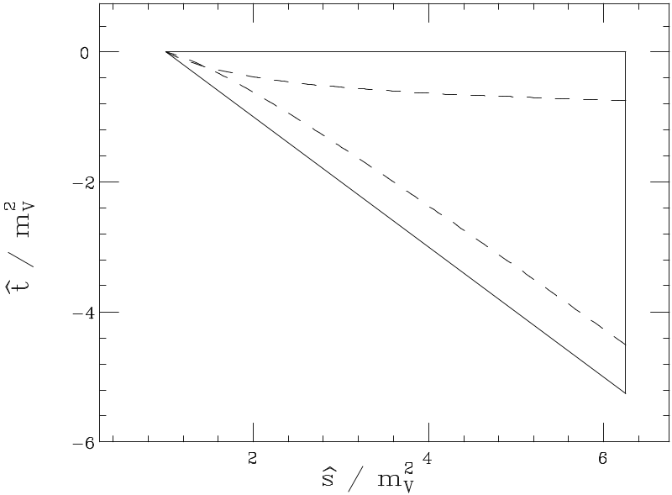
Matching Matrix Elements and Parton Shower
Parton Shower
The oldest approaches are usually called matching matrix elements and parton showers or the matrix element correction.
Slightly different for HERWIG and PYTHIA.
In HERWIG
HERWIG phase space for Drell-Yan
Dead Zone
  Use the leading order matrix element to fill the dead zone.
  Correct the parton shower to get the leading order matrix element in the already filled region.
PYTHIA fills the full phase space so only the second step is needed.

Slide 32
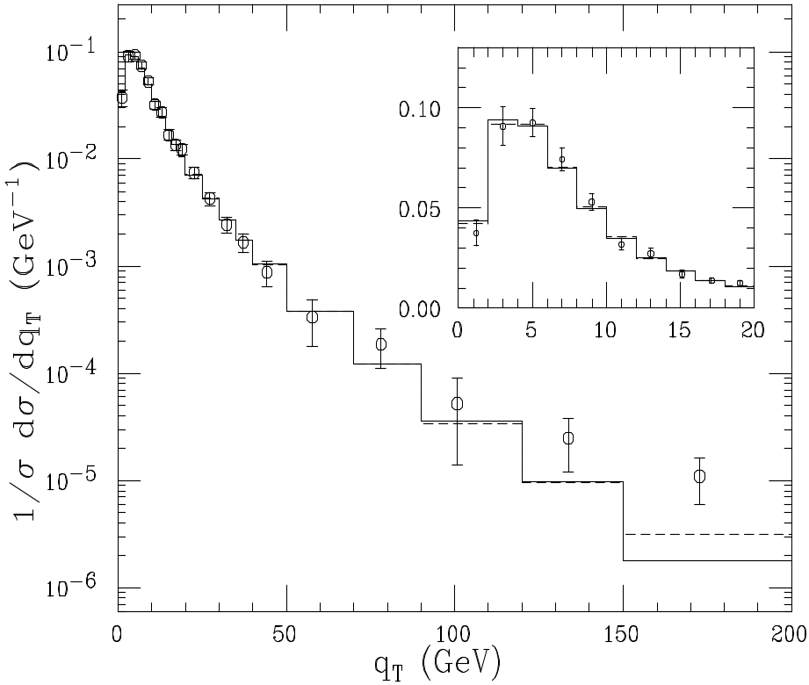
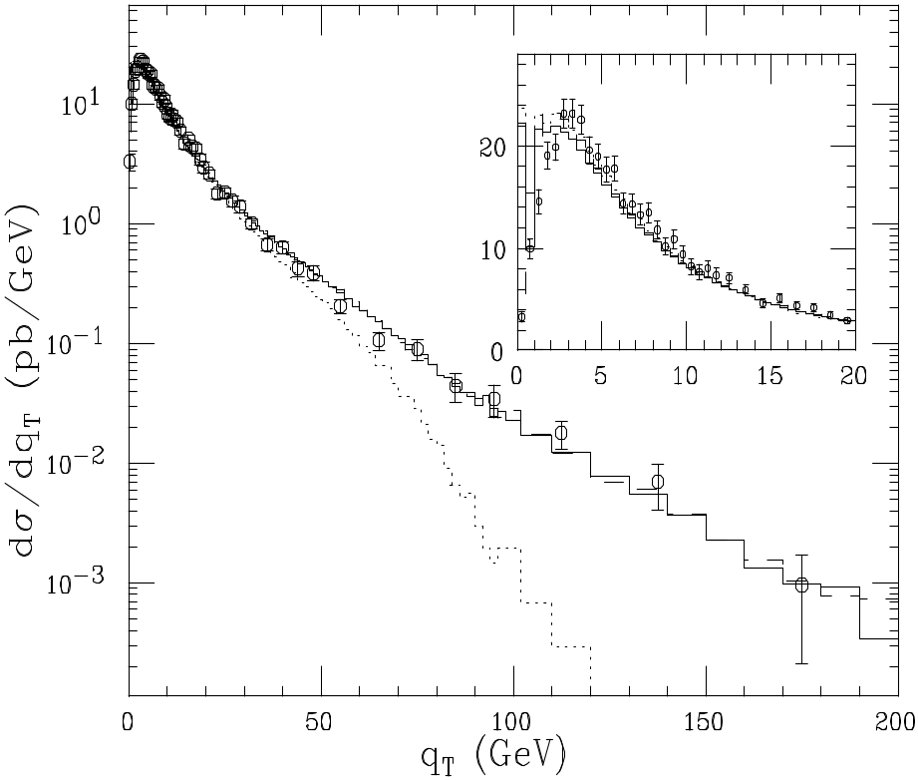
Matrix Element Corrections
W q_{T} distribution from D0
Z q_{T} distribution from CDF
G. Corcella and M. Seymour, Nucl.Phys.B565:227-244,2000.

Slide 33
Matrix Element Corrections
There was a lot of work for both HERWIG and PYTHIA. The corrections for
  e⁺e⁻ to hadrons
  DIS
  Drell-Yan
  Top Decay
  Higgs Production
were included.
There are problems with this
  Only the hardest emission was correctly described
  The leading order normalization was retained.

Slide 34
Recent Progress
In the last few years there has been a lot of work addressing both of these problems.
Two types of approach have emerged
NLO Simulation
  NLO normalization of the cross section
  Gets the hardest emission correct
Multi-Jet Leading Order
  Still leading order.
  Gets many hard emissions correct.

Slide 35
NLO Simulation
There has been a lot of work on NLO Monte Carlo simulations.
Only the MC@NLO approach of Frixione, Nason and Webber has been shown to work in practice.
Although an alternative approach by Nason looks promising and a paper with results for Z pairs appeared last week.

Slide 36
MC@NLO
MC@NLO was designed to have the following features.
  The output is a set of fully exclusive events.
  The total rate is accurate to NLO
  NLO results for observables are recovered when expanded in α_{s}.
  Hard emissions are treated as in NLO calculations.
  Soft/Collinear emission are treated as in the parton shower.
  The matching between hard emission and the parton shower is smooth.
  MC hadronization models are used.

Slide 37
Basic Idea
The basic idea of MC@NLO is
  Work out the shower approximation for the real emission.
  Subtract it from the real emission from
  Add it to the virtual piece.
This cancels the singularities and avoids double counting.
It’s a lot more complicated than it sounds.

Slide 38

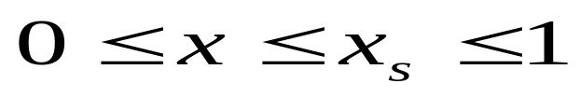
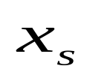
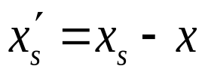
Toy Model
I will start with Bryan Webber’s toy model to explain MC@NLO to discuss the key features of NLO, MC and the matching.
Consider a system which can radiate photons with energy with energy with
where is the energy of the system before radiation.
After radiation the energy of the system
Further radiation is possible but photons don’t radiate.

Slide 39
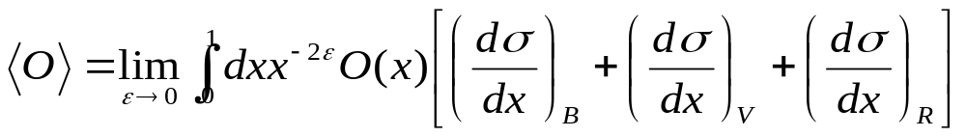
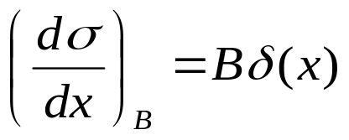
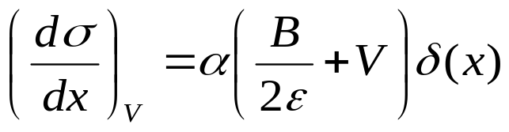
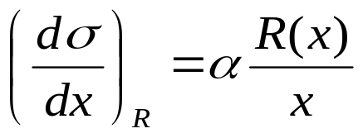
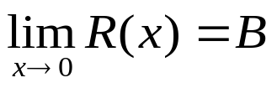
Toy Model
Calculating an observable at NLO gives
where the Born, Virtual and Real contributions are
α is the coupling constant and

Slide 40
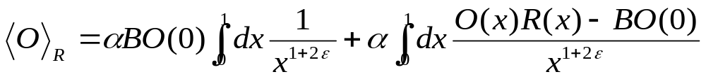

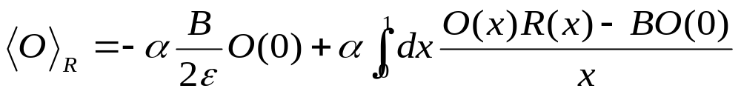
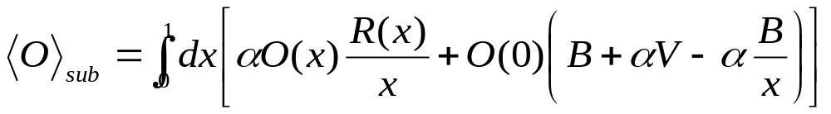
Toy Model
In a subtraction method the real contribution is written as
The second integral is finite so we can set
The NLO prediction is therefore

Slide 41








Toy Monte Carlo
In a MC treatment the system can emit many photons with the probability controlled by the Sudakov form factor, defined here as
  where is a monotonic function which has
is the probability that no photon can be emitted with energy such that .

Slide 42






Toy MC@NLO
We want to interface NLO to MC. Naïve first try
  start MC with 0 real emissions:
  start MC with 1 real emission at x:
So that the overall generating functional is
This is wrong because MC with no emissions will generate emission with NLO distribution

Slide 43



Toy MC@NLO
We must subtract this from the second term
This prescription has many good features:
  The added and subtracted terms are equal to
  The coefficients of and are separately finite.
  The resummation of large logs is the same as for the Monte Carlo renormalized to the correct NLO cross section.
  However some events may have negative weight.

Slide 44




Toy MC@NLO Observables
As an example of an “exclusive” observable consider the energy y of the hardest photon in each event.
As an “inclusive” observable consider the fully inclusive distributions of photon energies, z
Toy model results shown are for

Slide 45




Toy MC@NLO Observables

Slide 46
Real QCD
For normal QCD the principle is the same we subtract the shower approximation to the real emission and add it to the virtual piece.
This cancels the singularities and avoids double counting.
It’s a lot more complicated.

Slide 47
Problems
For each new process the shower approximation must be worked out, which is often complicated.
While the general approach works for any shower it has to be worked out for a specific case.
So for MC@NLO only works with the HERWIG shower algorithm.
It could be worked out for PYTHIA or Herwig++ but this remains to be done.

Slide 48


W⁺W⁻ Observables
P_{T} of W+W-
MC@NLO
HERWIG
Δϕ of W+W-
NLO
MC@NLO gives the correct high P_{T} result and soft resummation.
S. Frixione and B.R. Webber JHEP 0206(2002) 029, hep-ph/0204244, hep-ph/0309186

Slide 49


W⁺W⁻ Jet Observables
MC@NLO
HERWIG
NLO
S. Frixione and B.R. Webber JHEP 0206(2002) 029, hep-ph/0204244, hep-ph/0309186

Slide 50



Top Production
MC@NLO
HERWIG
NLO
S. Frixione, P. Nason and B.R. Webber, JHEP 0308(2003) 007, hep-ph/0305252.

Slide 51


Top Production at the LHC
MC@NLO
HERWIG
NLO
S. Frixione, P. Nason and B.R. Webber, JHEP 0308(2003) 007, hep-ph/0305252.

Slide 52


B Production at the Tevatron
S. Frixione, P. Nason and B.R. Webber, JHEP 0308(2003) 007, hep-ph/0305252.

Slide 53

Higgs Production at LHC
S. Frixione and B.R. Webber JHEP 0206(2002) 029, hep-ph/0204244, hep-ph/0309186

Slide 54
NLO Simulation
So far MC@NLO is the only implementation of a NLO Monte Carlo simulation.
Recently there have been some ideas by Paulo Nason JHEP 0411:040,2004 and recent results.
In this approach there are no negative weights but more terms would be exponentiated beyond leading log.

Slide 55
Multi-Jet Leading Order
While the NLO approach is good for one hard additional jet and the overall normalization it cannot be used to give many jets.
Therefore to simulate these processes use matching at leading order to get many hard emissions correct.
I will briefly review the general idea behind this approach and then show some results.

Slide 56
CKKW Procedure
Catani, Krauss, Kuhn and Webber JHEP 0111:063,2001.
In order to match the ME and PS we need to separate the phase space:
One region contains the soft/collinear region and is filled by the PS;
The other is filled by the matrix element.
In these approaches the phase space is separated using in k_{T}-type jet algorithm.

Slide 57







Durham Jet Algorithm
For all final-state particles compute the resolution variables
The smallest of these is selected. If is the smallest the two particles are merged. If is the smallest the particle is merged with the beam.
This procedure is repeated until the minimum value is above some stopping parameter .
The remaining particles and pseudo-particles are then the hard jets.

Slide 58



CKKW Procedure
Radiation above a cut-off value of the jet measure is simulated by the matrix element and radiation below the cut-off by the parton shower.
Select the jet multiplicity with probability
where is the n-jet matrix element evaluated at resolution using as the scale for the PDFs and α_{S}, n is the number of jets
Distribute the jet momenta according the ME.

Slide 59


CKKW Procedure
Cluster the partons to determine the values at which 1,2,..n-jets are resolved. These give the nodal scales for a tree diagram.
Apply a coupling constant reweighting.

Slide 60



CKKW Procedure
Reweight the lines by a Sudakov factor
Accept the configuration if the product of the α_{S} and Sudakov weight is less than otherwise return to step 1.

Slide 61
CKKW Procedure
Generate the parton shower from the event starting the evolution of each parton at the scale at which it was created and vetoing emission above the scale .

Slide 62
CKKW Procedure
Although this procedure ensures smooth matching at the NLL log level are still choices to be made:
  Exact definition of the Sudakov form factors.
  Scales in the strong coupling and α_{S}.
  Treatment of the highest Multiplicity matrix element.
  Choice of the k_{T} algorithm.
In practice the problem is understanding what the shower is doing and treating the matrix element in the same way.

Slide 63




e⁺e⁻ Results from SHERPA

Slide 64

p_{T} of the W at the Tevatron from HERWIG
ME
HW
0 jets
1 jets
2 jets
3 jets
4 jets

Slide 65

Tevatron p_{T} of the 4th jet from HERWIG
ME
HW
0 jets
1 jets
2 jets
3 jets
4 jets

Slide 66

LHC E_{T} of the 4th jet from HERWIG
ME
HW
0 jets
1 jets
2 jets
3 jets
4 jets

Slide 67
What Should I use?
Hopefully this lecture will help you decide which of the many different tools is most suitable for a given analysis.
  Only soft jets relative to hard scale MC
  Only one hard jet MC@NLO or old style ME correction
  Many hard jets CKKW.
The most important thing is to think first before running the simulation.

Slide 68
Summary
In this afternoon’s lecture we have looked at
  The basic parton shower algorithm
  Colour Coherence
  Backward Evolution
  Next-to-leading Order simulations
  Matrix Element matching
On Thursday we will go on and look at the non-perturbative parts of the simulation.

