Slide 1
B(n, p)
x successes in n trials
Pascal(r, p)
Bernoulli(p)
i.i.d. Bernoulli trials
obtain r-th success in the x-th trial
x failures before the r-th success
NB(r, p)
r = 1
Geom(p)

Slide 2
Exp(β), β = λ
time between successive arrivals
Poisson(k)
rate λ
time needed for next r arrivals
Gamma(α, β), α = r, β = λ
α = γ/2, β = 1/2
Chi-squared(γ)

Slide 3
repair
t
lead time
demand
aircraft
aircraft
aircraft
aircraft
...
...
...
...
#. of stored?
store
store
store
store

Slide 4
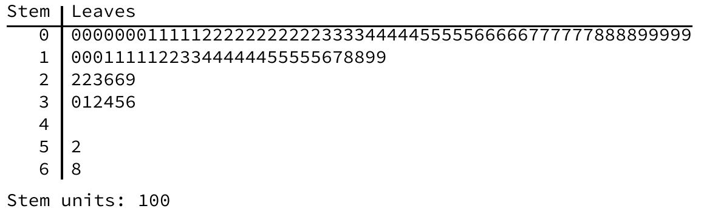

Slide 5
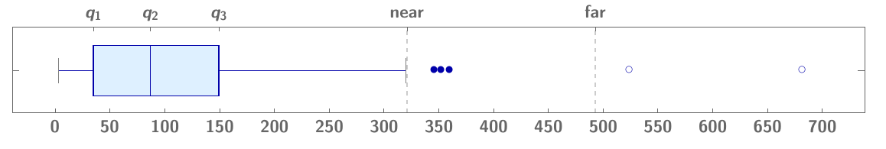
a1
f1
a3

Slide 6
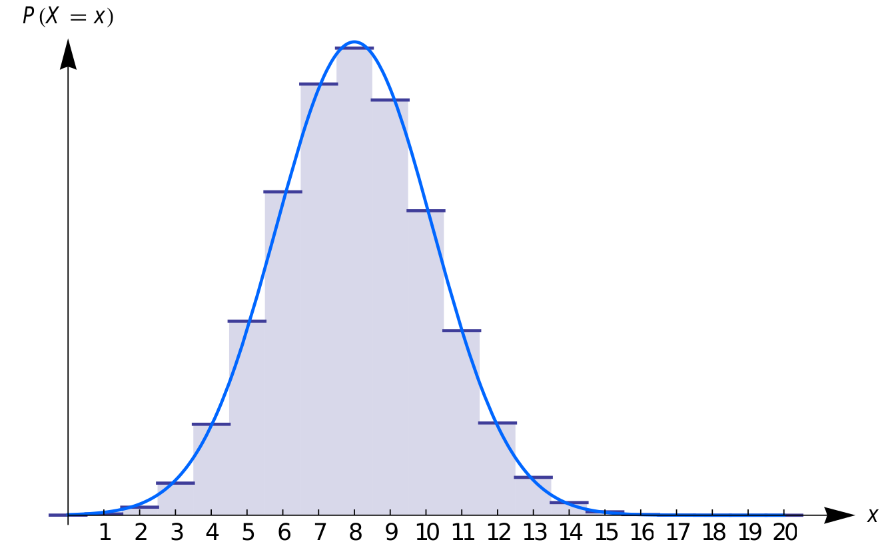
x₁
x₂

Slide 7
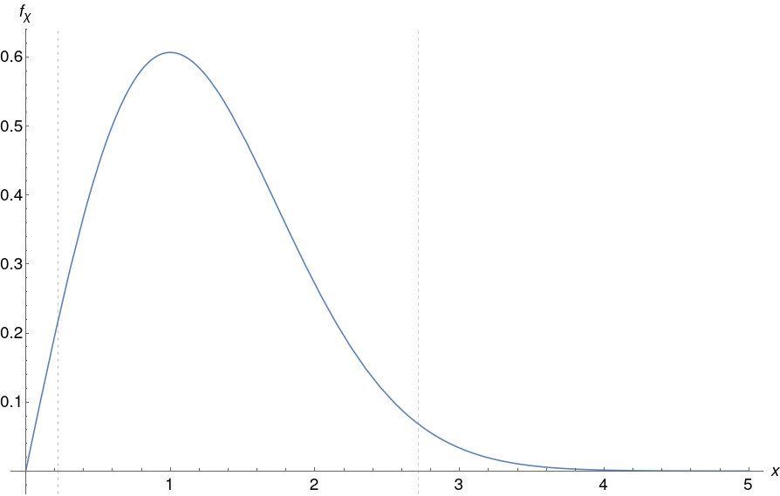
ᵪ_{1-α/2}
ᵪ_{α/2}

Slide 8
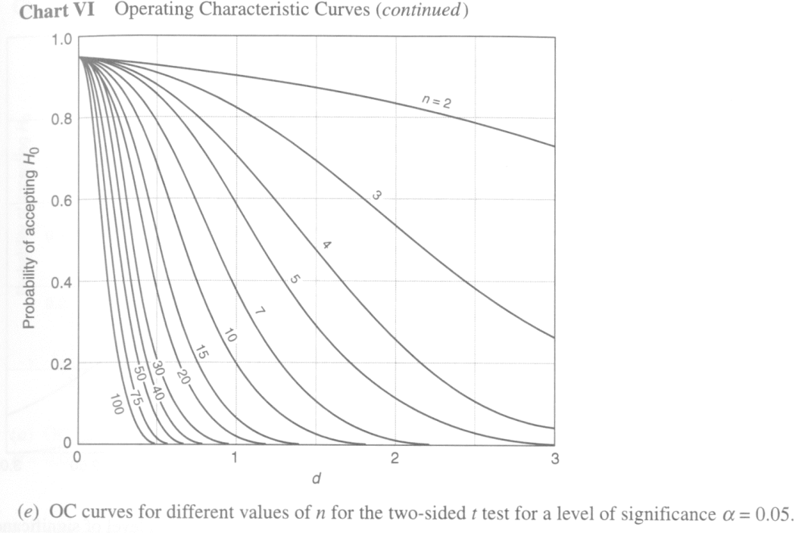

Slide 9
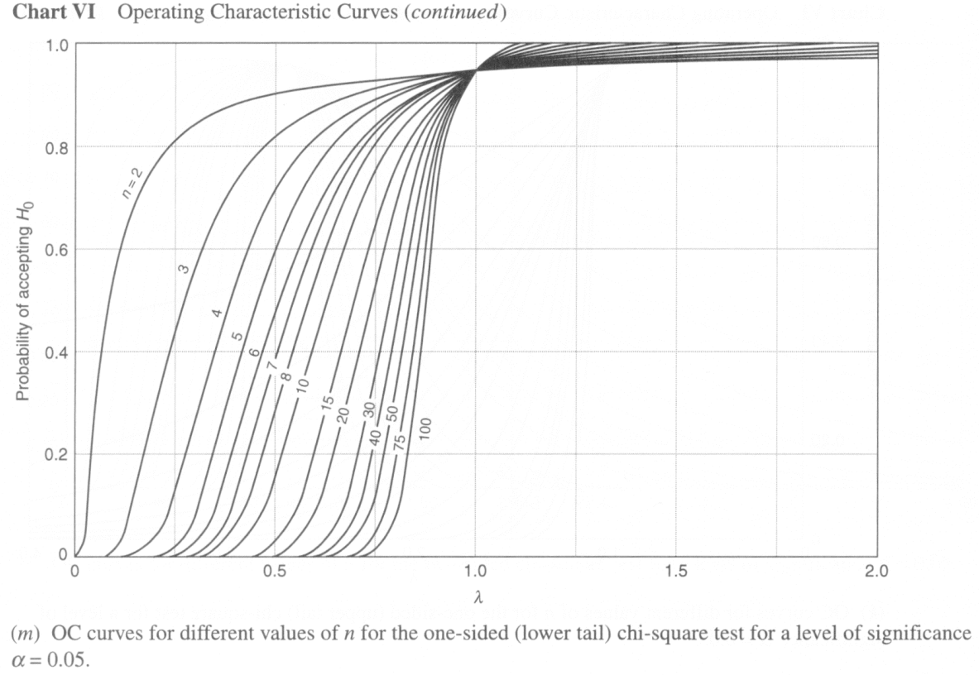

Slide 10
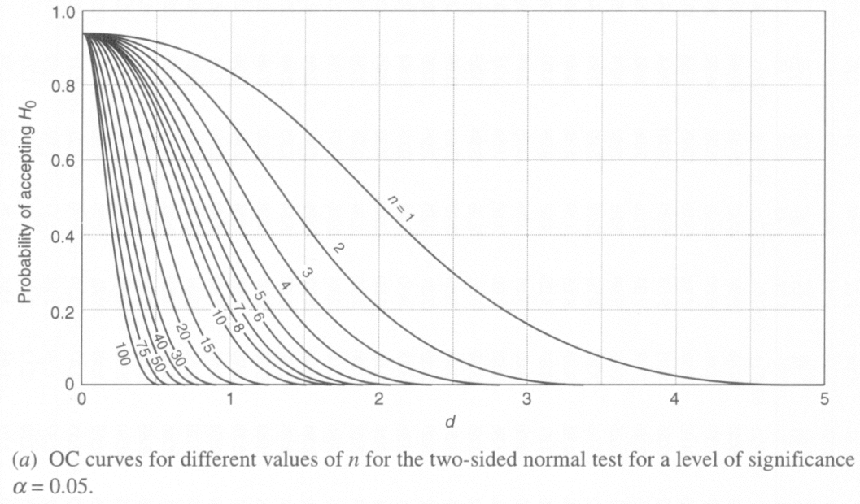

Slide 11
