Slide 1
Tipit
SIMPLE tipping and token sharing on popular Social platforms http://tipit.io

Slide 2
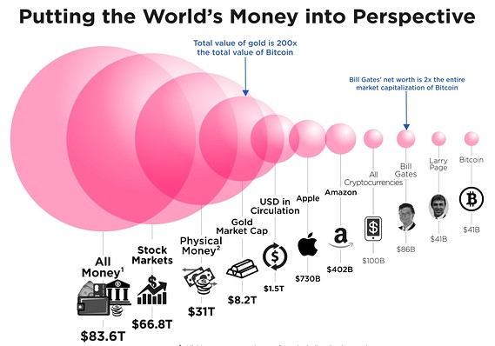

Slide 3
Crypto vs Internet Users
Crypto Today
Too Complex and Scary
Mainstream sees FUD not benefit
Adoption Solutions:
Simple
Disrupt/Displace
Better Future

Slide 4
POLL: Why Startups succeed
Which is the MOST important for Startup Success?
Funding
Business Model
Idea
Team
Timing

Slide 5

Tipit.io on Discord
SIMPLE!
Fun
Easy
Sharing & Giving
“PayPal of EOS”
Simple Commands
!bal
!send or !tip
!deposit
!help
!pull or !withdraw
!name EOS name check & link
!create EOS-name
Join Discussion Now!
https://discord.gg/UnE6z96

Slide 6
DEMO

Slide 7

Transparent on Chain
b13db4cf | Dec-08-2018, 11:59:08 AM | tipitaccount - sendtip | user: tipitaccount touser: realstep tomemo: 3631 fromuser: markstair frommemo: 5421 platform: discord platformid: 0 whotype: H5 symbol: EOS amount: 1.0 memo: Tipbot Test prevtx: ed172be44cf4b6a7d9de55133175b0fab552c7d719a029cc8892c35d18e105a0 previd: 249

Slide 8



Goals: Simple
Simple, Simple, SIMPLE!!!
Leverage EOS without ANY knowledge
Receive EOS and other token tips without account
Introduce EOS/Crypto/Blockchain gradually with Fun and Joy
Drive EOS
Usage
Accounts
Increase value of network

Slide 9
Tipit Business Models
1% Withdraw fee
Advertising
!sendif For user paid for ads
API for apps and games
!dice Roll dice on EOSdice
!bj play blackjack in channel
Premium Subscription Options
Group Token Creation
Ad-free
Custom tipit account
Obfuscated data option
TIP token Options
Stable coin
Utility token
Tip token for withdraw fee (Binance BNB)
Wanted: Token economics advise
Contact marks@tipit.io

Slide 10

Plan: Go Deep, Go Wide
Go Deep with Features
!create
Create EOS account name
!rain
Tip everyone in the channel
!sendif
Interactive Advertising
!sendif 1.0 TESLA “Click for Tesla Model”
Group Token Creation
Direct EOS to EOS
NOT needed initially as most people don’t have EOS accounts!
Send non-fungible digital assets =>Send a CryptoKitty, Stickers

Slide 11
TEAM
High5Software.com Supply Chain Management Software for Service
Mark Stair CEO & Owner
John Campbell Blockchain & Backend Developer
Ben Althauser UI/UX Developer
Mark Olson COO
David Grabowski Technical Support
David Hernandez Technical Support

Slide 12
Why Startups Succeed
Funding - 14%
Business Model - 24%
Ideas - 28%
Team - 32%
Timing - 42%
Source: Bill Gross, Idealab

