Slide 1
Cosimo Tarsia Morisco
Cosimo Tarsia Morisco
Verification Test Suite for SA-neg-QCR2000-R Turbulence Model
Boris Diskin, Yi Liu
National Institute of Aerospace, USA
Marshall Galbraith
Massachusetts Institute of Technology, USA
Cosimo Tarsia Morisco
INRIA, France
High-Fidelity CFD Verification Workshop
January x, 2024

Slide 2
Joukowski Airfoil (JA)

Slide 3
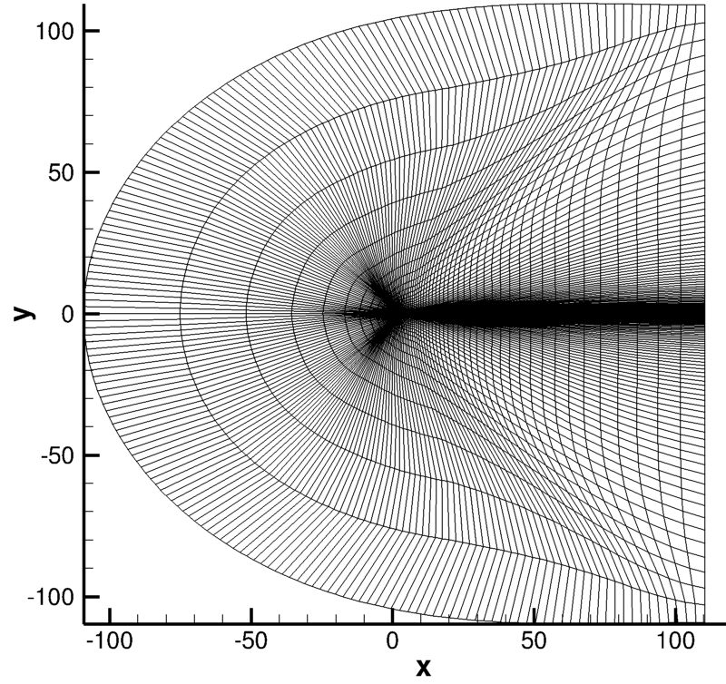
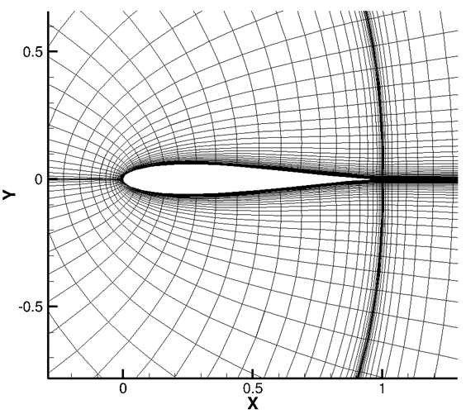

JA: Geometry, Grids, Solvers, Flow and Boundary Conditions
2D tri/quad fixed grids
M∞ = 0.15, $α$ = 0°, Re_{c} = $6×10^{6}$, T_{ref} = 520 R
Level | Nodes
0 | 816
1 | 3168
2 | 12,480
3 | 49,536
4 | 197,376
5 | 787,968
farfield boundary
airfoil surface
RANS Solvers
FUN3D – 2nd order, finite-volume, unstructured-grid, node-centered NASA’s CFD code
SANS – finite-element, adjoint-consistent MIT’s CFD code with polynomials P1, P2, P3
Wolf – 2nd order, finite-volume, unstructured-grid, node-centered INRIA’s CFD code
3

Slide 4
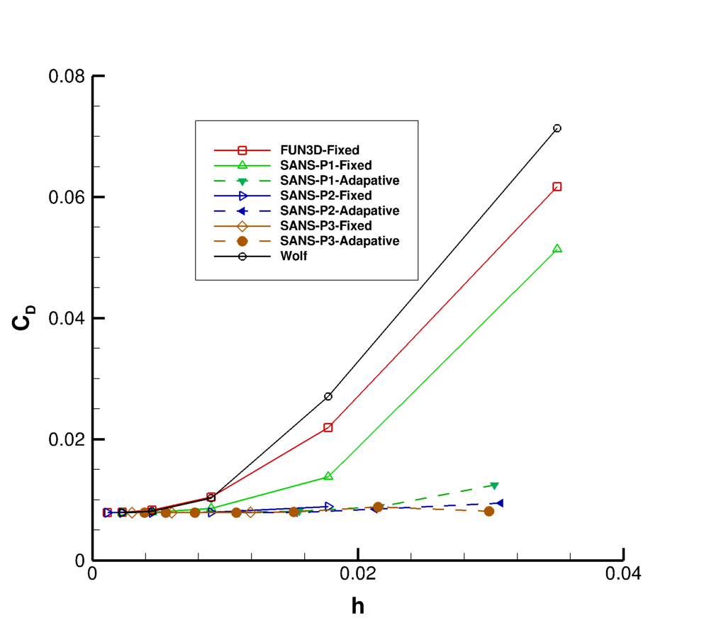
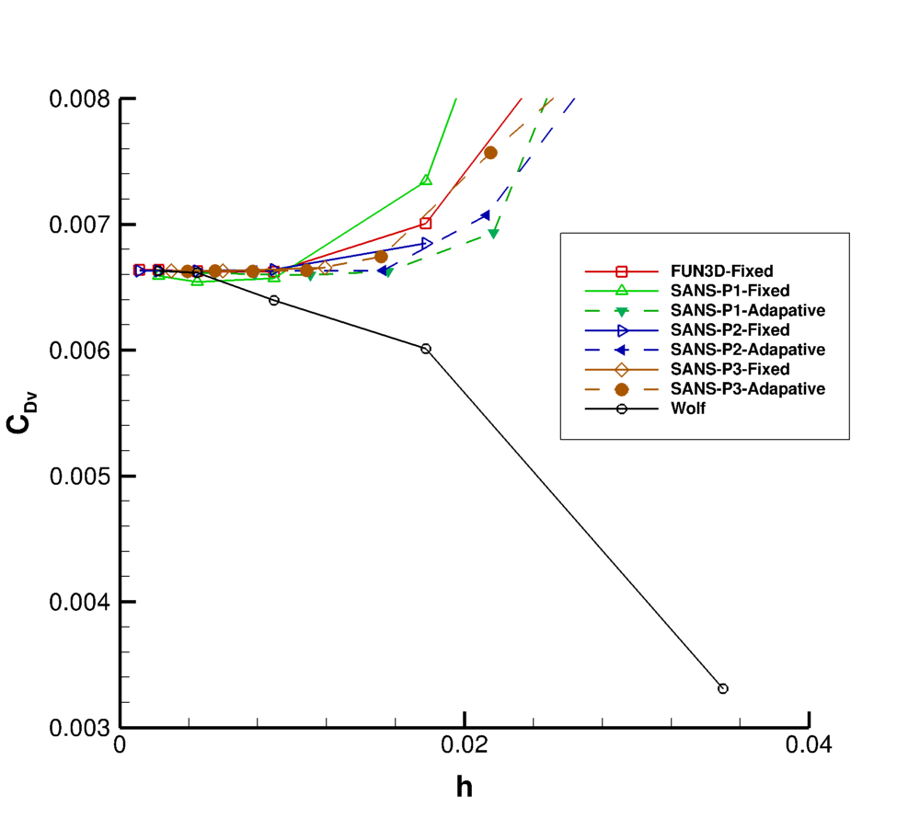
Total Drag and Viscous Drag

Slide 5
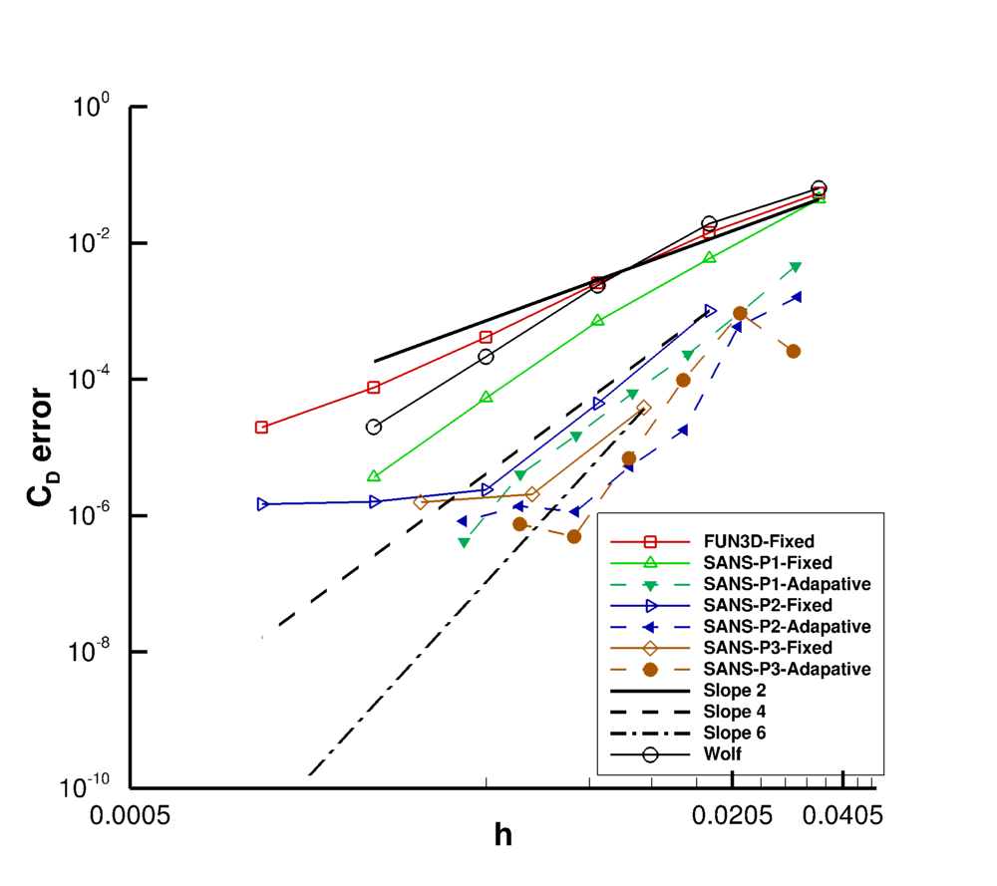
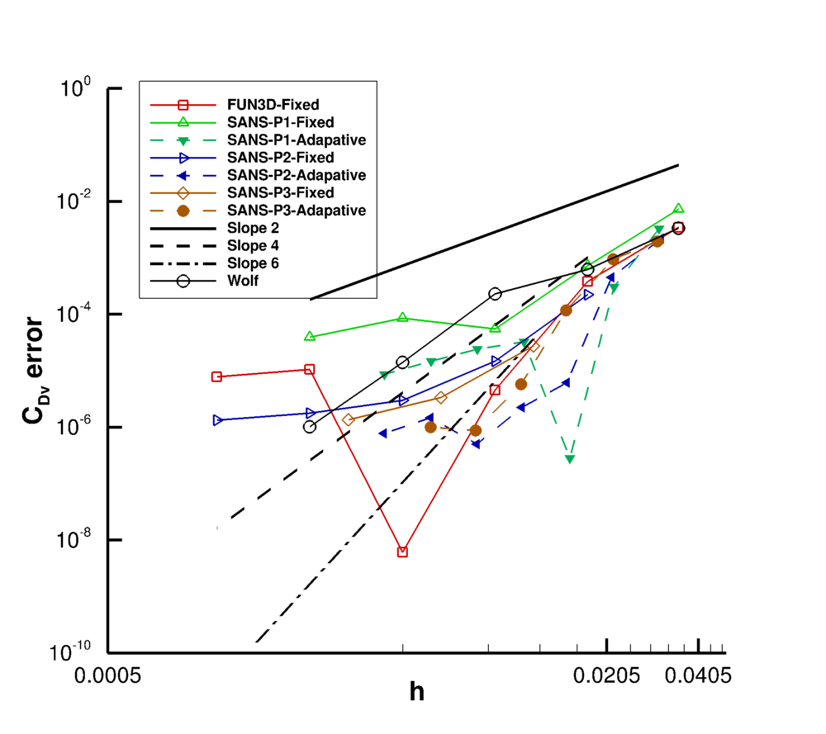
Error in Total and Viscous Drag
SANS-P3-Adaptive solution on the finest grid is taken as the truth

