Slide 1
HiitMan by Hyper Dystopia

Slide 2
Table of Contents
Game Mechanics
Dependencies
Future Implementations
Known issues and limitations

Slide 3
Game Mechanics
Leaderboard.
Group exercise = Points Multiplier.
Gacha system.
Different characters = different power.
Integration with smart watches ( we integrate with HPB's fitness tracker -> Healthy 365 points).

Slide 4
Software Stack and Acknowledgements
Godot
Characters and tile designs: https://free-game-assets.itch.io/free-tiny-hero-sprites-pixel-art
Unity tutorial: https://learn.unity.com/project/2d-platformer-template
Sky background: https://itch.io/queue/c/302894/2d-backgrounds-for-games?game_id=1801829

Slide 5
Future Implementations
Daily login rewards.
Mobile plugin.
Integration with smart watches to leverage on gyroscopic motion sensors.

Slide 6
Known issues and limitations
Unsure of potential loophole(s) that result in users exploiting them.

Slide 7
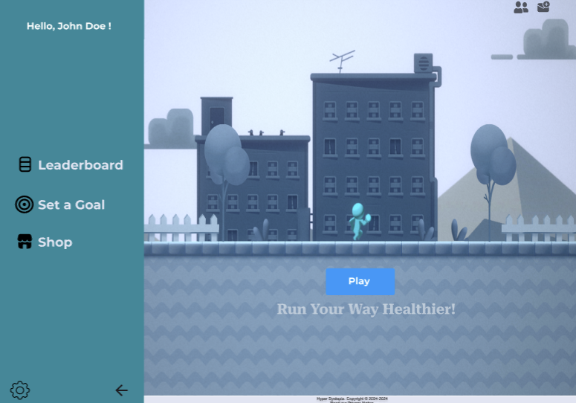

Slide 8
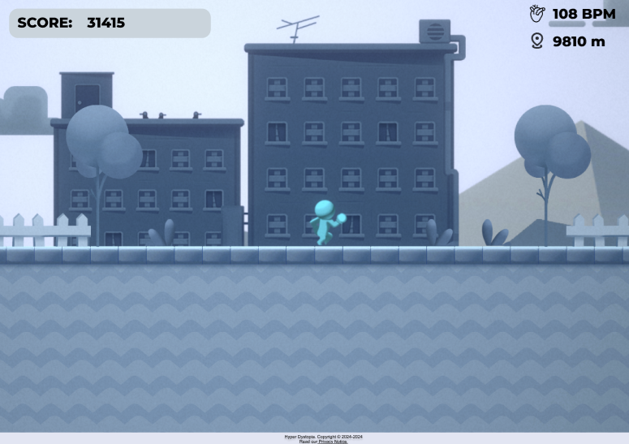

Slide 9



Our characters:
Blue House
Gum
Flambo

