Slide 1

SAP Build Process Automation
08.08.2024
Presentation Title

Slide 2
DISCLAIMER
This presentation contains certain forward looking statements concerning future business prospects and profitability of Highbar Technocrat Limited, which are subject to a number of risks and uncertainties and actual results could materially differ from those in such forward looking statements, important developments that could affect the company's operations include a downtrend in the information technology and infrastructure sectors, significant changes in political and economic environment in India, tax laws, labor relations, litigation etc. The company does not undertake to make any announcement in case any of these forward looking statements become materially incorrect in future or update any forward looking statements made from time to time by or on behalf of the company.
All rights reserved. Copyright with Highbar Technocrat Limited. Highbar is a trademark of Highbar Technocrat Limited & other names, logos are trademarks of their respective owners.
Presentation Title

Slide 3
Topic
1. About SAP Build Process Automation
2. Key Features of SAP Build Process Automation
3. SAP Build Process Automation some scenario can do
4. SAP BPA With On-Per and Public cloud
5. Q & A
Presentation Title

Slide 4
About SAP Build Process Automation
Presentation Title

Slide 5
About SAP Build Process Automation
SAP Build Process Automation (formerly known as SAP Robotic Process Automation, or “RPA”) can help automate manual, repetitive tasks, so your employees can focus on the things that really matter. SAP Build Process Automation combines RPA functionality, workflow management, decision management, process visibility, and embedded AI capabilities into one intuitive low-code experience. The solution is now part of the SAP Business Technology Platform (BTP).

Slide 6
Key Features of SAP Build Process Automation
Presentation Title

Slide 7
Key Features of SAP Build Process Automation
1. Robotic Process Automation
With RPA, SAP’s friendly “robots” help you automate repetitive manual tasks such as copy-and-paste operations, data extraction, data entry, and data creation using no-code and low-code capabilities.
2. Workflow Management
Workflow management helps enable users to create forms, manage decision logic, and build, adapt, and organize process flows with the simplicity of drag-and-drop functionality.
3. Embedded Artificial Intelligence (AI)
The built-in AI capabilities enable intelligent document processing without the need to engage a data scientist.

Slide 8
SAP Build Process Automation some scenario can do
Presentation Title

Slide 9

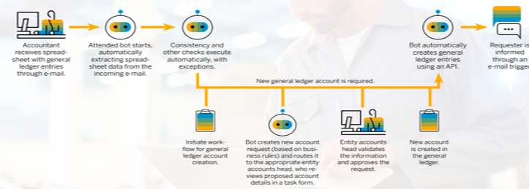
1. Finance
Challenge: A large automotive supplier creates its financial journal entries by manually copying and pasting data from spreadsheets. With more than 20,000 general ledger entries per year, this process is time-consuming and error-prone. The company wanted to reduce the time employees spend updating journal data and increase data accuracy.
Solution: SAP Build Process Automation uses bots to extract spreadsheets from incoming e-mails and posts financial data to the ERP system using an API. Posting activities are automatically logged to ensure compliance, and workflows handle exceptions in cases that require human intervention. Employees can now use their time to focus on complex cases and exceptions.

Slide 10
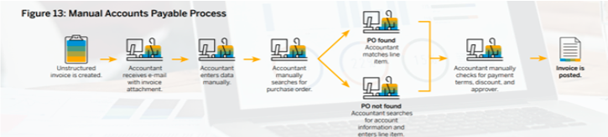
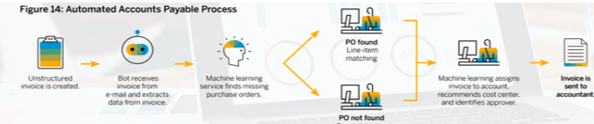
Accounts Payable Processing
Challenge: As part of its manual processing of 10,000 vendor invoices annually, a large pharmaceuticals distributor downloads information from vendor portals or retrieves it from supplier e-mails. The company wanted to replace time-intensive, error-prone download, data validation, and data transfer processes with more-efficient automated tasks.
Solution: SAP Build Process Automation combined with machine learning capabilities extracts and handles unstructured data from e-mails or PDFs to automate matching, locate purchase orders, and detect fraud. Bots automatically upload and post spreadsheet data and workflow tasks capture approvals. This helps improve the efficiency of financial operations and results in higher data accuracy.

Slide 11

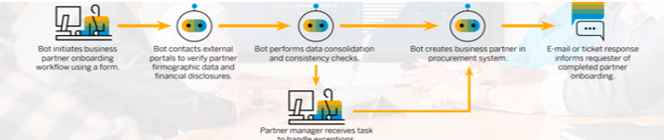
Procurement
Business Partner Onboarding
Challenge: A large software company works with 40,000 business partners. But onboarding each partner in the procurement system is a time-consuming task. The onboarding process collects internal information as well as data from external portals – resulting in significant manual processing for each account. The company wanted to automate the onboarding process while helping ensure data completeness and consistency over time.
Solution: SAP Build Process Automation onboards partners and identifies missing information. Bots automatically collect information from external portals and enrich data as well as perform consistency checks, and workflow tasks to track exception-handling activities performed by partner managers. This allows the company to speed up the account creation process, reduce manual effort, and improve master data quality.

Slide 12

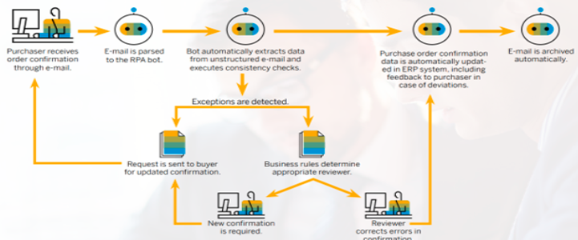
Purchase Order Confirmation
Challenge: A leading food producer uses e-mail to confirm specific quantities of products, prices, and delivery times for 10,000 purchase orders annually. When the e-mail response is received, the buying company’s procurement personnel manually record the task confirmation in the ERP system. The consumer products company wanted to speed up the process by automating purchase order verification.
Solution: SAP Build Process Automation extracts purchase order numbers and line item confirmation details from incoming e-mails, automatically updating purchase order confirmations in the ERP system. Exception tasks are forwarded to appropriate employees for additional investigation. The company is able to reduce the processing time and manual effort required for purchase order confirmation.

Slide 13
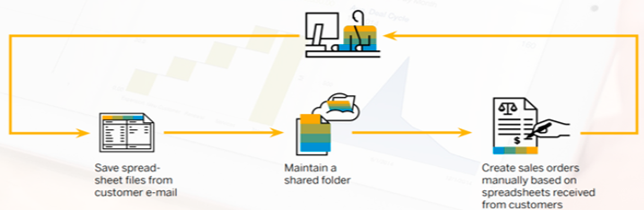
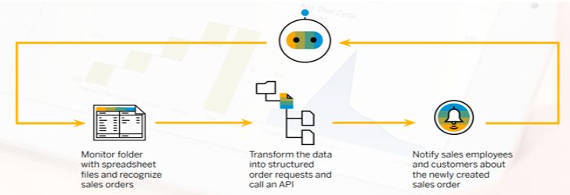
Sales & Customer Service
Sales Order Creation
Challenge: A regional logistics company receives multiple sales orders each day. Employees process these orders and add the data to the ERP system. Because uploading sales orders (using one or several company codes) is a time-consuming and error-prone task, the company wanted to find a better way to process them quickly.
Solution: SAP Build Process Automation automatically structures spreadsheet data and sends it to the ERP system. A pre-built bot replaces the manual processing of files while avoiding errors, and an automatic notification is sent to sales employees and customers when a sales order is created. The company is able to reduce the time needed to create sales orders, and improve employee productivity.

Slide 14

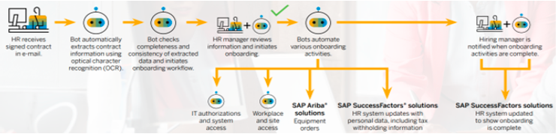
HR
Employee Onboarding
Challenge: A multinational bank hires 15,000 new employees annually. The lengthy onboarding process involves different systems and tools, from core HR systems to user provisioning, training systems, and the use of government portals to fulfil legal requirements. The bank wanted to accelerate the process; ensure it produces complete, consistent data; and create a better new-hire experience.
Solution: SAP Build Process Automation automates the execution of onboarding tasks across different systems and departments, such as creating system users, ordering equipment, or submitting required information to authorities. The company is able to reduce the manual workload and provide an exceptional employee onboarding experience.

Slide 15
What are the benefits of SAP Build Process Automation?
To keep up with evolving market requirements, your business needs to improve processes and operations. But, scarce development resources and skills can make it difficult to adapt to change.
SAP Build Process Automation helps business users to adapt, improve, and innovate their business processes.
Companies use SAP Build Process Automation to address a variety of process challenges, and it can help:
Fix broken or outdated processes
Automate manual process steps
Reduce unnecessary steps
This can then help your business:
Improve Productivity
Reduce Costs
Provide an exceptional employee & customer experience

Slide 16
SAP BPA With On-Per and Public cloud
Presentation Title

Slide 17
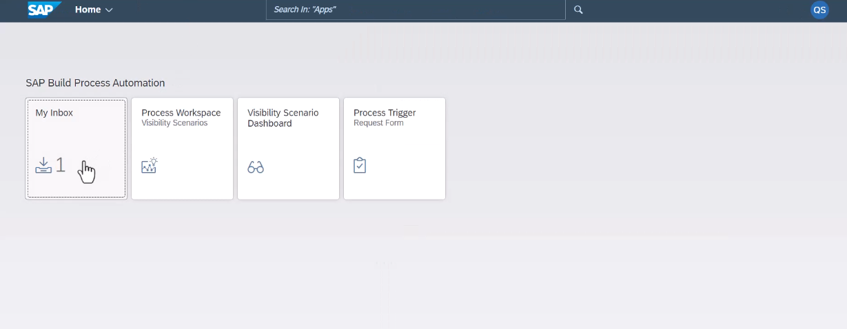
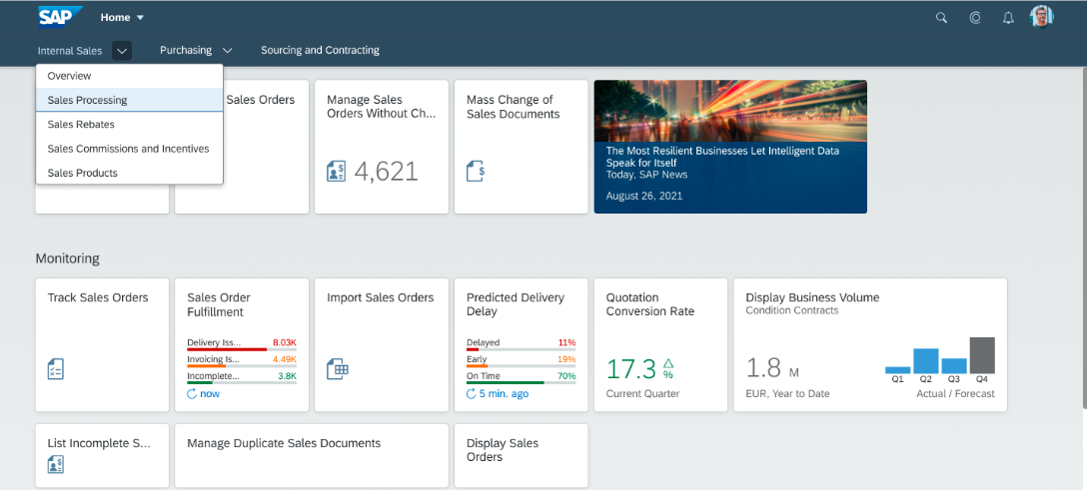
SAP Build Process Automation from an S/4 Hana On-Premise system Or Public Cloud Or Pvt Cloud
SAP Build Process Automation is the unified offering in SAP BTP that combines the capabilities of SAP Workflow Management and SAP Intelligent RPA and its staring point can be FORM or API.
The Build Process Automation is one of the BPT services so it consist of its own url i.e. User can access My Inbox (the one of the tile in Build portal) with different url
Build Launchpad (BTP Service)
Fiori Launchpad (S4 HANA on-prem, Pvt cloud, Public Cloud)

Slide 18
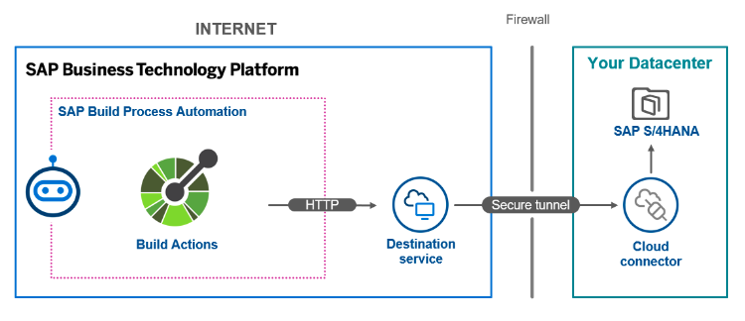
SAP Build Process Automation from an S/4 Hana On-Premise system Or Public Cloud Or Pvt Cloud
Connect S4 Hana to BPA via cloud connector
Document create in S4 and event pass to BPA for approval
User can access Build url to future process
Once process is complete than result send back to S4 hana.
As we have 2 url for user to access
1. On-Prem / Pvt Cloud / Public cloud Fiori launchpad URL
2. Build Url which consist of My Inbox Tile
Although we have provision to merge both url in one url.

Slide 19
Advantages
Improved Efficiency: Automation of repetitive tasks and processes reduces manual intervention, speeding up operations and decreasing errors.
Enhanced Integration: By connecting SAP BPA with on-premise systems, you ensure that automation workflows are directly integrated with existing systems, allowing for seamless data exchange and process continuity.
Better Control and Customization: On-premise systems often offer more control over the environment, enabling customizations that may not be possible in cloud-only solutions.
Data Security and Compliance: Keeping data on-premise can be advantageous for meeting specific regulatory or compliance requirements that necessitate data to remain within certain boundaries.

Slide 20
Disadvantages
Infrastructure Costs: Maintaining on-premise systems can involve significant infrastructure costs, including hardware, software, and ongoing maintenance expenses.
Scalability Issues: Scaling on-premise solutions to handle increased workloads or additional users can be complex and costly compared to the more flexible scaling options available in cloud environments.
Integration Complexity: Connecting on-premise systems with SAP BPA can be complex, requiring significant configuration and potentially custom development, which can increase project timelines and costs.
Limited Remote Access: On-premise solutions may not offer the same level of remote access and flexibility as cloud-based solutions, which can be a drawback for organizations with a distributed workforce.
Potential for Bottlenecks: On-premise systems may introduce bottlenecks if they are not optimized for high-volume or high-speed processing, which can affect the performance of automated processes.

Slide 21
Overall, the decision to connect SAP Build Process Automation with on-premise systems should be based on a thorough analysis of your organization’s specific needs, current infrastructure, and long-term strategic goals.
Integrating SAP Build Work Zone (formerly SAP Fiori Work Zone) with Fiori applications involves ensuring that users can seamlessly access their Fiori applications and workflows from within the Work Zone environment. SAP Build Work Zone is a collaborative workspace designed to integrate various SAP and third-party applications, providing a unified user experience.

Slide 22
Q & A
Presentation Title

Slide 23
Thank You

