Slide 1
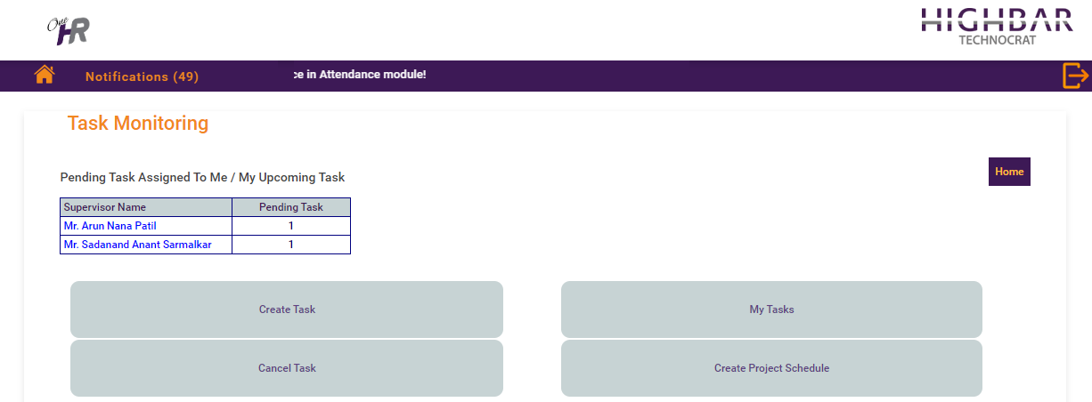
Task Monitoring Landing Page

Slide 2
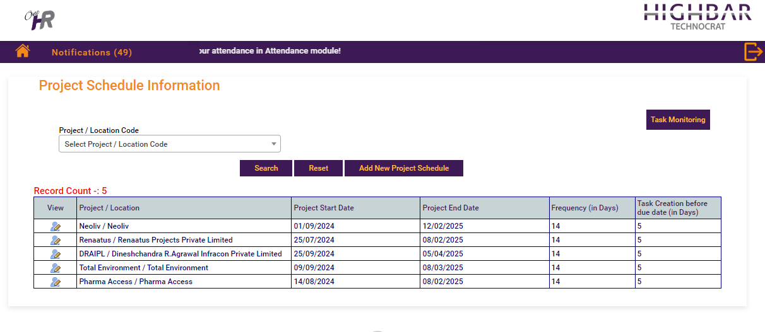
List Of Project Schedule Information

Slide 3
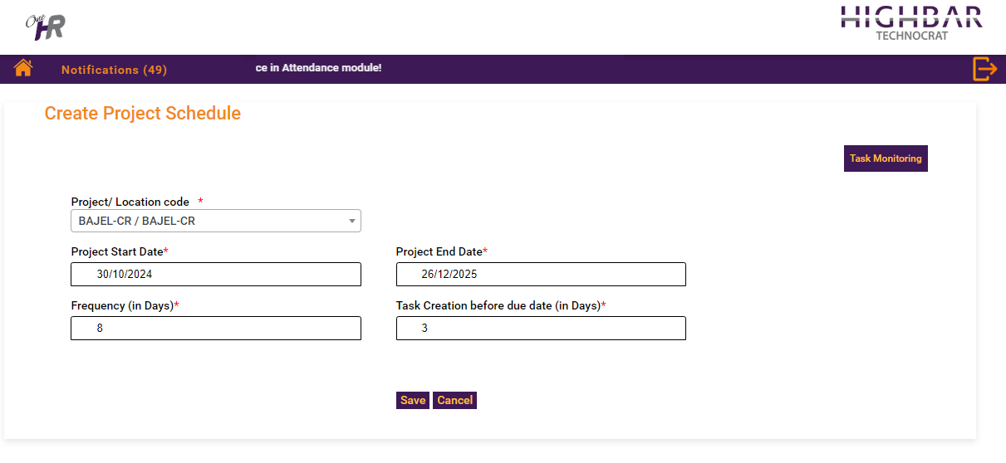
Create new entry for Project Schedule

Slide 4
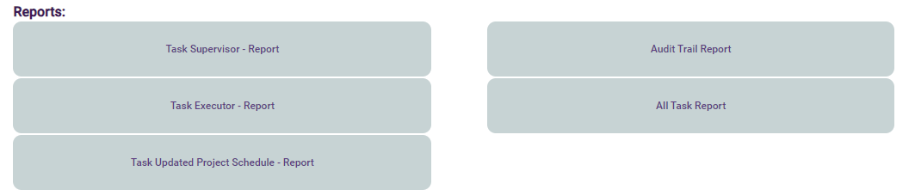
Report for Project Schedule

Slide 5
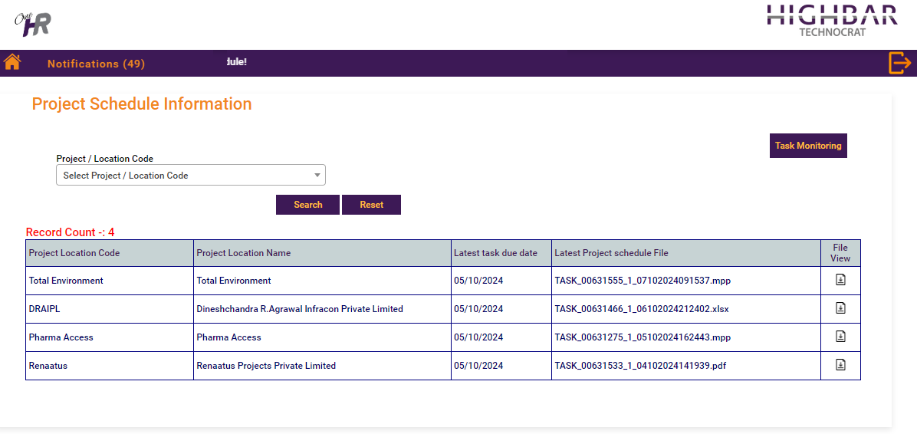
Latest Uploaded Project Schedule

Slide 6
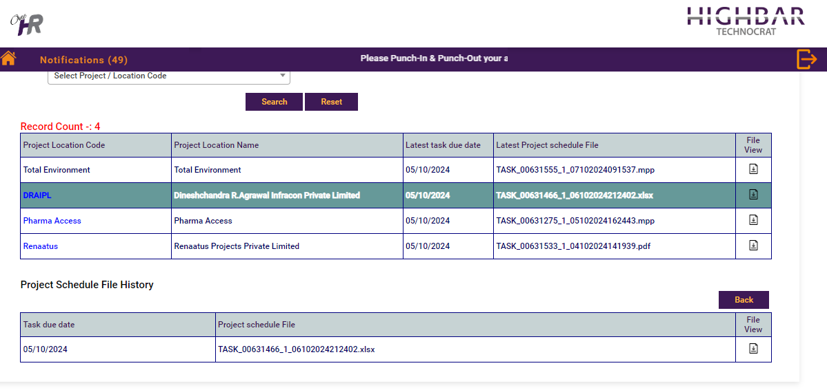
Uploaded Project Schedule Files

