Slide 1

HEALTH EVALUATION & ANALYSIS LAB
-TEAM STING

Slide 2

WHY HEAL ?
Research says.....
Globally, medical errors are one of the leading causes of death. To add, a John Hopkins study claims that more than 250 , 000 people die in the US every year from medical errors, and i t is the third leading cause of death after heart disease and cancer.
As medical errors are primarily a result of human mistakes, i t is possible to leverage the r ight technology l ike Artificial intelligence and Deep learning , clinical mobility solutions to overcome the challenges.
We have utilized artificial and deep learning models to assist doctors, research analysts, and the general public in predicting medical outcomes from reports with high accuracy in minimal t ime.

Slide 3
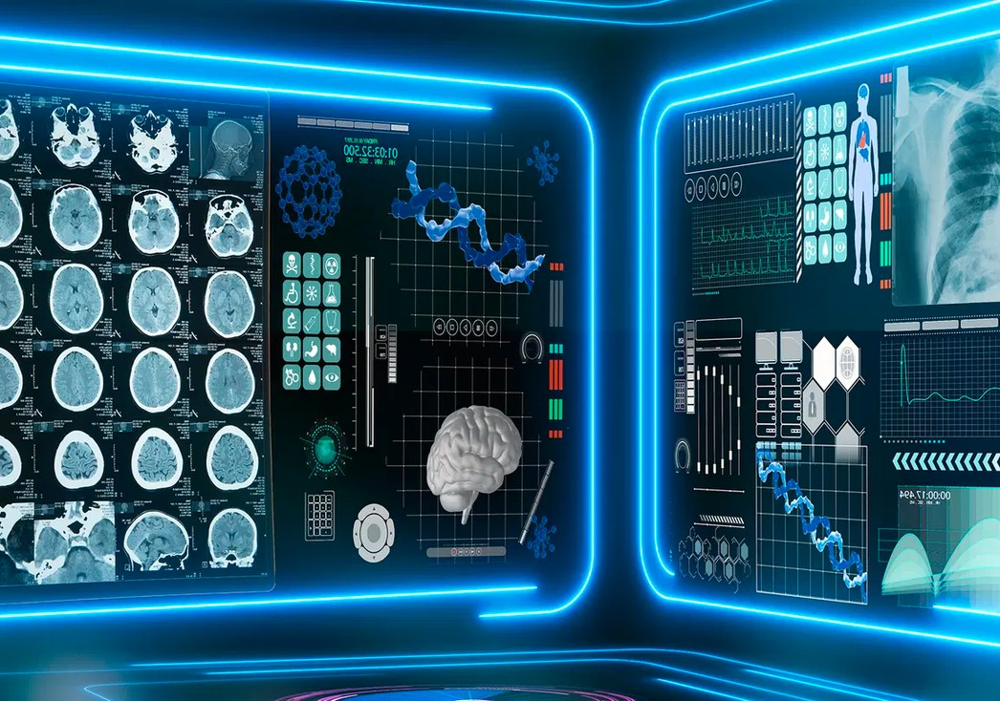
EXPLANATION OF IDEA
Our website utilizes and
powerful models,
artificial including
deep
Random Forest, Decision
learning
Trees, XGBoost, CNN and
intelligence
KNN classifiers, which are trained on patients' medical reports. These models enable us to provide accurate medical predictions with ease, giving doctors and researchers valuable insights into patient health."
The site is used by authorized individuals , who
use the patient' s medical data as input and applies the selected disease model to determine with a high level of accuracy whether the patient is suffering from the
disease.

Slide 4



FOR WHOM ?
DOCTORS
Research/Scientist
Cross verifying predictions of a patient's medical condition using this website can greatly reduce the chances of prescribing the wrong medication, improving overall patient care.
This website can be utilized primarily by researchers and scientists to analyze patterns within large amounts of medical data, by training on medical reports and making predictions through our website. This tool can aid in discovering new medical breakthroughs, which will prove to be a valuable asset for improving future health prospects.

Slide 5







Python
sklearn , tensorflow, matplotlib, numpy, pandas, keras,skit-learn… etc
HTML
JAVA SCRIPT
Bootstrap
CSS
TECH STACK USED
FLASK

Slide 6

THANK YOU!!

