Slide 1
PASSWORD DOOR-LOCK

Slide 2
FEATURES:
Hexadecimal password.
4.2 billion possible combinations.
Limited number of wrong attempts.
Reset Signal to reset the circuit.

Slide 3
BLOCK DIAGRAM:
INPUT (OUTSIDE)
ALARM
DOOR LOCK
RESET (INSIDE)
ACCESS

Slide 4
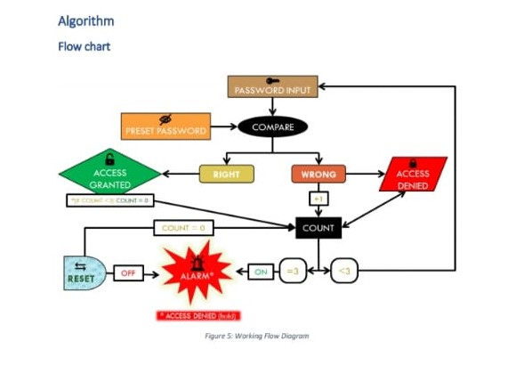
FLOW CHART:

Slide 5
PROGRAM:
module password(access,alarm,in,reset);
parameter [31:0]pass = 'h1234abcd;
output access,alarm;
input [31:0]in;
input reset;
reg access,alarm,condition;
integer count;
initial begin
count = 0;
access = 0;
alarm = 0;
condition = 1;
end
always@(in,reset) begin
if ((in==pass)&&(condition==1)) begin
access = 1;
condition = 0;
end
else if(condition==1) begin
count = count+1;
end
if (count==4) begin
alarm = 1;
condition = 0;
end
if (reset==1) begin
access = 0;
alarm = 0;
count = 0;
condition = 1;
end
end
endmodule

Slide 6
STIMULUS BLOCK:
module testbench;
wire access,alarm;
reg [31:0]in;
reg reset;
password p0(access,alarm,in,reset);
initial begin
$monitor($time,"Access=%b,Alarm=%b,Input=%h,Reset=%b",access,alarm,in,reset);
end
initial begin
#10 in='h12345678; reset=0;
#10 in='h14343542;
#10 in='h1242adcb;
#10 in='h1234abcd;
#10 in='h14343542;
#10 in='h12345678; reset=1;
#10 in='h12342378; reset=0;
#10 in='h1234abcd;
#10 in='h12345678;
#10 in='h12aca358; reset=1;
#10 in='h12345678; reset=0;
#10 in='h1242adcb;
#10 in='h1234abcd;
#10 $stop;
end
endmodule

Slide 7
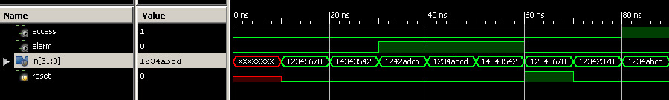
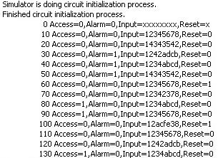
WAVEFORM AND OUTPUT:

Slide 8
THANK YOU!

