Slide 1
Time Management Application
By Munene Gatobu

Slide 2
Overview
This is a CLI application that allows a user to manage their time
It allows a user to track what they spend their time on by recording information like time, date, and tags
All tasks can be found or listed through various commands

Slide 3

Creating Tasks
Tasks can be created and stored with the following information: date, start/end time, description, and tags
Dates are fairly flexible and allow for multiple different formats when both creating & searching
Times also support the use of AM and PM

Slide 4
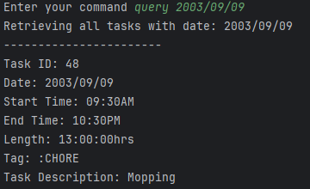
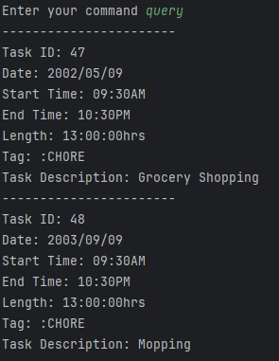
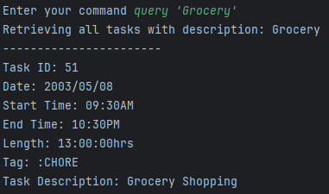
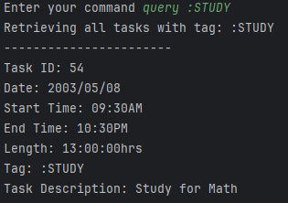
Searching
Stored tasks can then be searched and displayed in a readable format
The command query can be used to retrieve a list of tasks based on specific information
A task can be found using dates, tags, or description

Slide 5
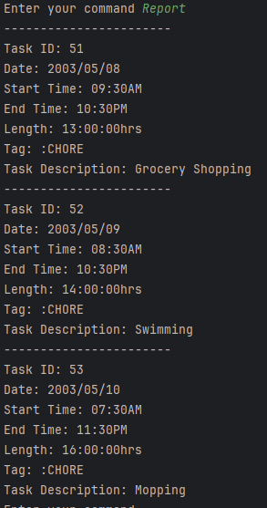
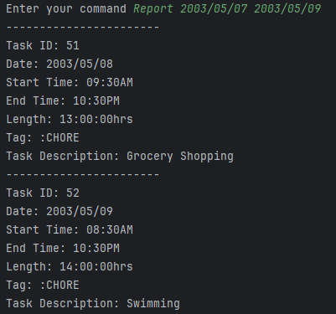
Reporting
The Report command can be used to find tasks that occurred in a specific date range
Report can also be used to generate a list of the most time consuming tasks
Examples on the right show both of these features

