Slide 1



QA NPCC Digitalization
Proposal
By: Angel Alvarez

Slide 2
Initial proposal
Platform using, Power apps, Power automate and Power BI.
Software | Purpose | Handles
Power Apps | Will serve as the front-end app where the team can create, edit, and review product launch information, | Automatic designation of Early- Stage. Early Stage Control Number. Part name. Vehicle model. Part number. Customer.
Power Automate | Adds all the logic and automation behind the scenes. | Automatic weekly reminders of update progress. Logging history updates. Alerts when a stage is on date or delayed. Status change notifications.
Power BI | Will visualize and storage all data in a professional dashboard. | Launch calendar. Products delayed, or on-time. KPIs like % completion. Filters by responsible person or category. Risk indicators

Slide 3
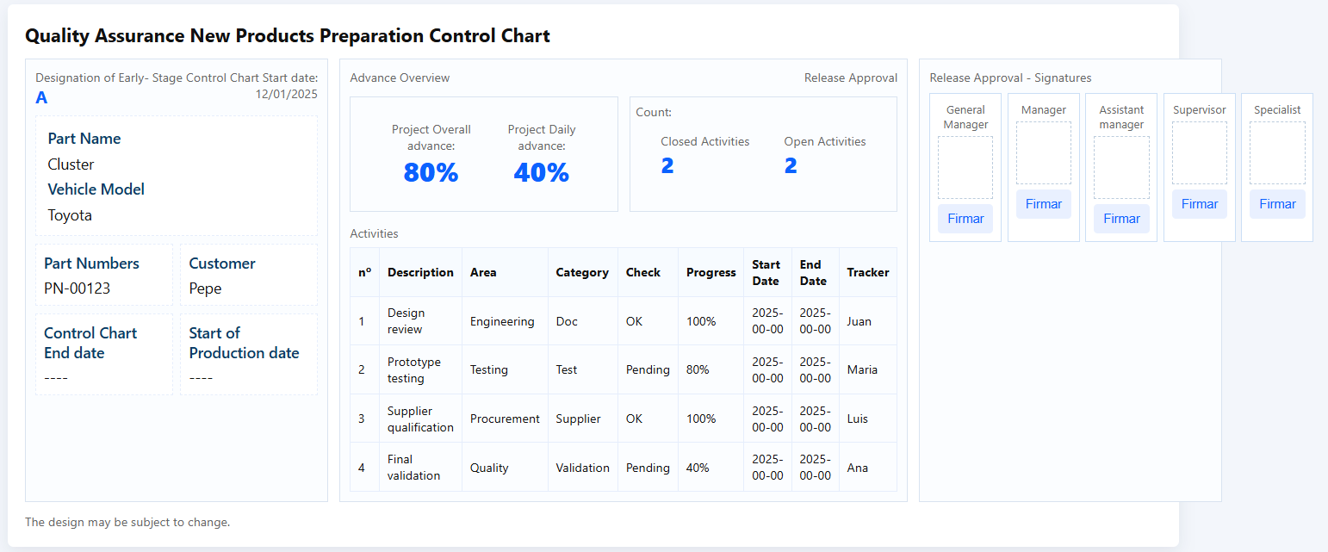
Preview
User-friendly navigation: The design focuses on making the system intuitive and easy to use.
Readable and organized information: The layout likely prioritizes clarity and accessibility.
Automation benefits: Include elements like buttons, dashboards, or workflow indicators that represent automated processes.

