Slide 1



GROUP 9
HOSPITAL
MANAGER SYSTEM
Covenience solution for hospital

Slide 2

Contents
01.
Introduction
02.
Problems with conventional system
03.
Advantages of Computerized Hospital Management System
04.
Database diagrams
Schema Diagram
ER Diagram
05.
User Interface

Slide 3




About
Us
Nguyễn Quý Minh
Nguyễn Đăng Phi Long
Leader
Database
Đỗ Chí Nghĩa
Nguyễn Quang Khải
GUI
Report

Slide 4

PROBLEMS OF CONVETIONAL SYSTEM
01.
02.
03.
Unresponsive
Inconvenience
Risky
Lack of immediate retrievals and prompt updating
Lack of immediate information storage
Error prone manual calculation

Slide 5

Advantages
- Immediate Access of data
- Friendly user interface
- Time saving
- Data can be easily insert/update/delete
- Saving paper work
- Give facility of different types of Enquiry
Of Computerized Hospital Manager System
- Data’s are easily approachable

Slide 6
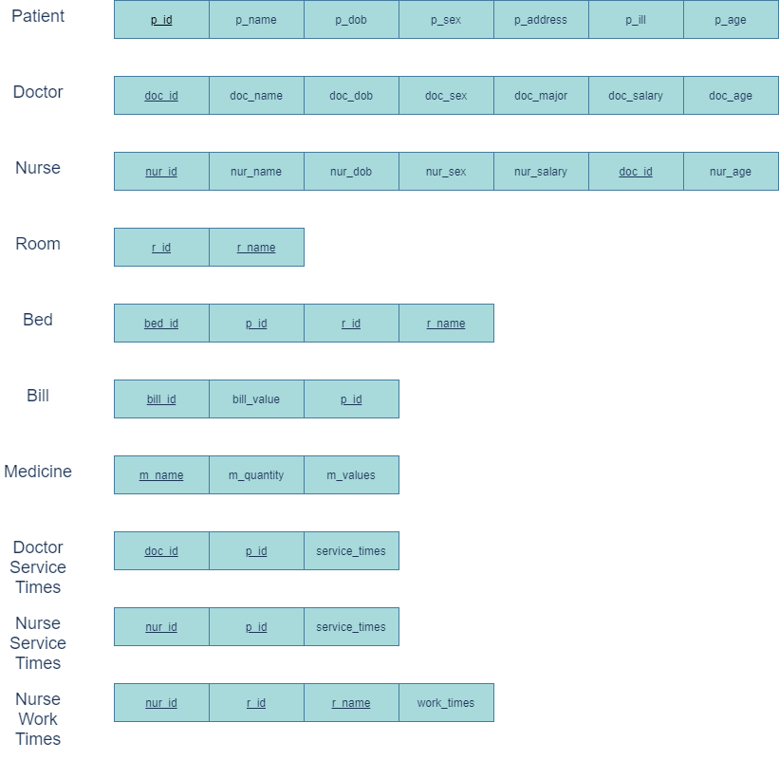
DATA BASE
Schema
Diagram

Slide 7
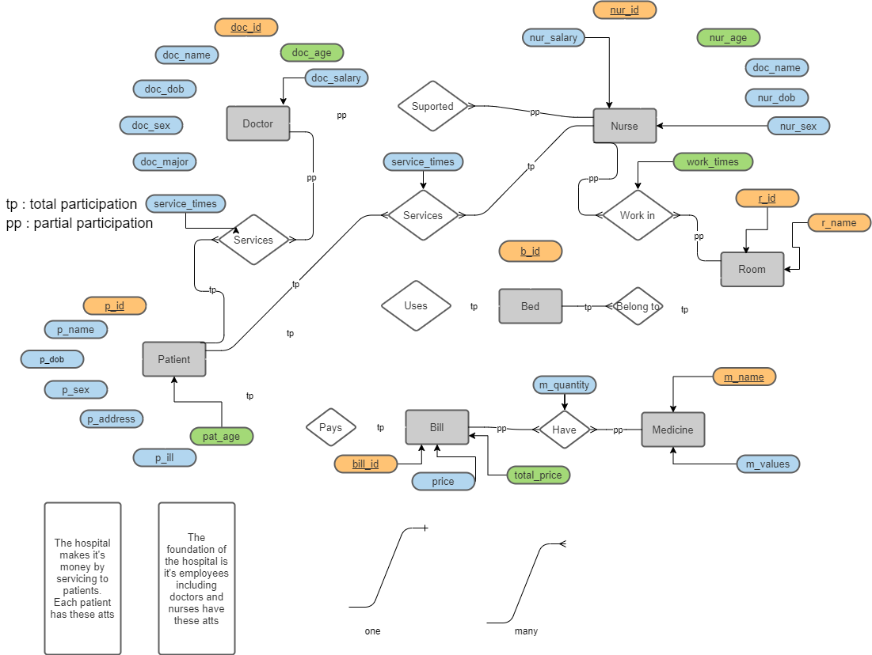
ER Diagrams

Slide 8
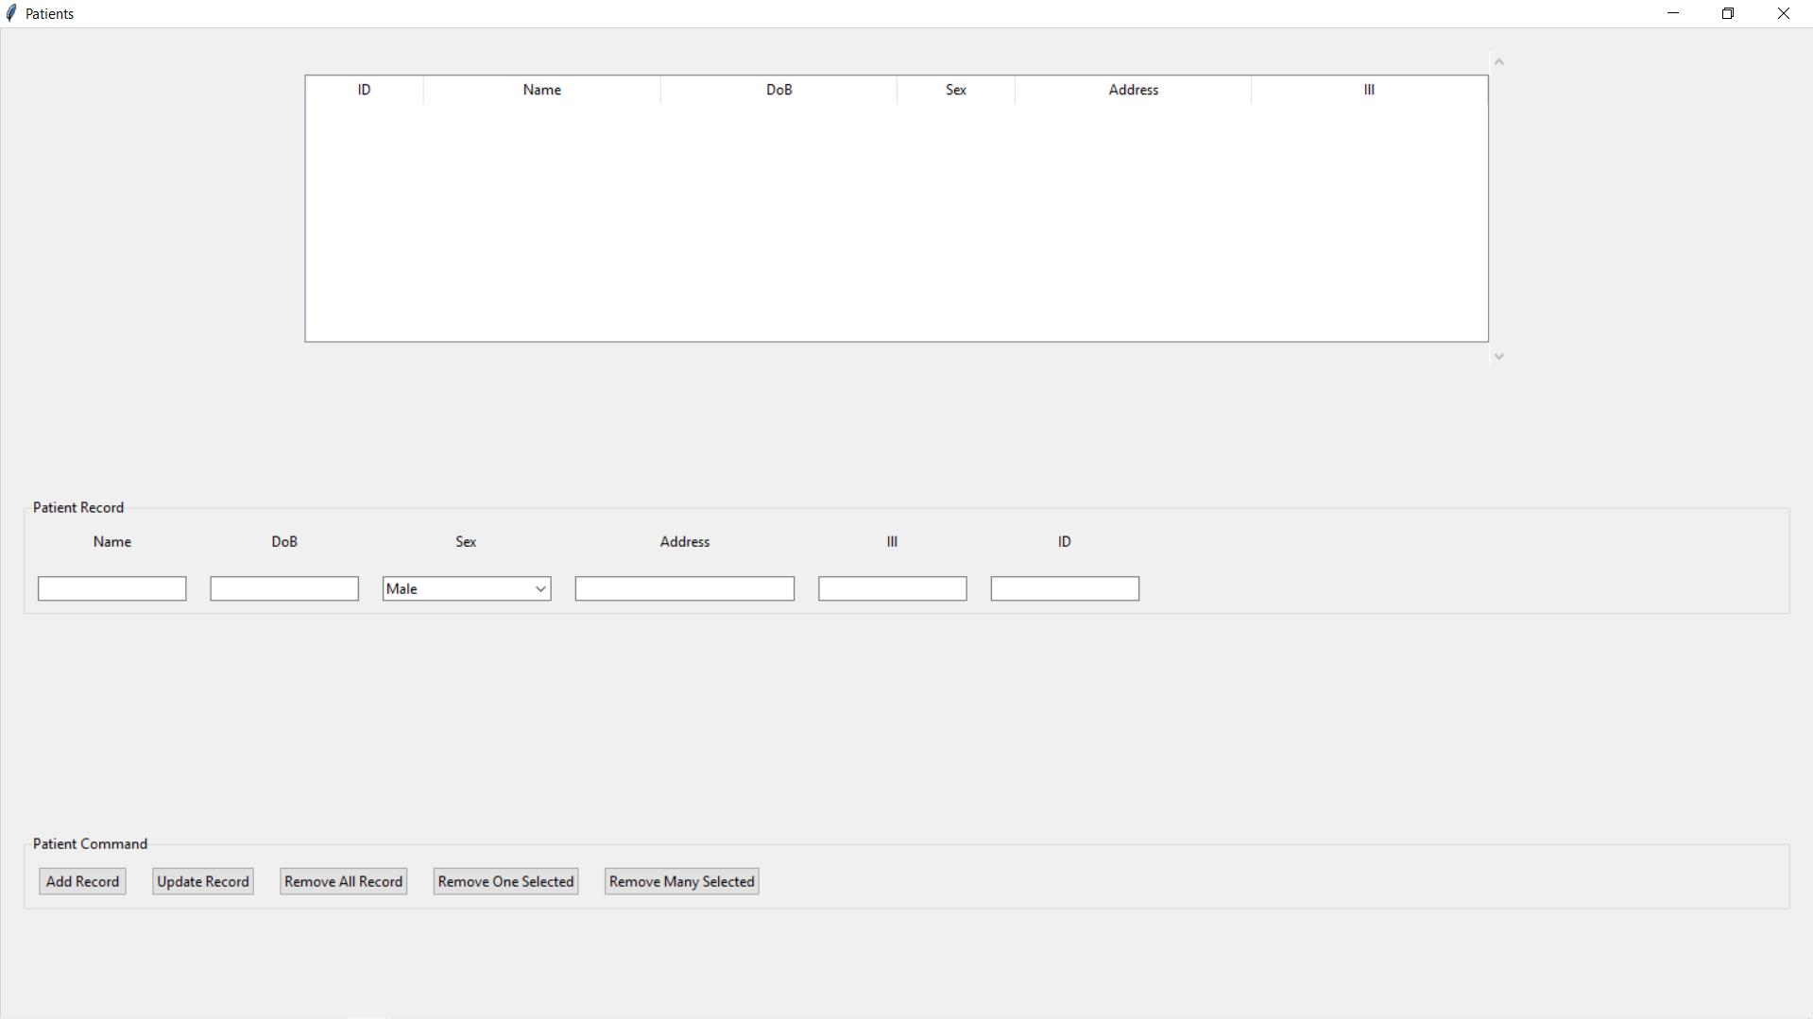

Slide 9
PA9999 Huấn Hoa Hồng 12/01/2001 Male Hà Nội Trầm cảm
Huấn
12/01/2001
Hà Nội
Trầm cảm
PA9999

Slide 10
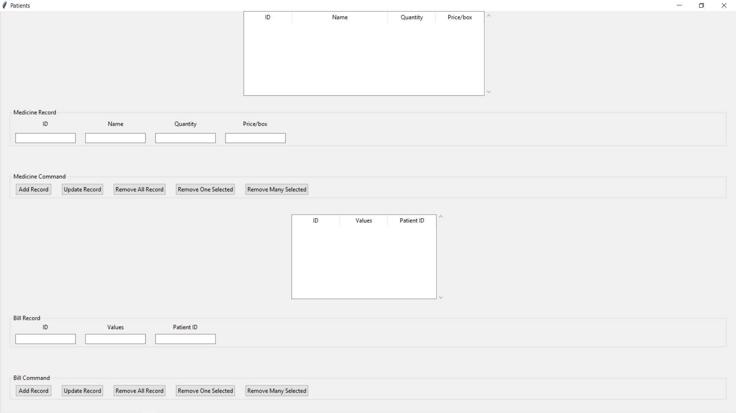

Slide 11
Bi10100 Thuốc trị trầm cảm 100 1.000.000
Me10100
Thuốc trị
100
1.000.000
Bill1000
10.000.000
Pa9999
Bill1000
10.000.000
PA9999

Slide 12
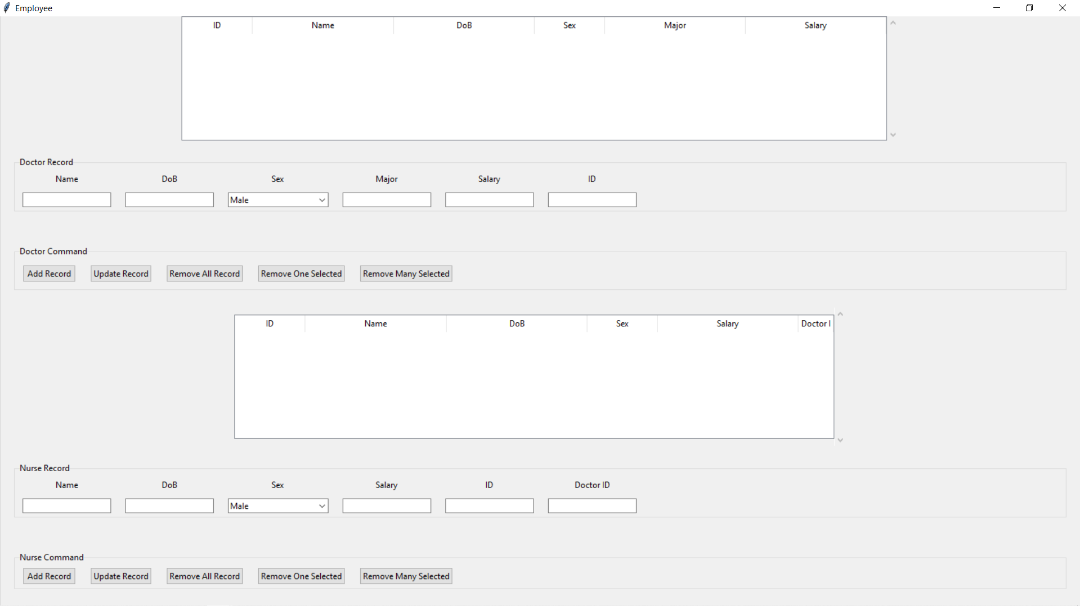

Slide 13
DOC999 Nguyễn Phương Hằng 12/01/1999 Female CEO 1.000.000.000
Hằng
12/01/1999
CEO
1.000.000.000
DOC999
NUR999 Tiến Bịp 12/01/1990 Male 100.000.000 DOC
Tiến Bịp
12/01/1990
100.000.000
NUR999
DOC999

Slide 14
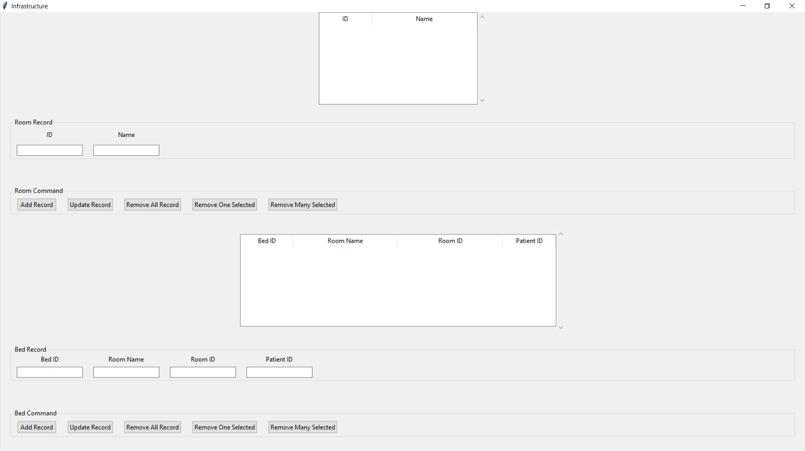

Slide 15
INF10100 Đèn Nhiều Màu
INF10100
Đèn nhiều màu
BED999 Phòng VIP RO999 PA999
BED999
Phòng VIP
RO999
PA999

Slide 16
Thanks !

