Slide 1
Cardon Protocol
Turbin3 Builders Cohort — Capstone
An on-chain transaction firewall for Solana AI agents.
Cardon sits between an autonomous agent and the network. Every transaction is simulated, checked against a policy stored in an Anchor program, and either auto-approved, queued for human review, or rejected. Because the policy lives on-chain, no operator can quietly raise a spend cap.
Live demo
Program ID (devnet)
cardon-protocol.vercel.app
5Zy73PLH2hpNvsCvyeqpn2tKjHBXNihjX7UbeAZ41tQc

Slide 2
The Problem
Cardon Protocol
The Problem
No firewall between intent and the network
Autonomous agents sign and broadcast transactions on their own. A single bad prompt, jailbreak, or model regression can drain an entire hot wallet — instantly and irreversibly.
Centralized policy is silently mutable
Existing products run policy as centralized middleware. Anyone with code access can quietly raise a spend cap or remove a kill switch with no audit trail visible to token holders.
No programmable human-in-the-loop
There is no standard on-chain primitive to pause high-value transactions and route them to a human approver before they hit the network.
"One bad prompt can drain a hot wallet — and there is currently no firewall between an agent's intent and the network."
2
cardon-protocol.vercel.app

Slide 3
The Solution
Cardon Protocol
The Solution
1 Simulate
2 Check Policy
3 Decide
Every transaction is run through RPC simulation before anything is signed.
Checked on-chain: per-tx cap, program allowlist, daily volume ceiling, kill switch.
Under threshold → auto-approve. Over threshold → queue for human. Cap hit → reject.
Key Benefits
Immutable authority
Full audit trail
Policy authority can be a Squads multisig or DAO — rotating rules is an on-chain transaction, not a config push.
Every approval, rejection, and policy change is emitted as a log event, indexed off-chain via Helius.
Human-in-the-loop built in
Zero-trust kill switch
High-value transactions are automatically queued for human review before broadcasting.
set_enabled can freeze an agent instantly — no operator coordination or code deploy required.
3
cardon-protocol.vercel.app

Slide 4
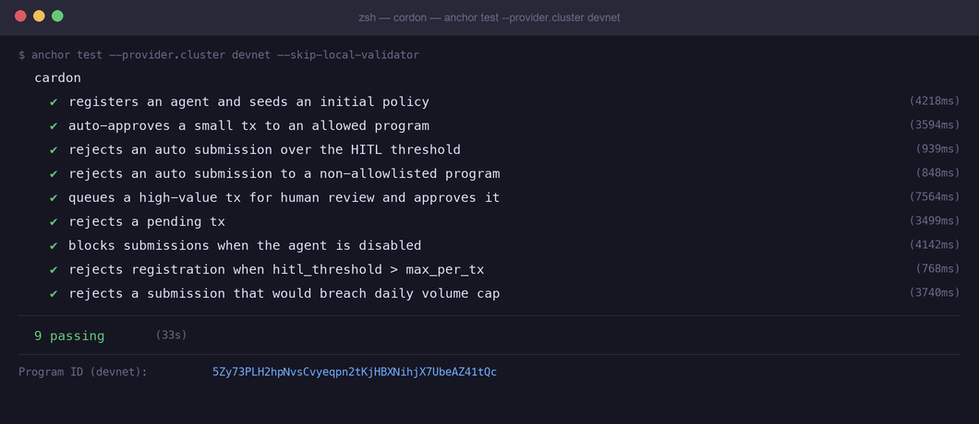
Verified on Devnet
Cardon Protocol
All 9 Tests Passing on Devnet
NETWORK
Solana Devnet
STATUS
9 / 9 passing ✓
PROGRAM ID
5Zy73PLH2hpN vsCvyeqpn2tKjHBXNihjX7UbeAZ41tQc
LIVE SITE
cardon-protocol .vercel.app
4
cardon-protocol.vercel.app

