Slide 1
The Missing Semester of Your CS Education
Fundamental Concepts of Application Security

Slide 2
What is Application Security
The process of process of developing, adding, and testing security features within applications to prevent security vulnerabilities against threats such as unauthorized access and modification.
Commonly members of an Application Security team have development experience in order to best perform their job duties.

Slide 3

OWASP
Open Web Application Security Project
Sets forth many (unofficial) industry standards
Provide resources for how to handle different challenges in application security

Slide 4
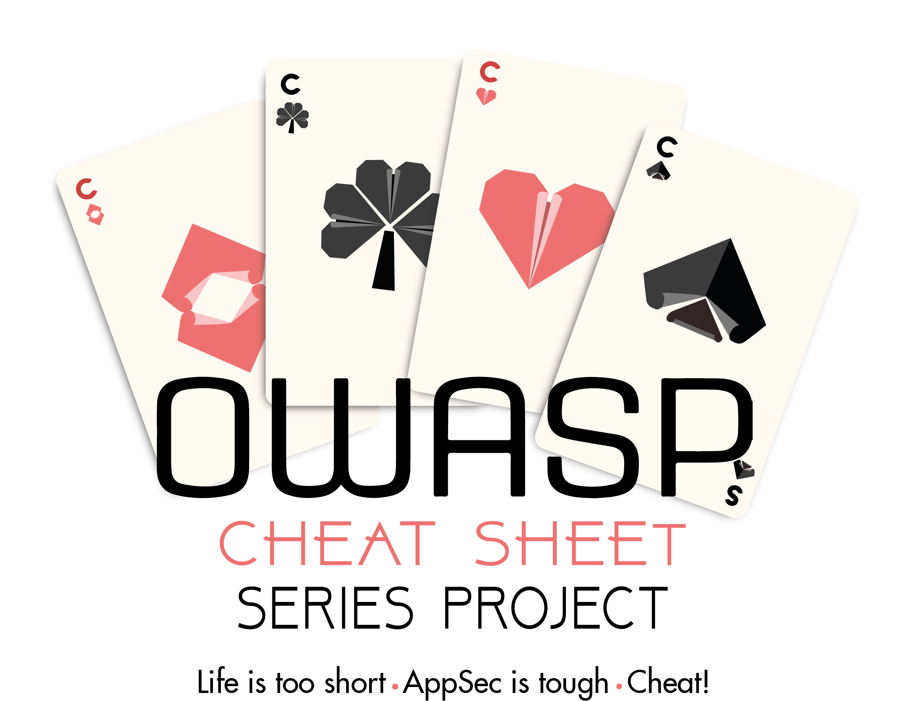
OWASP Cheat Sheets
A concise set of guides to common Application Security topics
Provide a generalized set of guidance, rather than specifics for a language or framework

Slide 5
Encryption and Hashing
Hashing:
One way, not meant to be reversible
Used for protecting passwords in a database
Encryption:
Reversible, used to store user data
Data should be encrypted both at rest and in transit

Slide 6
Encryption: Asymmetric vs Symmetric
Symmetric:
Same key is used for both encryption and decryption
Commonly used to encrypt data stored at rest
Asymmetric:
Data is encrypted with a ”public” key by the sender, and decrypted with the “private” key
Much more computationally intensive

Slide 7
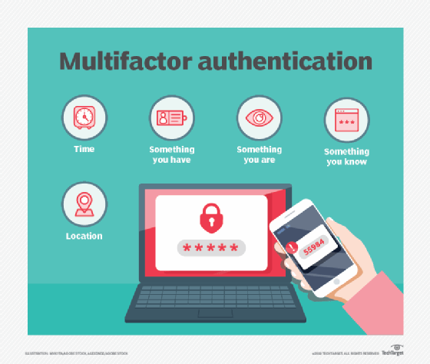
Authentication
The process of validating that user is who they say they are
Typically, a username and password in user facing systems
Often now uses mutli-factor authentication with an OTP or biometrics
Often an API key for non-human account access

Slide 8
Authentication Concepts
Implement password complexity and length requirements
Passwords should never be stored in plain text; always hashed in database
Generic error messages should be implemented for authentication failures
Logging should be implemented for every authentication request
Webpages should allow for easy Password Manager use

Slide 9
Authorization
Validating that a user has the necessary permissions to perform the requested action on the requested resource
A user may have read permissions, but not write permissions
A user may not have access to provide other users with access permission

Slide 10

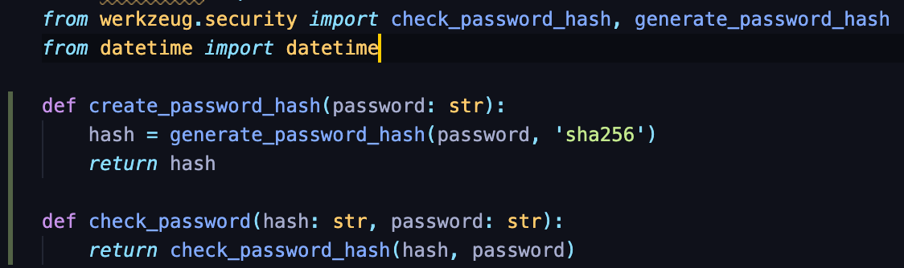
Handling Authorization with Hashing

Slide 11
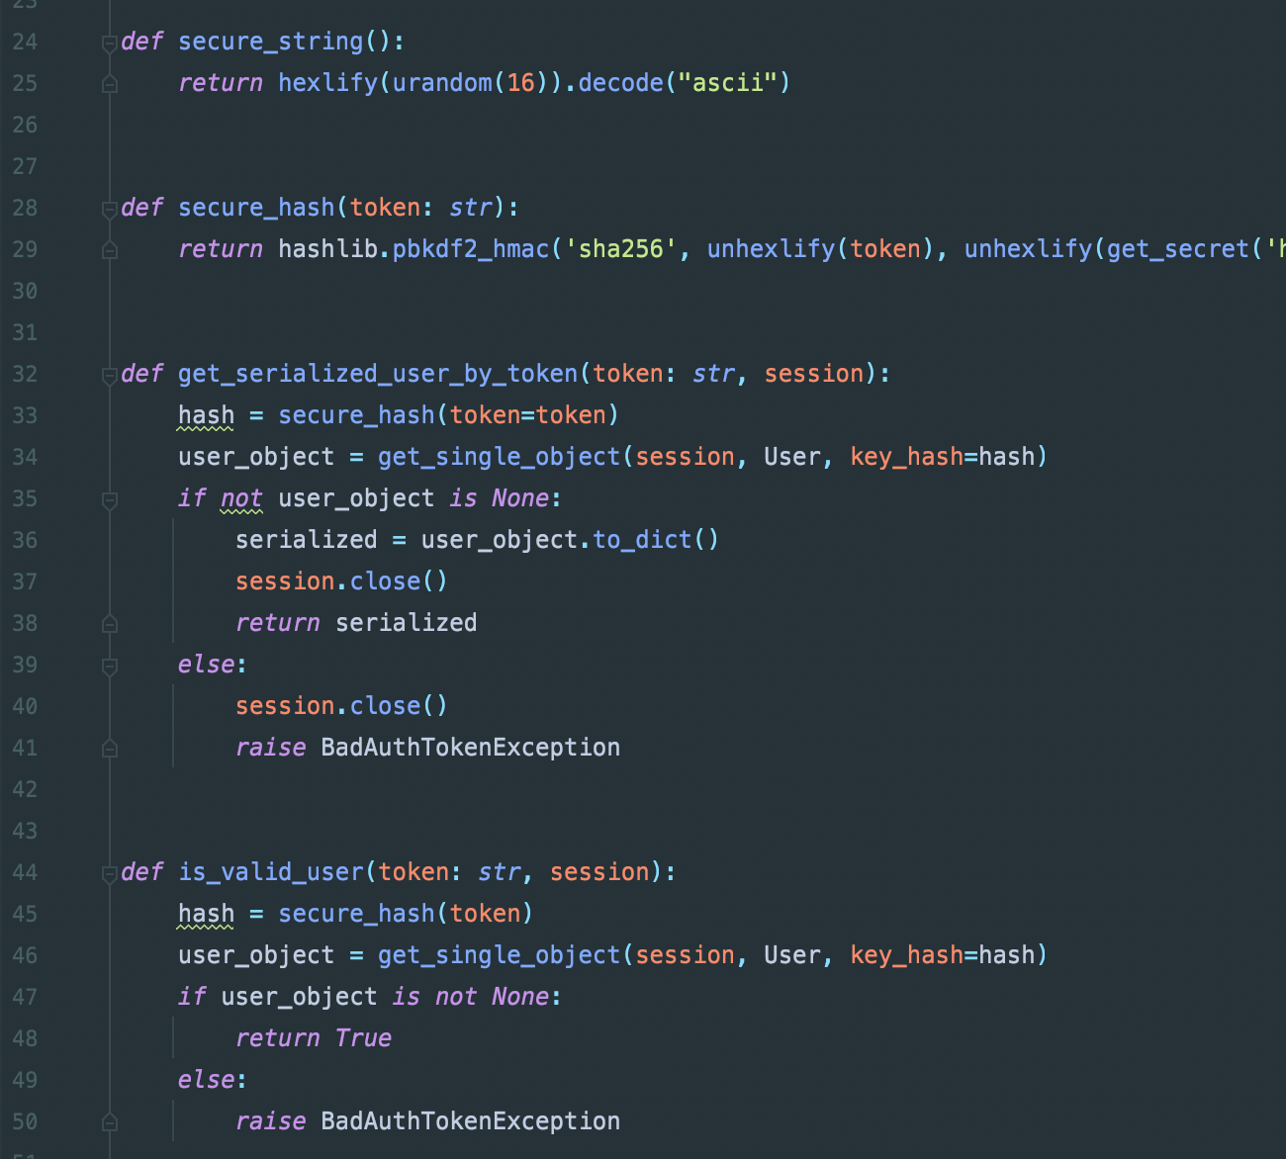
Handling Authorization With Hashing

Slide 12
Authorization Concepts
Validate permissions on every single request
Deny by default
Never perform authorization checks client side
Exit safely when authorization checks are failed
Typically, a 404 or 405 response should be returned
Log all authorization attempts, both successful and failed

Slide 13
Input Validation
Trust nothing and no one
Validate that every piece of information is in the same format you expect it to be in
Two major types: Syntactic vs Semantic
Many frameworks offer built in validation libraries
While tempting, it is a bad idea to use block list validation

Slide 14
Clientside vs Serverside validation
Clientside:
Provides near instant results to users
Easily bypassed by an attacker; provides no real security
Typically used for a “quick check”
Serverside:
Takes longer to return results (10s or 100s of milliseconds)
Much stronger protection against attacks
Most often, both are used

Slide 15
Logging
Log everything, all the time
Useful to know exactly what happened in the case of a data breach, or a simple error
Record:
Who: Human or machine identifier, IP
What: Type of event, severity
When (Date and Time)
Where: Application identifier, Geolocation

Slide 16
Logging: What to Exclude
App source code
Access tokens
Master keys
Personally Identifiable Information (PII)

Slide 17
Vulnerable Dependencies
External dependencies are a must for any developer
Like any other program, the packages used in a developer's code are often vulnerable
It is crucial to stay up-to-date on dependencies which are vulnerable, and to patch these dependencies as necessary to maintain security

Slide 18
Error Handling
Fail gracefully
Use try-catch/try-except to catch potential errors
Provide generic error messages to end users
Use error codes or event IDs to provide information to assist in troubleshooting
Never print stack traces in production
Never provide PII in error messages

Slide 19
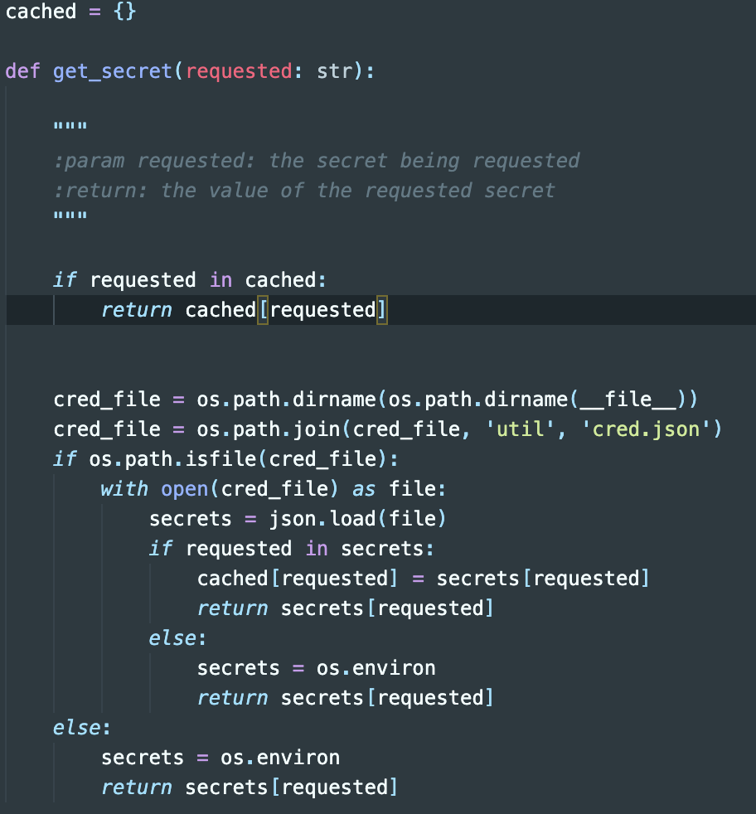
Secret Protection
Secrets should never be stored in a source code repository
Typically passed into an application via a credentials file, or environment variables
If using Kubernetes, integrations with products like Hashicorp Vault are an excellent option

Slide 20
Denial of Service
Use cheap validation first
Push long running tasks to asynchronous queues
Use threading when possible
Limit request size
Limit number of requests in a given period of time

Slide 21
REST Security
Do not expose sensitive information in the request URL
Store in either the header of the request, or a body
Make proper usage of security headers, such as a Content Security Policy and CORS
Do not expose management endpoints over the internet unless absolutely necessary
Define allowed content types
Always usage some form of authentication, if for no other reason than to allow for rate limiting

Slide 22
Database Security
Clients should never connect to a remote database
All connections should be done through an intermediary API
Database should allow only encrypted connections over a network
Database should require authenticated users
An application using a database should only have minimum necessary permissions
Typically, two accounts are configured for an application to access the database. One has higher permissions, but is only used to create tables are startup, and the other does not have permissions to add/delete tables, and is used for “everyday” usage

