Slide 1
The Missing Semester of Your CS Education
Cross Site Scripting (XSS) and SQL Injection (SQLi)

Slide 2
Cross Site Scripting
A kind of injection attack, used to execute malicious code, typically Javascript, in a user’s browser on a trusted site
Flaws that allow these types of attacks are widespread, and incredibly dangerous
Can occur either where a web application allows for user input, or where dynamic content is sent to an end user and used in a site without validation

Slide 3
Potential Results of Cross Site Scripting
Arbitrary, malicious code is executed in a user’s browser
Can allow an attacker to hijack a user’s session, thus taking over their account
Something like a keylogger can easily be developed to steal a users information when they enter it on the attacked website
Can be used to create a crypto miner in the user’s browsers
Modify what a user sees on a website, and modify the information presented to them

Slide 4
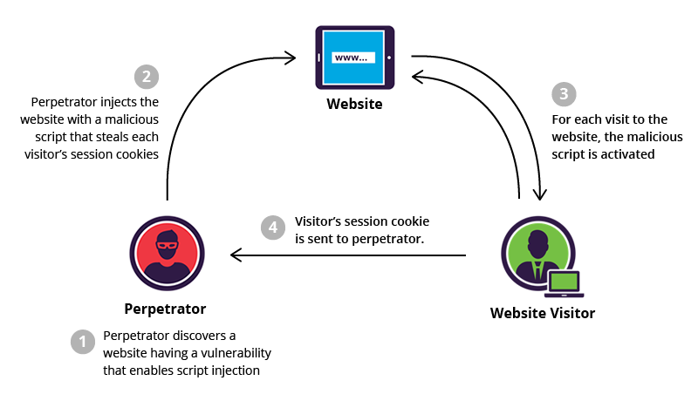
Persistent XSS
XSS which is created and stored on the persistent storage of the web server
When a user loads this content on the web page, the code is then executed in their browser

Slide 5
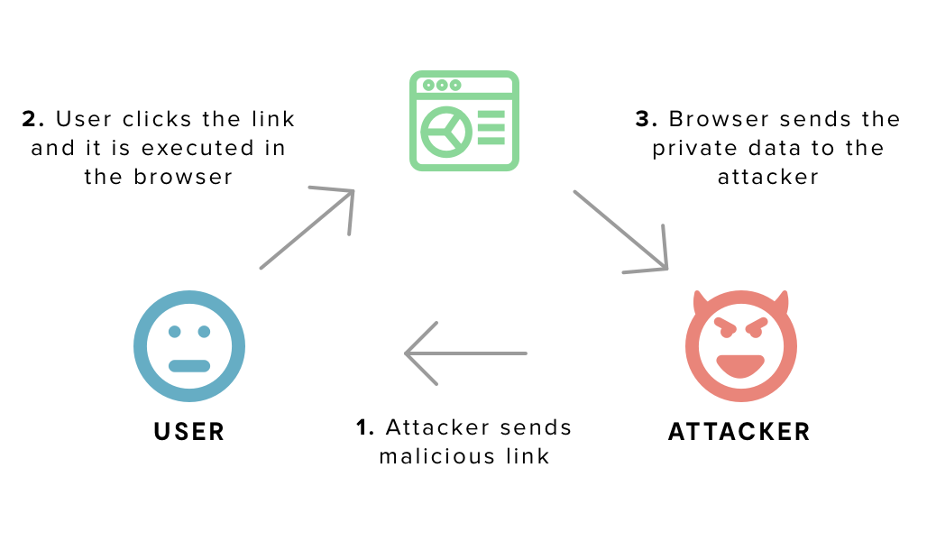
Reflected XSS
XSS which ”reflected” off of the website by means such as an error message or search result
Sent to user by a medium outside of the vulnerable website, such as an email link, or a link on another website
When the user clicks the malicious link, the injected code travels to the vulnerable website, and is run in the user’s browser since it is considered “trusted”

Slide 6
Preventing XSS
Never insert untrusted data (aka, user input data) except into specific, selected locations
Encode data before placing it in HTML elements or attributes
Encode data before using it in Javascript
Encode data before placing it in an HTML URL
(Sense a pattern?)
& --> &amp;
< --> &lt;
> --> &gt;
" --> &quot;
' --> &#x27;

Slide 7
Preventing XSS -- CSP
Content Security Policy
Define exactly which locations content (scripts, fonts, images, etc.) are allowed to be pulled from, and run
In a perfect world, no JavaScript should be “inline” (within the HTML), thus CSP can be used to disable running inline Javascript, thwarting the many XSS attacks

Slide 8

XSS Demo
Examples and prevention

Slide 9
SQL Injection
The insertion or “injection” of a SQL query via input data from the client to the server of an application
Can perform essentially any SQL query (if unrestricted), including reading data, modifying data or deleting data
Can even sometimes perform management commands on the SQL server
Extremely common, as SQL databases are used in a large variety of applications

Slide 10
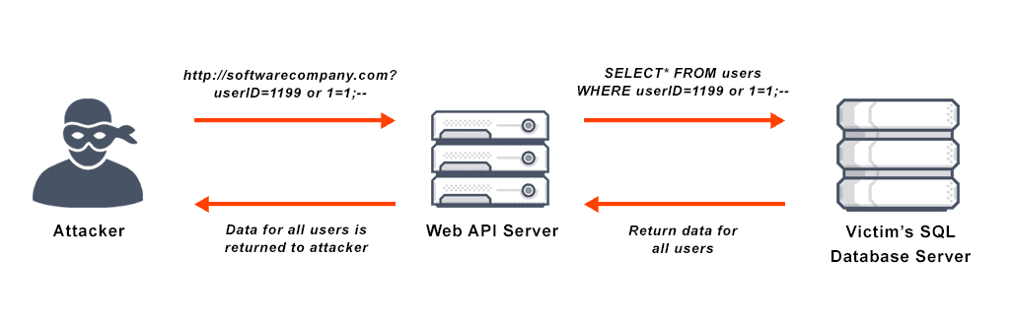

Slide 11
Preventing SQL Injection
Use Parameterized Queries
Use Store Procedures
Escape User Input
Enforcing least privilege
If an attacker can bypass your defenses, allow them to do the least amount of damage possible

Slide 12
SQL Injection Demo
Examples and Prevention

