Slide 1
The Missing Semester of Your CS Education
Containerization

Slide 2
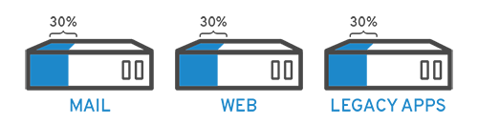
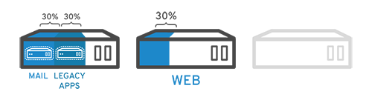
Virtualization
The creation of a fully computerized, or ”virtual”, piece of hardware
Allows for one physical server to have multiple separate running operating systems
Makes for easier troubleshooting and maintenance than having one operating system run all applications
Much more cost effective than one physical server per application

Slide 3
Virtualization: The Downsides
Running multiple virtual machines of the same operating systems requires multiple instances of what are effectively the same resource
10 virtual machines running Ubuntu Server use the basic Ubuntu Server system requirement’s worth of resources 10 times
Hypervisors, while efficient, add a layer of overhead

Slide 4
Containerization
Allows you to deploy many applications that use the same operating system to a system
Similar to a virtual machine, except share their kernel with the host operating system
Spin up time is often measured in seconds; ideal for short lived applications
Incredibly scalable
Need more resources? Spin up some more containers

Slide 5
Containerization: The Downsides
Containers must use the same kernel as the host OS
Because the kernel is shared between the host and the container, a security exploit to the container can very easily become a security exploit to the host

Slide 6

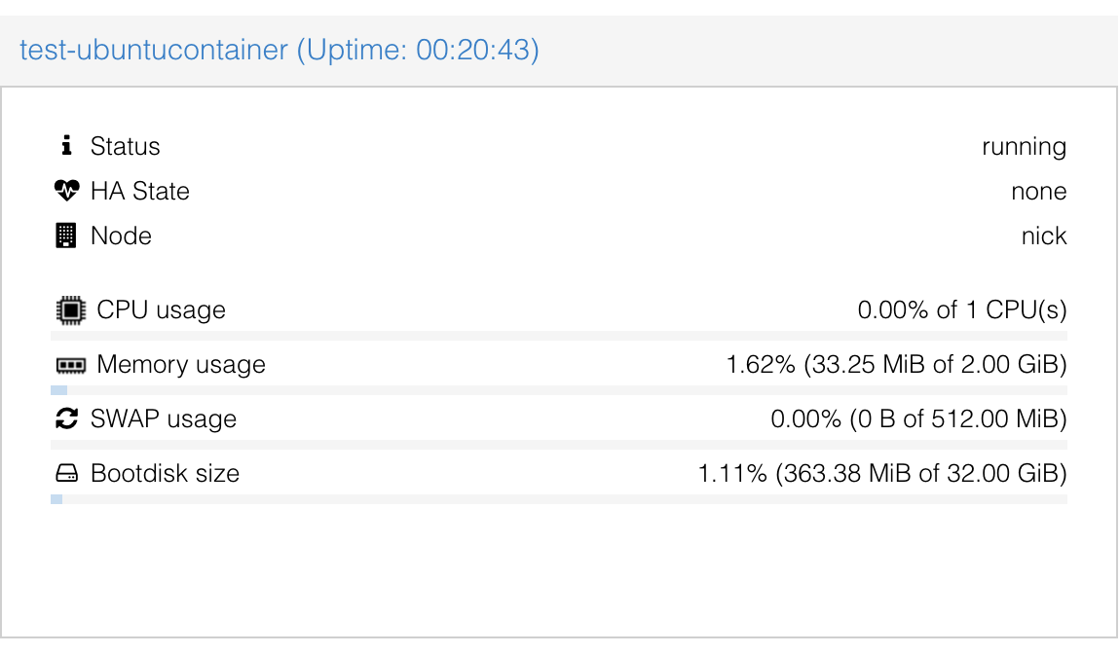
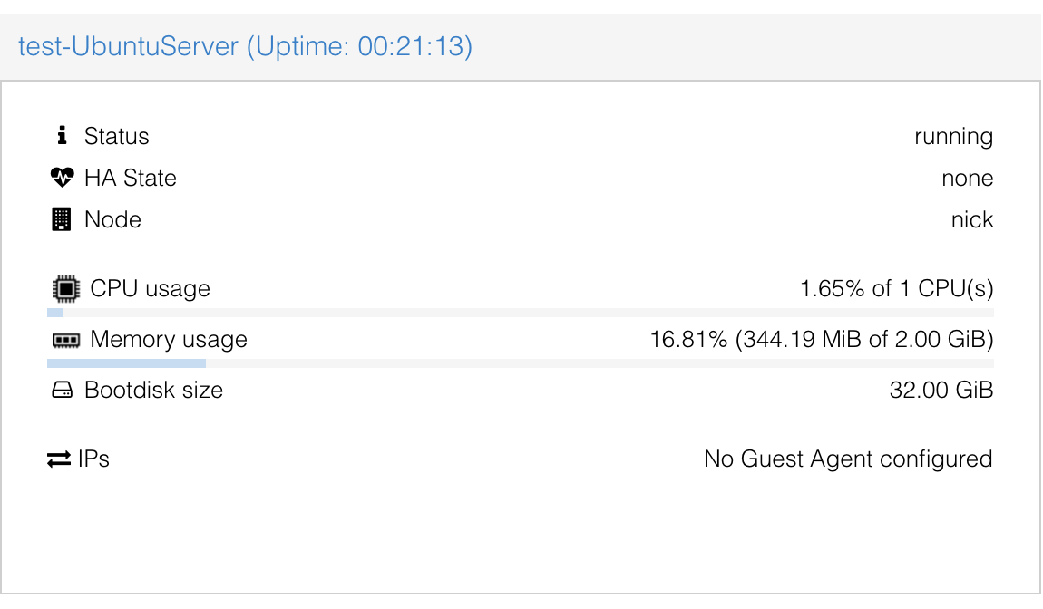
Containerization vs Virtualization

Slide 7
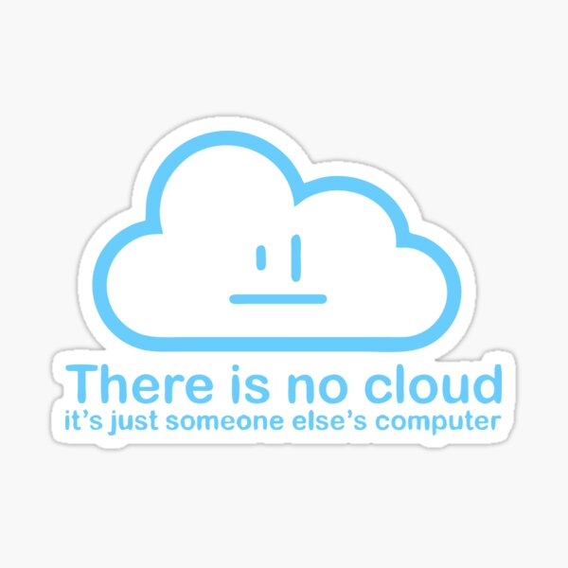
Serverless
A cloud computing model where the provider will spin up and down resources as customers request them
Most serverless environments are really just containers being spun up as necessary

Slide 8
Container Terminology
Image: A self contained, static file that includes runnable code
Act as a set of instructions on how to build a container
Typically built in a series of layers
Container: A running instance of an image

Slide 9
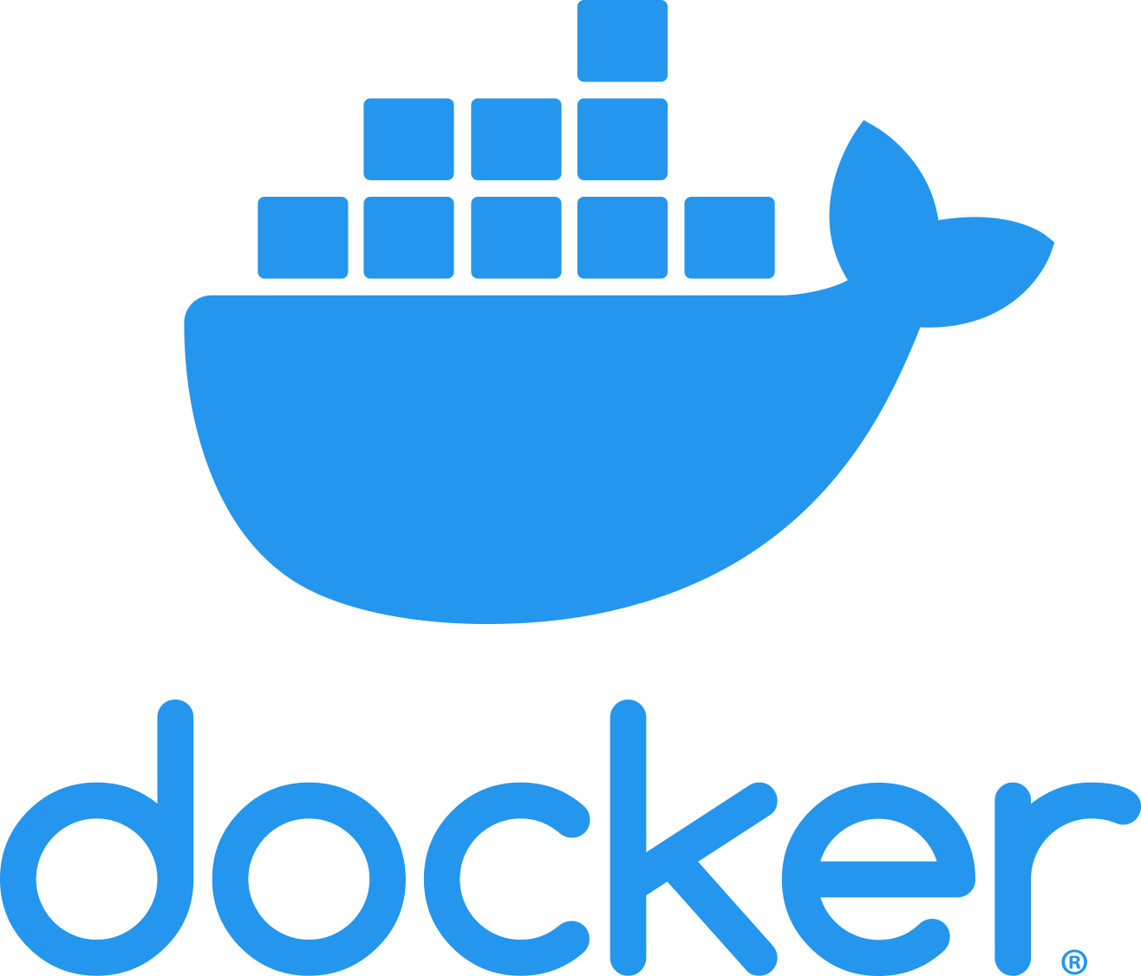
Docker
The most common tool for creating images
Most containers that developers create are written with Dockerfiles to define how to build their images
Follows the standards set by the Open Container Initiative, so Docker images are largely interchangeable with other image formats

Slide 10
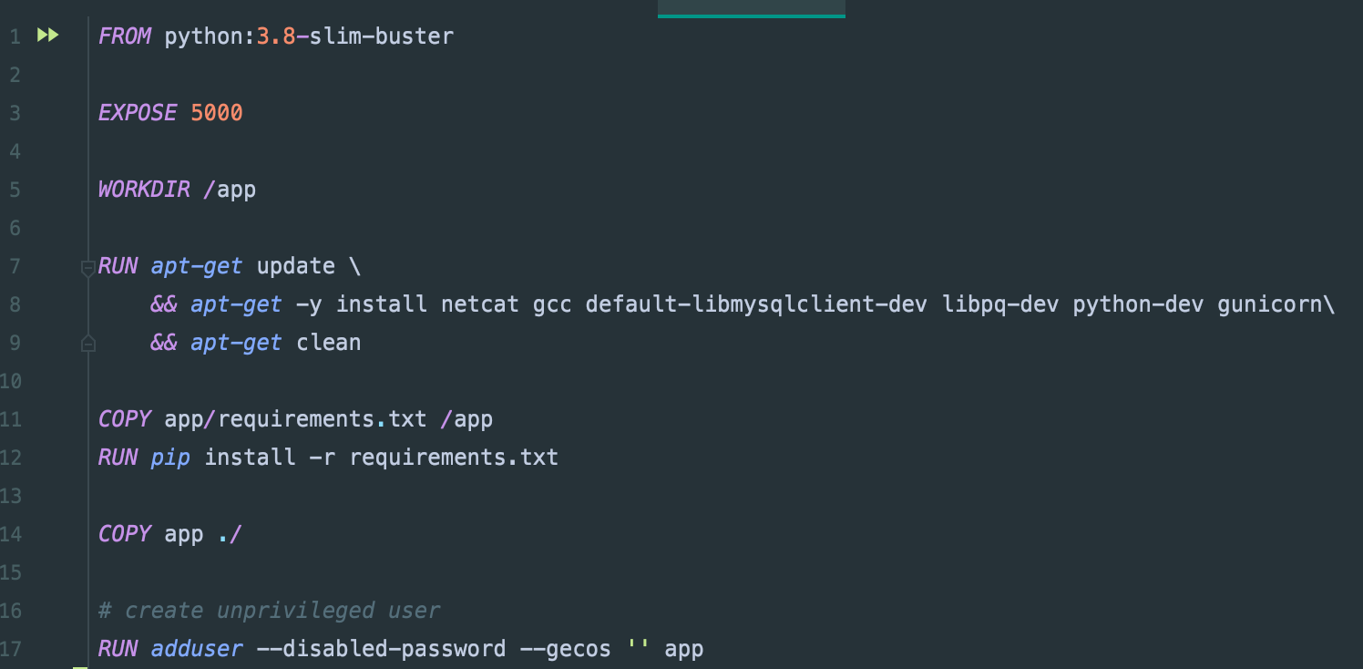
Dockerfile
The written specification of how to build a Docker image
Written as a series of steps, corresponding to layers of a finished Docker Images

Slide 11
Deploying Multiple Containers
Docker-compose and Kubernetes

Slide 12
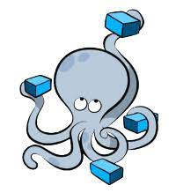
docker-compose
A way to spin up multiple docker containers easily with one command
Defined with a YAML file
Rather than passing command line arguments for specific options, container options are specified here
Good for running multiple containers on a machine when developing, not very good at scaling containers in a production setting

Slide 13

Kubernetes
With great power comes great… complexity?
Significantly more scalable than docker-compose
Much more complex to write the definitions for
Allows for options such as provisioning more containers in times of high resource utilization, and deprovision when the need is not as great
Typically used in a production environment

