Slide 1
The Missing Semester of Your CS Education
Devops

Slide 2
What is DevOps
The convergence of Development, and Operations
Can refer to both refer to a job role as well as a type of development culture
Becoming increasingly common in many development processes—especially with the rise of Agile

Slide 3
IT Operations
Typically focused on stability, and don’t like change
Manage servers that the applications run on, as well as the databases, networks, etc.
Often take over the management of an application after development completes work on it
Stereotypically are at odds with development groups, as these groups typically want constant change

Slide 4
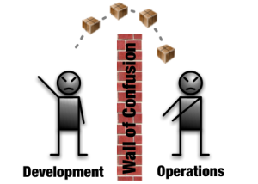
The Handoff
Often when Development ”hands off” an application to IT Operations, there is little to no documentation, and IT Ops ends up with a mess
When things go wrong, there’s finger pointing on both sides, and problems take longer to be resolved

Slide 5
DevOps Philosophy
DevOps operates on a philosophy that Development and Operations should work closely together, to provide minimal time to deployment, and allow for many small releases
Applications developed with a DevOps philosophy or often more reliable, scalable, and having a quicker time to market
More releases means more changes to integrate a security patch into an an application
Sometimes, Development and Operations are no longer two separate teams, and “DevOps Engineers” make up the entire team

Slide 6
What is the Job of a DevOps Engineer?
Develop and maintain the “pipeline” between the Development teams’ local environments, and the various environments used, such as Dev, QA, and Prod
1
Coordinate the smooth transition of code between each of these environments
2
Typically maintain these different environment in Infrastructure as Code Systems (IaC)
3

Slide 7
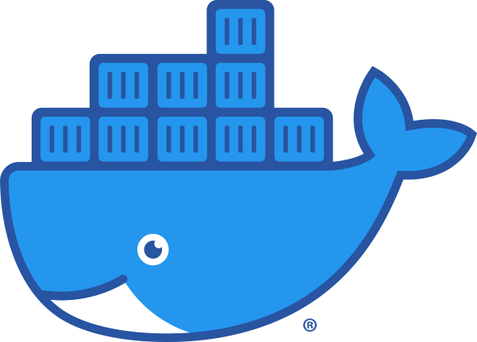
DevOps System Architectures
DevOps prides itself on scalability; containerization is a cornerstone of the DevOps philosophy
IaC and other DevOps philosophies lend themselves well to quickly spinning up containers as necessary during increase demand
Microservices are much more easily used with containers, thus many DevOps applications make use of a microservice architecture

Slide 8

DevSecOps
The integration of Security (and often QA) into the DevOps workflow
Security vulnerabilities pop up all the time? Why not allow quick and easy fixes for them?
DevOps works with both applications as well as the infrastructure they run on—the perfect team to integrate Security into

Slide 9
Infrastructure as Code (IaC)
A practice where virtual hardware is represented by code, and managed using software development techniques such as version control
The API-driven nature of clouds is extremely powerful and allows for pretty much any infrastructure to be represented as few lines of code
Infrastructure can be easily standardized, and identical resources can easily be created as necessary
Allows for automated deployments of new virtual infrastructure on an as-needed basis

Slide 10

Terraform
An IaC tool, typically used to define the “hardware” provided to virtual resources
Configures a VM’s RAM, CPU, Disk, and other resources
Used to manage external service providers’ tools (Azure, AWS, etc.)
Dependent on lifecycle management

Slide 11
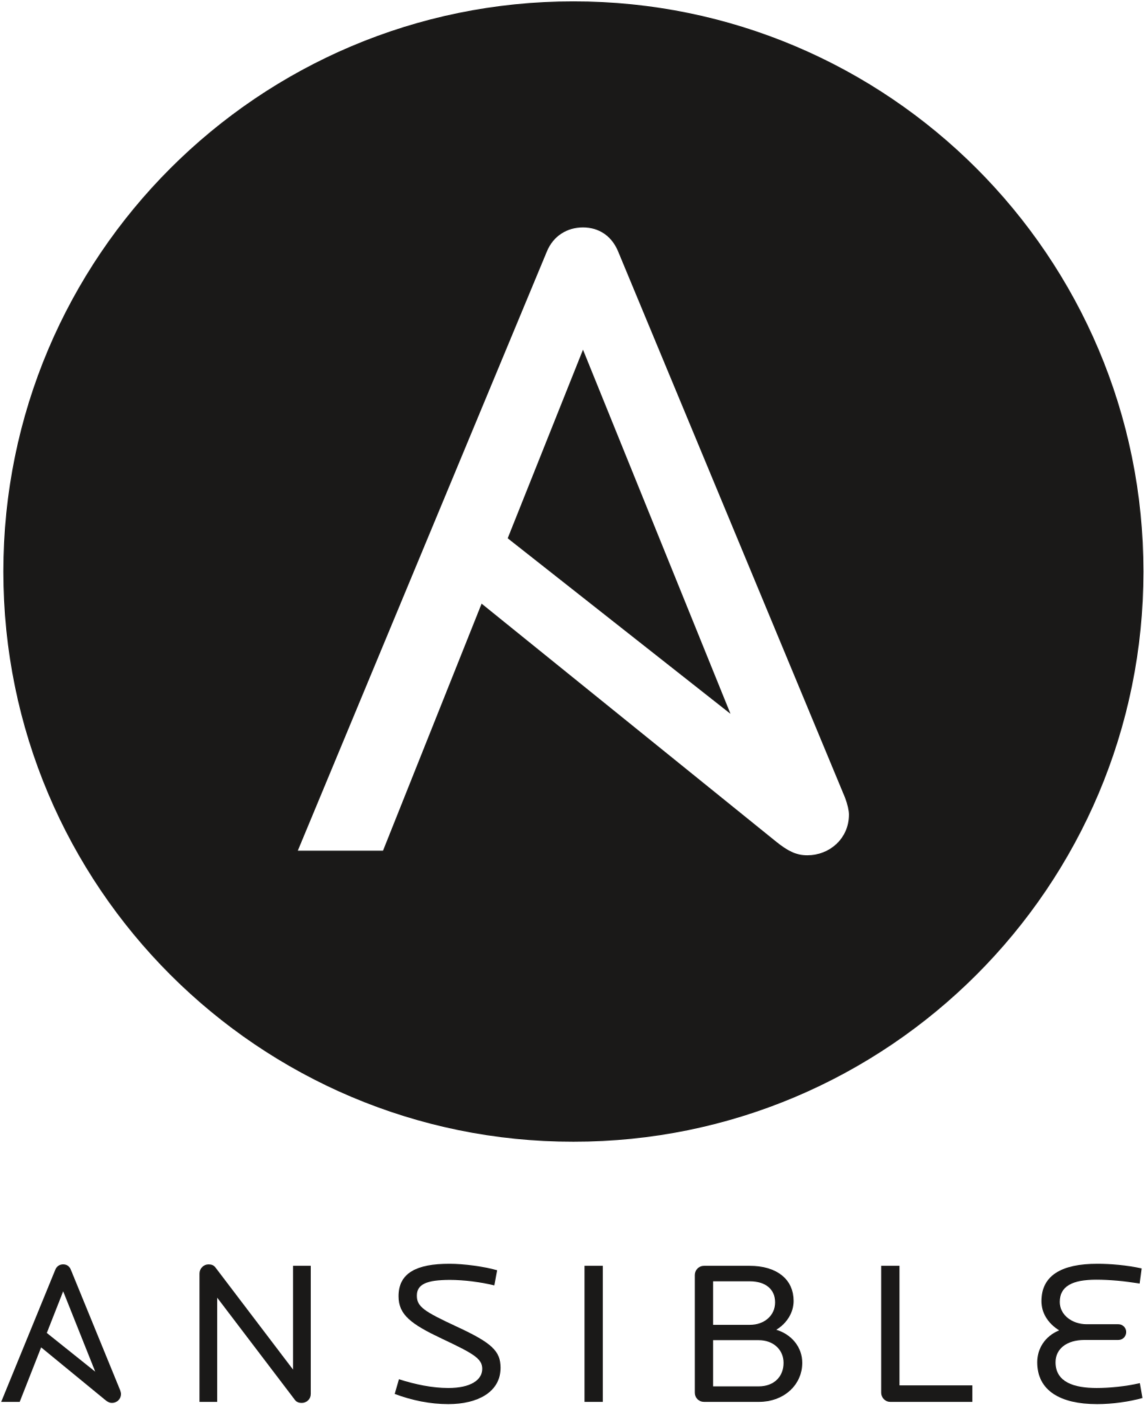
Ansible
IaC tool for configuring virtual resources, typically on the software side
Installing packages, updates, changing system settings
Automatically SSH’s into various servers and makes required changes
Not dependent on life cycle management

Slide 12
Continuous Integration (CI)
A development practice where developers are constantly “pushing” their code into a remote repository
Tests and builds are run automatically
Bugs and QA issues are found quicker
Fixes can be implemented in a timely fashion

Slide 13
Continuous Delivery
Code is automatically built, tested, and readied for a deployment into production
Builds upon CI by pushing the code into a testable environment, such as a Dev or QA environment
If implemented properly, developers will always have a testable version of the code to use to validate their work

Slide 14
CI/CD Pipelines
Typically have two major stages:
Build: compiles the source code, and creates a container image from the defined parameters
Deploy: push the built image as a container to an environment, such as Dev
Can be run automatically on push to source control, or be run automatically
The foundation of any DevOps program

Slide 15

Jenkins
The “original” CI/CD pipeline
Still widely used by many companies
Open source, with a massive library of extensions
A large number of capabilities, but a bit complicated to get started with

Slide 16
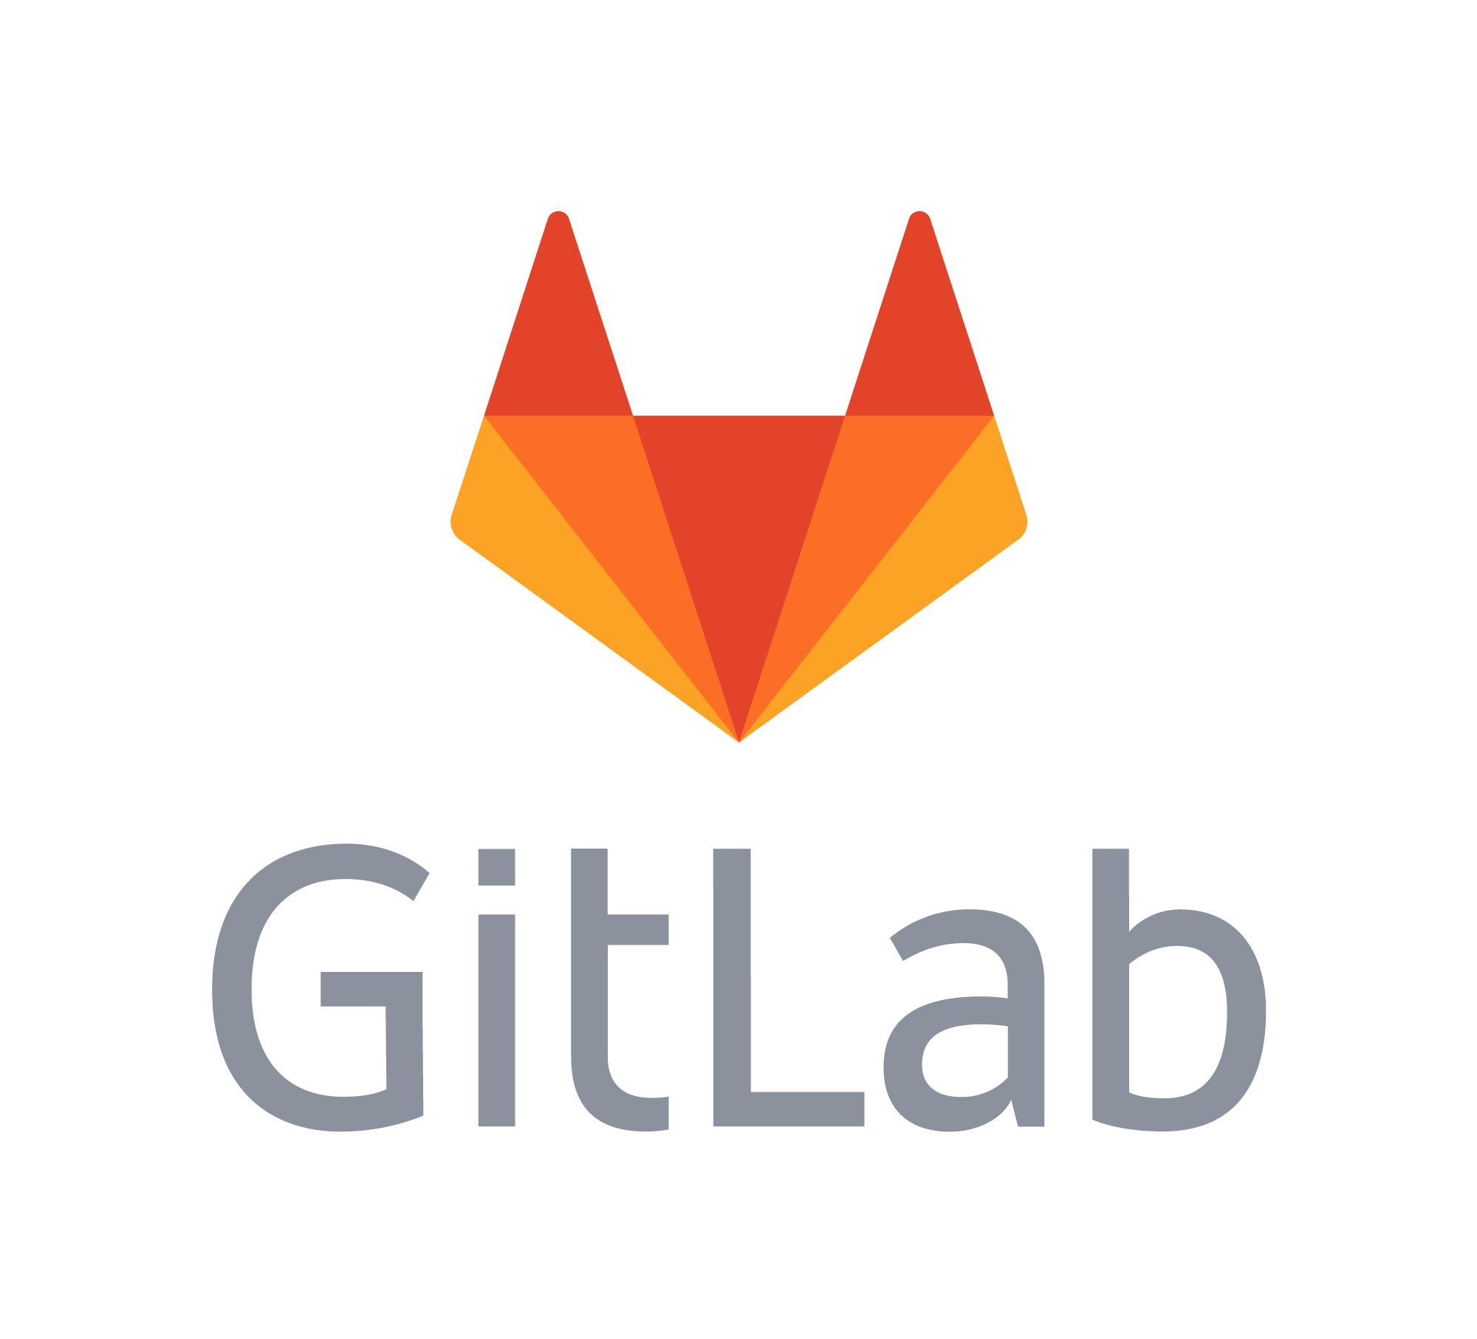
Gitlab CI/CD
Built into the Gitlab architecture from the ground up
Very easy to get start with, offers options for SAST and DAST security scanning out of the box, with little customization required for basic scans
Built in container image repository to store the results of image builds

Slide 17
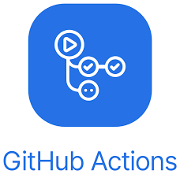
GitHub Actions
A latecomer to the CI/CD stage, operates similarly to Gitlab’s CI/CD offering
Simple to get started with, but still lacking in extensibility and options

