Slide 1
The Missing Semester of Your CS Education
API Development

Slide 2
Fundamental Concepts of API Development
Trust no one, not even yourself
Validate everything
Sanitize all input
Long running tasks should be handled asynchronously
Everything should be documented

Slide 3
API Documentation – Postman
Postman offers very robust features for documentation as well as testing
Built in support for providing descriptions of API request usage
Super simple to provide users with various parameters, both in URL and Queries
No good way to specify schemas for request/response bodies

Slide 4
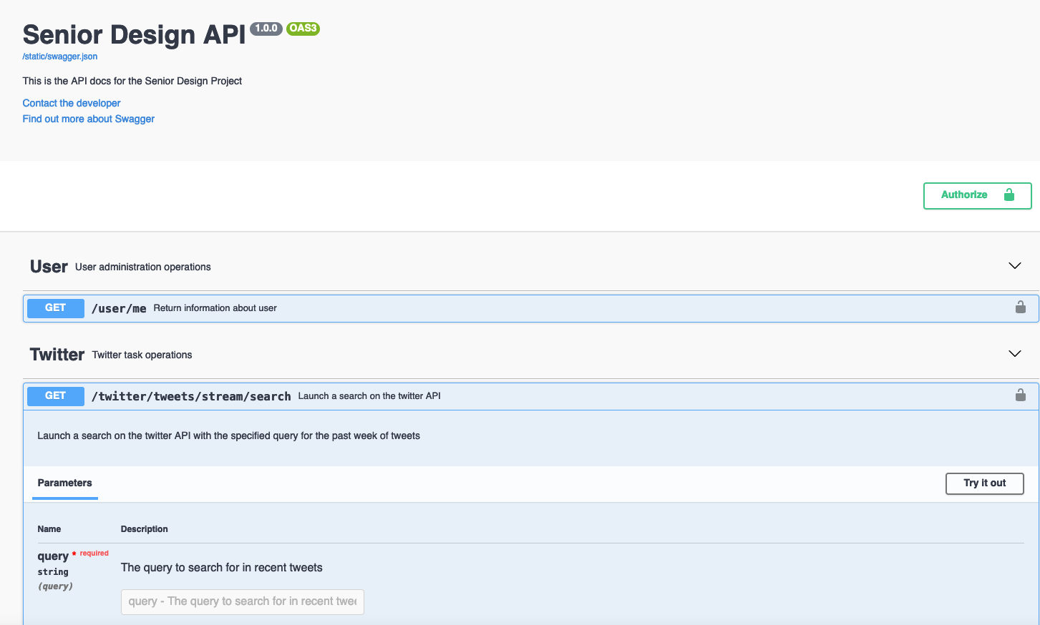
API Documentation -- Swagger
Written in YAML or JSON
Provides an interactive API Doc for developers to use
Very good at defining schemas for request/response bodies
Can be autogenerated with a variety of libraries

Slide 5
Python Concepts

Slide 6
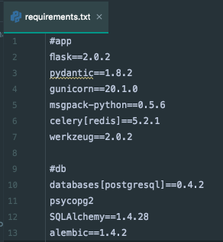
requirements.txt
Larger projects can have dozens of required packages
Manually installing these is obviously not effective
We define a requirements.txt file with a list of all of the external packages to be installed, including a version number
Install using “pip3 install –r requirements.txt”

Slide 7

__name__ == ‘__main__’
Sometimes we want to have a python file that can both be run as an executable and a library
We want to run code only when a file is directly run directly
The variable __name__ refers to the effective name of a file
‘__main__’ is the effective name of the file run from a commandline

Slide 8

Libraries – Flask
A barebones framework for API development
Uses a “bring your own X” approach, for things like an ORM, serializer, security, etc
Good for beginners, as it’s easy to understand, and forces you to learn how API development works

Slide 9

Libraries – FastAPI
Flask, but with built in integrations with SQLAlchemy’s ORM, Pydantic’s Serializer, and others
Built for rapid API development and quick prototyping
Automatically generates Swagger Docs based on the code you write

Slide 10

Libraries – Django Rest Framework
A library built of of Django
Built in ORM, Serializers, Validators, and a host of other useful utilities
Writing a minimal amount of code for many API functions
A lot to learn—not a good starting point for understanding APIs

