Slide 1

Movie Classification

Slide 2
Objective
The goal of this project is to create a classification system for movies.
There are many movies with a myriad of genres. However, a movie does not have one genre since it can be an action and sci-fi or just be an action movie.
Thus, classifying movies to fit them neatly into one category isn't easy.

Slide 3

Target Audience
Streaming Services
Movie archivist

Slide 4
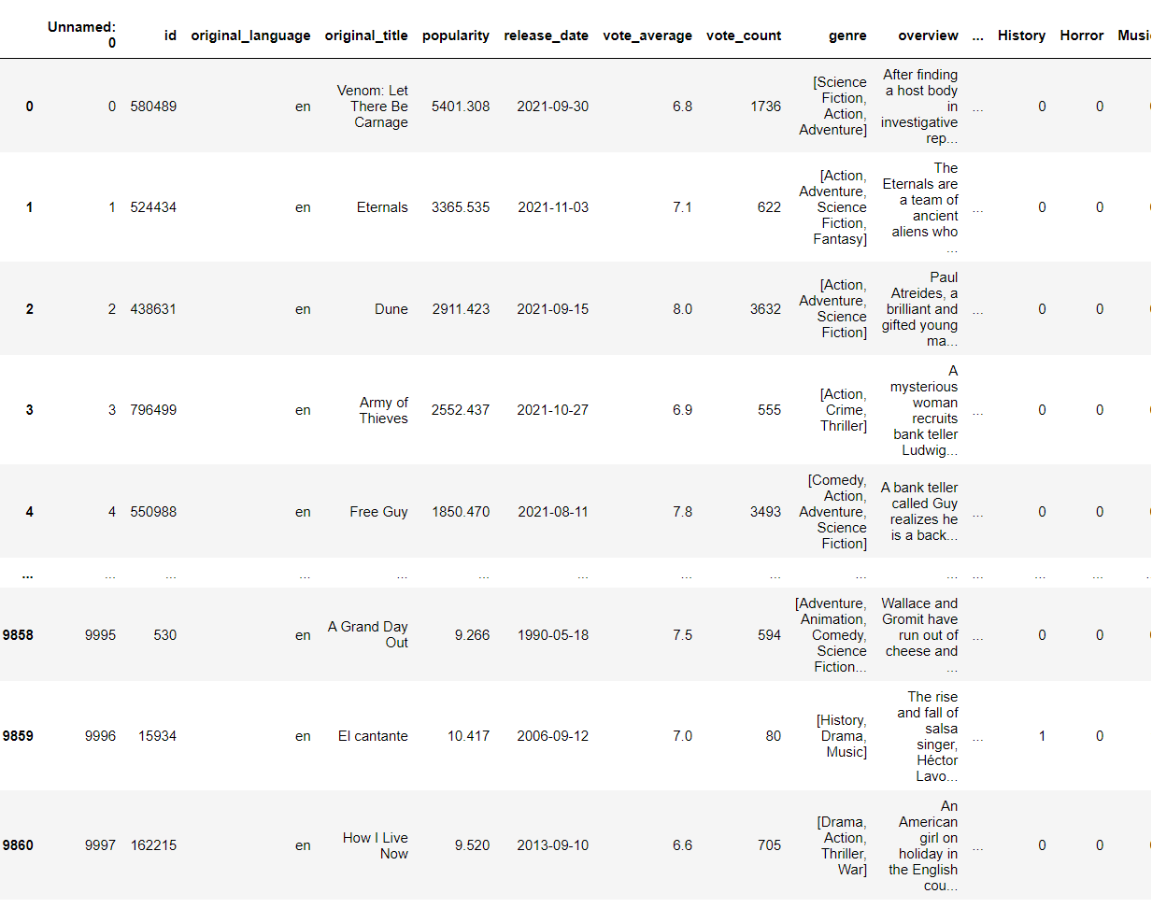
Data
Notes:
This dataset was chosen as it was the most numerous. IMDB while does contain many movies, but the summary on it was too short to be used.

Slide 5
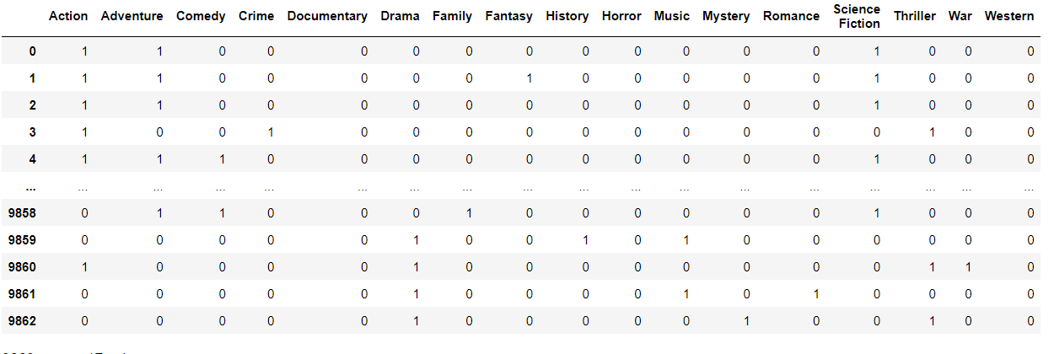
Data Wrangling
Notes:
In this classification system, the output is the genre. Thus, it is important to distinguish what genre each movie contains. In addition, many movies contain unnecessary words and names that are only useful in limited scope. The first problem was the genre was, while looking like a list, a string. Because of this, the machine understood each genre as a long text and couldn’t separate different genres. As a solution, the strings had to be converted to a list. The second problem was making sure to track what genre each movie contained. Since a movie could have multiple genres or be singular, I had to make sure to track them properly. The solution, create a dummy variable so tracking each genre would be quite simple. The third issue was certain overviews containing too many unnecessary words, mostly proper nouns. The solution was going through each overview and eliminating compound words like “won’t “ or “can’t”. And utilizing nltk’s tagging, I was able to tag words that contain NNP and get rid of them.

Slide 6
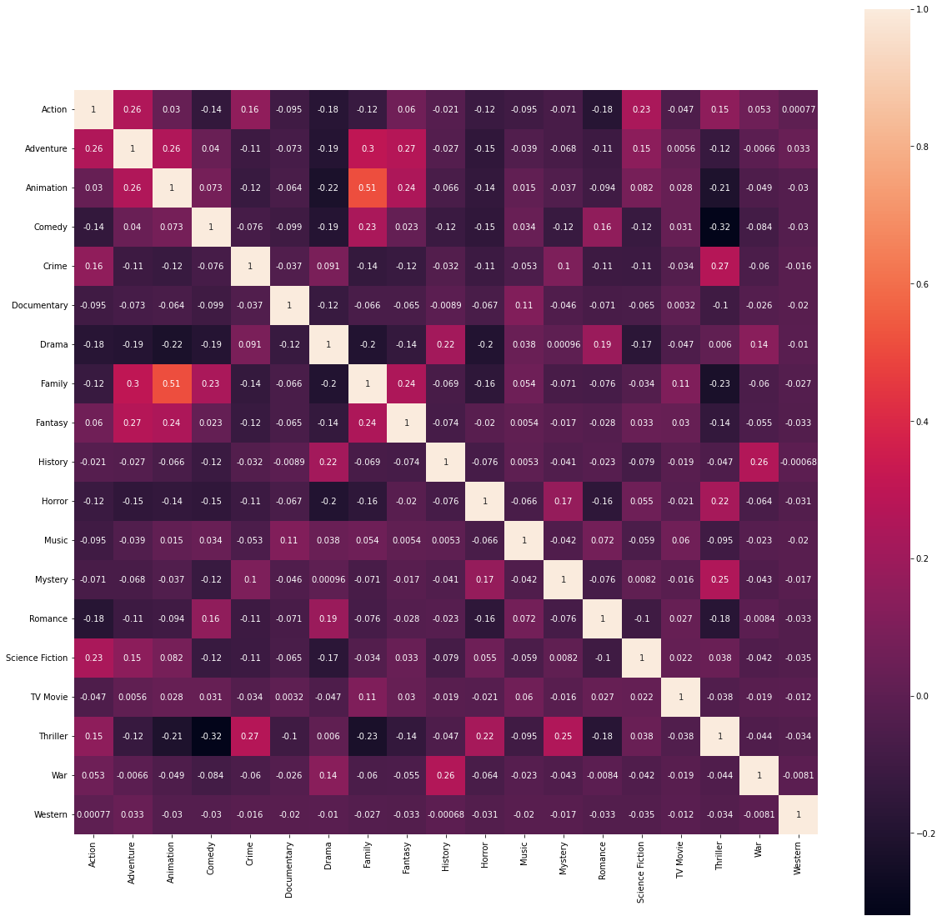
EDA
Notes:
For EDA I went through many different factors that could lead to predicting movie genres, such as the length of the movie summary for each genre or the connection between each genre. However, these connections were loose and

Slide 7
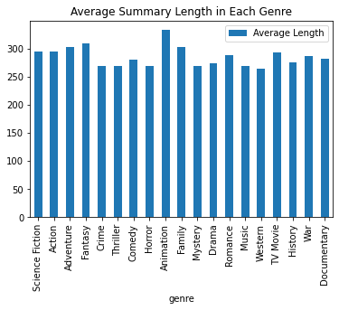
EDA

Slide 8
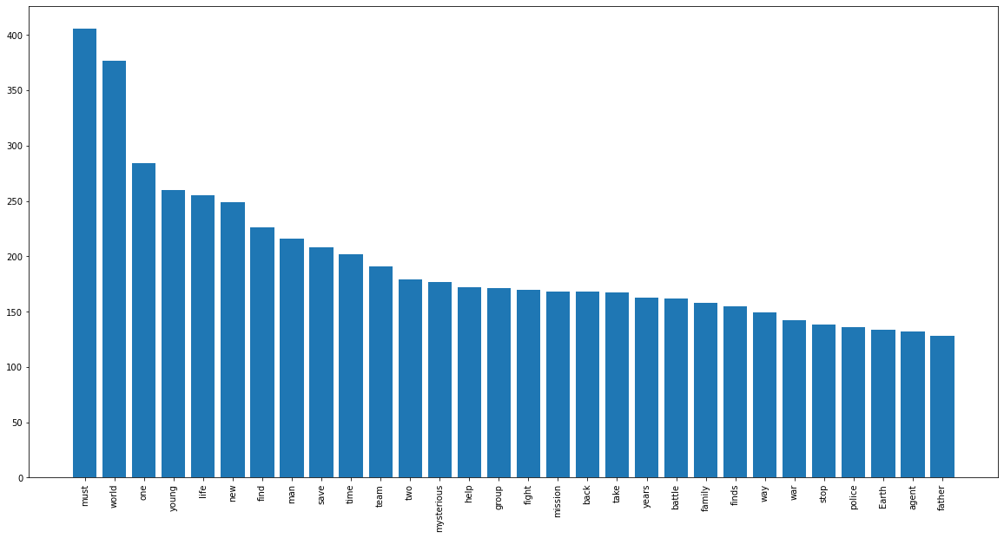
EDA

Slide 9
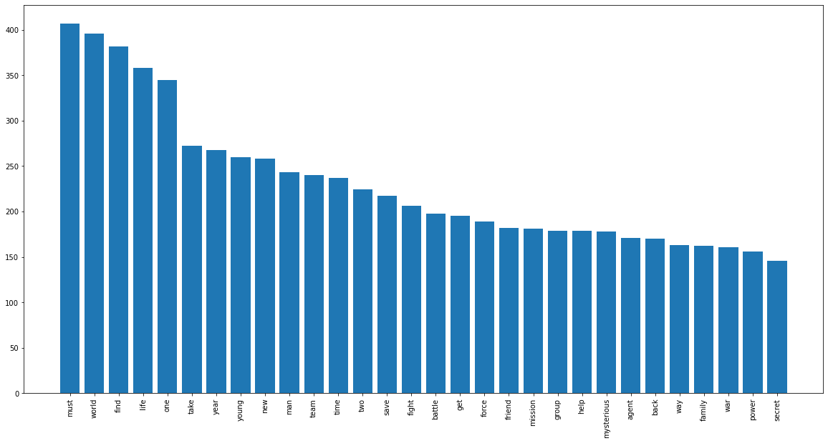
EDA

Slide 10
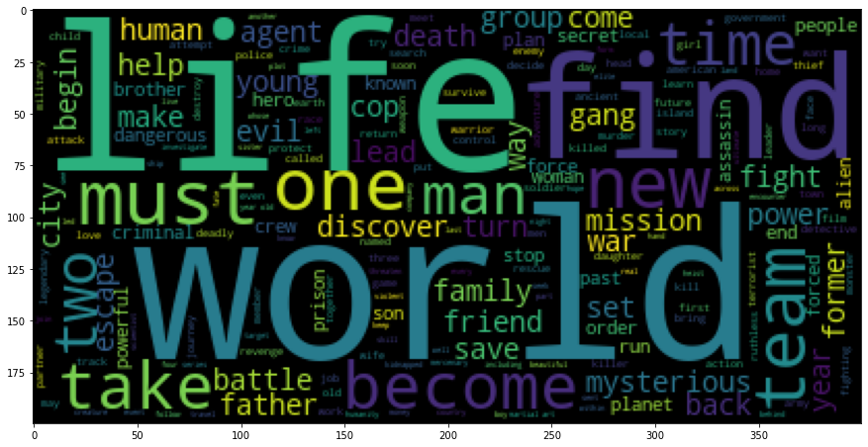

Slide 11
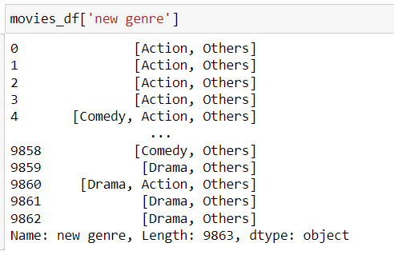
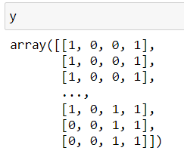
Modeling
Notes:
For modeling, I used MultiLabelBinarizera the output wouldn’t just be one. Since there was more than one label, LabelGinarizer couldn’t be used. In addition, I had to cut down the genre to three most numerous ones, drama, action, and comedy. The reason being, the data wasn’t enough as each summary was too short and there weren’t enough movies.

Slide 12
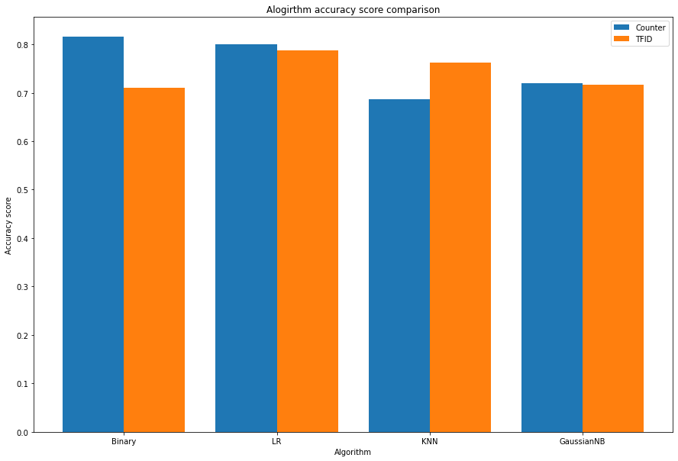
Counter or TFIDF
Notes:
For the vectorizer, Counter led to better results overall by a bit, except for KNN. Perhaps because of how short each summary was; thus the number of words had more weight.

Slide 13
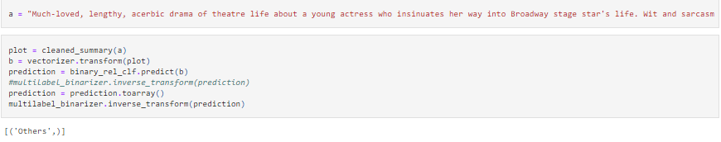
Implementation

Slide 14
Areas that could be improved
Additional data
Add additional features instead of just overview, possibly add things like movie poster or director/actors
Longer plot summary

