Slide 1

Unfortunate reality of mixed dogs

Slide 2
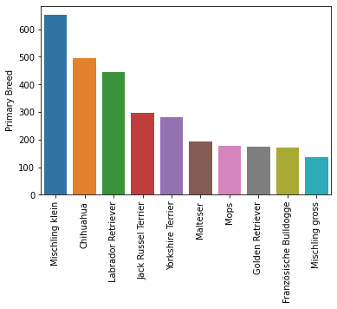
The most popular dogs in Zurich
Notes:
These dogs are popular. There are many breeds of dog in Zurich, demonstrating dogs are probably popular here.

Slide 3
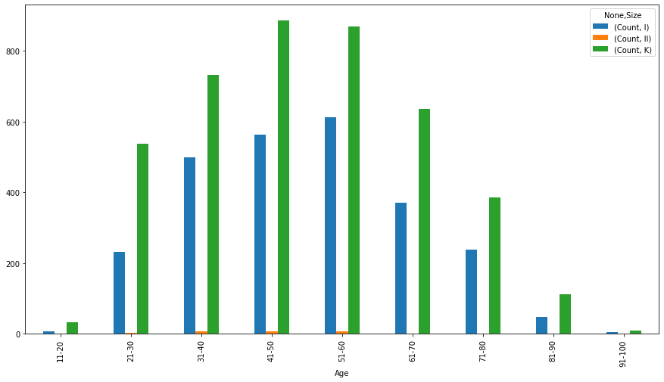
People prefer smaller dogs (by age)
Notes:
No matter the age group, people prefer smaller dogs. The reason behind this could be numerous.

Slide 4
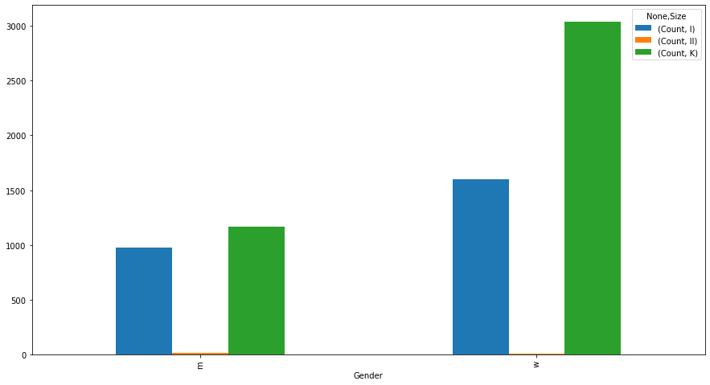
People prefer smaller dogs ((by sex)
Notes:
Women seem to prefer smaller dogs.

Slide 5

Let’s flip the idea.
Notes:
We also need to think which types of dog’s aren’t popular and why.

Slide 6
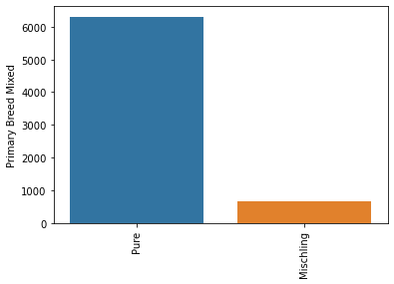
Mixed dogs are neglected
Notes:
For whatever reason, mixed dogs are neglected compare to mixed dogs.

Slide 7
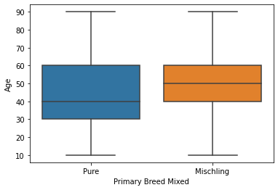
Younger people prefer pure breed.
Notes:
It seems that it is important to raise awareness that mixed breed dogs are being neglected, especially amongst younger crowd. People in their 20s and 30s are more likely to avoid getting mixed dogs.

Slide 8
Questions we need to ask
Why do people prefer smaller dogs?
Why pure breed dogs?

