Slide 1
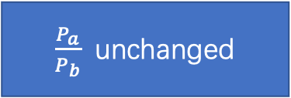
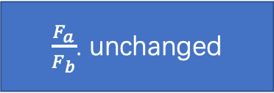

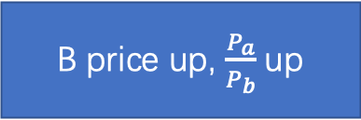
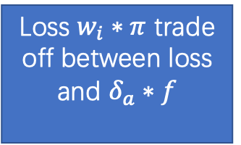





B price up, $\frac{P_{a}}{P_{b}}$ up
$\frac{F_{a}}{F_{b}}$. unchanged
Investor buy A
Bonding curve
inside AMM
Outside AMM
A amount down
Price shock
arbitragers
Liquidity providers
mechanism
Use B for A
Can not bid at $π$
Profit $π$ rent
$$Y_{a_{i}},Y_{b_{i}}=0$$
Loss $w_{i}∗π$ trade off between loss and $δ_{a}∗f$
Solution:
1 frequent batch auction
2 pricing function design
3 arbitragers indentification for opportunity
Liquidity freeze
Profit $δ_{b}∗P_{b}$
Use A for B
Can not bid at $π$
arbitragers
Liquidity providers
$\frac{F_{a}}{F_{b}}$. down
$\frac{P_{a}}{P_{b}}$ unchanged
Outside AMM
User trade B for A
Bonding curve
Inside AMM
B amount up
A ampunt down
Price shock

Slide 2
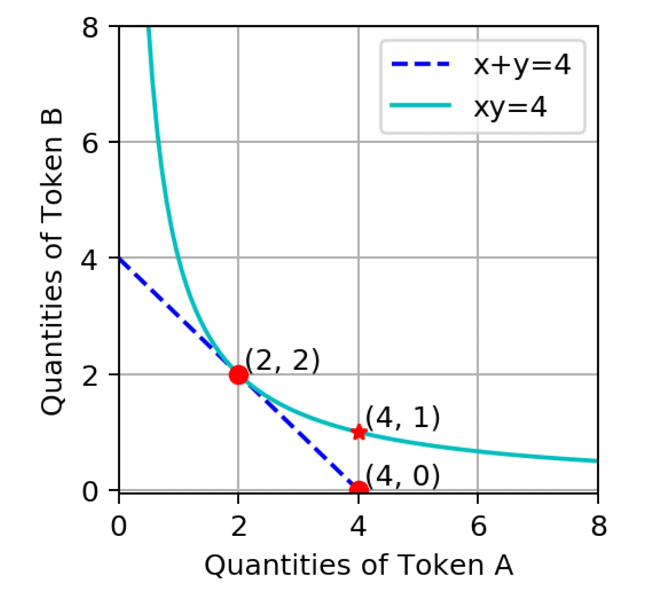
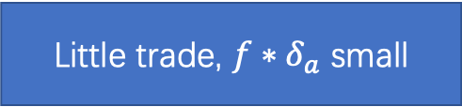
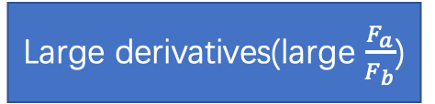
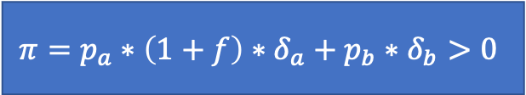
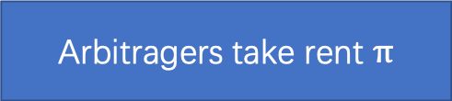
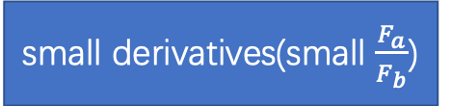
Large derivatives(large $\frac{F_{a}}{F_{b}}$)
Little trade, $f∗δ_{a}$ small
Pricing function design(for liquidity providers)
small derivatives(small $\frac{F_{a}}{F_{b}}$)
Arbitragers take rent $π$
Optimization of convex function
Socially optimal pricing curve
Solution:
1 frequent batch auction
2 pricing function design
3 arbitragers indentification for opportunity
Reserve function
Snipping problem
Frequent batch option
Invariance relation + bonding curve
Arbitrage(for arbitragers)
$$π=p_{a}∗\left(1+f\right)∗δ_{a}+p_{b}∗δ_{b}>0$$

Slide 3




Investor
Invest A
arbitragers
Use B for A
Liquidity providers
Can not bid $π$ ,liquidity freeze
Invest B
arbitragers
Use A for B
Liquidity providers
Large convexity
arbitragers
Do not trade
Small convexity
arbitragers
Get profit $π$
Reserve function
arbitragers
Use A for B
arbitragers
Use B for A
Use B for A
arbitragers
Use A for B
Can not bid $π$ ,liquidity freeze
Large convexity
arbitragers
Do not trade
Small convexity
arbitragers
Get profit $π$
Reserve function
arbitragers
Use A for B
arbitragers
Use B for A
Use B for A
arbitragers
Use A for B

