Slide 1
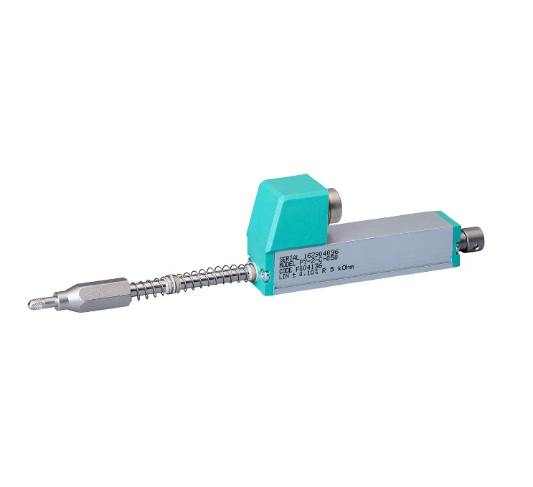

black
Arduino 3.3V
Yellow
ADS1115 ADC ->A0
brown
1 KΩ
Arduino GND
outer
sheath

Slide 2
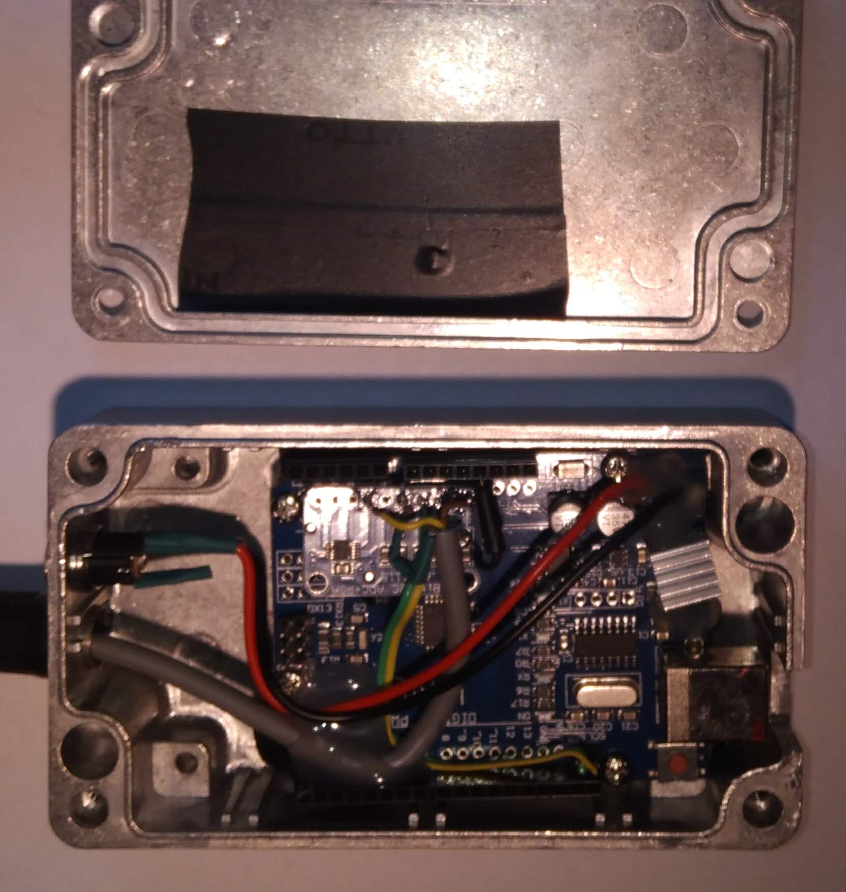
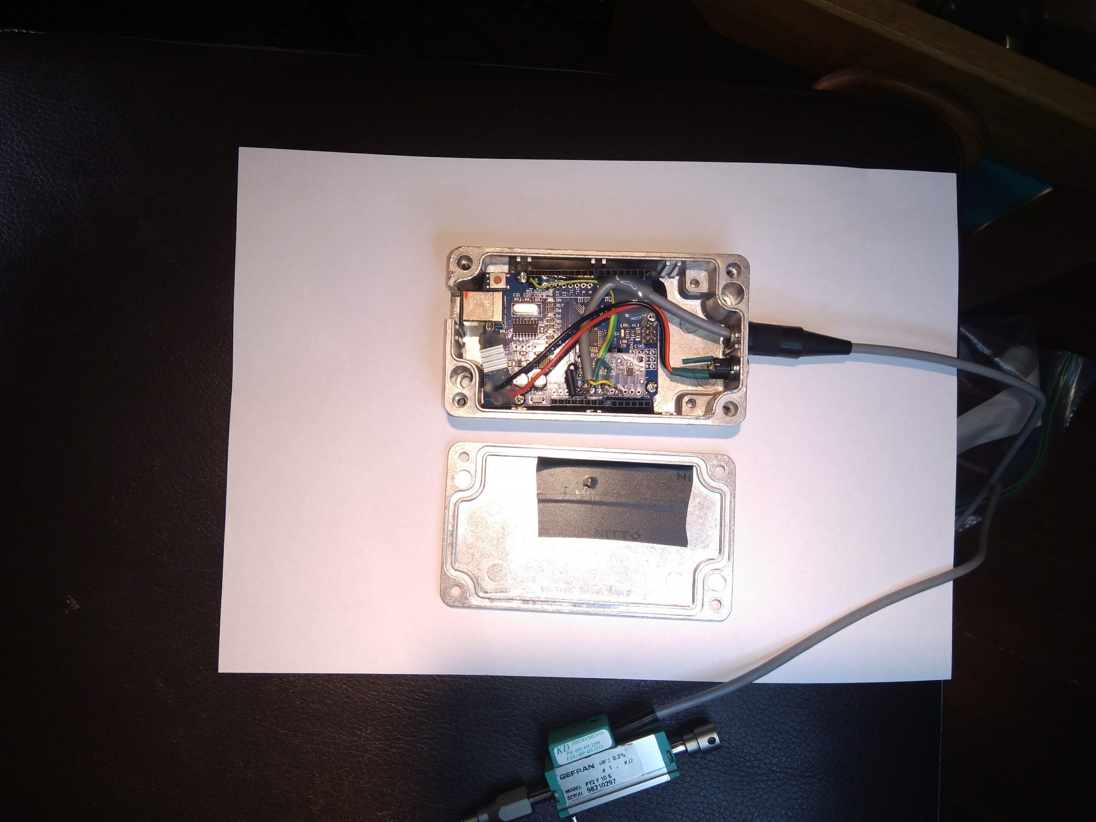
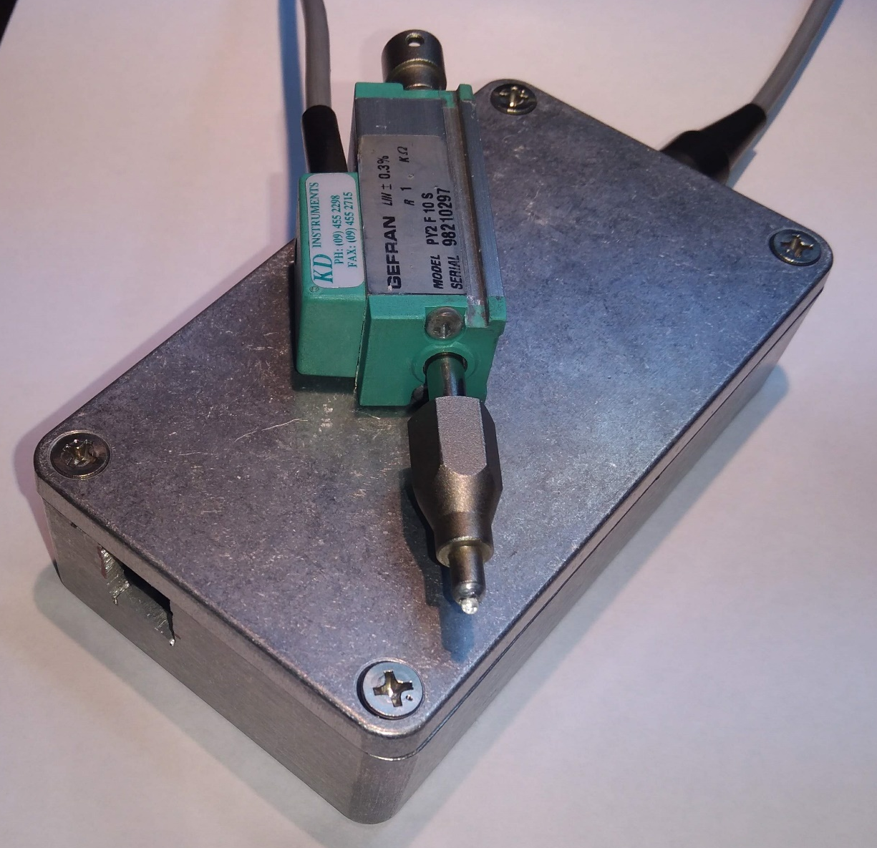
From GEFRAN PY2 connector
USB I/O
(b)
(a)
GND
ADS1115 ADC ->A0
Heatsink
(also contacts lid for
better conduction)
3.3V
Power jack removed – direct wired to panel mount 2.5mm socket
(c)
Insulation on lid to prevent short to ADS1115 ADC
Heatsink touches lid here for better conduction

