Slide 1
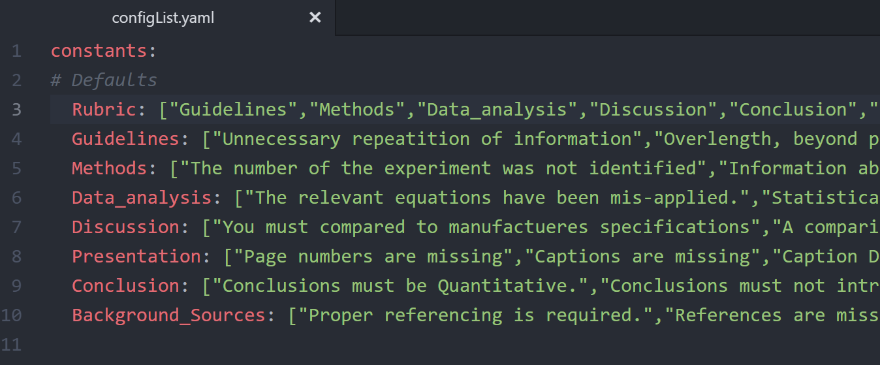
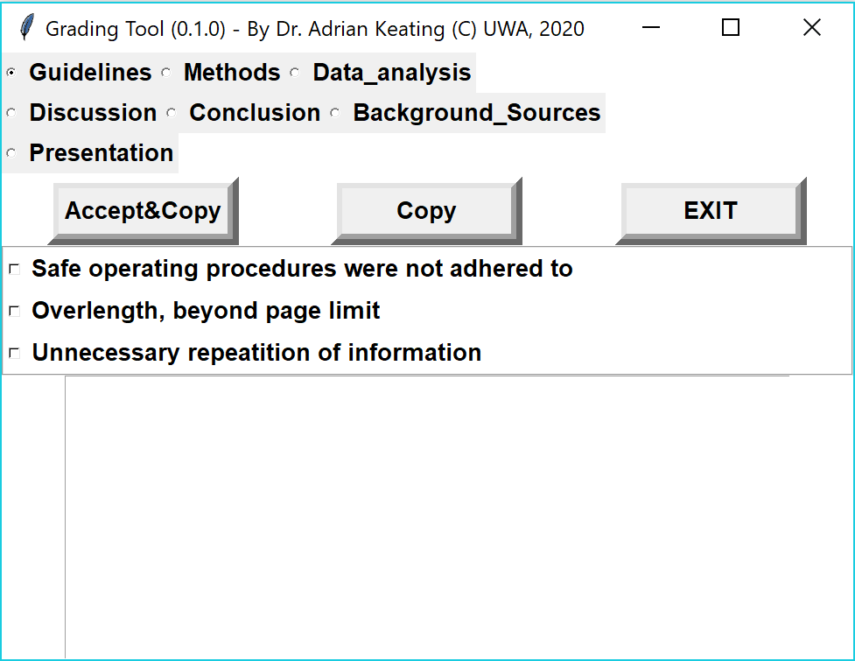
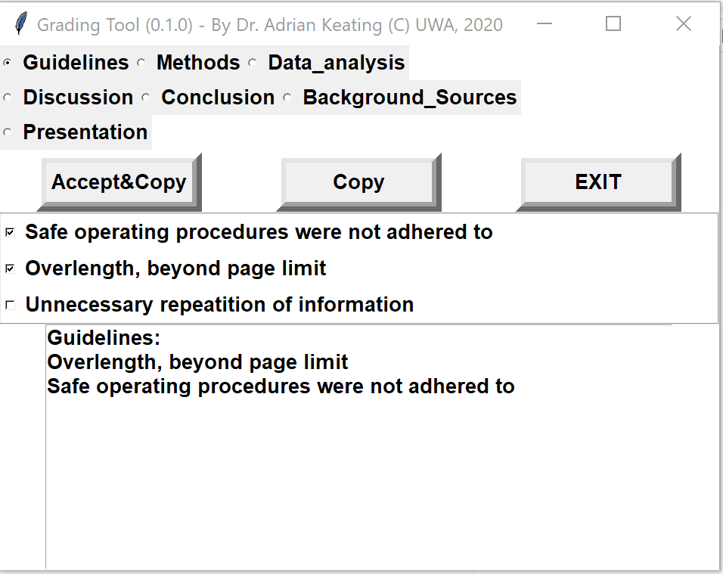
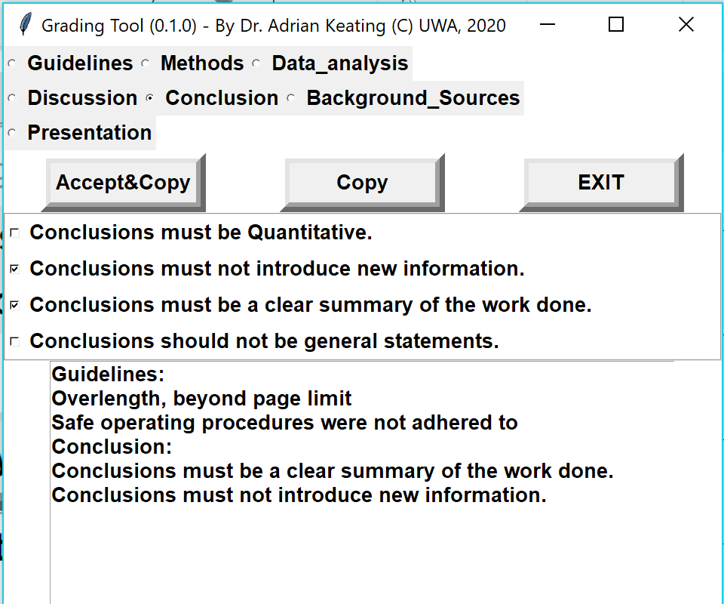
Guidelines:
Overlength, beyond page limit
Safe operating procedures were not adhered to
Conclusion:
Conclusions must be a clear summary of the work done.
Conclusions must not introduce new information.
STEP #1
STEP #1
STEP #2
STEP #1

Slide 2
