Slide 1
片上系统接口与模块设计 嵌入式系统芯片设计
主讲教师：张培勇
浙江大学超大规模集成电路设计研究所
Notes:
2次课
一共10次课讲到本章结束

Slide 2
7. SPI模块设计
嵌入式系统芯片设计---基于microblaze

Slide 3
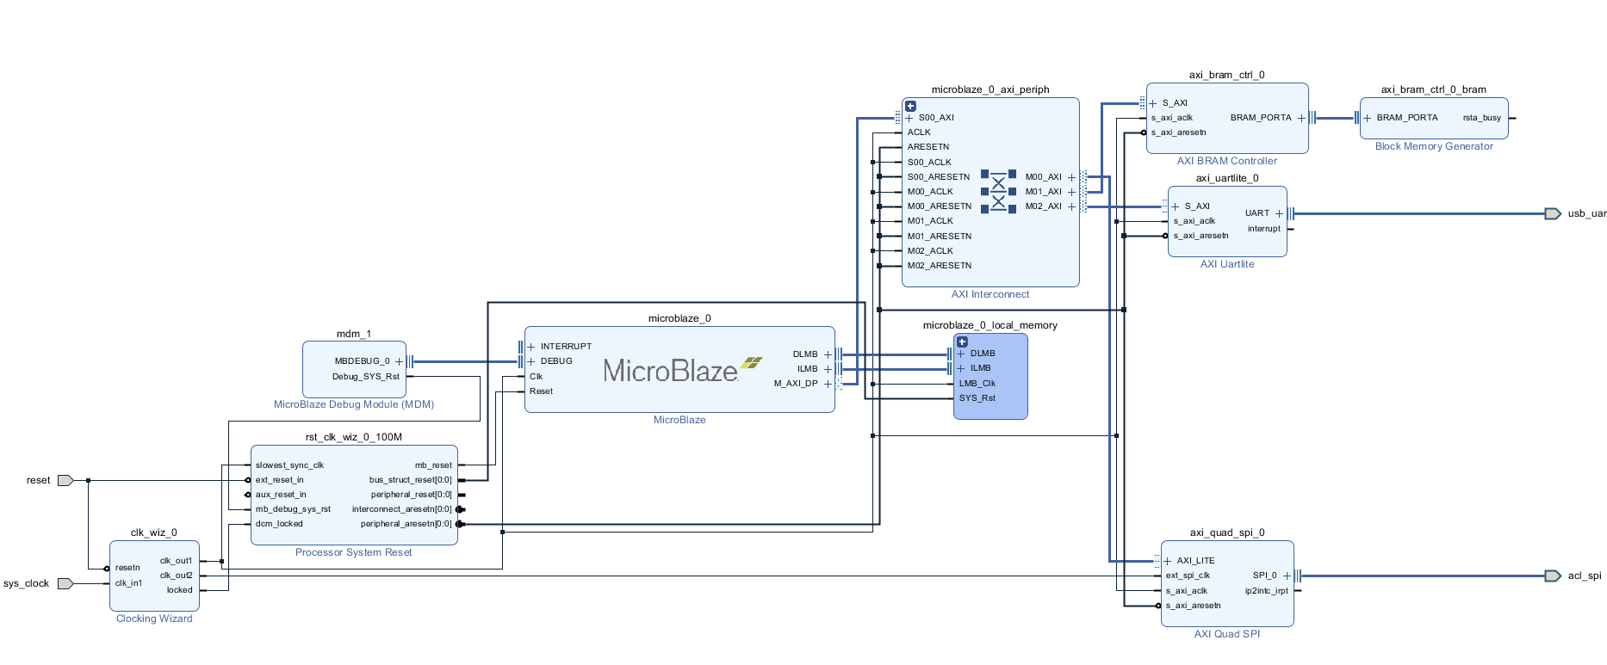
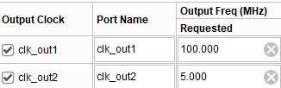

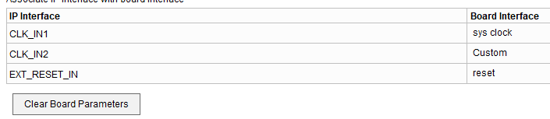
一、硬件设计

Slide 4
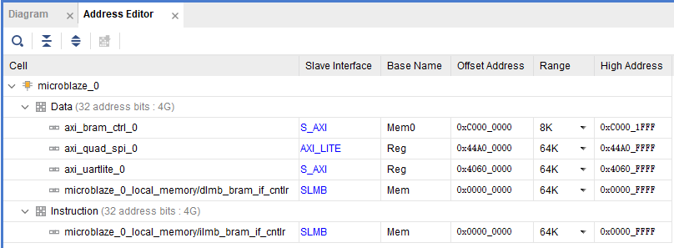
一、硬件设计
地址分配：

Slide 5
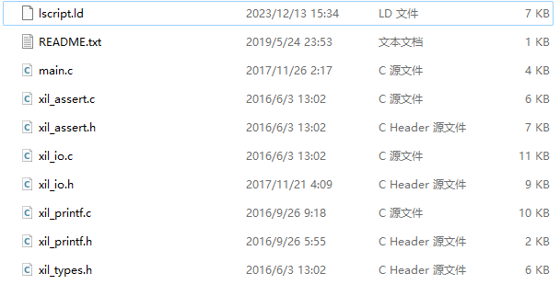
二、软件设计
文件包含如下：

Slide 6
二、软件设计
主函数
#include "xil_printf.h"
#include "xil_io.h"
#define XPAR_SPI_0_BASEADDR 0x44A00000
#define XSP_DGIER_OFFSET 0x1C /**< Global Intr Enable Reg */
#define XSP_IISR_OFFSET 0x20 /**< Interrupt status Reg */
#define XSP_IIER_OFFSET 0x28 /**< Interrupt Enable Reg */
#define XSP_SRR_OFFSET 0x40 /**< Software Reset register */
#define XSP_CR_OFFSET 0x60 /**< Control register */
#define XSP_SR_OFFSET 0x64 /**< Status Register */
#define XSP_DTR_OFFSET 0x68 /**< Data transmit */
#define XSP_DRR_OFFSET 0x6C /**< Data receive */
#define XSP_SSR_OFFSET 0x70 /**< 32-bit slave select */
#define XSP_TFO_OFFSET 0x74 /**< Tx FIFO occupancy */
#define XSP_RFO_OFFSET 0x78 /**< Rx FIFO occupancy */

Slide 7
二、软件设计
#define XSpi_WriteReg(BaseAddress, RegOffset, RegisterValue) \
Xil_Out32((BaseAddress) + (RegOffset), (RegisterValue))
#define XSpi_ReadReg(BaseAddress, RegOffset) \
Xil_In32((BaseAddress) + (RegOffset))
unsigned char read(unsigned char addr);
void write(unsigned char addr, unsigned char data);
int main()
{
xil_printf("device id:%x\n",read(0x00));//打印设备ID
xil_printf("device id:%x\n",read(0x01));
xil_printf("device id:%x\n",read(0x02));
write(0x23,0x96);//写入数据
write(0x25,0x03);
write(0x27,0x0c);
write(0x2a,0x20);
write(0x2c,0x83);
write(0x2d,0x02);
while(1){
xil_printf("device x:%x\n",read(0x08));//打印设备X
xil_printf("device y:%x\n",read(0x09));//打印设备Y
xil_printf("device z:%x\n",read(0x0a));//打印设备Z
}
return 0;
}

Slide 8
二、软件设计
unsigned char read(unsigned char addr){
int i;
unsigned char data;
XSpi_WriteReg(XPAR_SPI_0_BASEADDR, XSP_CR_OFFSET,0x1c6);//写寄存器
XSpi_WriteReg(XPAR_SPI_0_BASEADDR, XSP_SSR_OFFSET,0x1);
XSpi_WriteReg(XPAR_SPI_0_BASEADDR, XSP_CR_OFFSET,0x186);
XSpi_WriteReg(XPAR_SPI_0_BASEADDR, XSP_SSR_OFFSET,0x0);
XSpi_WriteReg(XPAR_SPI_0_BASEADDR, XSP_CR_OFFSET,0x086);
XSpi_WriteReg(XPAR_SPI_0_BASEADDR, XSP_DTR_OFFSET,0x0b);
for(i = 0 ; i <10000; i++){continue;}
XSpi_ReadReg(XPAR_SPI_0_BASEADDR, XSP_DRR_OFFSET);
XSpi_WriteReg(XPAR_SPI_0_BASEADDR, XSP_DTR_OFFSET,addr);
for(i = 0 ; i <10000; i++){continue;}
XSpi_ReadReg(XPAR_SPI_0_BASEADDR, XSP_DRR_OFFSET);//读寄存器
XSpi_WriteReg(XPAR_SPI_0_BASEADDR, XSP_DTR_OFFSET,0xff);
for(i = 0 ; i <10000; i++){continue;}
data = XSpi_ReadReg(XPAR_SPI_0_BASEADDR, XSP_DRR_OFFSET);
XSpi_WriteReg(XPAR_SPI_0_BASEADDR, XSP_SSR_OFFSET,0x0);
XSpi_WriteReg(XPAR_SPI_0_BASEADDR, XSP_CR_OFFSET,0x186);
return data;
}
void write(unsigned char addr,unsigned char data){
int i;
XSpi_WriteReg(XPAR_SPI_0_BASEADDR, XSP_CR_OFFSET,0x1c6);//写寄存器
XSpi_WriteReg(XPAR_SPI_0_BASEADDR, XSP_SSR_OFFSET,0x1);
XSpi_WriteReg(XPAR_SPI_0_BASEADDR, XSP_CR_OFFSET,0x186);
XSpi_WriteReg(XPAR_SPI_0_BASEADDR, XSP_SSR_OFFSET,0x0);
XSpi_WriteReg(XPAR_SPI_0_BASEADDR, XSP_CR_OFFSET,0x086);
XSpi_WriteReg(XPAR_SPI_0_BASEADDR, XSP_DTR_OFFSET,0x0a);
for(i = 0 ; i <10000; i++){continue;}
XSpi_ReadReg(XPAR_SPI_0_BASEADDR, XSP_DRR_OFFSET);//读寄存器
XSpi_WriteReg(XPAR_SPI_0_BASEADDR, XSP_DTR_OFFSET,addr);
for(i = 0 ; i <10000; i++){continue;}
XSpi_ReadReg(XPAR_SPI_0_BASEADDR, XSP_DRR_OFFSET);
XSpi_WriteReg(XPAR_SPI_0_BASEADDR, XSP_DTR_OFFSET,data);
for(i = 0 ; i <10000; i++){continue;}
XSpi_ReadReg(XPAR_SPI_0_BASEADDR, XSP_DRR_OFFSET);
XSpi_WriteReg(XPAR_SPI_0_BASEADDR, XSP_SSR_OFFSET,0x0);
XSpi_WriteReg(XPAR_SPI_0_BASEADDR, XSP_CR_OFFSET,0x186);
}

Slide 9
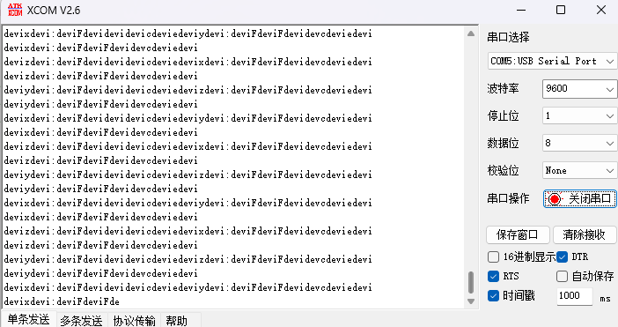
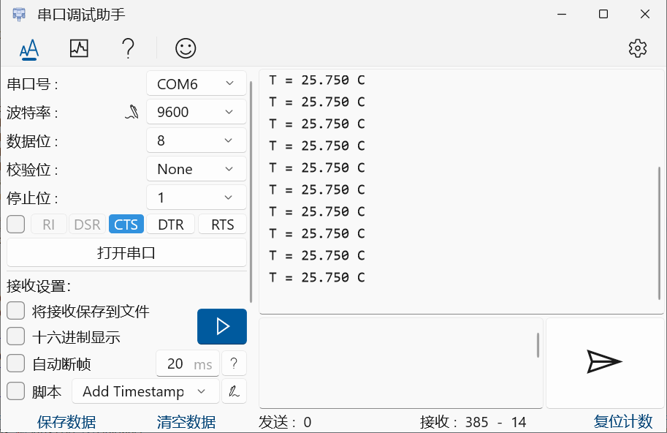
三、实验结果

