Slide 1
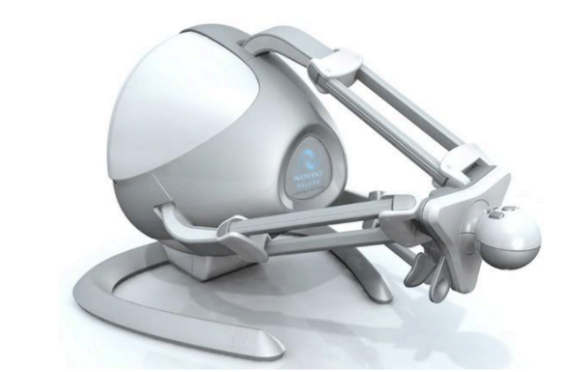
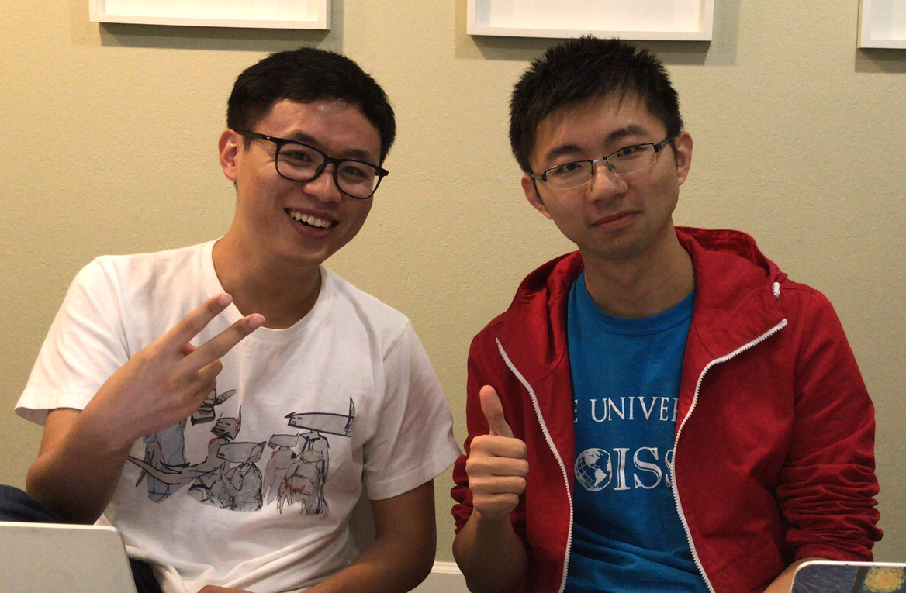

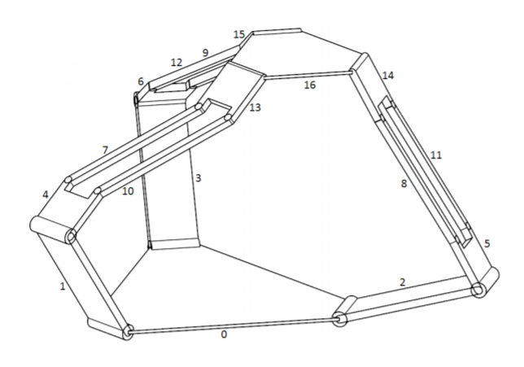
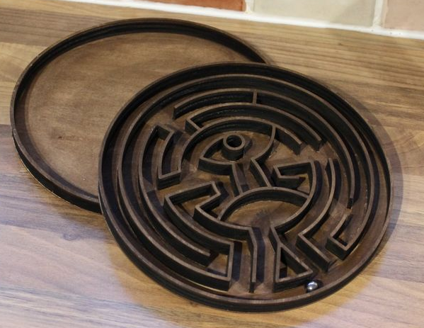
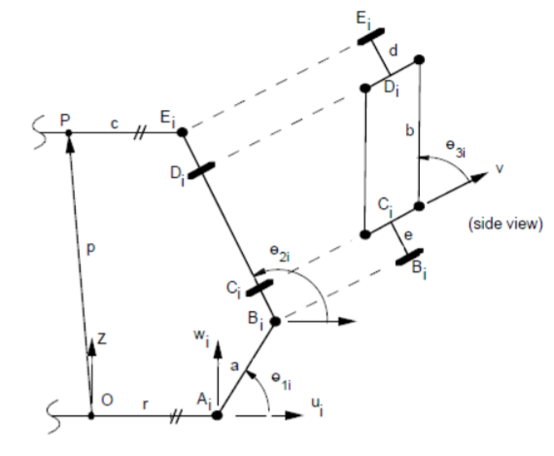
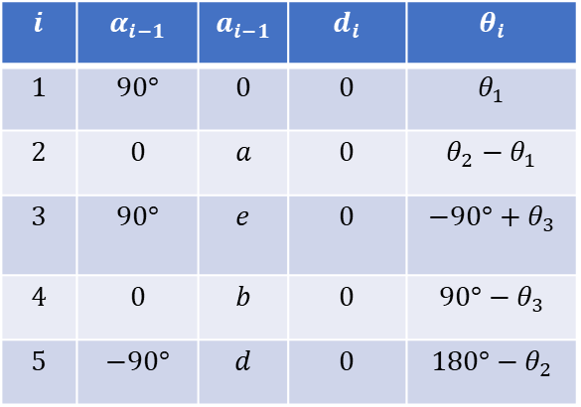
Analysis of Novint Falcon Haptic Device as Manipulator
Sichao Zhang, Peiguang Wang
Rice University, Houston, Texas
Motivation
Result
Novint Falcon is a parallel haptic device that has only three transitional DOFs. In this study, we analyze the Novint Falcon as a 3-DOF manipulator to solve the pinball maze problem.
Video 1 shows the Novint Falcon moves in the expected three dimensional Helix line.
Kinematics
Figure 1. Novint Falcon [1] and Pinball Maze
Approach
Video 1. Novint Falcon Moves in Helix Line
Forward and Inverse Kinematics
Based on Tsai and Stamper’s research on the kinematics configuration [2].
Build DH parameters from the general base to the end effector for each leg.
Solve the inverse kinematics and find the optimal solution in each iteration.
$$i$$ | $$α_{i−1}$$ | $$a_{i−1}$$ | $$d_{i}$$ | $$θ_{i}$$
$$1$$ | $$90°$$ | $$0$$ | $$0$$ | $$θ_{1}$$
$$2$$ | $$0$$ | $$a$$ | $$0$$ | $${θ_{2}−θ}_{1}$$
$$3$$ | $$90°$$ | $$e$$ | $$0$$ | $$−90°+θ_{3}$$
$$4$$ | $$0$$ | $$b$$ | $$0$$ | $$90°−θ_{3}$$
$$5$$ | $$−90°$$ | $$d$$ | $$0$$ | $$180°−θ_{2}$$
Video 2. Novint Falcon Solves Pinball Maze
Figure 2. Kinematics [2] and DH Table
Conclusion
Dynamics and Control
Based on Nima Karbasizadeh team’s work on the dynamic identification of the Novint Falcon. [3]
Apply different control laws to observe the displacement responses.
Simulation shows the end effector moves as expected, which verifies the feasibility of kinematics in former research.
Controls are applied to make the robot move to expected states.
Simulation
Reference
Implement MATLAB codes for the kinematic configuration of the robot.
Make the end effector move in the expected routine and generate a video demo.
Apply control laws to drive the robot to move and solve pinball maze.
[1] Application of the Novint Falcon haptic device as an actuator in real-time control, Daniel J. Block, et. al. DOI: 10.2478/pjbr-2013-0017 JBR · 4(3) · 2013 · 182-193
[2] A Parallel Manipulator with Only Translational Degrees of Freedom, Lung-Wen Tsai, Richard E. Stamper. Technical Research Report
[3] Dynamic Identification of the Novint Haptic Device, Nima Karbasizadeh, et. al. International Conference on Robotics and Mechatronics. October 26-28, 2016, Tehran, Iran.

