Slide 1

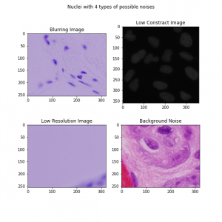
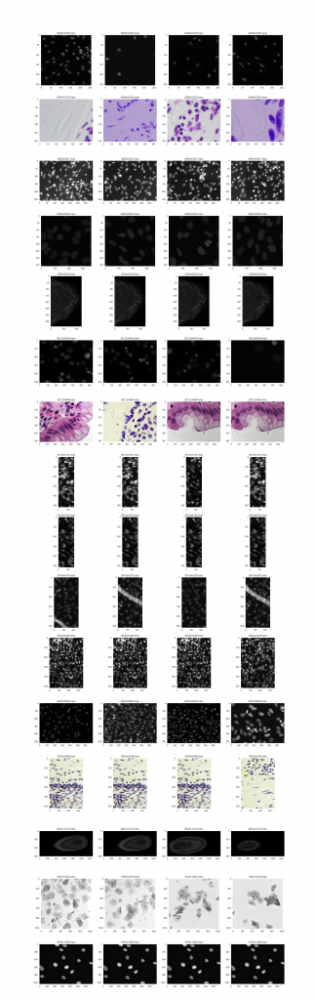
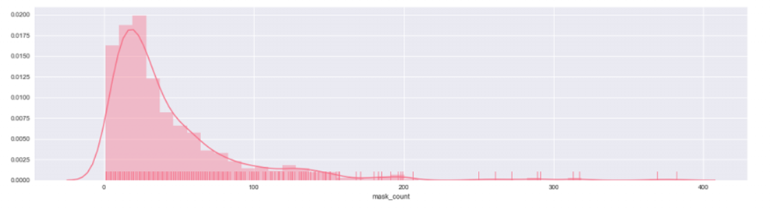
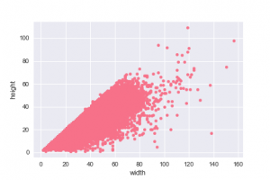
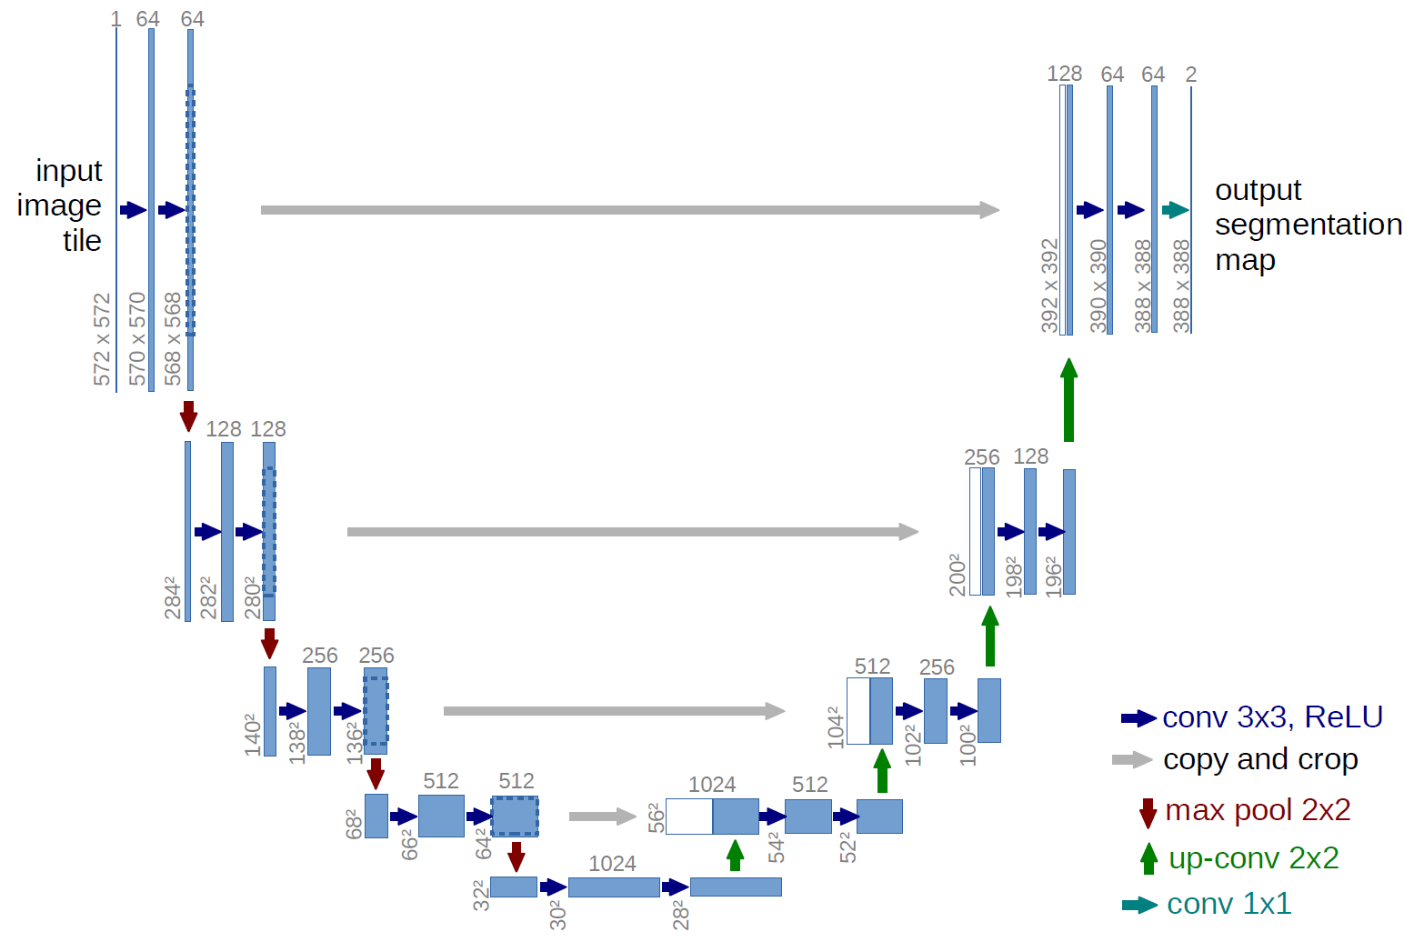
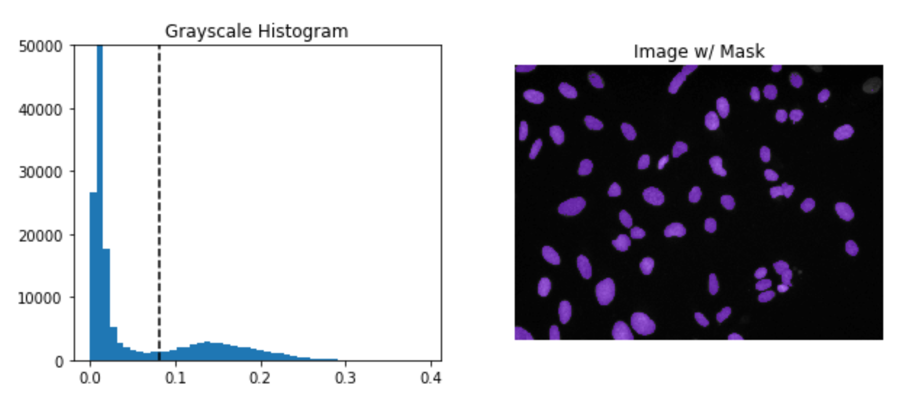
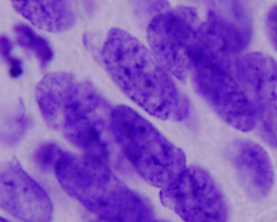
2018 Kaggle Competition
Xinran Zhou(xz60), Peiguang Wang(pw15)
Rice University, Houston, Texas
Project Overview
Problem Description
In this competition, we are asked to create a computer model that can identify a range of nuclei across varied conditions. The program should automatically identify and extract the nuclei area.
Our Work
We first analyze the data and do data exploration. We tried to classified based on size, color, shape number of nuclei, and try to identify the potential noise. We also did statistical analysis on the data. After EDA, We use CV methods and U-Net models to solve the problem. CV methods is trying to solve the problem from the traditional computer vision point of view. U-NET is a modified version of fully connected network, which is considered one of standard architectures for image classification tasks. We train our network in Google “colab” platform and do prediction on test set locally.
Result
We submit 11 times in stage 1 and we submitted 1 time in stage 2. Stage 1 score(highest) is 0.344. Our stage 2 score is 0.44. Our Rank is 392/861.
Workflow
Data Analysis & preprocessing
Data
Preprocessing
Model
Postprocessing
Output
4 important EDA results
Potential Noise
Different Sizes
Nuclei number distribution
Pre-processing: Do preprocessing to the raw data. This includes resizing the original images, image normalization, and transform the data into the desired representation. In U-Net model, transform the data into a matrix; in CV model, we also need to compute the histogram of the image.
Model: We used CV model and U-Net network model.
Post-processing: Do postprocessing to the outcome from the model. This includes resizing the masks, augmenting the masks, and line encoding the results.
Height & Width distribution
U-Net Model
CV Methods
Load in raw data
Overview
CV method is to setup a reasonable threshold and set pixels that above the threshold to 1. The CV method achieves 0.22 accuracy (stage 1 score).
How to choose a reasonable threshold
Assumption (1): Assume that the background pixels are more than nuclei pixels and remove the background based on this.
Assumption (2): Treats the image histogram as two additive distributions.
Find threshold value based on Otsu’s method.
Why it fails
The first assumption can be wrong. Some special cases that CV method will fail. Image below shows a failure case.
Resizing images and masks
Images: 384*384*3 Masks: 384*384*1
Normalize the images and masks
Images: convert pixel values from[0,255] to [0,1]
Invert images that each one has a dark background
Masks: set the pixel to be either 0 or 1
U-Net Introduction and Features
U-NET is considered one of standard architectures for image classification tasks.
In the up-sampling part, a large number of feature channels is added to the original channels. It allows the network to propagate context information to higher resolution layers.
The network does not have any fully connected layers and only use the valid part of each convolution.
Cross-validation
Fold = 10
Feed the data to U-net model
Load model and make test predictions
Resizing the predicted masks to original size
Grayscale Histogram
After Removing Background
Apply run-length encoding for the submitting file
U-Net Workflow
Special Case for CV method
Improvements on U-Net
Submit History & Result
How to Overcome Overfit
Add dropout in our model. This is implemented by only keeping a neuron active with some probability p or setting it to zero otherwise.
“Early stop” trick. This trick saves the best model every epoch and stop if the accuracy in validation set does not decrease.
In our final model, the dropout rate is set to 0.3.
Learning Rate Adjustment
Reduce Learning periodically. Starting from learning rate of 0.0015, and after every 3 epochs, we reduce the learning rate of 40%.
Other Improvements
We trained the model for 10 epochs and add early stop to save the best result
Update score metric
Submitting History
We submit 11 times in stage 1 and we submitted 1 time in stage 2.
Submit # | Stage | Model | Score | Milestone
1 | Stage 1 | CV | 0.18
2 | Stage 1 | CV | 0.22 | Normalization
3 | Stage 1 | U-Net | 0.286
4 | Stage 1 | U-Net | 0.289 | Epochs
5 | Stage 1 | U-Net | 0.311 | Resize
6 | Stage 1 | U-Net | 0.328 | Dropout rate
7 | Stage 1 | U-Net | 0.320
8 | Stage 1 | U-Net | 0.336 | Learning rate
9 | Stage 1 | U-Net | 0.322
10 | Stage 1 | U-Net | 0.340
11 | Stage 1 | U-Net | 0.344
12 | Stage 2 | U-Net | 0.44
Stage 1
Stage 2
Result
Stage 1 score(highest) is 0.344
Stage 2 score is 0.44.
Rank 392/861.

