Slide 1

Measurement Of Code Duplication
GROUP 3: Dr. Java

Slide 2
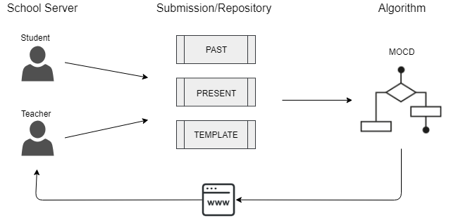
Components Process Overview
Frontend (School Server)
React
PHP, Python, PostgreSQL
Anonymization
Backend
Java
Algorithm

Slide 3
Frontend
React on the web
PHP, Python, PostgreSQL
Zip file management
Admin management

Slide 4
Anonymization
Immediately
Database level
File names are not anonymized
File contents are anonymized

Slide 5
Between Server Communication
Java Sockets
JSON
ZIP
Authorization

Slide 6
Features
Input
Template (exclude)
Past (include)
Present
Between language comparison
Gradients (granularity)

Slide 7
Algorithm
Desired Properties
Whitespace
Noise Suppression
Positional Independence
Processing and Parsing
Winnowing
Output

Slide 8

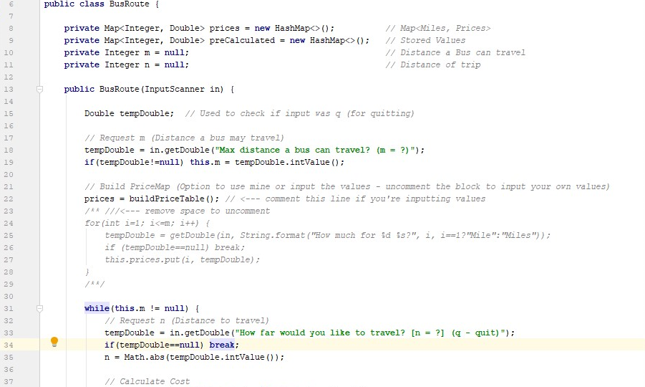
Example:
Java
(Source)

Slide 9
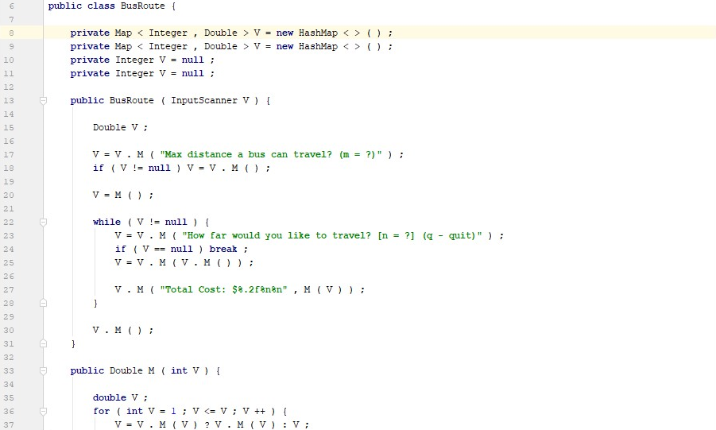
Example:
Java
(Intermediate)

Slide 10
User Interface (Storyboard)
Log-In Page
Submission Page
Result(Output Page)

Slide 11
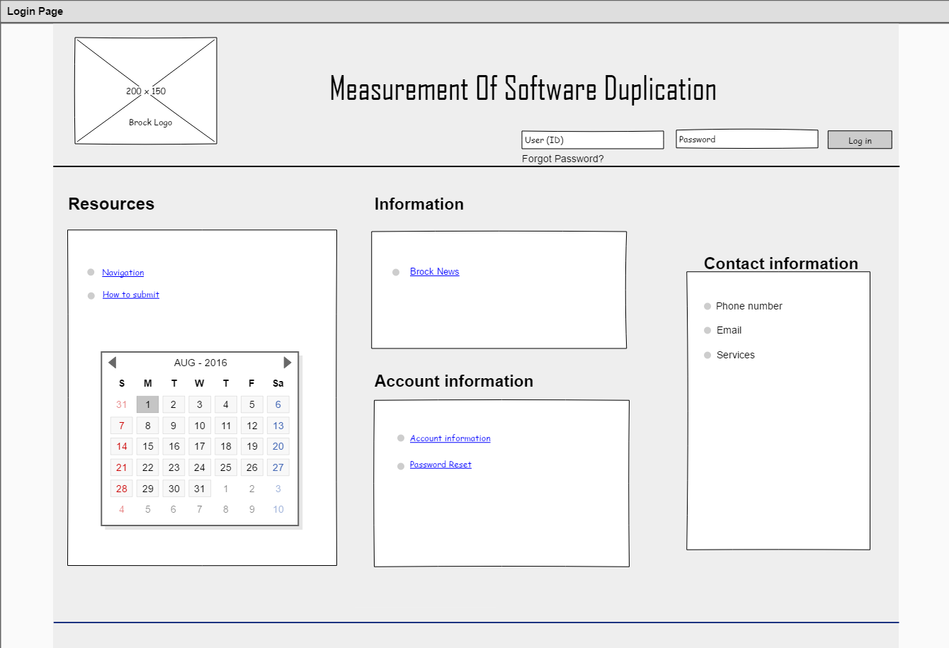
Log-In Page

Slide 12
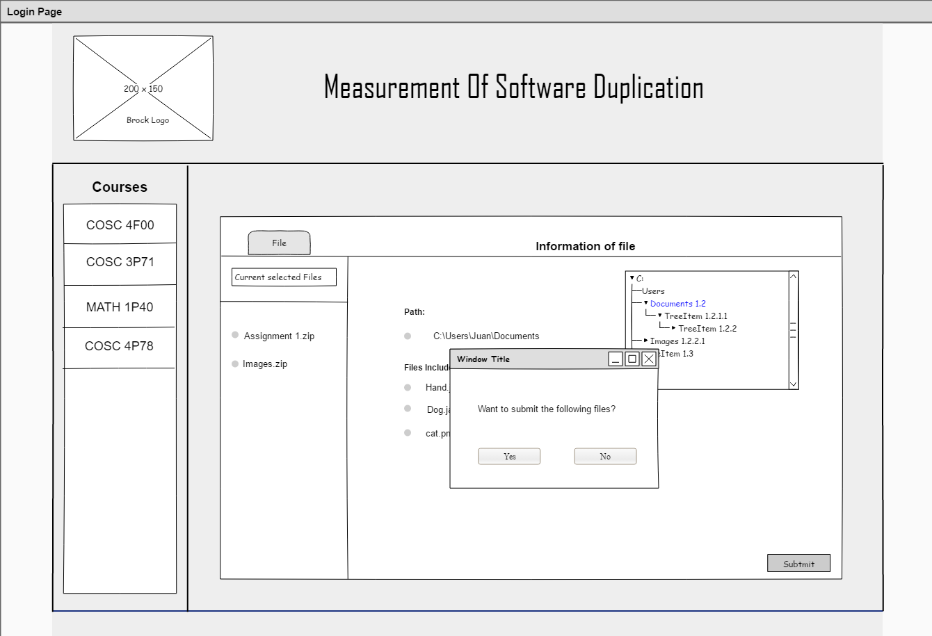
Submission Page

Slide 13
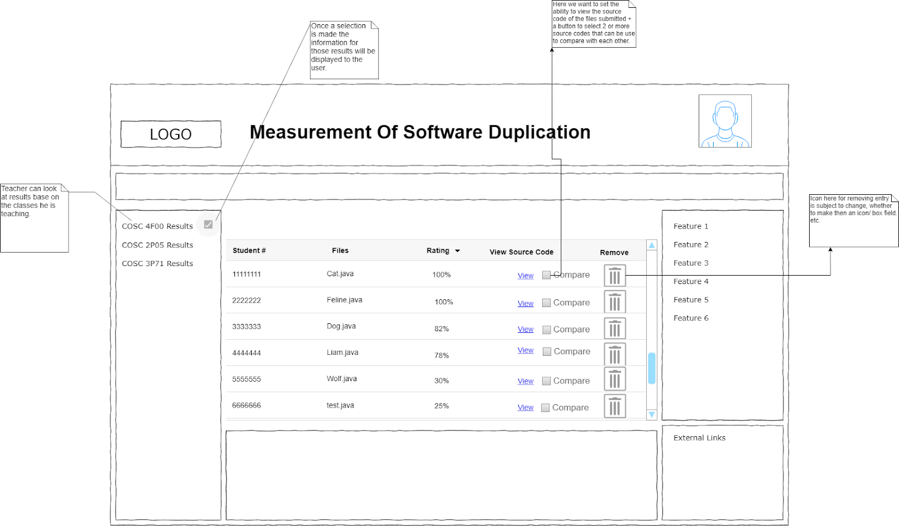
Result Page

Slide 14
Discussion
Things to improve on
Implementation changes
Any problems with our approach
Thoughts?

Slide 15
Credits
https://github.com/Treleaven6/COSC-4F00
Jensen Hung, Liam Marcassa, Tina Pazaj, Jesse Treleaven, Juan Manuel Vallecilla, Ji Wang

