Slide 1


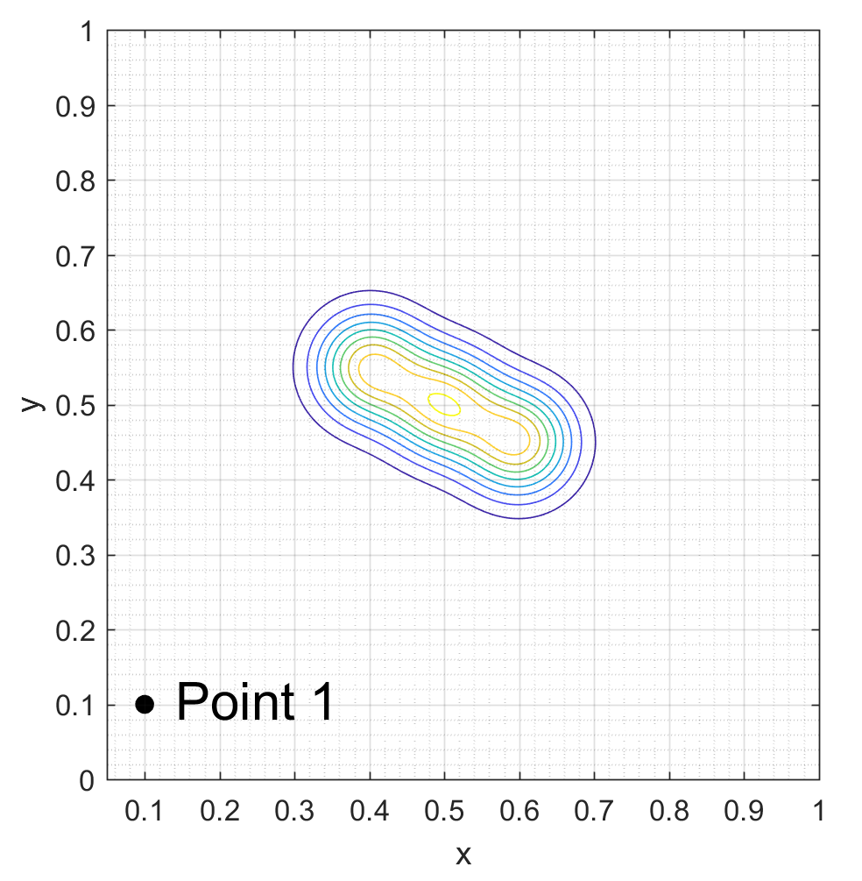
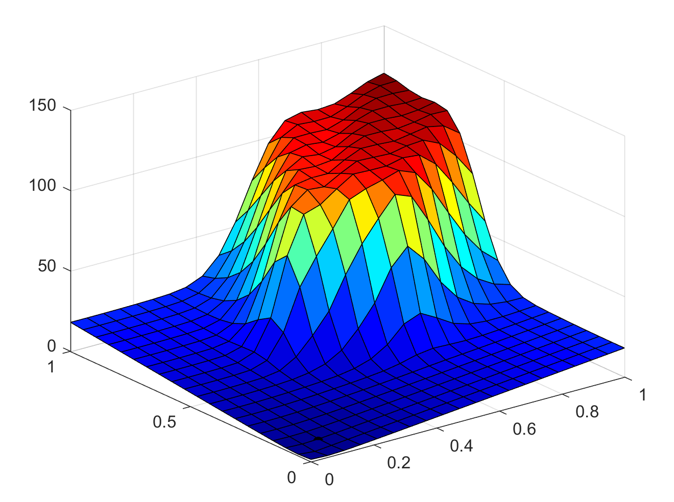
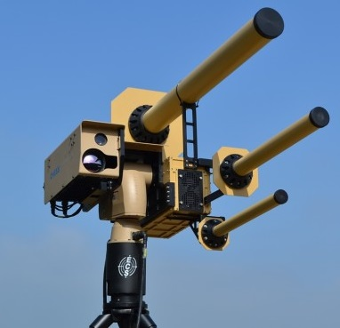
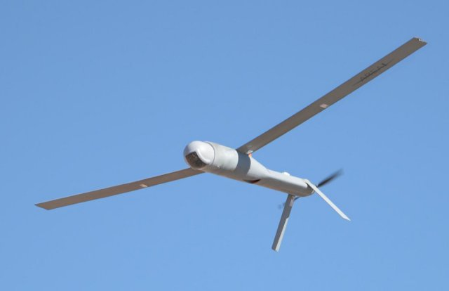
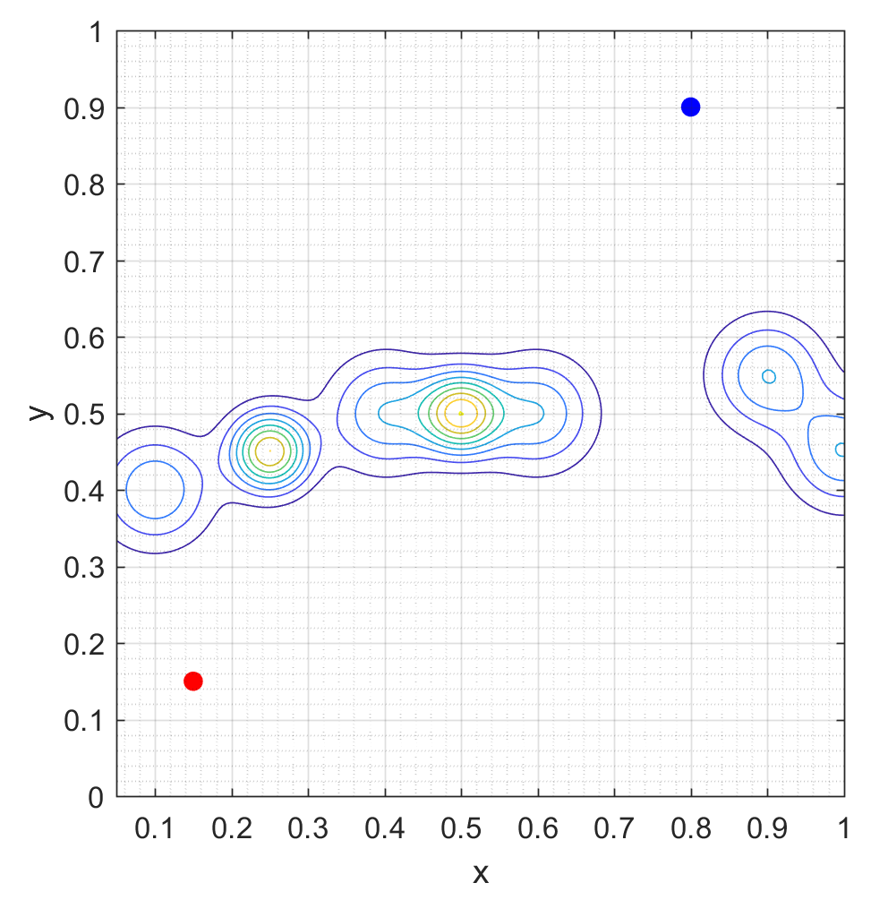
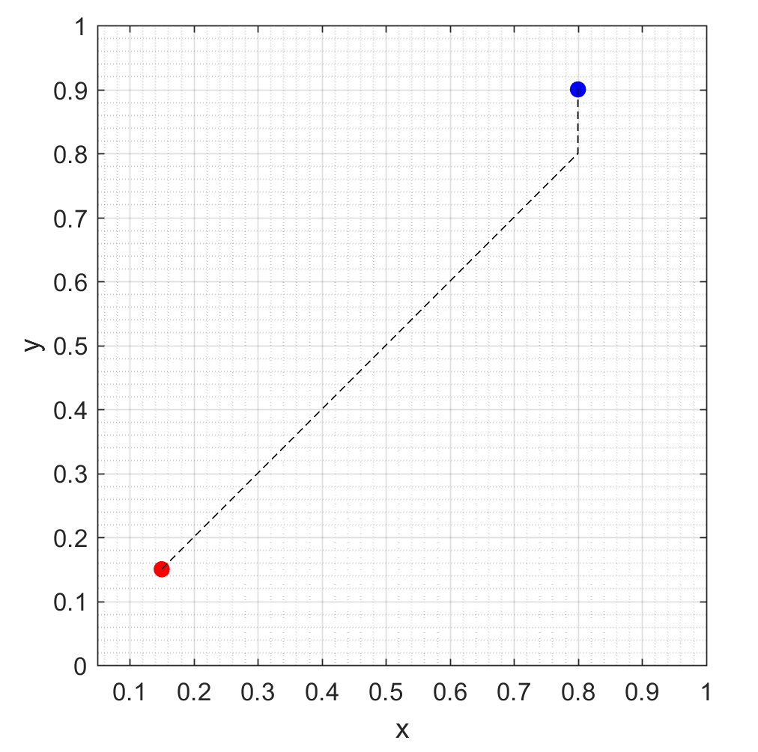
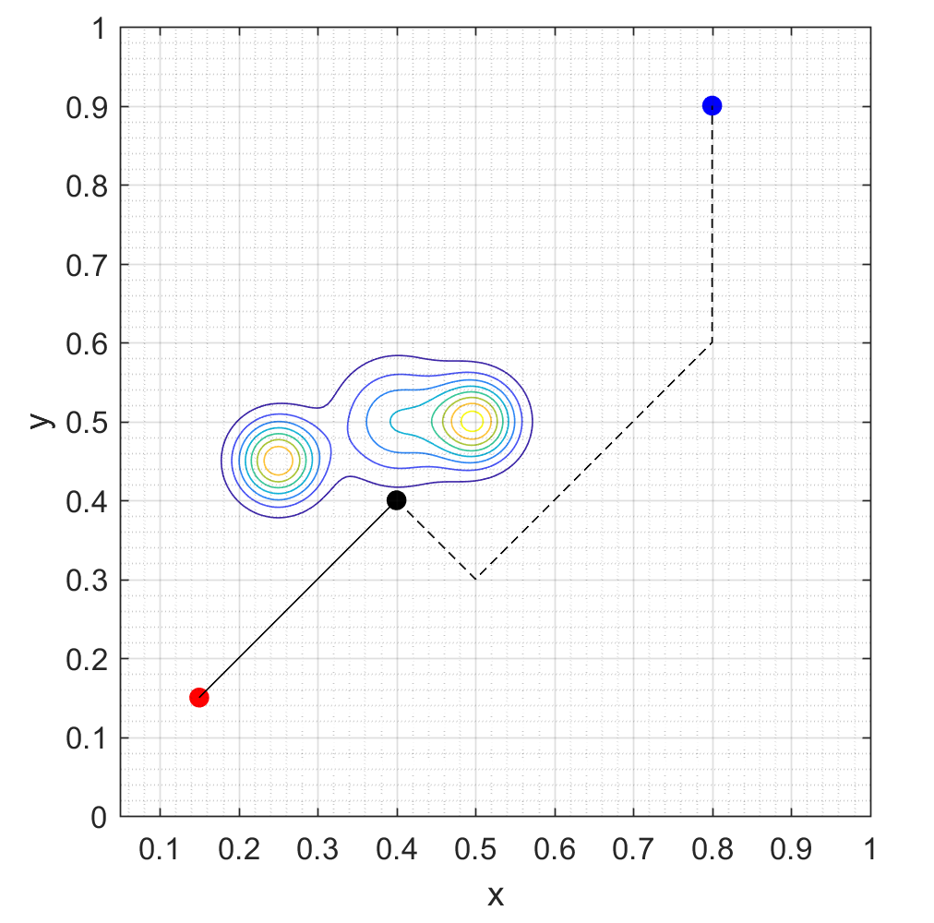
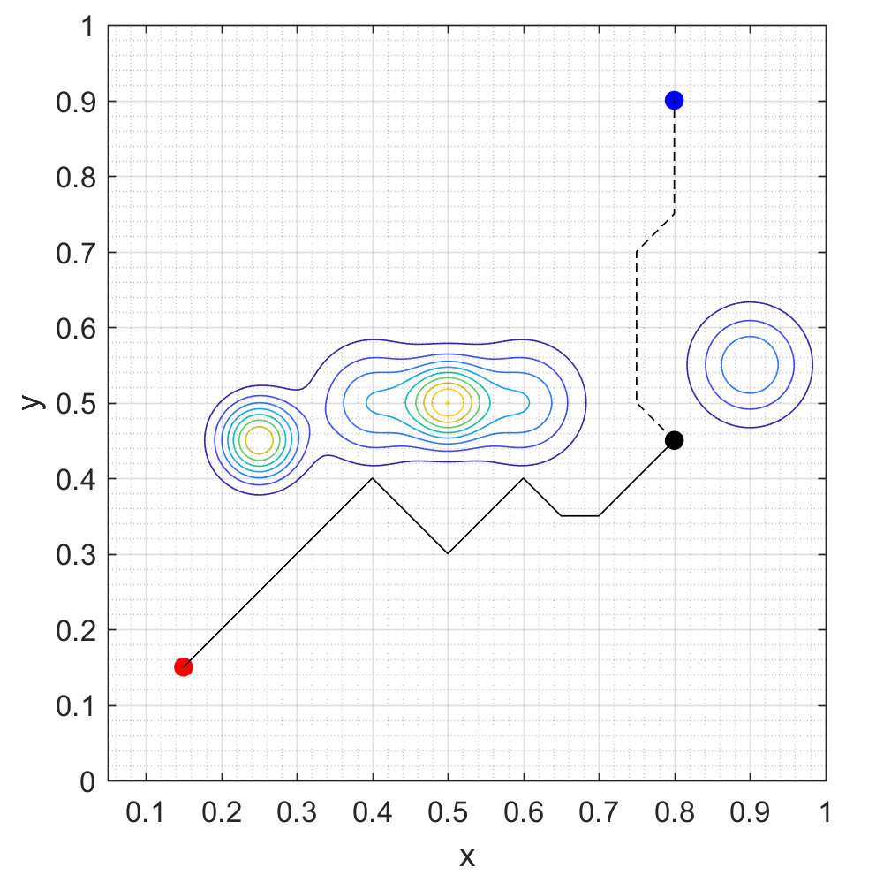
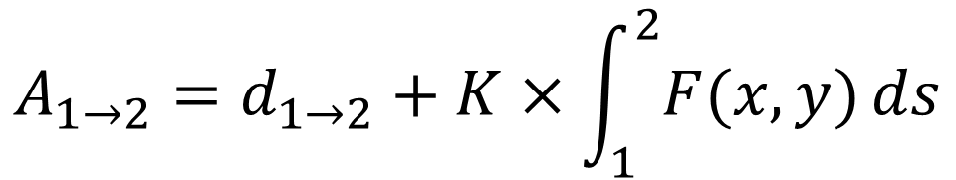
Adaptive Multi-Agent Path Planning for
Distributed UAV Systems
Lloyd Maza (lmaza) and Cameron McMillan (cmac12)
CS 229 Final Project, Autumn 2017
Motivation
Method
Conclusions
Proliferation of low cost UAVs allows them to explore more dangerous environments. Novel path planning algorithms are needed to control these UAVs.
Problems:
Unknown risk environment
Real time planning
Multiple cooperative agents
Multiple targets
Cooperative and Geometric Learning Algorithm (CGLA) ^{[2]}
Offshoot of Q-learning
Balance between minimizing path length and minimizing risk
Simplifies information sharing between agents
Generate risk map (A) of the known environment
Generate cost matrix (G)
Execute path planning
If an unmodeled threat is discovered, repeat from step 1
$$A_{1→2}=d_{1→2}+K×\int_{1}^{2}{F(x,y)}ds$$
Results
Scenario
Learning an Unknown Environment
Future Work
The environment is initialized with a group of unseen threats
Scenario Environment
Unknown environment with threats representing anti-air/jamming
Realistic observation radius to discover threats
Must visit all targets in each scenario
CGLA is iteratively executed to update the path as the agent encounters unseen threats
References
[1]: Zhang, B., Mao, Z., Liu, W., et. al. "Geometric Reinforcement Learning for Path
Planning of UAVs," Journal of Intelligent and Robotic Systems, Volume 77, No. 2,
2015, pp 391–409.
[2]: Zhang, B., Mao, Z., Liu, W., et. al. "Cooperative and Geometric Learning Algorithm
(CGLA) for path planning of UAVs with limited information," Automatica, Volume
50, No. 3, 2014, pp 809-820.

Slide 2
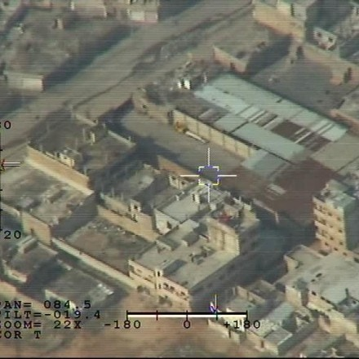
Adaptive Multi-Agent Path Planning for
Distributed UAV Systems
Lloyd Maza (lmaza) and Cameron McMillan (cmac12)
CS 229 Final Project, Autumn 2017
Motivation
Method
Conclusions
Proliferation of low cost UAVs allows them to explore more dangerous environments. Novel path planning algorithms are needed to control these UAVs.
Problems:
Unknown risk environment
Real time planning
Multiple cooperative agents
Multiple targets
Cooperative and Geometric Learning Algorithm (CGLA) ^{[2]}
Offshoot of Q-learning
Balance between minimizing path length and minimizing risk
Simplifies information sharing between agents
Generate risk map (A) of the known environment
Generate cost matrix (G)
Execute path planning
If an unmodeled threat is discovered, repeat from step 1
$$A_{1→2}=d_{1→2}+K×\int_{1}^{2}{F(x,y)}ds$$
Results
Scenario
Learning an Unknown Environment
Information Sharing in an Unknown Environment
Multiple Target – Multiple UAV
Environment
Future Work
Threats such as anti-air and terrain are initially unknown to UAVs. Must be discovered.
The environment is initialized with a group of unseen threats
Scenario with one UAV must discover all threats as it encounters them
Scenario with only one UAV
Targets are initially known to UAVs. Scenario runs until UAVs have visited all targets or run out of fuel.
CGLA is iteratively executed to update the path as the agent encounters unseen threats
UAVs share risk information as it’s discovered, speeding up target observation
Efficient target assignment speeds up the target observation with multiple UAVs
References
UAVs have realistic observation radii and fuel capacity. UAVs can share threat information.
[1]: Zhang, B., Mao, Z., Liu, W., et. al. "Geometric Reinforcement Learning for Path
Planning of UAVs," Journal of Intelligent and Robotic Systems, Volume 77, No. 2,
2015, pp 391–409.
[2]: Zhang, B., Mao, Z., Liu, W., et. al. "Cooperative and Geometric Learning Algorithm
(CGLA) for path planning of UAVs with limited information," Automatica, Volume
50, No. 3, 2014, pp 809-820.

Slide 3
Image source - https://www.uasvision.com/2017/05/22/us-air-force-research-lab-to-extend-aircraft-isr-range/
https://www.uasvision.com/2015/10/12/anti-uav-defence-system-upgraded/
https://theintercept.com/2016/01/28/hacked-images-from-israels-drone-fleet/

