Slide 1


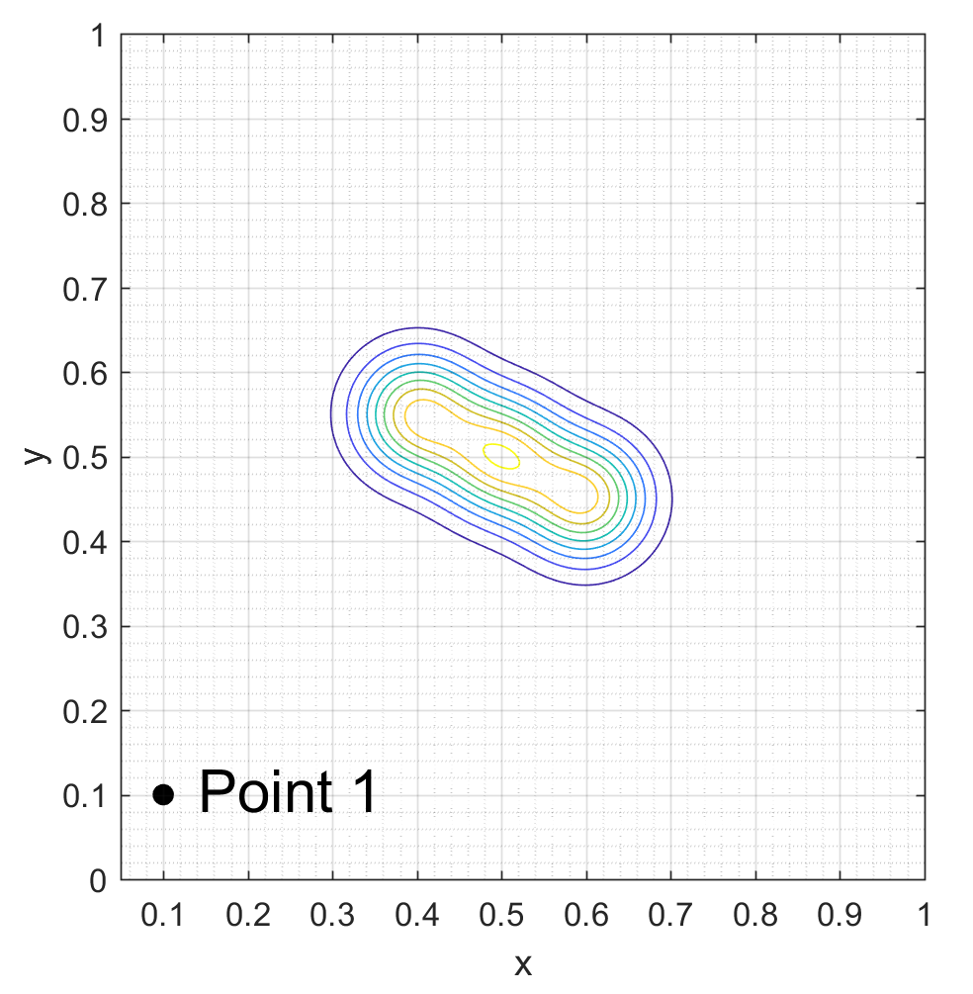
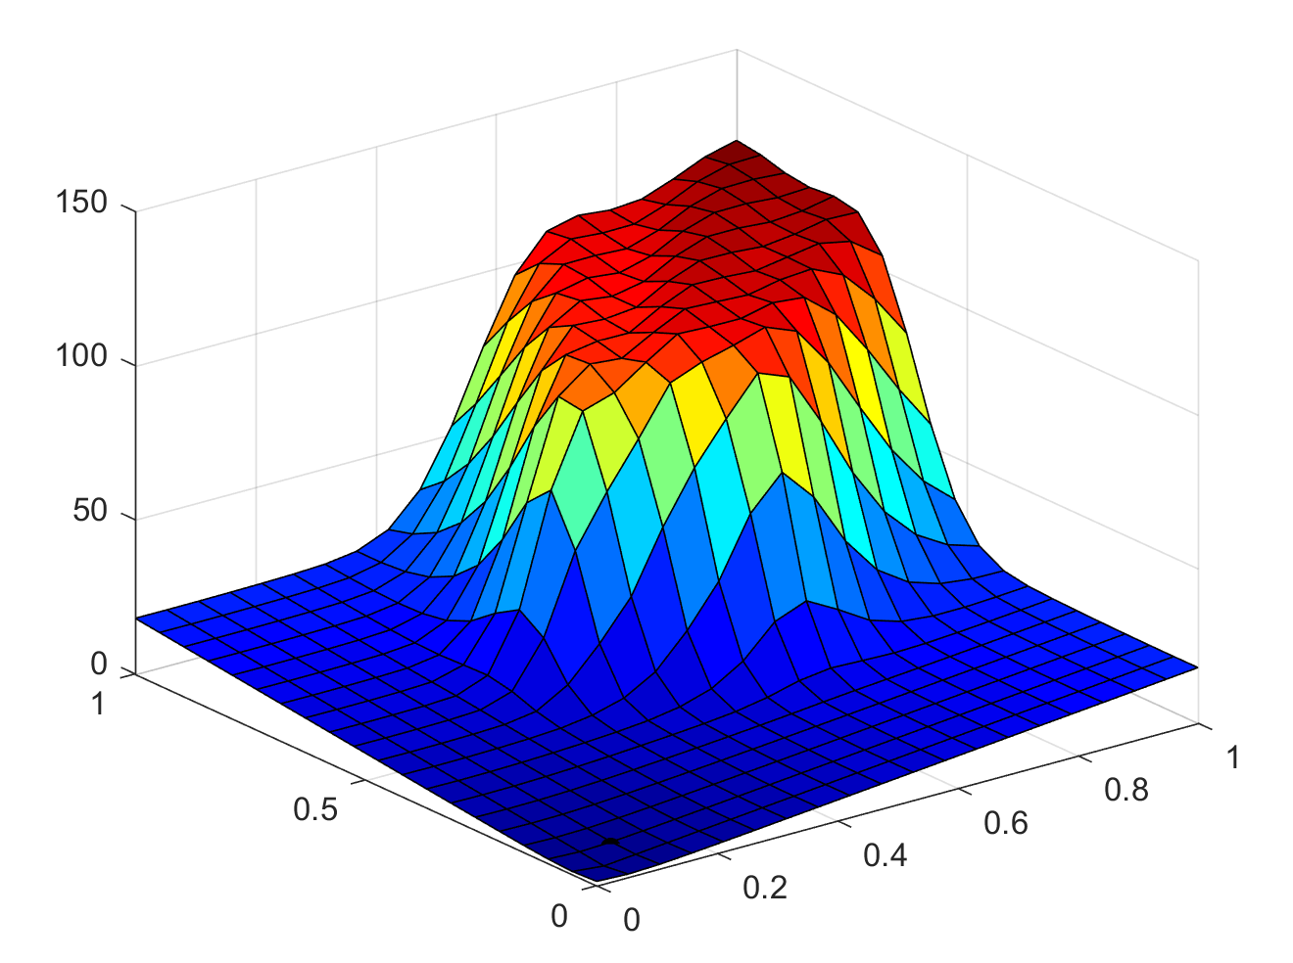
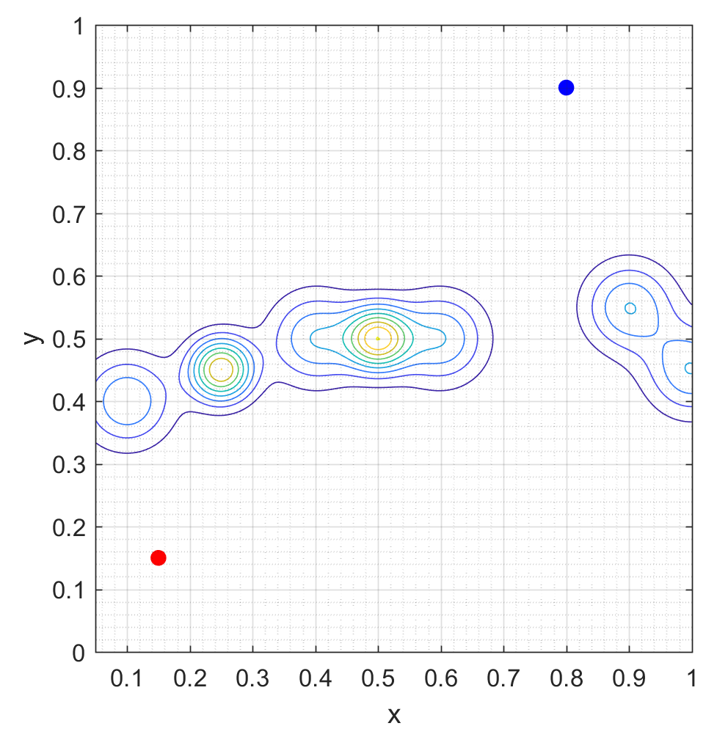
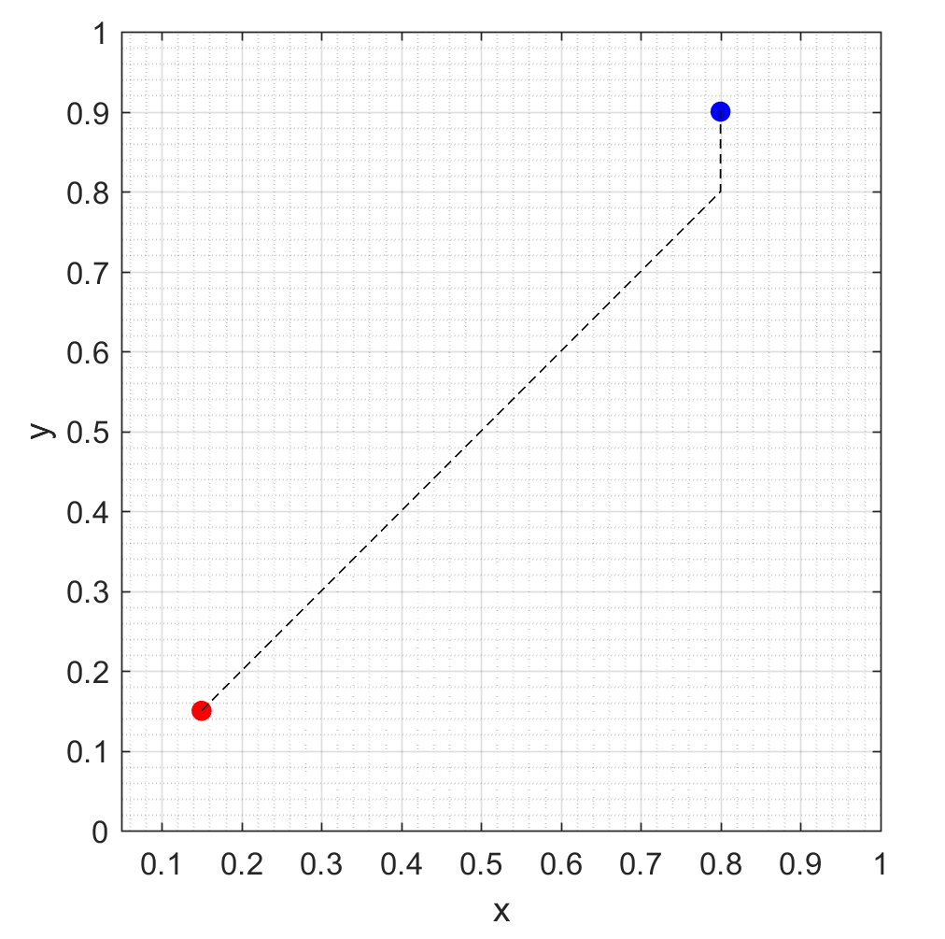
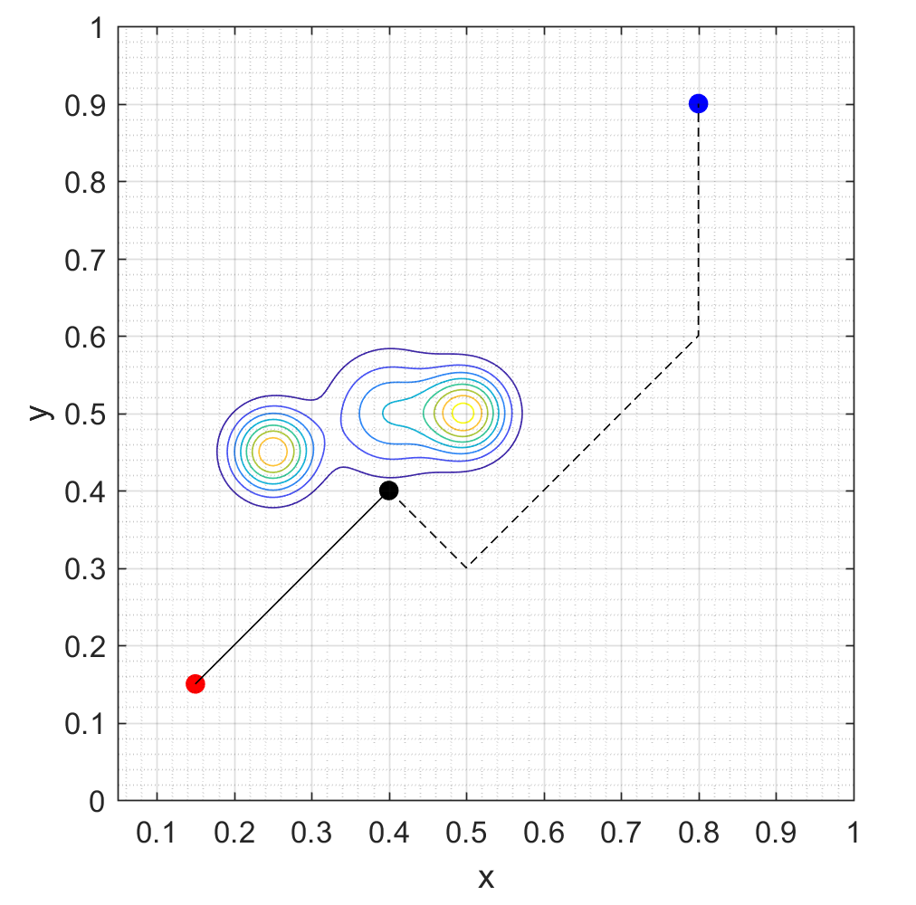
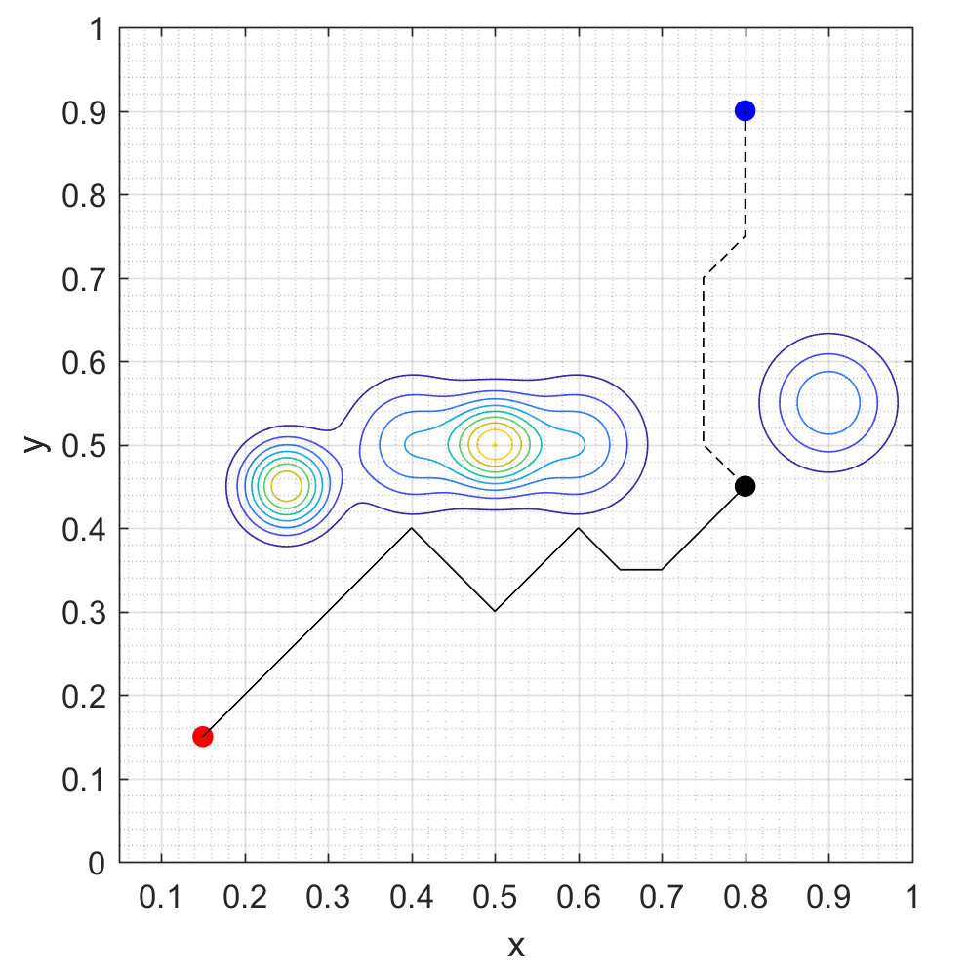
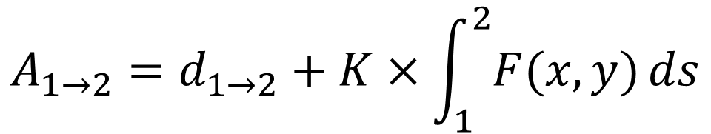
Adaptive Multi-Agent Path Planning for
Distributed UAV Systems
Lloyd Maza (lmaza) and Cameron McMillan (cmac12)
CS 229 Final Project, Autumn 2017
Motivation
Method
Conclusions
Cooperative and Geometric Learning Algorithm (CGLA) ^{[2]}
Offshoot of Q-learning
Balance between minimizing path length and minimizing risk
Simplifies information sharing between agents
Generate risk map (A) of the known environment
Generate cost matrix (G)
Execute path planning
If an unmodeled threat is discovered, repeat from step 1
$$A_{1→2}=d_{1→2}+K×\int_{1}^{2}{F(x,y)}ds$$
Results
Scenario
Learning an Unknown Environment
Future Work
The environment is initialized with a group of unseen threats
CGLA is iteratively executed to update the path as the agent encounters unseen threats
References
[1]: Zhang, B., Mao, Z., Liu, W., et. al. "Geometric Reinforcement Learning for Path
Planning of UAVs," Journal of Intelligent and Robotic Systems, Volume 77, No. 2,
2015, pp 391–409.
[2]: Zhang, B., Mao, Z., Liu, W., et. al. "Cooperative and Geometric Learning Algorithm
(CGLA) for path planning of UAVs with limited information," Automatica, Volume
50, No. 3, 2014, pp 809-820.

