Slide 1


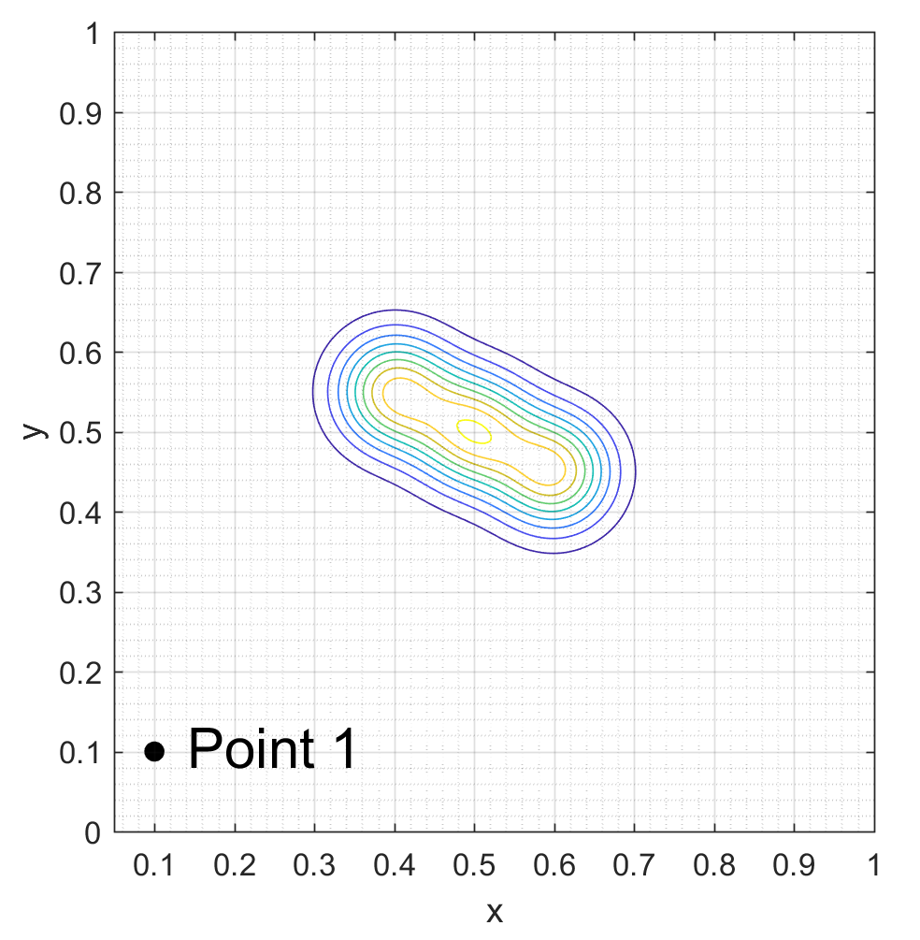
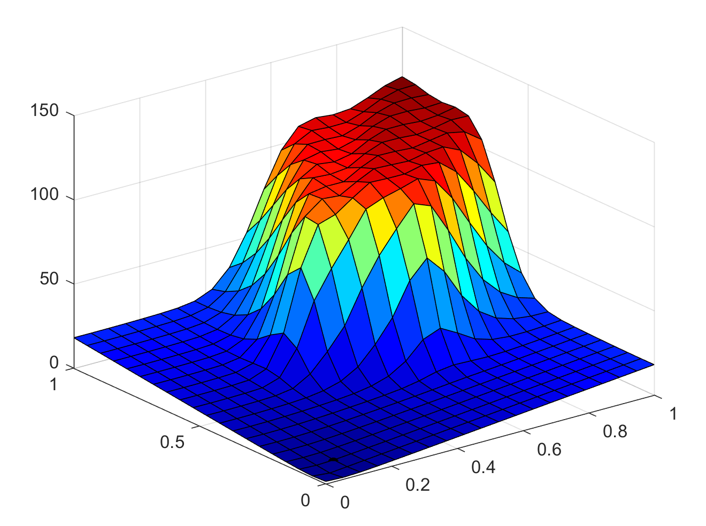
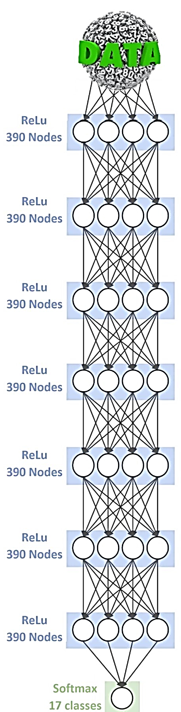
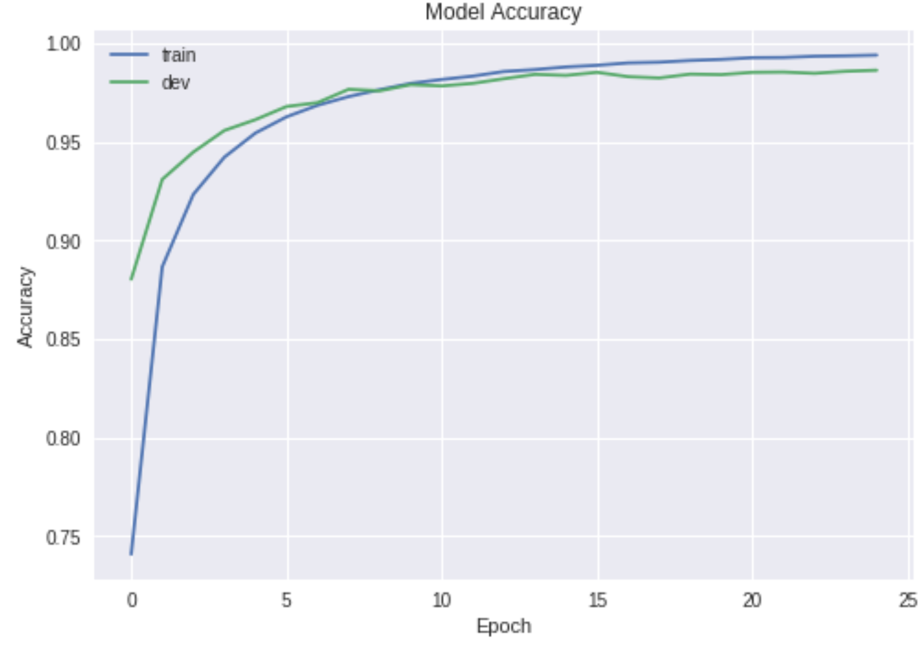
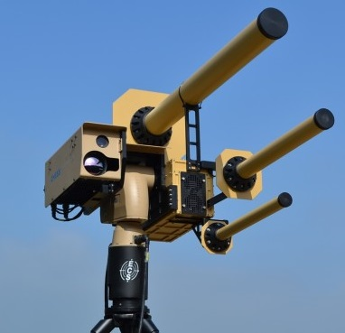
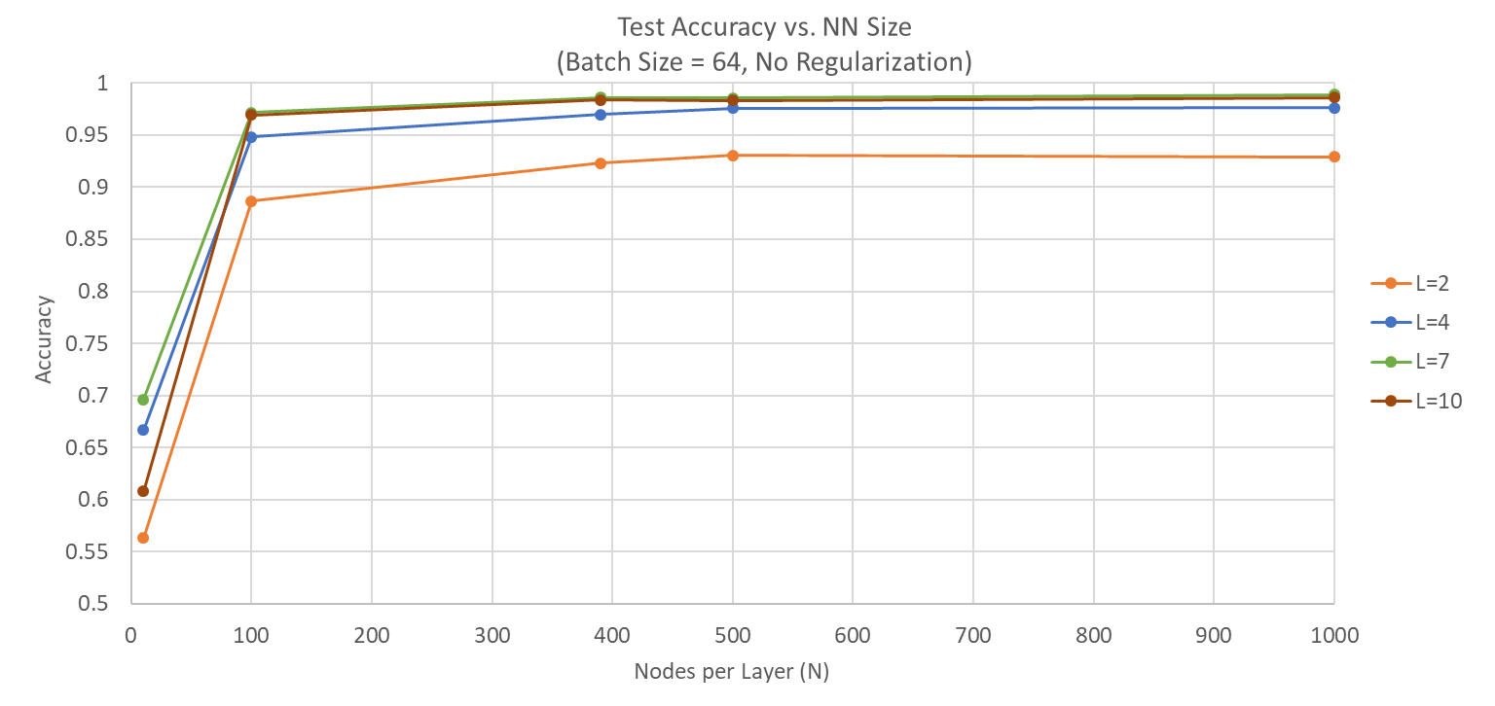
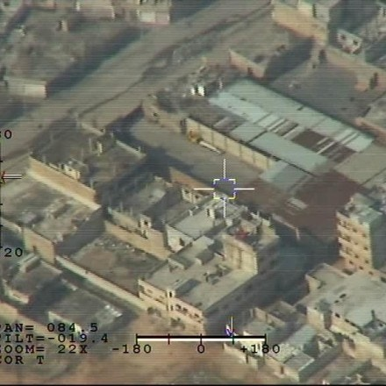
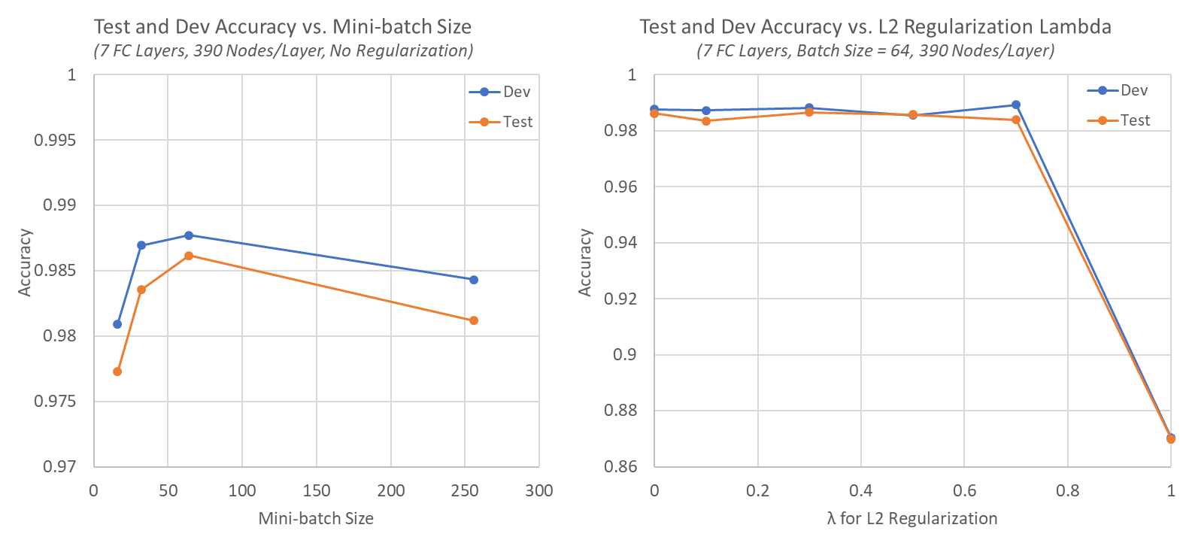
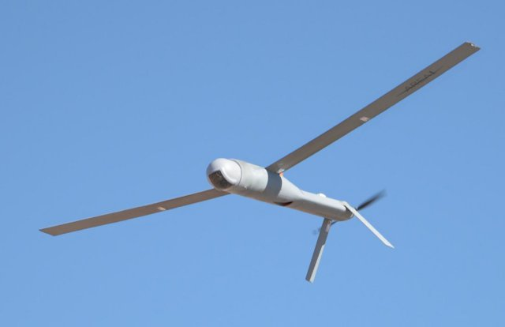
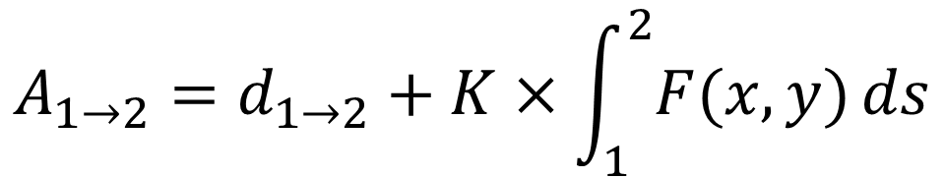
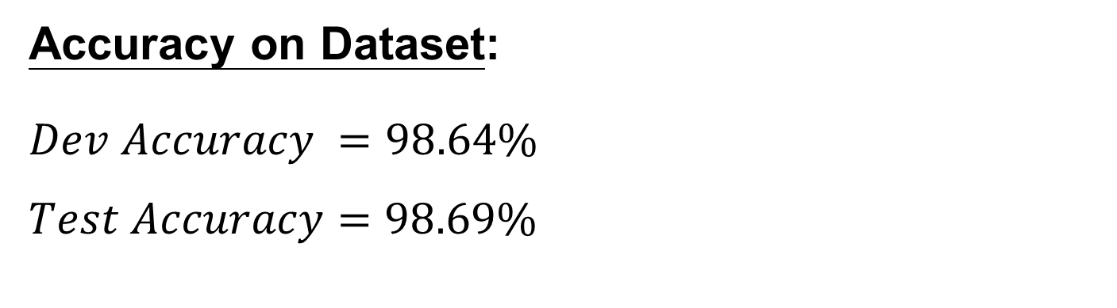

Intelligent Voice Identification
with Neural Networks
Lloyd Maza (lmaza) - Michael Thompson (mt1) - David Troner (dtroner)
CS 230 Final Project, Winter 2018
Motivation
Pre-Processing
Conclusions
Proliferation of low cost UAVs facilitates the exploration of more dangerous environments. Novel path planning algorithms are needed to control these UAVs.
Problems:
Unknown risk environment
Real time planning
Multiple cooperative agents
Multiple targets
Cooperative and Geometric Learning Algorithm (CGLA) ^{[2]}
Offshoot of Q-learning
Use UAV positions as states
Balance between minimizing path length and minimizing risk
Simplifies information sharing between agents
Generate risk map (A) of the known environment
Generate cost matrix (G)
Execute path planning
If an unmodeled threat is discovered, repeat from step 1
$$A_{1→2}=d_{1→2}+K×\int_{1}^{2}{F(x,y)}ds$$
CGLA does a great job of facilitating complex distributed tasks for UAV systems
Handles an unknown dynamic environment robustly
Easily allows many UAVs to cooperate on their tasks
Algorithm runs quite slowly and may not work well for very large or finely discretized maps
Threat distribution
Risk map
Architecture
Results
Dataset
Neural Network Parameters:
7 FC layers with ReLu activations
Softmax output with 17 classes
Run for 25 epochs
Mini-Batch Size of 64
Early Stopping with $δ_{min}=0, patience=10$
L2 Regularization with $λ=0.7$
Adam Optimization with $α=0.001, β_{1}=0.9, β_{2}=0.999, learning decay=0.00001$
Batch Normalization with $Momentum = 0.99$
Tuned hyperparams in space $N=\left[2,4,7,10\right], λ=\left[0,.1,.3,.5,.7,1\right], L=\left[10,100,390,500,1000\right]$, $Batchsize=\left[16,32,64,256\right]$
Accuracy on Dataset:
$$Dev Accuracy =98.64\%$$
$$Test Accuracy=98.69\%$$
Future Work
Threats such as anti-air and terrain are initially unknown to UAVs. Must be discovered.
Performance improvements to speed up algorithm
Introduce additional states (e.g. 3rd dimension)
Compare CGLA performance against Q-learning or other deterministic baseline
Add the ability to handle unknown mobile threats
Implement on hardware
Targets are initially known to UAVs. Scenario runs until UAVs have visited all targets or run out of fuel.
References
UAVs have realistic observation radii and fuel capacity. UAVs can share threat information.
[1]: Zhang, B., Mao, Z., Liu, W., et. al. "Geometric Reinforcement Learning for Path
Planning of UAVs," Journal of Intelligent and Robotic Systems, Volume 77, No. 2,
2015, pp 391–409.
[2]: Zhang, B., Mao, Z., Liu, W., et. al. "Cooperative and Geometric Learning Algorithm
(CGLA) for path planning of UAVs with limited information," Automatica, Volume
50, No. 3, 2014, pp 809-820.

