Slide 1


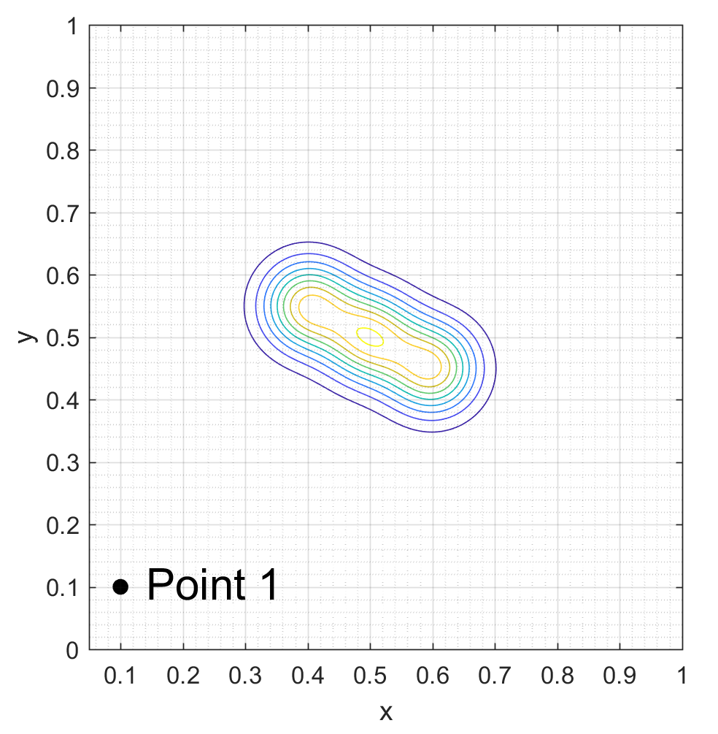
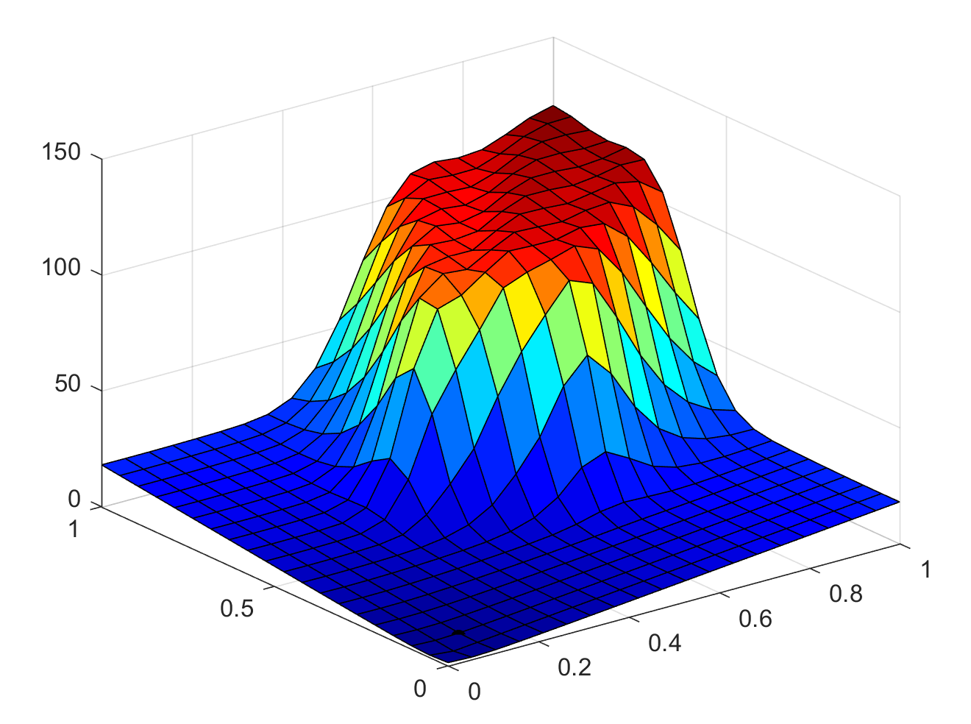
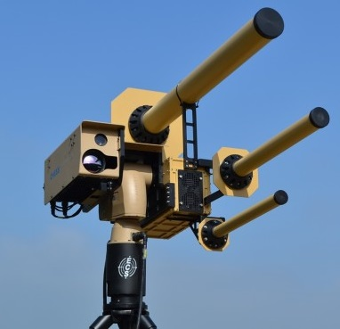
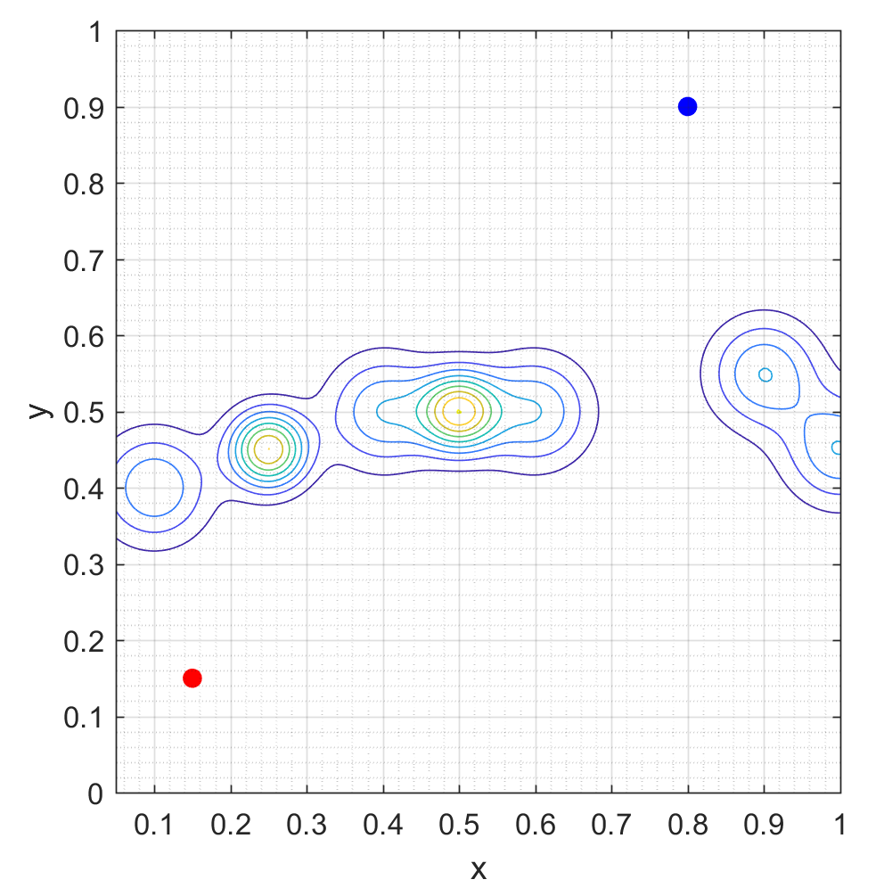
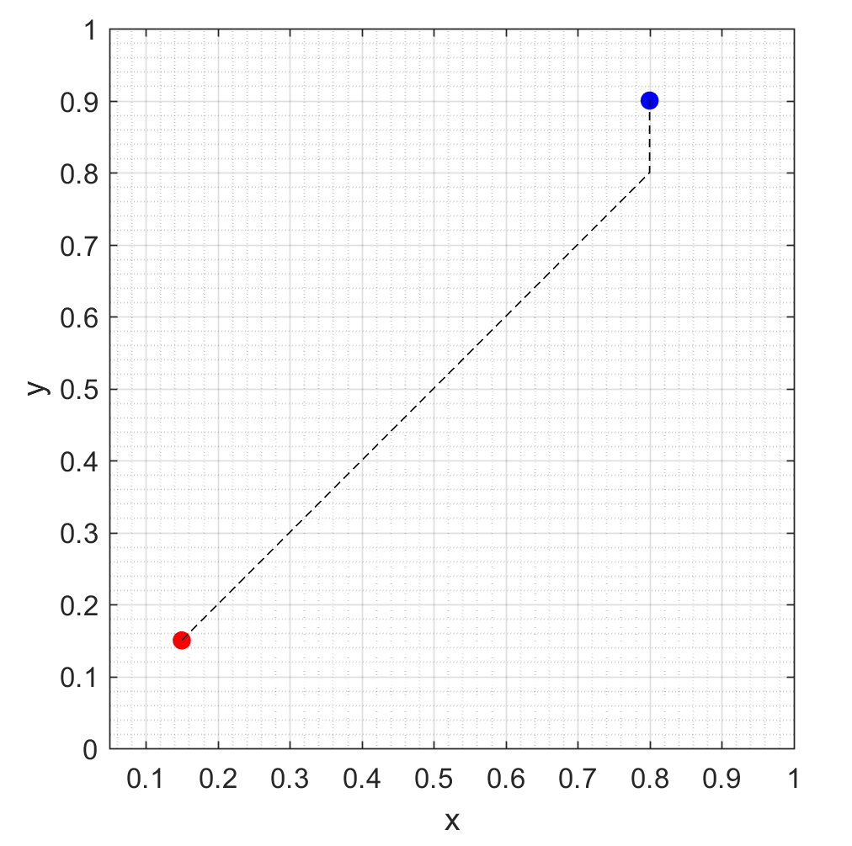
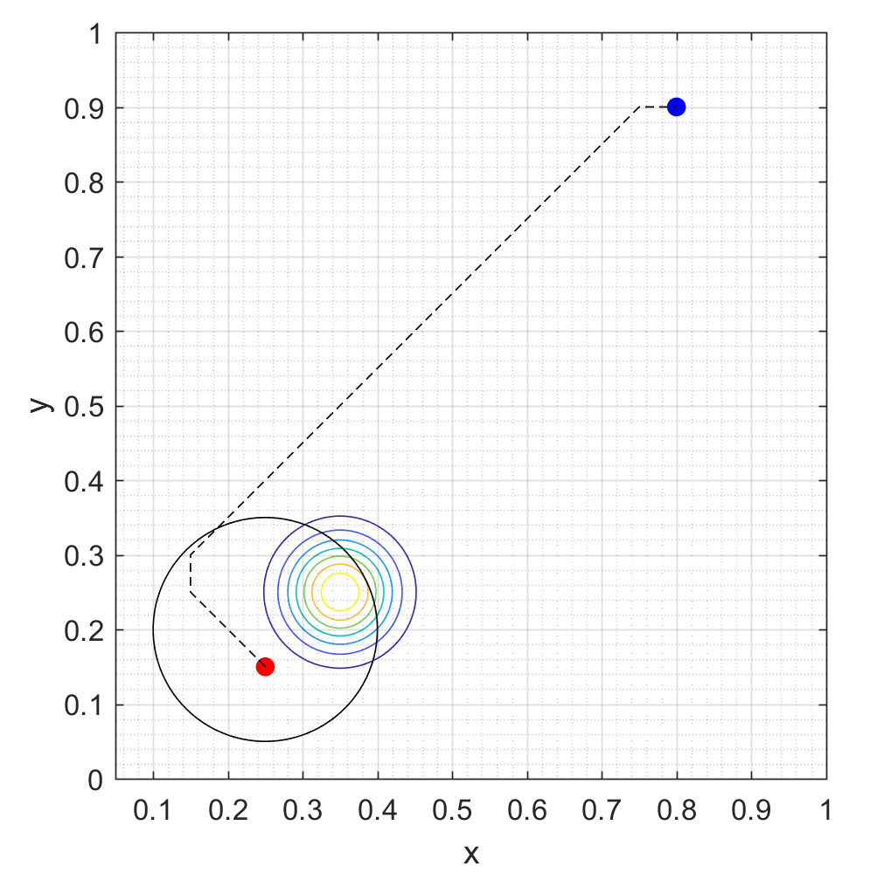
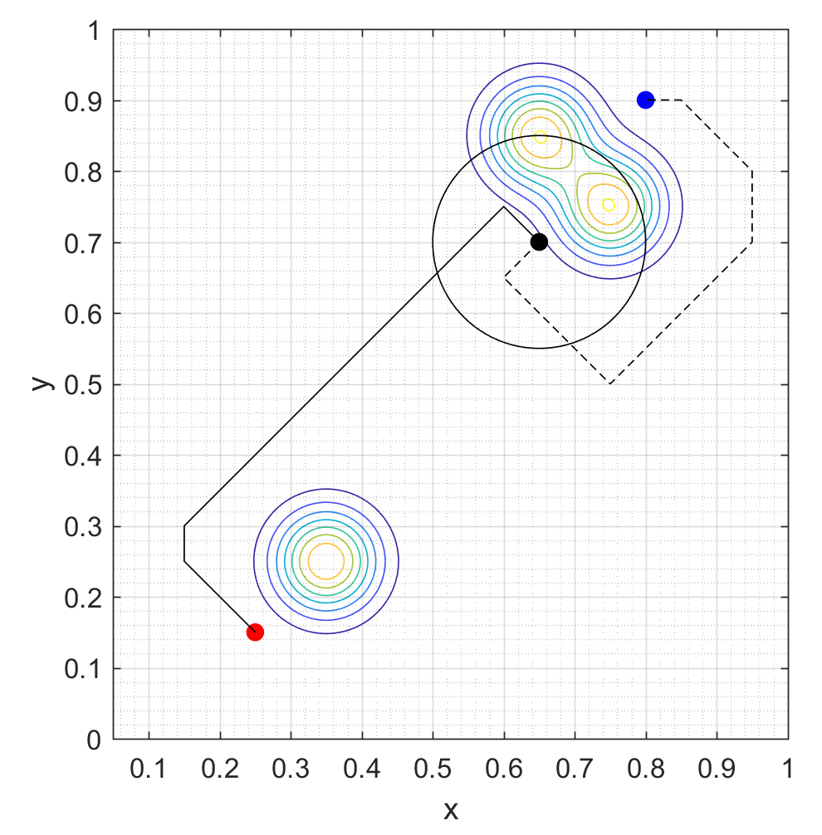
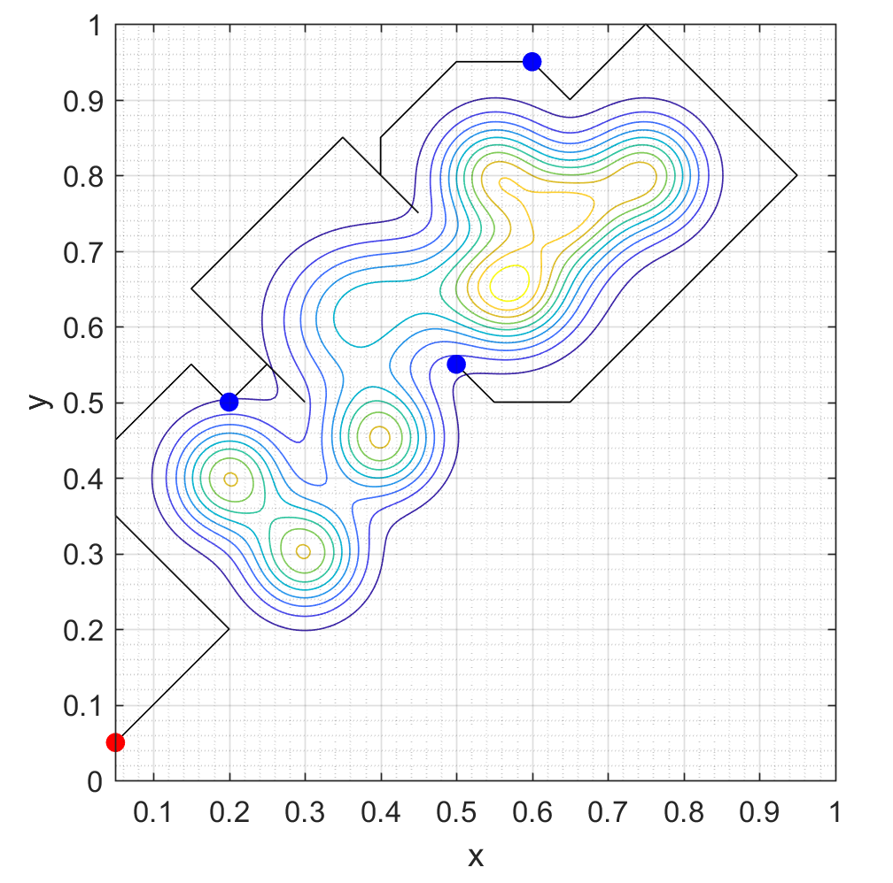
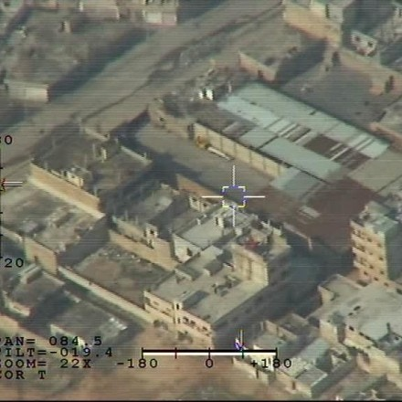
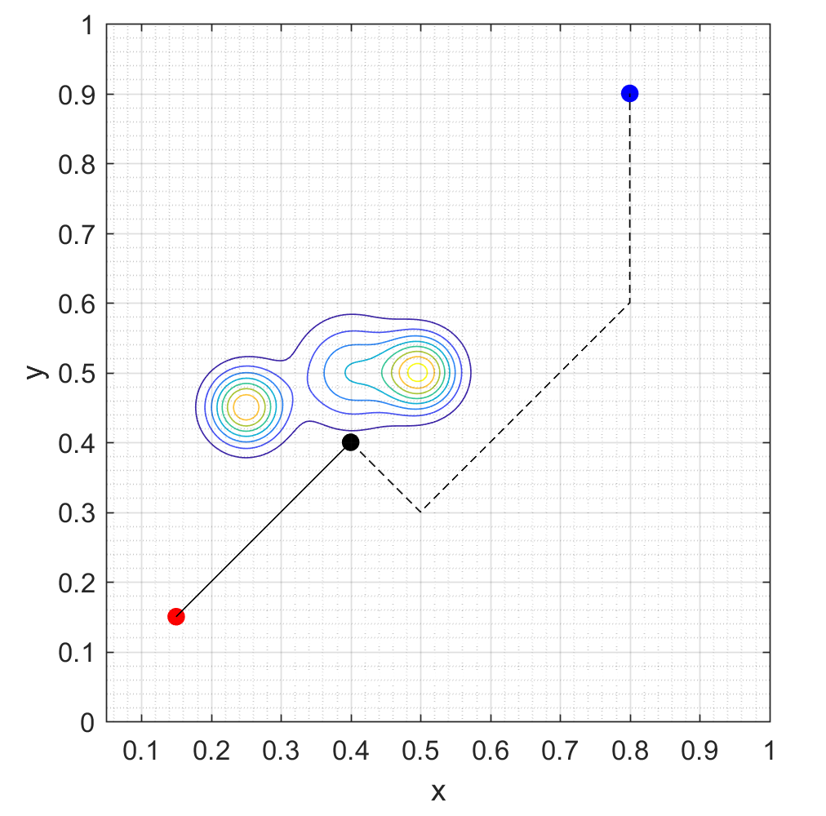
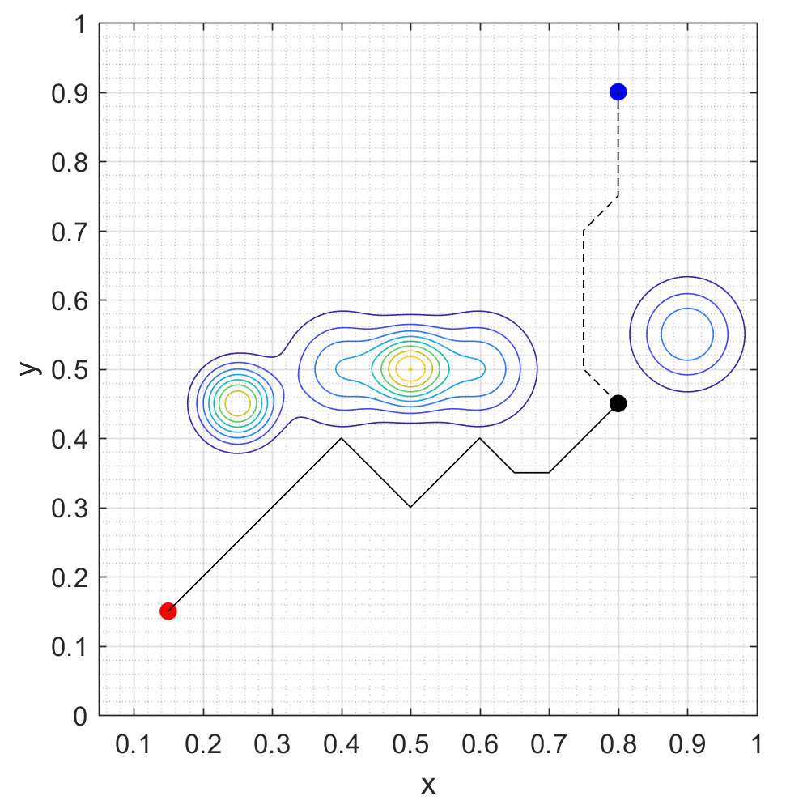
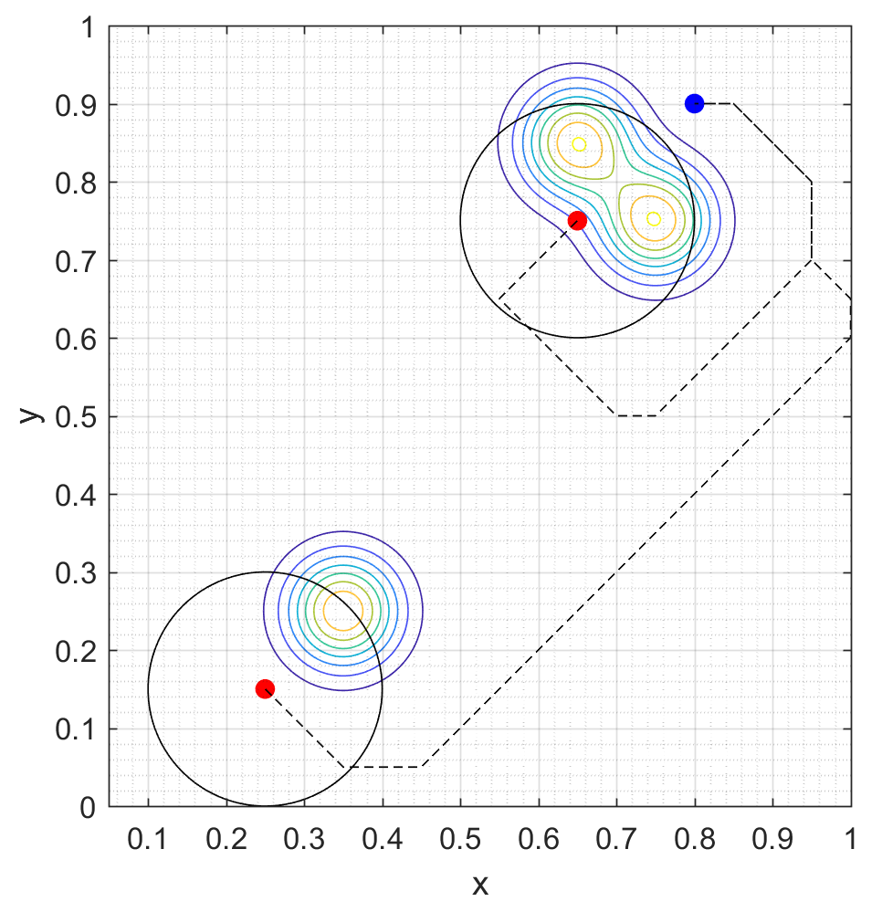
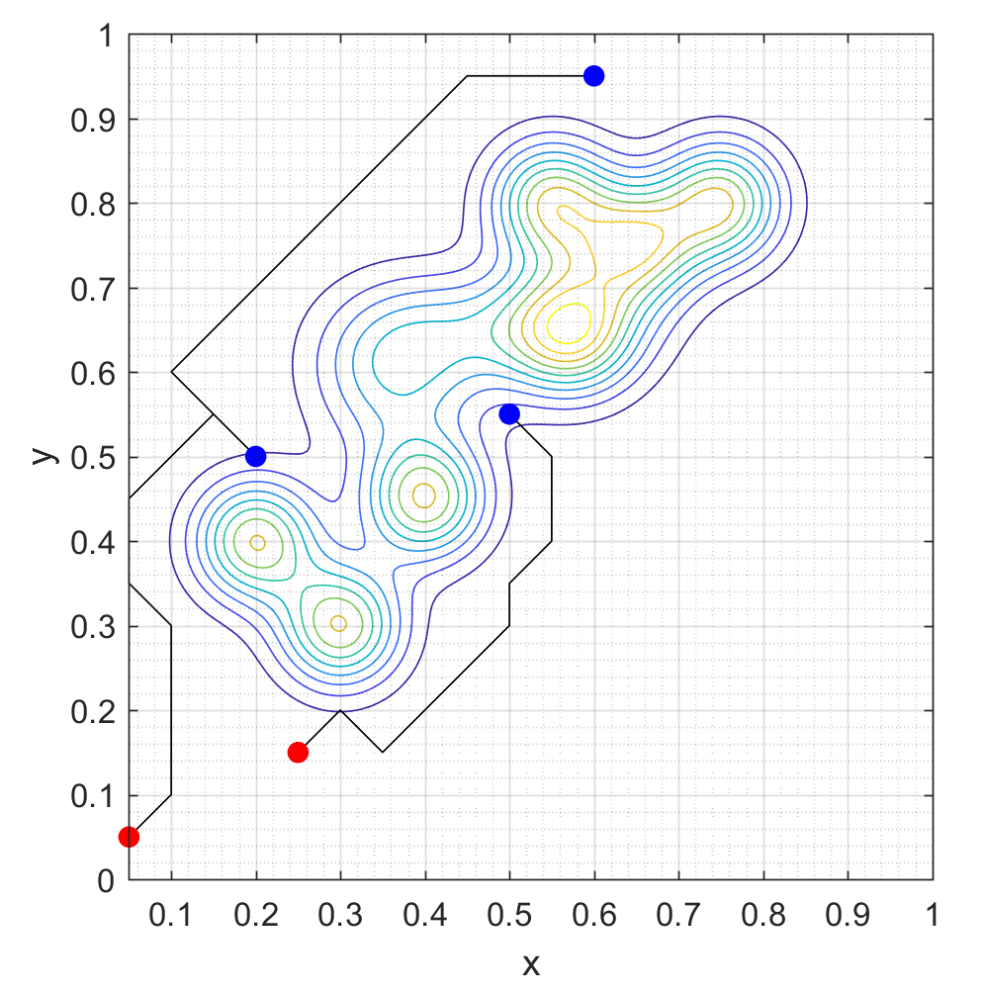
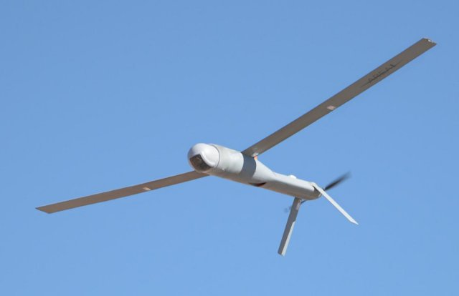
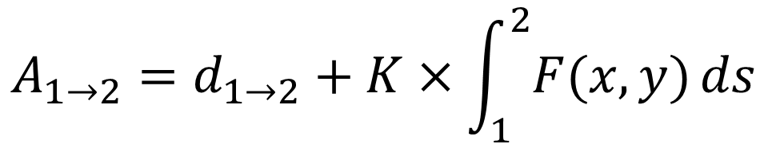
Adaptive Multi-Agent Path Planning for
Distributed UAV Systems
Lloyd Maza (lmaza) and Cameron McMillan (cmac12)
CS 229 Final Project, Autumn 2017
Motivation
Method
Conclusions
Proliferation of low cost UAVs facilitates the exploration of more dangerous environments. Novel path planning algorithms are needed to control these UAVs.
Problems:
Unknown risk environment
Real time planning
Multiple cooperative agents
Multiple targets
Cooperative and Geometric Learning Algorithm (CGLA) ^{[2]}
Offshoot of Q-learning
Use UAV positions as states
Balance between minimizing path length and minimizing risk
Simplifies information sharing between agents
Generate risk map (A) of the known environment
Generate cost matrix (G)
Execute path planning
If an unmodeled threat is discovered, repeat from step 1
$$A_{1→2}=d_{1→2}+K×\int_{1}^{2}{F(x,y)}ds$$
CGLA does a great job of facilitating complex distributed tasks for UAV systems
Handles an unknown dynamic environment robustly
Easily allows many UAVs to cooperate on their tasks
Algorithm runs quite slowly and may not work well for very large or finely discretized maps
Threat distribution
Risk map
Results
Scenario
Learning to Navigate in an Unknown Environment
Information Sharing in an Unknown Environment
Multiple Target – Multiple UAV
Environment
Future Work
Threats such as anti-air and terrain are initially unknown to UAVs. Must be discovered.
The environment is initialized with a group of unseen threats
Scenario with one UAV must handle each threat as it encounters them
A single UAV must try to find the optimal path that visits all targets
Performance improvements to speed up algorithm
Introduce additional states (e.g. 3rd dimension)
Compare CGLA performance against Q-learning or other deterministic baseline
Add the ability to handle unknown mobile threats
Implement on hardware
Targets are initially known to UAVs. Scenario runs until UAVs have visited all targets or run out of fuel.
CGLA is iteratively executed to update the path as UAVs encounter unseen threats
Teams of UAVs share information as threats are discovered, leading to smarter paths
Efficient target assignment speeds up the target observation with multiple UAVs
References
UAVs have realistic observation radii and fuel capacity. UAVs can share threat information.
[1]: Zhang, B., Mao, Z., Liu, W., et. al. "Geometric Reinforcement Learning for Path
Planning of UAVs," Journal of Intelligent and Robotic Systems, Volume 77, No. 2,
2015, pp 391–409.
[2]: Zhang, B., Mao, Z., Liu, W., et. al. "Cooperative and Geometric Learning Algorithm
(CGLA) for path planning of UAVs with limited information," Automatica, Volume
50, No. 3, 2014, pp 809-820.
Blue – Target position
Red – UAV starting position

