Slide 1
“Memory Hungry”: Competitive Programming Techniques
Benjamin Carey and Jack Smoroske
CS395 Final Project
University of Kentucky

Slide 2
Problem Background
You’re a fresh, “unique” AI B2B SaaS company.
You have the new LLM that will change the world!
But it’s too expensive to run on your ancient ThinkPad self-hosted server and upgrading RAM is too expensive...
Fortunately, you’re a competitive programmer!
After sufficient tests (a single benchmark), you’ve identified the cost of running the model in terms of its context window.

Slide 3
The Problem
For each test case, you receive N messages with L[0], L[1], … L[N-1] tokens each. You also receive a maximum window size W and a reduction factor K.
As you receive messages, you may “summarize” by setting the token sizes L[i]..L[j] to L[i]/K..L[j]/K.
You can only summarize starting from the least-recent unsummarized message.
The cost to summarize is 64+2*sum(L[i]..L[j]).
Your task: minimize this cost, or print DOWNLOAD MORE RAM if impossible.

Slide 4
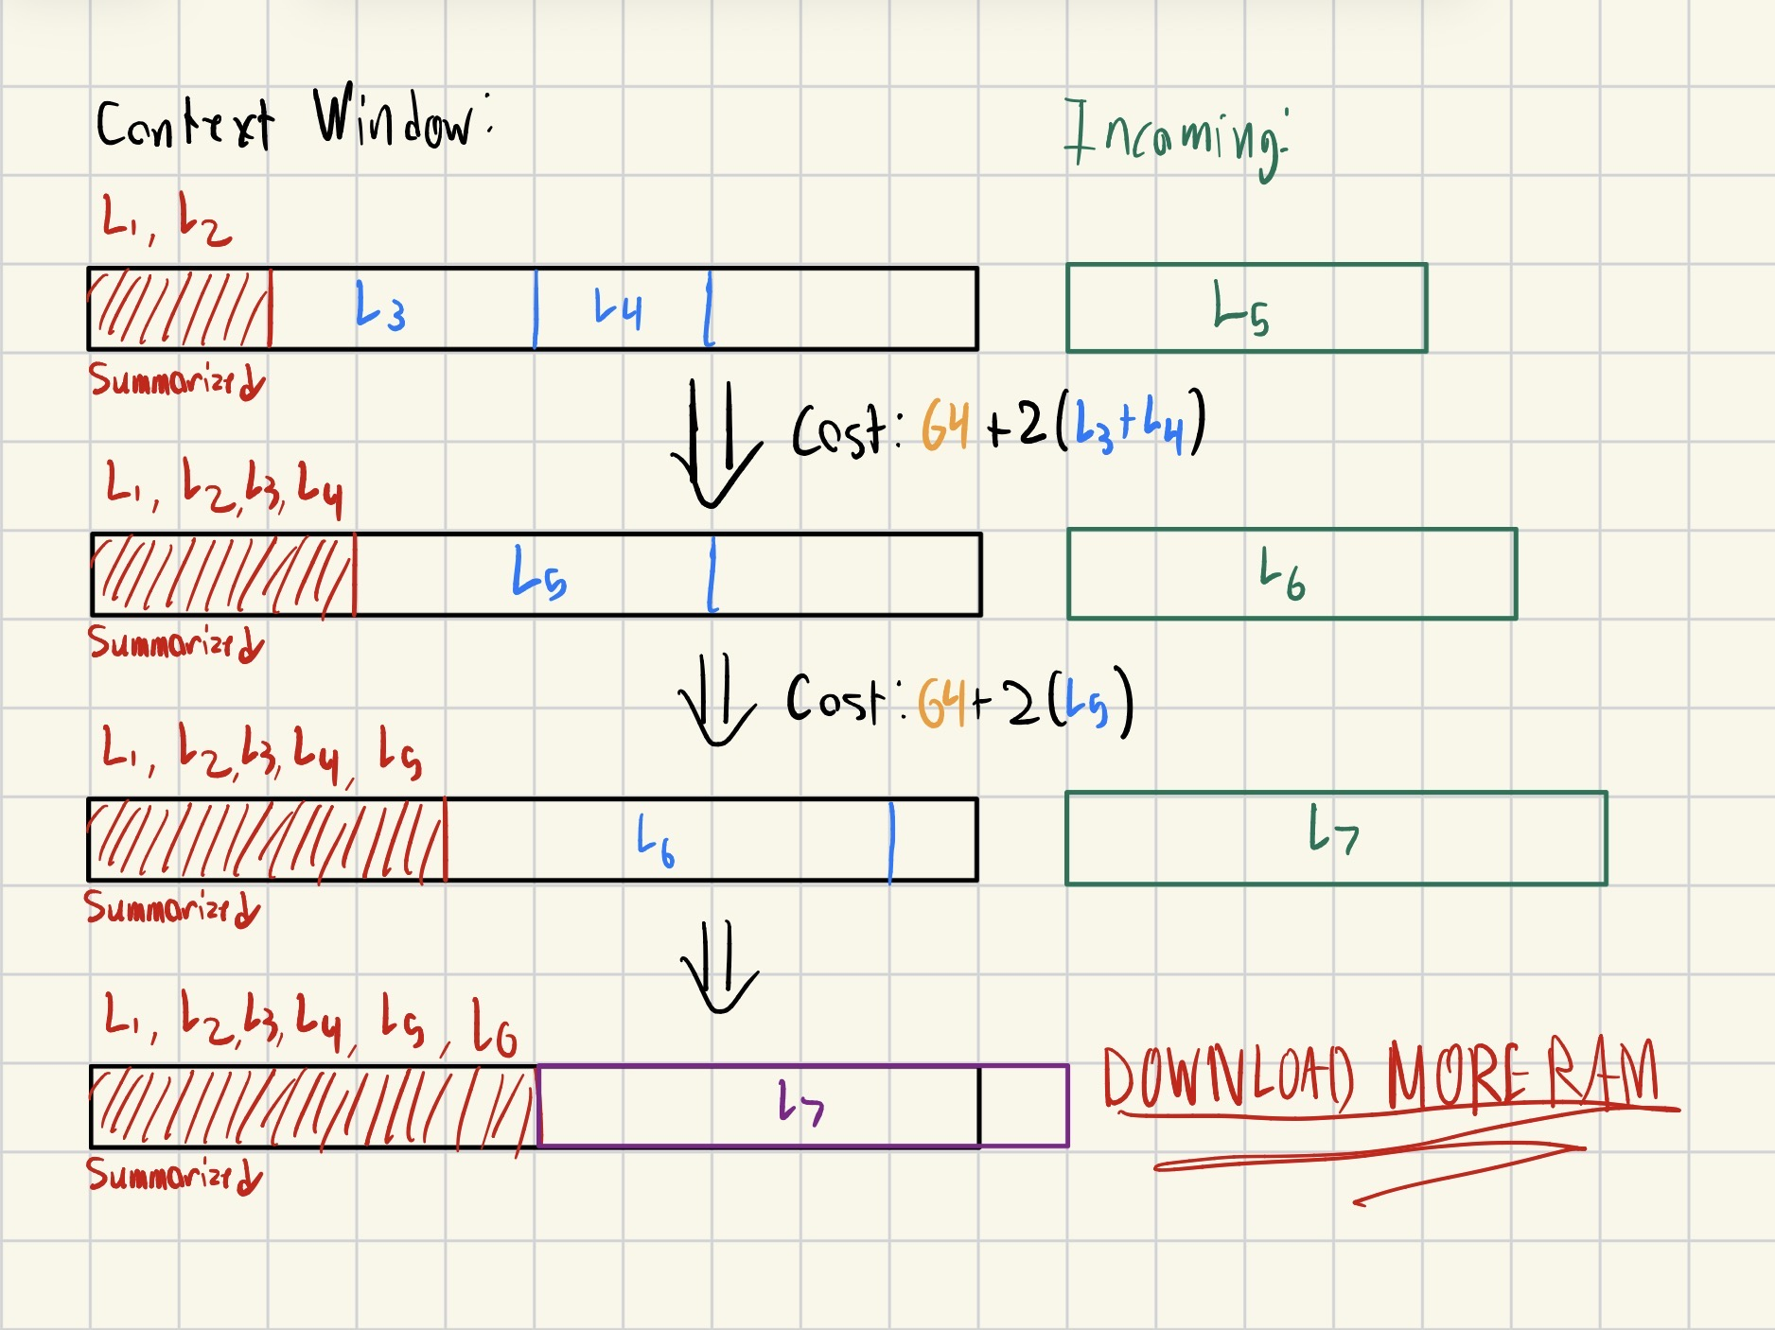
The Problem (Visualized)

Slide 5
Solution Strategy
How do we identify the correct approach?
Checking sums of ranges frequently
Prefix sums for efficient calculations
Consider ranges of messages at a time
Sliding window reduces time complexity
Optimization problem
Indicates dynamic programming & solving subproblems

Slide 6
Prefix Sums
Prefix sum array is an array where P[i]=L[1]+L[2]+…+L[i]
Allows for immediate, O(1) indexing when consulting the sums of ranges
Size of reduced (P[j]/K) or unreduced (P[i]-P[j]) sections
Index j splits in two
Total cost is 64n + 2P[j]
Messages 1-j are reduced, regardless of how many n reductions
i | 1 | 2 | 3 | 4 | 5
L[i] | 10 | 40 | 30 | 60 | 100
P[i] | 10 | 50 | 80 | 140 | 240

Slide 7
Sliding Window
Slide a view (L, R) over the array – shift L and R rightward
Reduces higher complexities to O(n)
Use j_min as R for reduced section, L for unreduced
[1, j_min-1] must be reduced
[j_min, i] could be unreduced
Stay under W
50 | 90 | 30 | 20 | 50
Ex: W = 150, K = 10 j_min = 3

Slide 8
Sliding Window
Use j_max ( > j_min) in a Queue object as another bound
(j_max, i) unreduced window, updated discretely
Push j_max right when it falls behind j_min
Need a new reduction
Only as far as needed

Slide 9
Dynamic Programming
Solve smaller subproblems to build up optimal solution
“Smart” optimizing vs. greedy
DP table stores how many reductions needed to reduce up to index i
Increment values inside by 1 whenever new reduction is needed
Whenever i=N, checking dp[j] gives us our answer
j = minimum index of reduced messages to stay under W
dp[i] | 0 | 1 | 1 | 2 | 2 | 3 | 3 | 4 | 5
j

Slide 10
Demo
W = 100
K = 8
i | 1 | 2 | 3 | 4
L[i] | 64 | 64 | 16 | 16
P[i] | 64 | 128 | 144 | 160
Size:
0
j_min
i
j_max
i | 0 | 1 | 2 | 3 | 4
dp[i] | 0 | INF | INF | INF | INF
Cost:
0

Slide 11
Demo
W = 100
K = 8
i | 1 | 2 | 3 | 4
L[i] | 64 | 64 | 16 | 16
P[i] | 64 | 128 | 144 | 160
Size:
64
j_min
i
j_max
i | 0 | 1 | 2 | 3 | 4
dp[i] | 0 | 1 | INF | INF | INF
Cost:
0

Slide 12
Demo
W = 100
K = 8
i | 1 | 2 | 3 | 4
L[i] | 64 | 64 | 16 | 16
P[i] | 64 | 128 | 144 | 160
Size:
128
j_min
i
j_max
i | 0 | 1 | 2 | 3 | 4
dp[i] | 0 | 1 | INF | INF | INF
Cost:
0

Slide 13
Demo
W = 100
K = 8
i | 1 | 2 | 3 | 4
L[i] | 64 | 64 | 16 | 16
P[i] | 64 | 128 | 144 | 160
Size:
8+64=72
j_min
i
j_max
i | 0 | 1 | 2 | 3 | 4
dp[i] | 0 | 1 | 2 | INF | INF
Cost:
0

Slide 14
Demo
W = 100
K = 8
i | 1 | 2 | 3 | 4
L[i] | 64 | 64 | 16 | 16
P[i] | 64 | 128 | 144 | 160
Size:
88
j_min
i
j_max
i | 0 | 1 | 2 | 3 | 4
dp[i] | 0 | 1 | 2 | 2 | INF
Cost:
0

Slide 15
Demo
W = 100
K = 8
i | 1 | 2 | 3 | 4
L[i] | 64 | 64 | 16 | 16
P[i] | 64 | 128 | 144 | 160
Size:
104
j_min
i
j_max
i | 0 | 1 | 2 | 3 | 4
dp[i] | 0 | 1 | 2 | 2 | INF
Cost:
0

Slide 16
Demo
W = 100
K = 8
i | 1 | 2 | 3 | 4
L[i] | 64 | 64 | 16 | 16
P[i] | 64 | 128 | 144 | 160
Size:
16+32=48
j_min
j_max
i
i | 0 | 1 | 2 | 3 | 4
dp[i] | 0 | 1 | 2 | 2 | 3
Cost:
0

Slide 17
Demo
W = 100
K = 8
i | 1 | 2 | 3 | 4
L[i] | 64 | 64 | 16 | 16
P[i] | 64 | 128 | 144 | 160
Size:
16+32=48
j_min
j_max
i
Size: 160
i | 0 | 1 | 2 | 3 | 4
dp[i] | 0 | 1 | 2 | 2 | 3
Cost:
0
j_min

Slide 18
Demo
W = 100
K = 8
i | 1 | 2 | 3 | 4
L[i] | 64 | 64 | 16 | 16
P[i] | 64 | 128 | 144 | 160
Size:
16+32=48
j_min
j_max
i
Size: 104
i | 0 | 1 | 2 | 3 | 4
dp[i] | 0 | 1 | 2 | 2 | 3
Cost:
192
j_min

Slide 19
Demo
W = 100
K = 8
i | 1 | 2 | 3 | 4
L[i] | 64 | 64 | 16 | 16
P[i] | 64 | 128 | 144 | 160
Size:
16+32=48
j_min
j_max
i
Size: 48
i | 0 | 1 | 2 | 3 | 4
dp[i] | 0 | 1 | 2 | 2 | 3
Cost:
384
j_min

Slide 20
Conclusions
Prefix sums, sliding windows, and dynamic programming are all powerful tools for solving competition problems.
While powerful on their own, the way these techniques are combined to solve non-trivial problems.
Mastering these techniques and when to use them will level up your problem solving abilities.
For made-up and real-world problems alike!

Slide 21
Questions?
bjca251@uky.edu jack.smoroske@uky.edu jurek@cs.uky.edu

