Slide 1
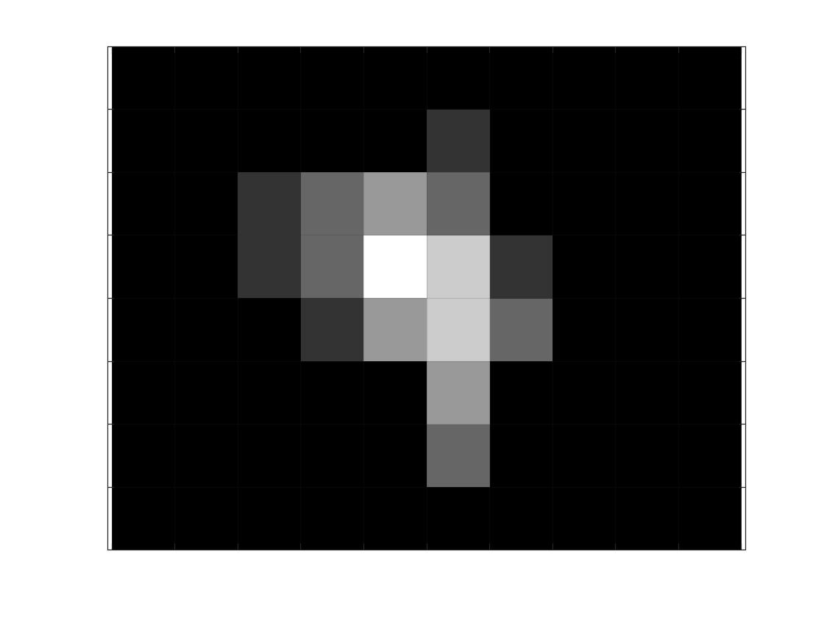
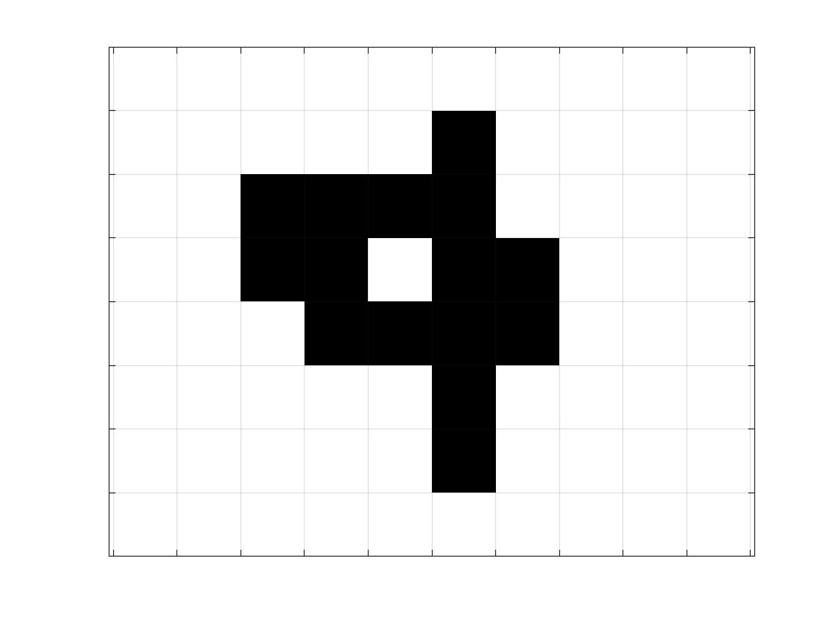
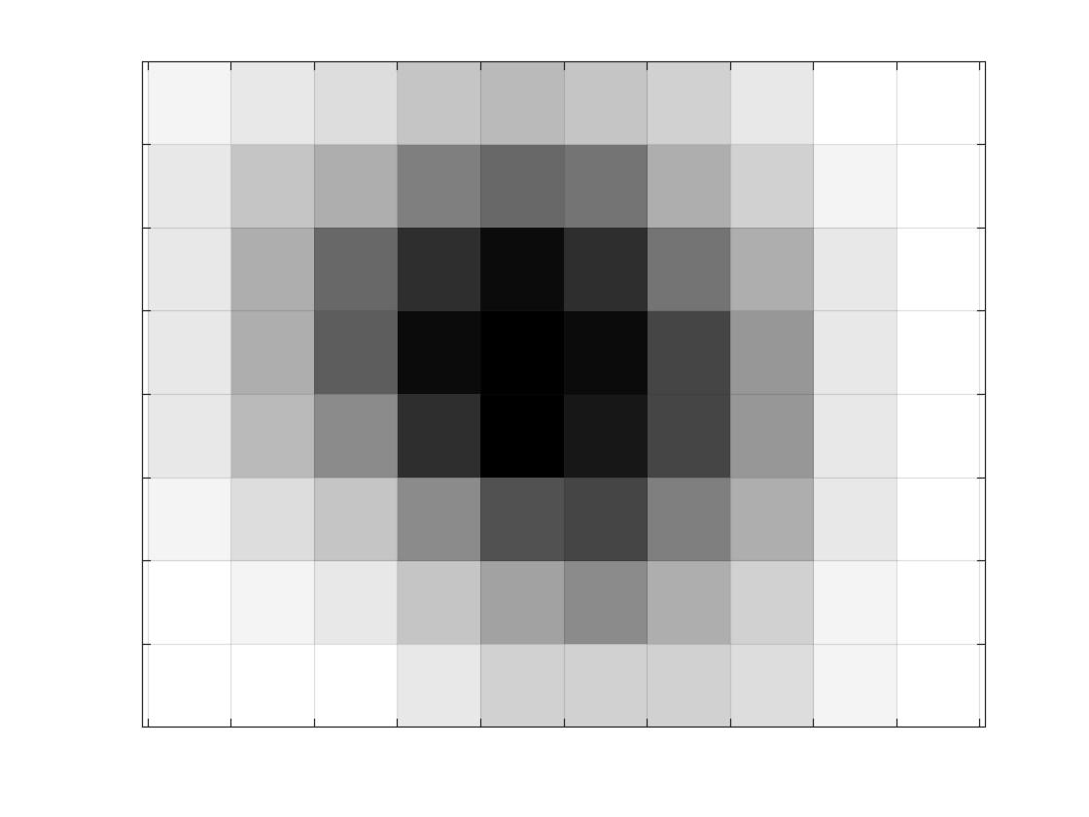

Tree State
Burning Trees
Ignition Rate

Slide 2
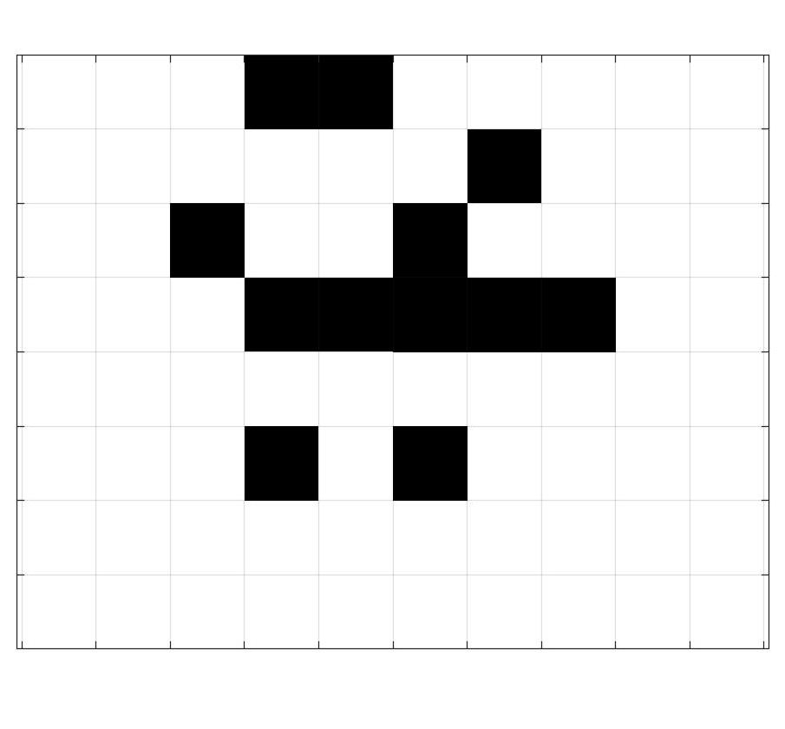
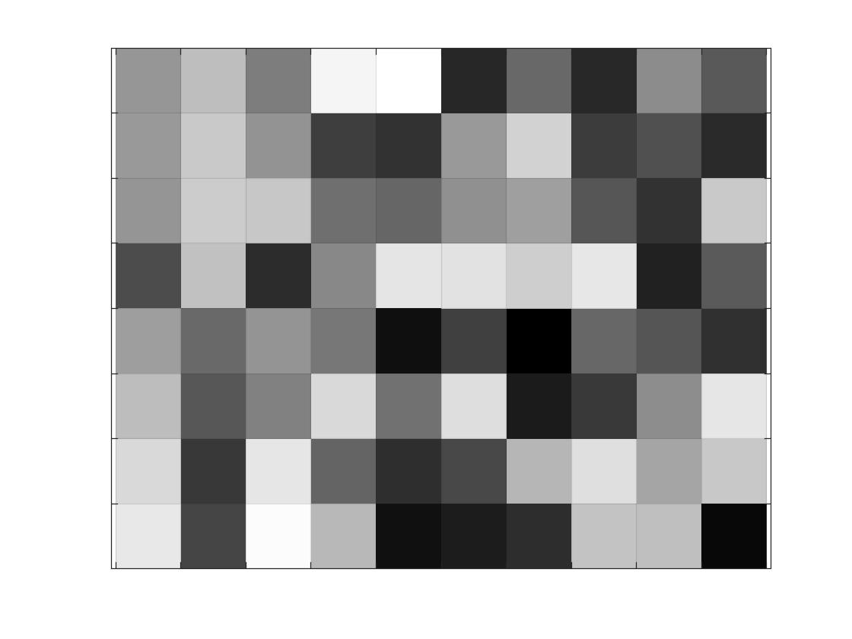
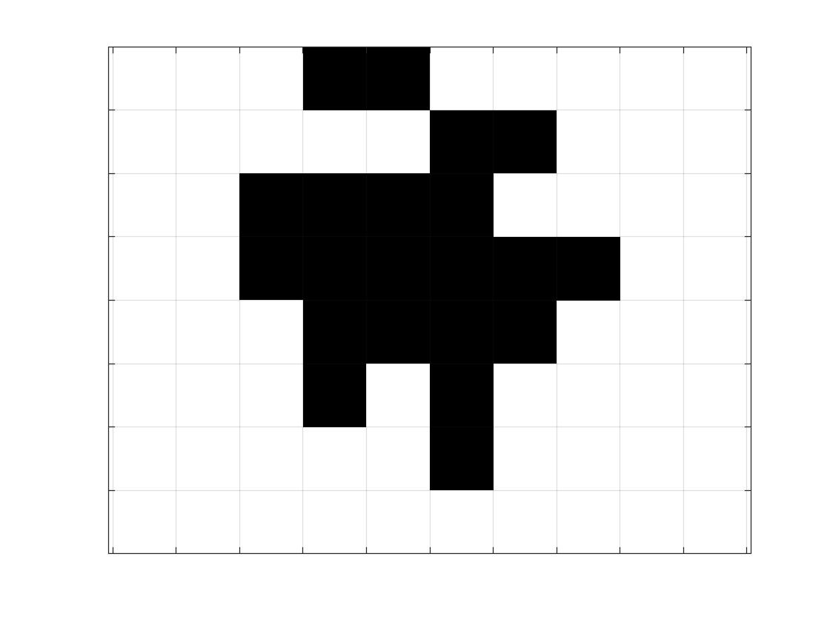
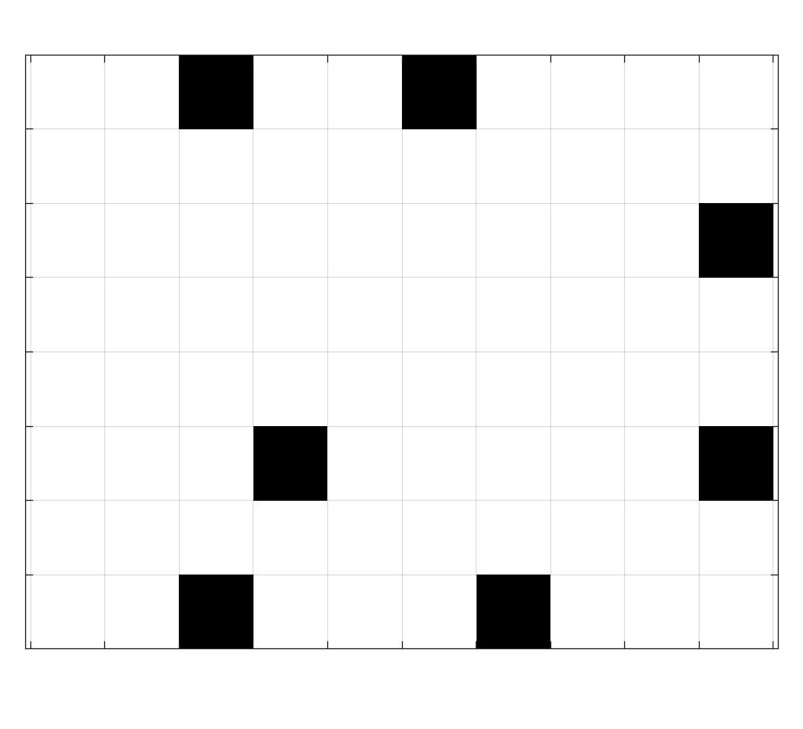
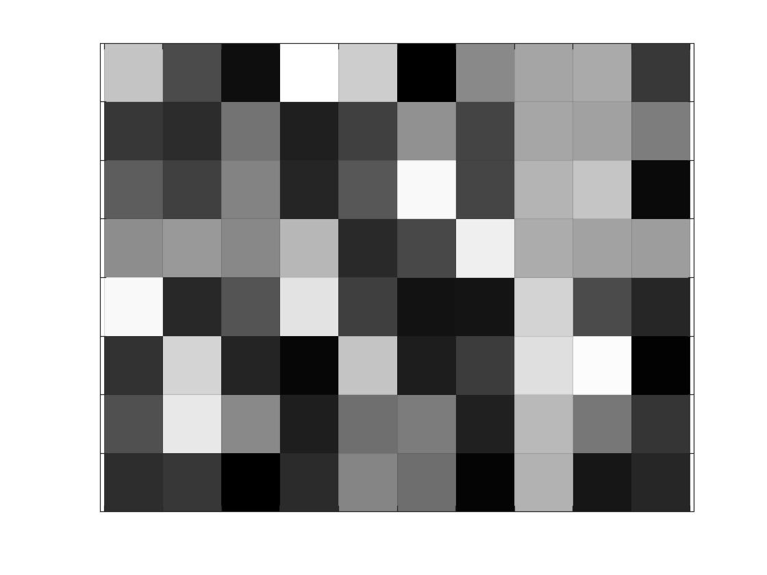
Ignition Rate
Ignite Map
Ignition Probability Map
Burning Trees(t+1)
Extinguish Rate
Extinguish Map
Extinguish Probability Map
Burning Trees(t)

Slide 3
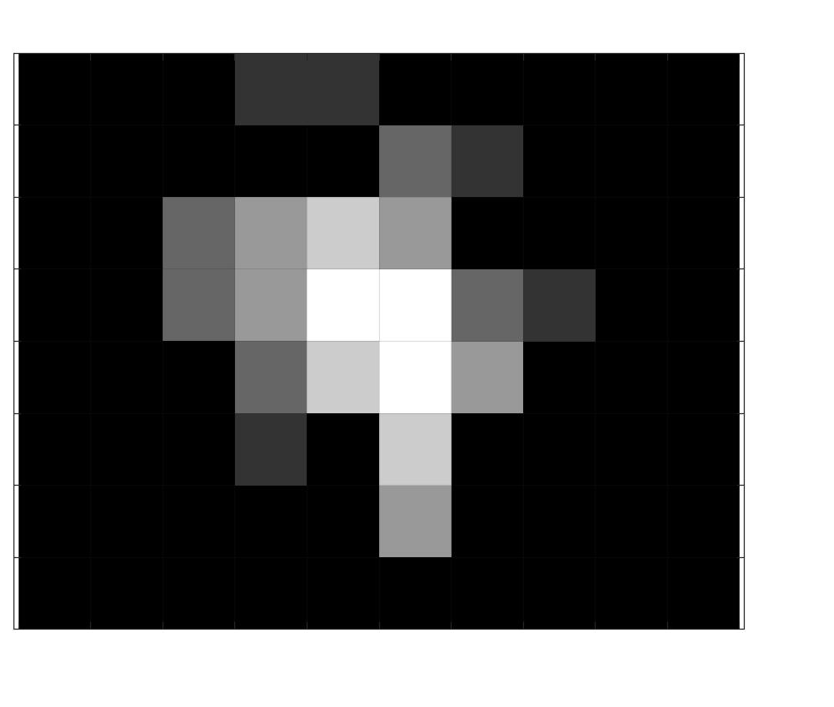
Tree State(t)
Tree State(t+1)
Burning Trees(t+1)

Slide 4
Terrain(i,j)
SSA Drone
Transmit Limit
Result
Ratio Repeater Drone
EOC
Distance

Slide 5
Drone Layer
Time Layer
Information Layer
Detection Revenue
Flame Layer

Slide 6
x( i , j )
Drone Layer
t( i , j )
Time Layer
I( i , j )
Information Layer
n
n-1
h( i , j )
Flame Layer
1
( i , j )
Composite Layer
0
1
m-1
m

Slide 7
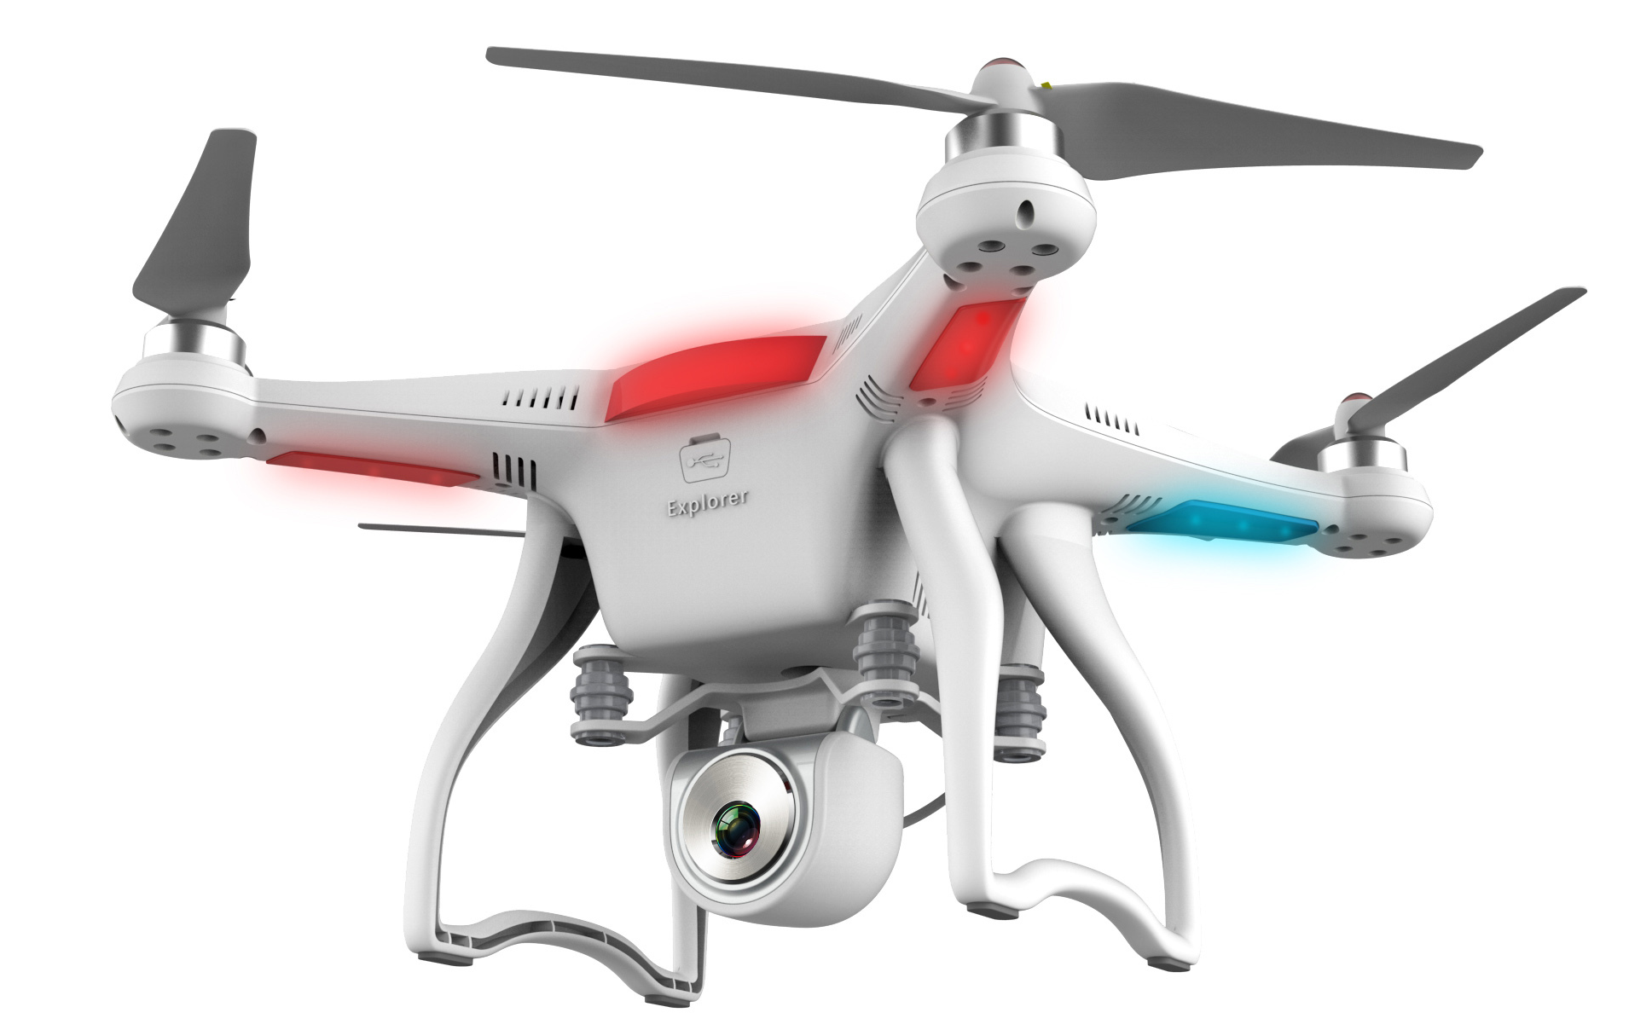
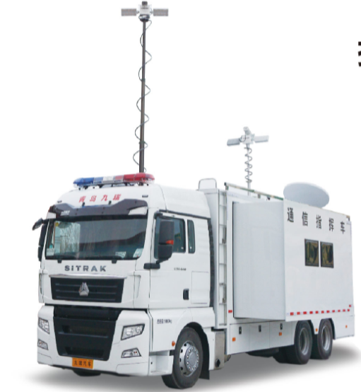
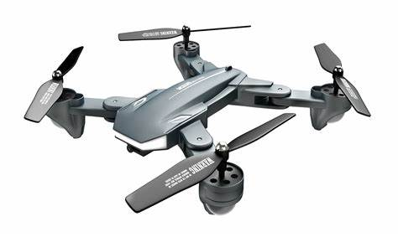
Emergency Operations Center
Radio Repeater Drones
SSA Drones

