Slide 1
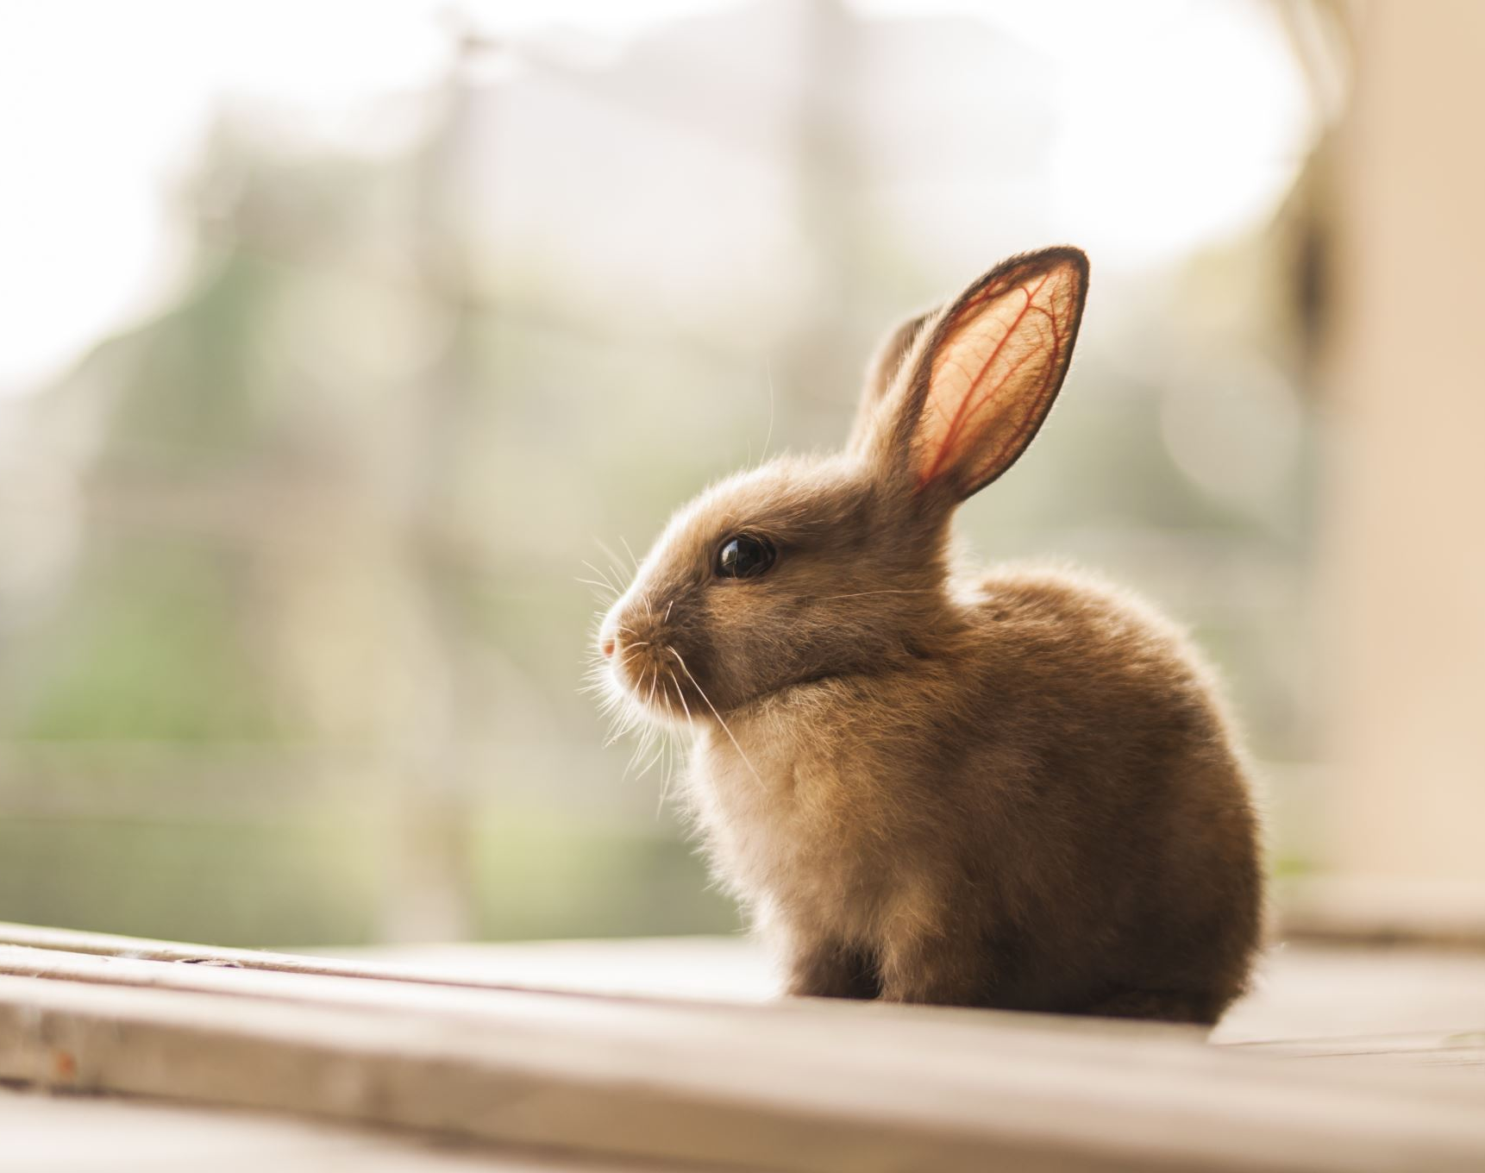
How Long in the Shelter? Predictors of Rabbit Time to Adoption
Rachel S. Anderson
CIS 164
December 10, 2025

Slide 2
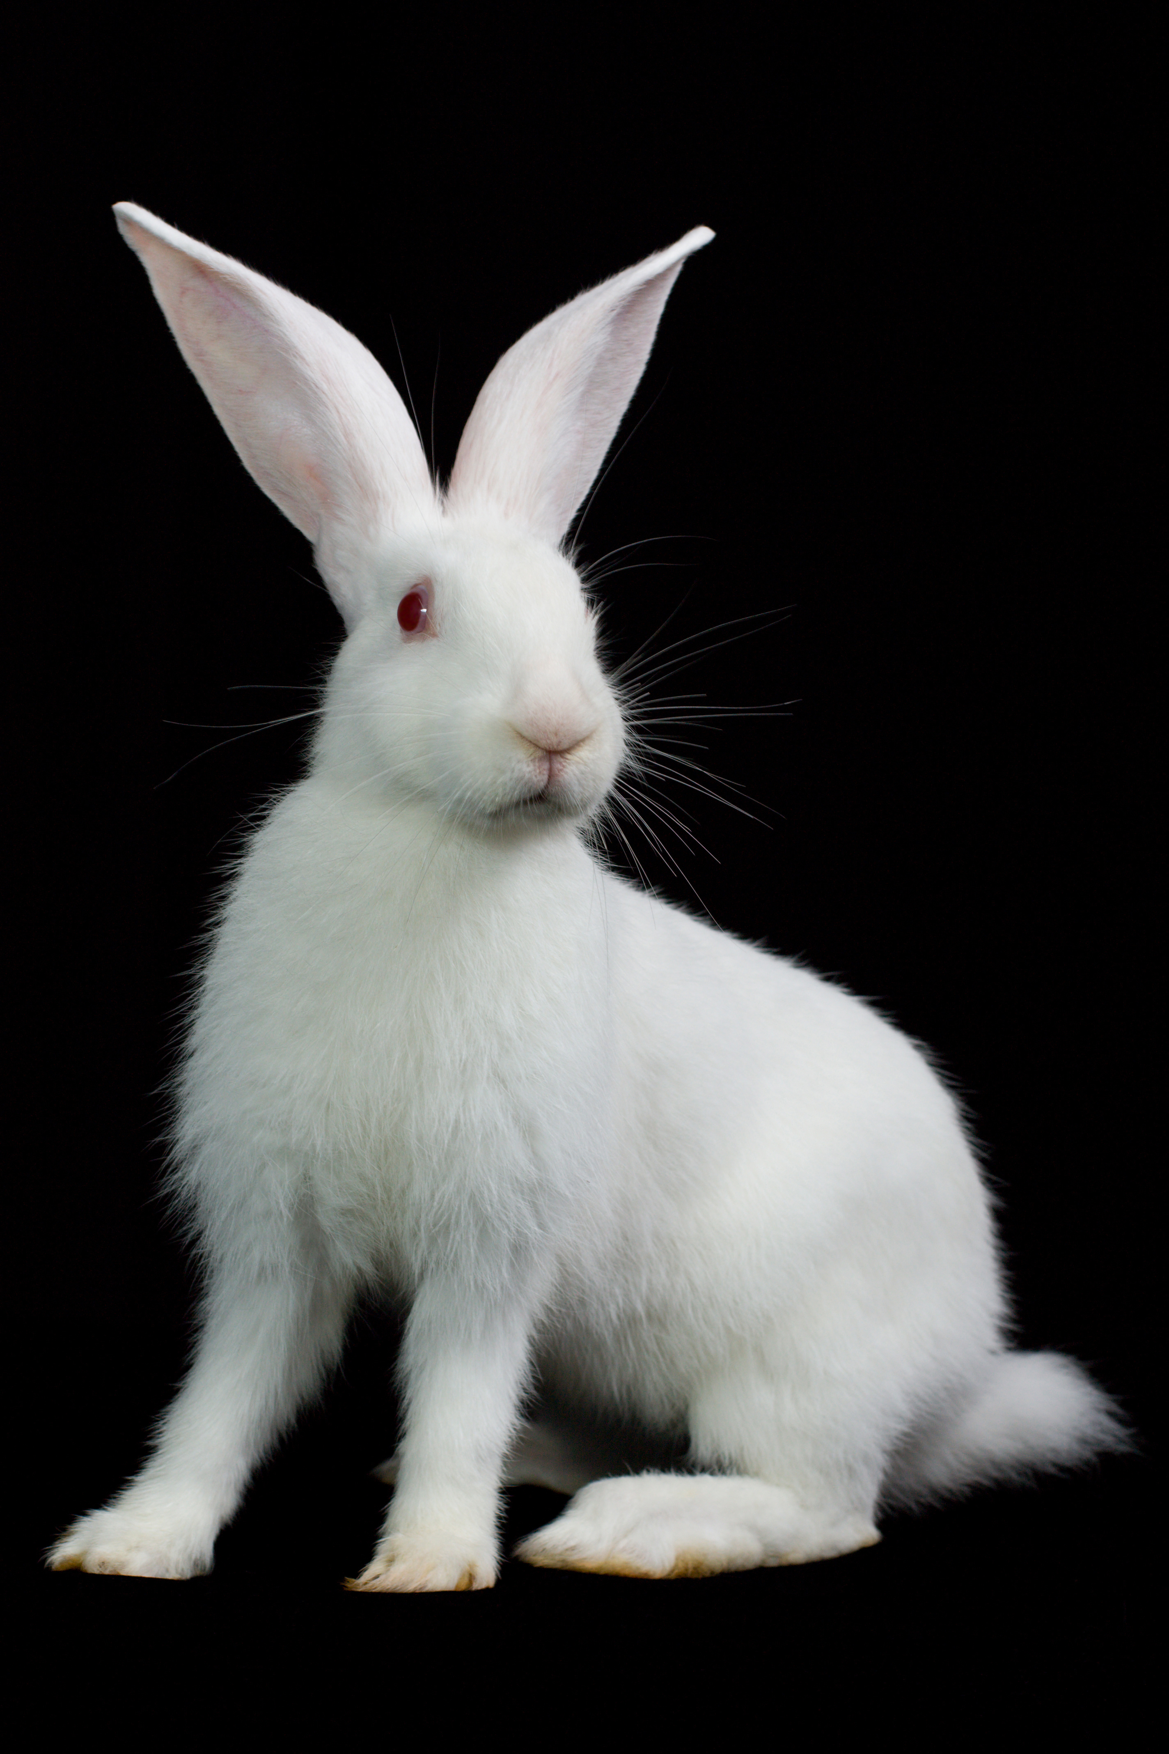
Questions & Objectives
How long do rabbits stay in a shelter before they’re adopted?
How valid is anecdotal evidence?
Compare two models: Multilinear Regression and Random Forest Regression
Evaluate the results
Images, except where noted, are Adobe Stock

Slide 3
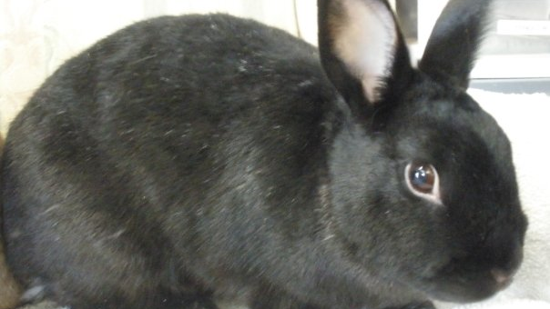
Introducing: Marley
Name: Marley
Date of Birth: 2004
Age at Adoption: 5 years
Gender: Female
Breed: American/Netherland mix
Characteristics: black, short hair
Image by author

Slide 4
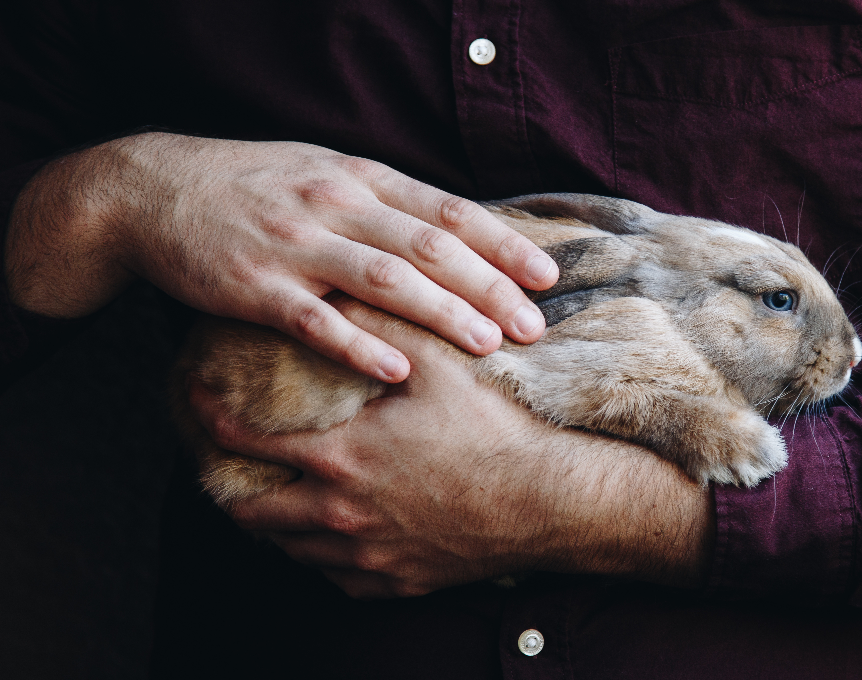
Background
Rabbits are in approximately 900,000 homes in the US (0.7% of all homes)¹
In 2024²
11,223 intakes of rabbits into shelters
57% were owner-surrendered
9,148 adopted (rate – 78%)
¹ U.S. pet ownership statistics | American Veterinary Medical Association. (2025). Retrieved December 6, 2025, from https://www.avma.org/resources-tools/reports-statistics/us-pet-ownership-statistics
² 2024 Statistics. (2024). Shelter Animals Count. Retrieved December 6, 2025, from https://www.shelteranimalscount.org/explore-the-data/statistics-2024/

Slide 5
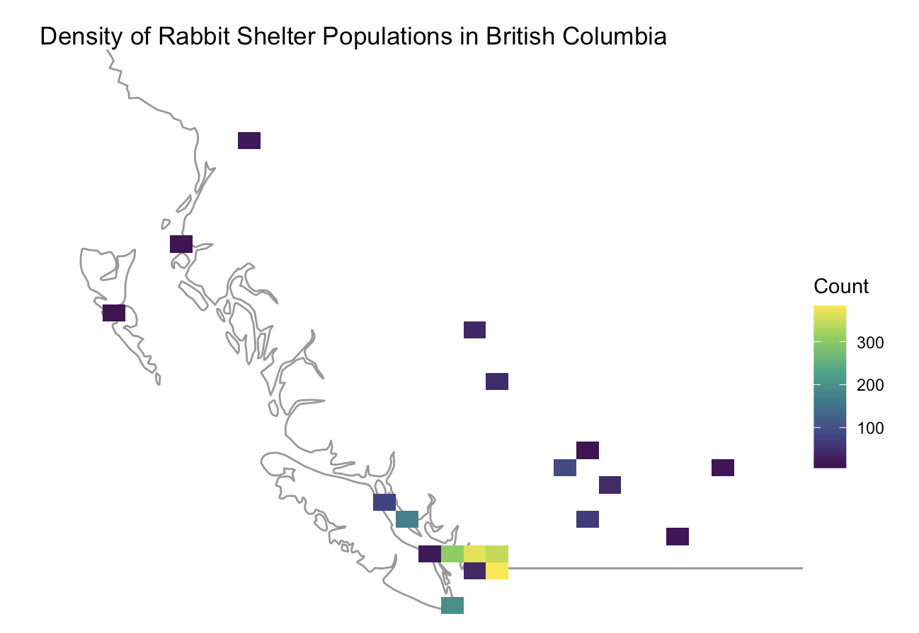
Data Description
Rabbit records (n= 1,807) from shelters in British Columbia, Canada from 2017-2021.
Data obtained from ShelterBuddy, a tracking database used by the shelters in BC.
Factors included rabbit breed, primary coat color, length of stay and date of birth.
Map made in R using dataset with Lat/Long coordinates from Canadian government

Slide 6
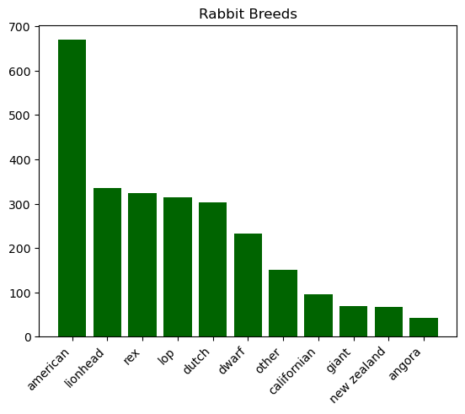
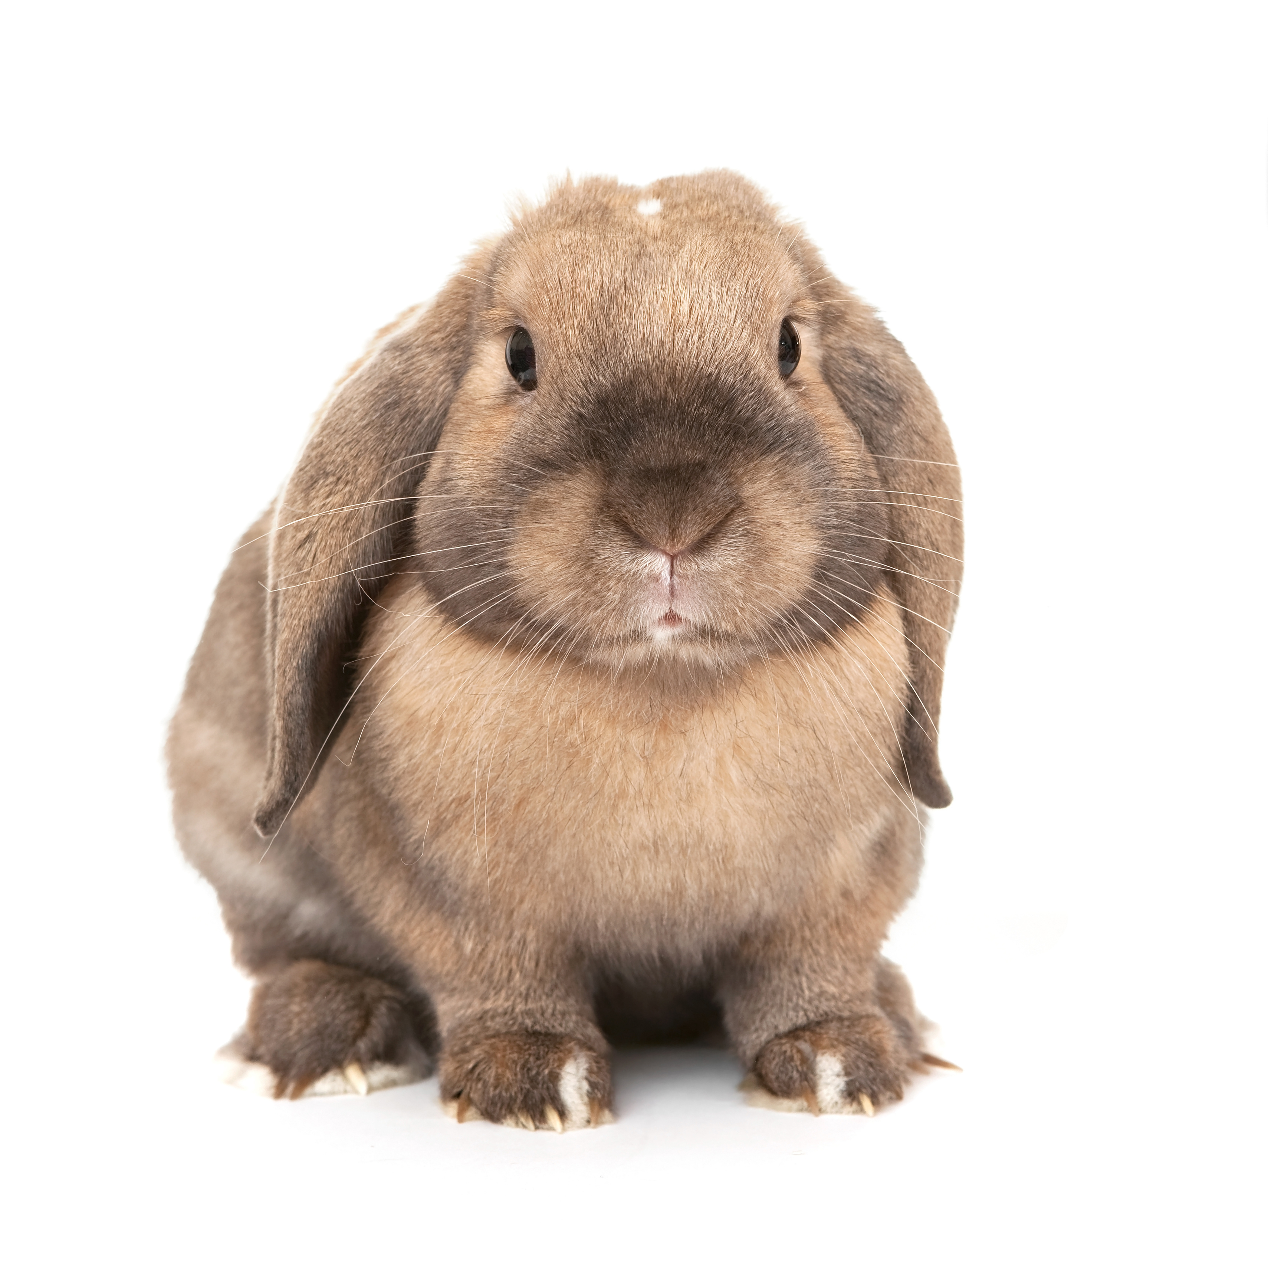
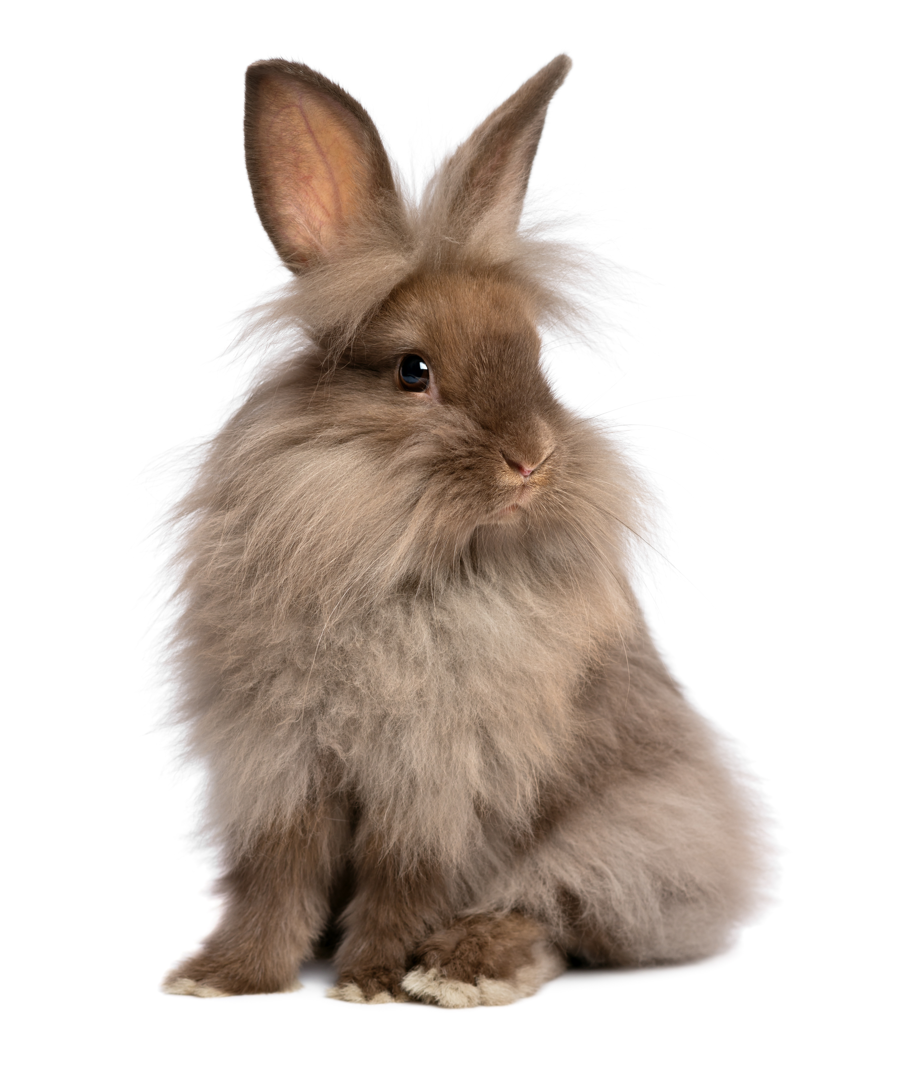
Rabbit Breeds
lop
lionhead

Slide 7
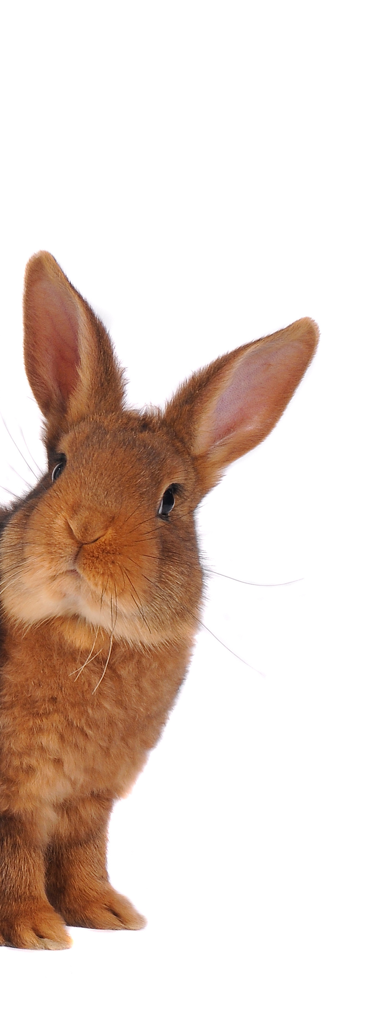
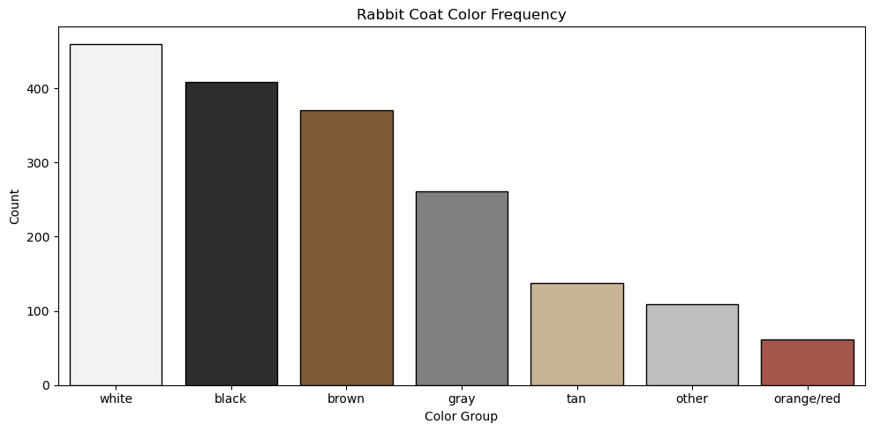
Rabbit Coat Colors

Slide 8
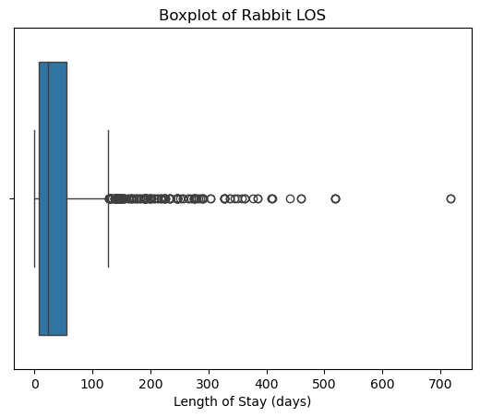
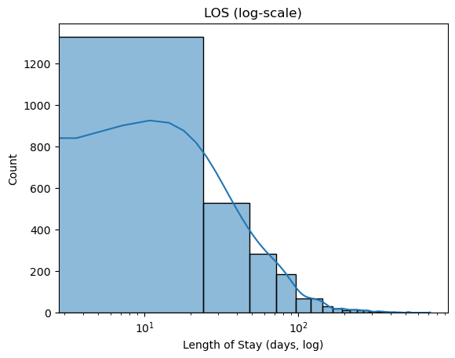
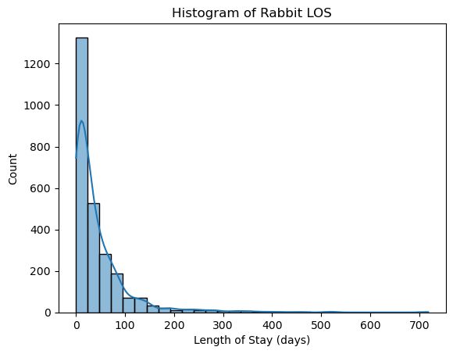
Length of Stay (LOS) at Shelters

Slide 9
Leading Indicators of Length of Stay Multilinear Regression Analysis: U. et al. (2024)
Factors with impact
Factors without impact
Factor | Strength (p-value) | Direction of Stay Length
Age | Very strong (7.2e-7) | Younger = shorter
Breed Size | Strong (5.5e-6) | Giant = shorter
Intake Month | Moderate (7.8e-4) | May = longest
Factor | Strength (p-value)
Sex | Very weak (0.12)
Primary Coat Color | Weak (0.082)
Ear Type | Very weak (0.68)
U. ASY, Hou CY, Protopopova, A (2024) Rabbit intakes and predictors of their length of stay in animal shelters in British Colombia, Canada. PLoS ONE 19(4): e0300633. https://doi.org/10.1371/journal.pone.0300633

Slide 10
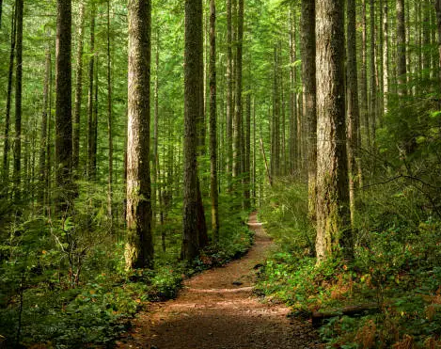
Random Forest Analysis
Random Forest analysis is a machine learning methodology that uses decision tree analysis.
Decision tree problems start from the root, and move along decision nodes to leaves that indicate no more information is gained.
Random Forest aggregates and averages many decision trees; this reduces overfitting.
Random Forest analysis is good for data with a lot of categorical features.
Kavlocoglu, E. (2021, October 20). What Is Random Forest? | IBM. https://www.ibm.com/think/topics/random-forest

Slide 11
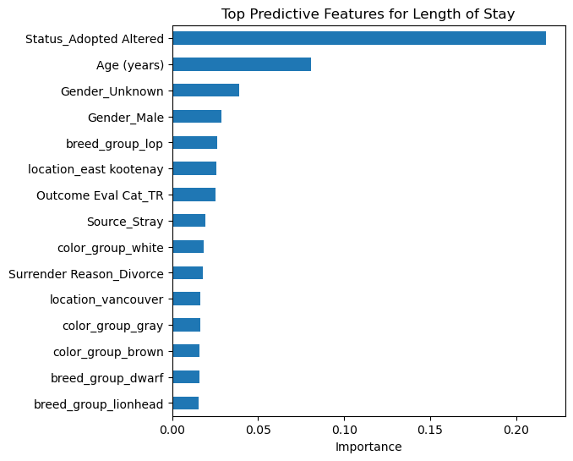
First Train/Test: Data Leakage!
Overfitting/Data leakage example:
a professor made every answer on a multiple choice test “C”
You train your algorithm on this exam
It then thinks every multiple choice answer is C (and ignores other factors)

Slide 12
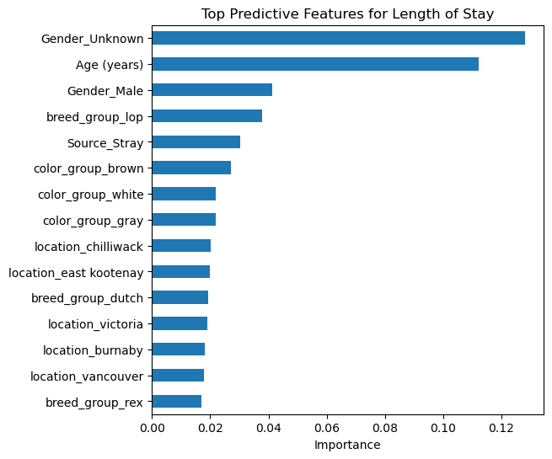
Second Train/Test: Much Better
Top Indicators
Gender (unknown)
Age
Gender (male)
Breed (lop)
Source (stray)
Color (brown)
But which direction?

Slide 13
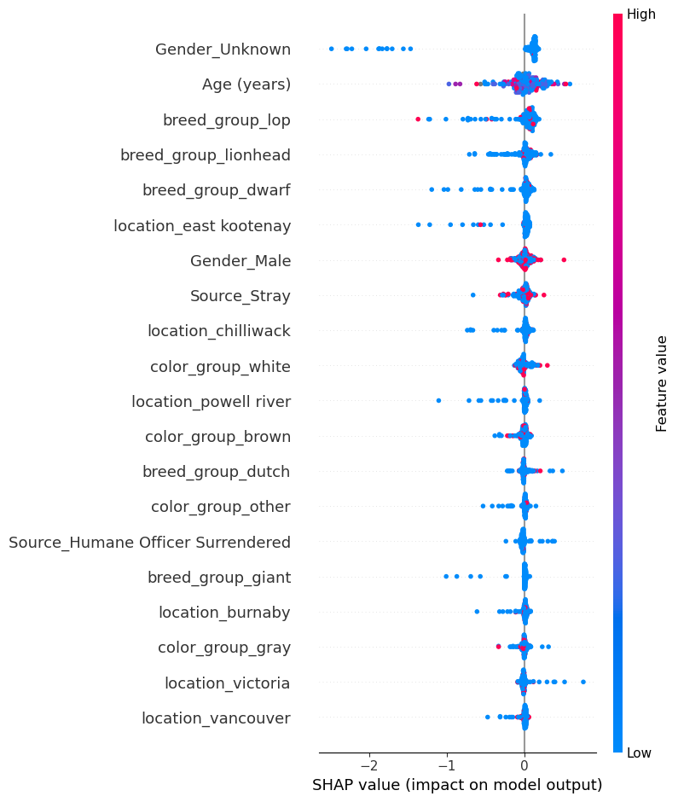
SHAP Analysis
SHapley Addictive exPlanations)
Each factor assigned an importance value
red = high
blue = low
Individual dots show direction of impact

Slide 14
SHAP Analysis

Slide 15

Takeaways
Both the MLR and the RF models see the age of the rabbit as a leading indicator of their time in shelter.
The RF model saw gender and ear type (lop/non-lop) as more influential compared to the MLR model.
Both models indicated that coat color was not a reliable predictor of time in shelter.

Slide 16
Marley’s Time in Shelter: Predicted with Random Forest Model
Name: Marley
Date of Birth: 2004
Age at Adoption: 5 years
Gender: Female
Breed: Netherland/American mix
Characteristics: black, short hair
3.48 days

Slide 17
References
2024 Statistics. (2024). Shelter Animals Count. Retrieved December 6, 2025, from https://www.shelteranimalscount.org/explore-the-data/statistics-2024/
Cook, A. J., & McCobb, E. (2012). Quantifying the Shelter Rabbit Population: An Analysis of Massachusetts and Rhode Island Animal Shelters. Journal of Applied Animal Welfare Science, 15(4), 297–312. https://doi.org/10.1080/10888705.2012.709084
DeMello, M. (2016). Rabbits Multiplying Like Rabbits: The Rise in the Worldwide Popularity of Rabbits as Pets. In M. P. Pręgowski (Ed.), Companion Animals in Everyday Life: Situating Human-Animal Engagement within Cultures (pp. 91–107). Palgrave Macmillan US. https://doi.org/10.1057/978-1-137-59572-0_7
Glasser, C. L. (2024). “The 21st Century Rabbit Paradox”: Attitudes Toward and Experiences with Rabbits in the United States. Society & Animals, 32(3), 287–308. https://doi.org/10.1163/15685306-bja10100
Kavlocoglu, E. (2021, October 20). What Is Random Forest? | IBM. https://www.ibm.com/think/topics/random-forest
Shelter Animals Count. (n.d.). [Video recording]. Retrieved December 6, 2025, from https://www.facebook.com/shelteranimalscount/posts/-february-is-adopt-a-rescued-rabbit-month-as-we-wrap-up-the-month-to-celebrate-h/645736767845114/
U, A. S. Y., Hou, C. Y., & Protopopova, A. (2024). Rabbit intakes and predictors of their length of stay in animal shelters in British Columbia, Canada. PLOS ONE, 19(4), e0300633. https://doi.org/10.1371/journal.pone.0300633
Updated Rabbit Statistics: How Many Pet Rabbits are There in the USA? (2025, September 19). https://rabbit.org/resources/how-many-pet-rabbits-are-there-in-the-usa/
U.S. pet ownership statistics | American Veterinary Medical Association. (n.d.). Retrieved December 6, 2025, from https://www.avma.org/resources-tools/reports-statistics/us-pet-ownership-statistics

