Slide 1
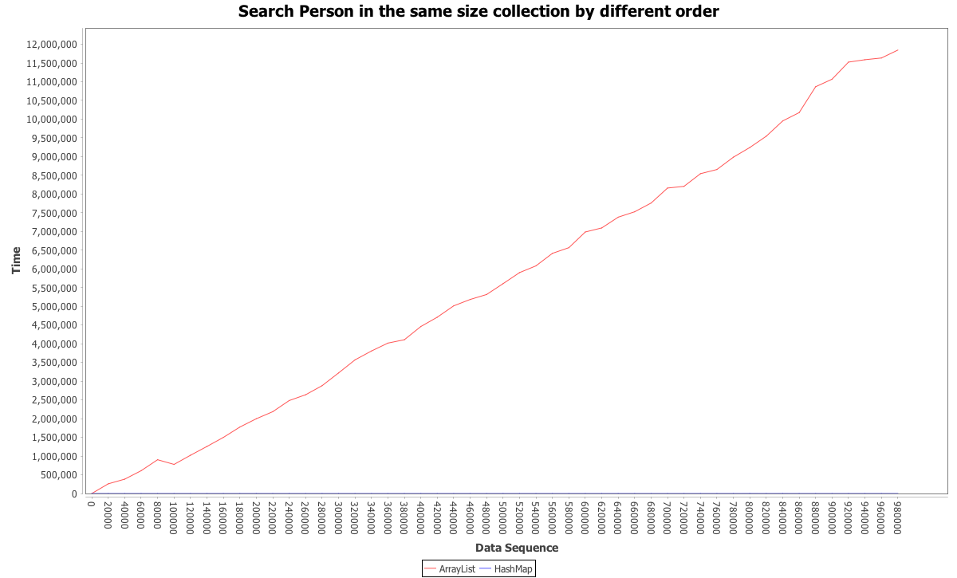
Test Search: Same Size, Different Order
Size: 1000000
Order: 50 Sample Points
from 0 – 98000
20000 per hop
ArrayList: O(N)
HashMap: O(1)

Slide 2
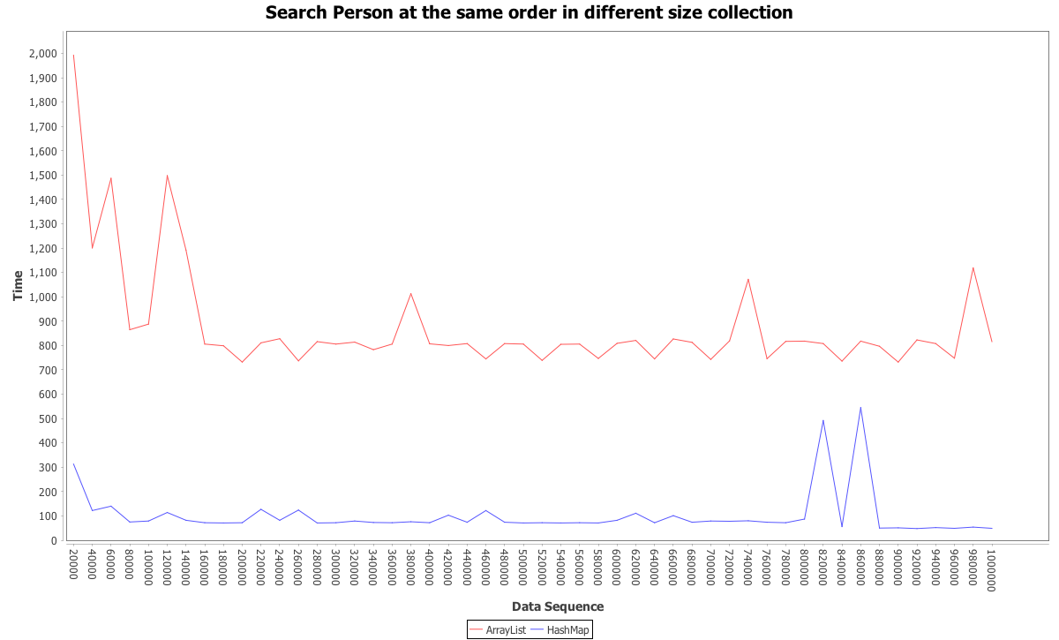
Test Search: Same Order, Different Size
Order: Person5
Size:
50 Sample Points
20000 - 1000000
20000 per hop
Search depends on order.

Slide 3
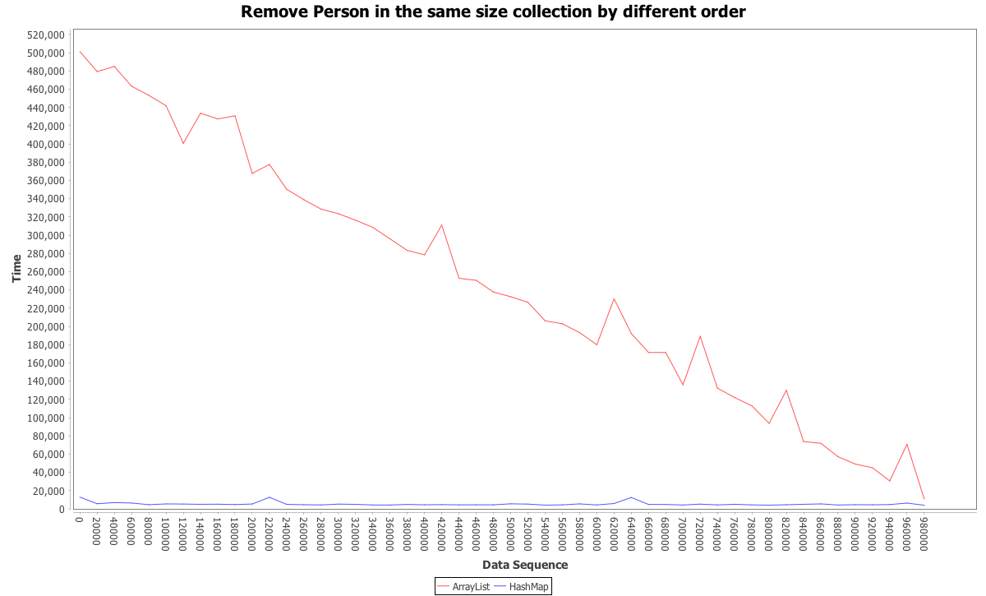
Test Remove: Same Size, Different Order
Size: 1000000
Order:
50 Sample Points
0 - 980000
20000 per hop
ArrayList: O(N)
HashMap: O(1)
ArrayList needs to shift right part after remove
HashMap does not need to shift after remove

Slide 4
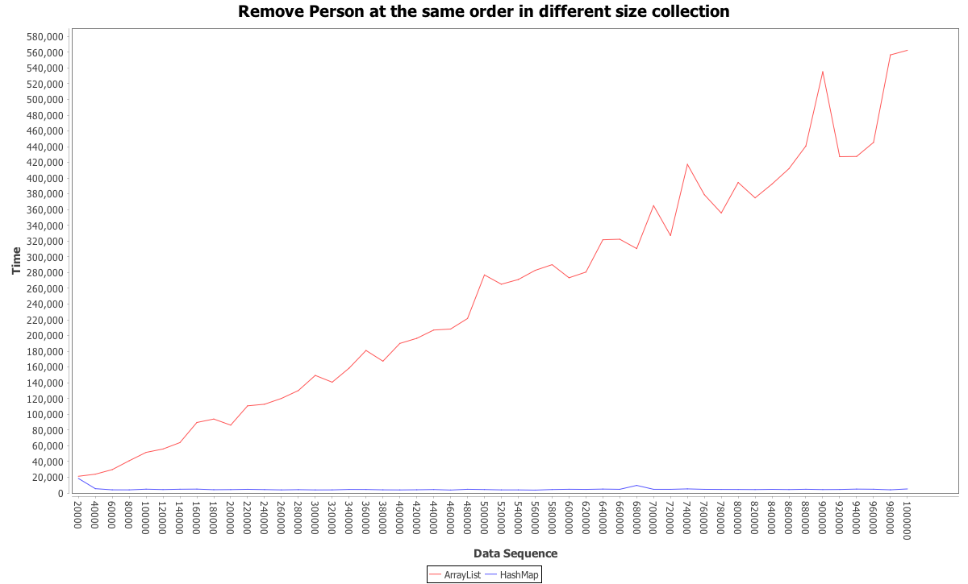
Test Remove: Same Order, Different Size
Order: 1000000
Size:
50 Sample Points
20000 - 1000000
20000 per hop
Larger size, more to shift.

Slide 5
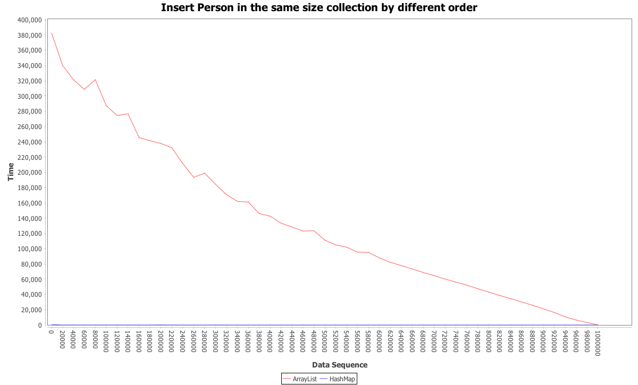
Test Insert: Same Size, Different Order
Size: 1000000
Order:
51 Sample Points
0 - 1000000
20000 per hop
Insert at normal location
ArrayList: O(N), needs to shift right part.
HashMap: O(1)

Slide 6
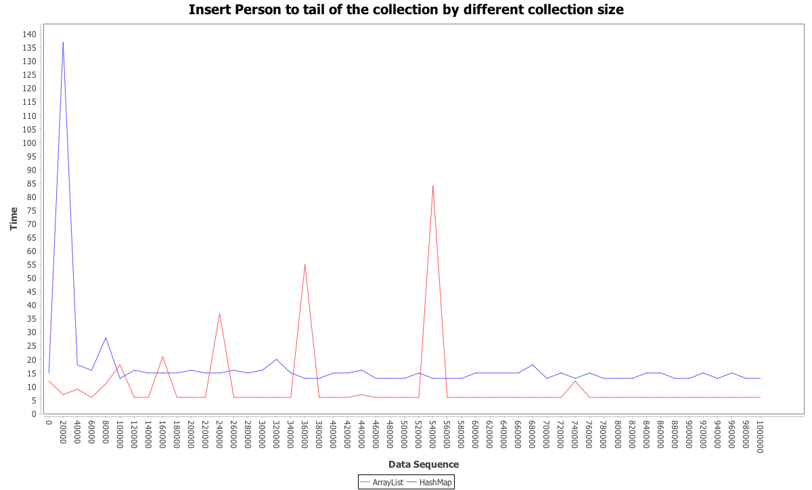
Test Insert: Same Order (Tail), Different Size
Order: Tail of the collection
(add without index parameter for Array List)
Size:
51 Sample Points
20000 - 1000000
20000 per hop
Insert to tail of the collection
Normally add operation for ArrayList: add(object)
ArrayList: O(1), no shift
HashMap: O(1)

