Slide 1

Emotion Identifier: User Manual
Hileri Shah

Slide 2
AGENDA
Who am I?
My Internship Journey with Clevered
Introduction to Facial Emotion Identifier
How do I Use the App?
Contact Information

Slide 3

Who am I?
It’s me Hileri Shah
I am 13 years old
I am a student in Grade 9
You can find me coding or if not, I would be reading.
I am pursuing my interest in AI through Clevered

Slide 4

My Internship Journey with Clevered
The mentorship sessions are truly educative and trains me to move forward with my project development.
I was able to go deep in and learn more about AI every week.
The opportunity to intern here is one of the best so far, and I look forward to learning a lot more.
Ms. Shivani has made the course simple for us to understand and has been patient and motivated me to discover more on the topic myself.

Slide 5
Introduction to Facial Emotion Identifier
My goal is to make a Sentiment Analyzer that detects the emotion of people and returns it to them.
There are many types of emotions stored in it and the model has been trained with various images of all types of emotions.
An image can be uploaded, and is returned with its emotion detected by the bot.
I am aiming to include a camera in the UI for live face detection as well.

Slide 6
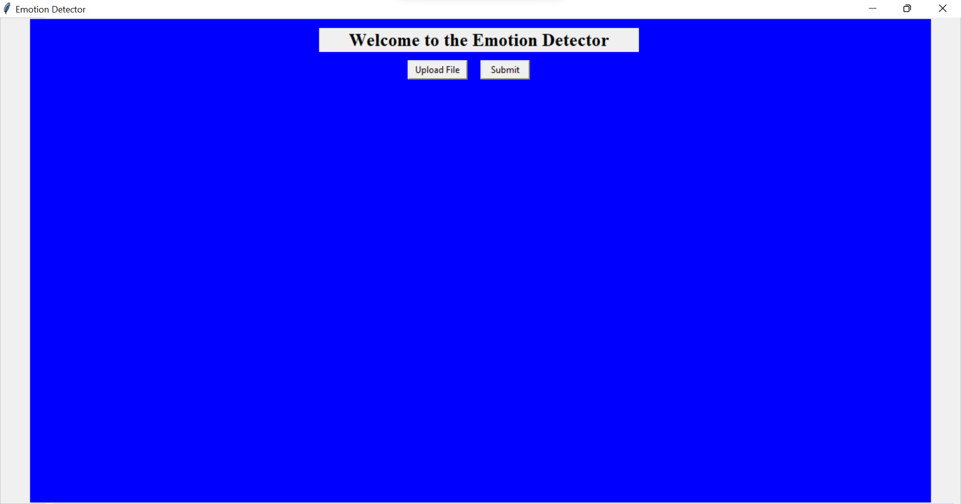
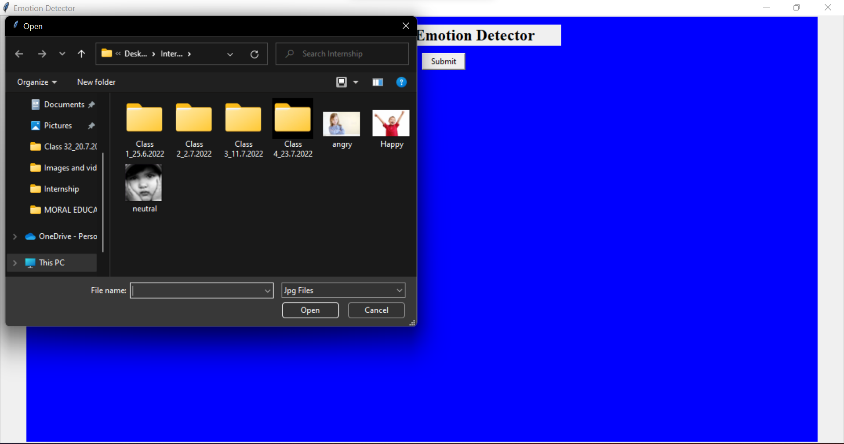

How Do I Use The App?
The UI appears.
There is a button to upload the file.
Press it and browse and select your file in which the emotion is to be detected.

Slide 7
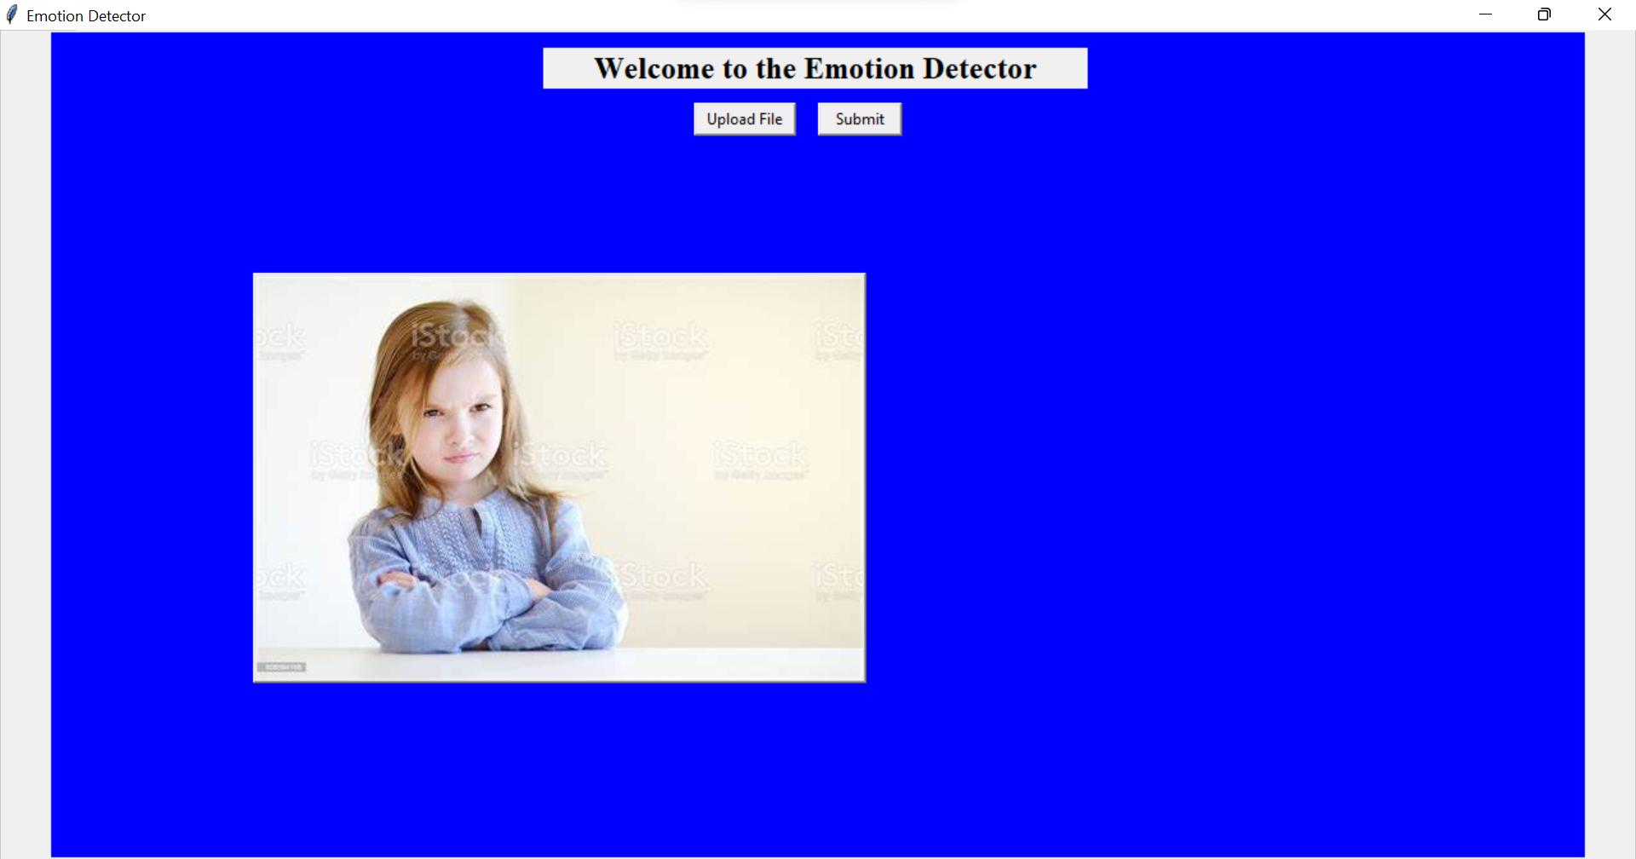
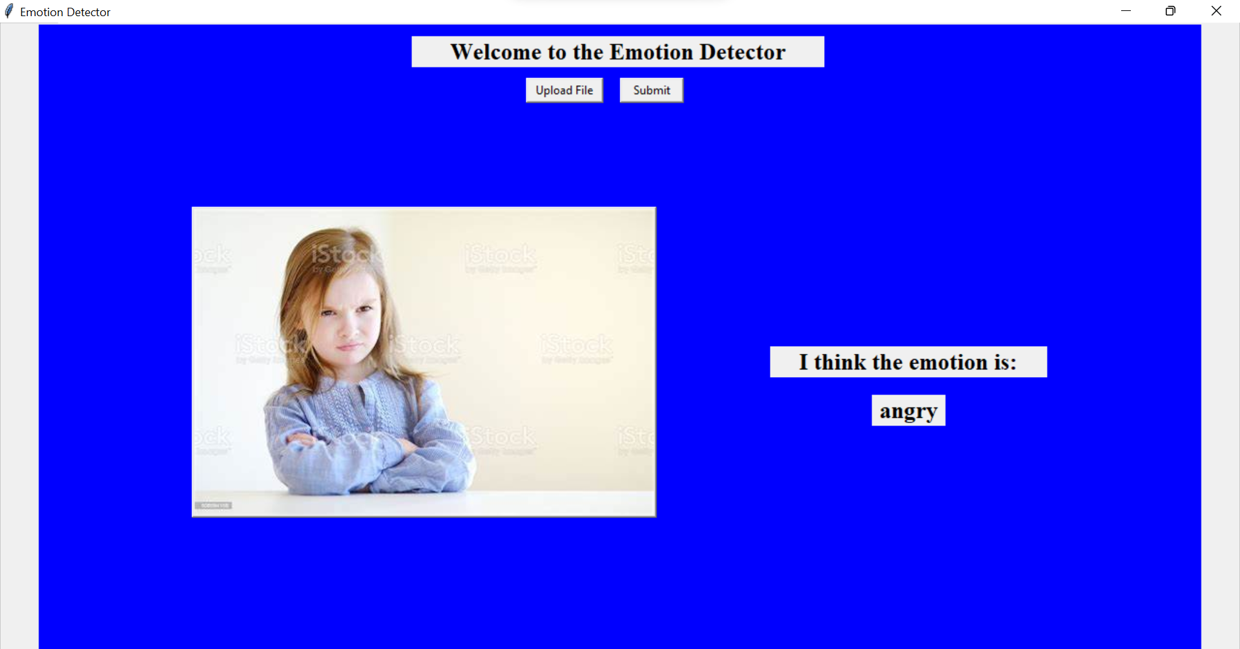
Press Submit
The emotion detected by the AI will be shown next to the image.

Slide 8

Contact Information
Hileri Shah
Mail: hilerishah16@gmail.com

Slide 9
Any Queries or Feedback?

Slide 10


