Slide 1
CodeLinc 7.0
Submission
Hunter Hawkins
Bryan Hill
Ethan Little

Slide 2
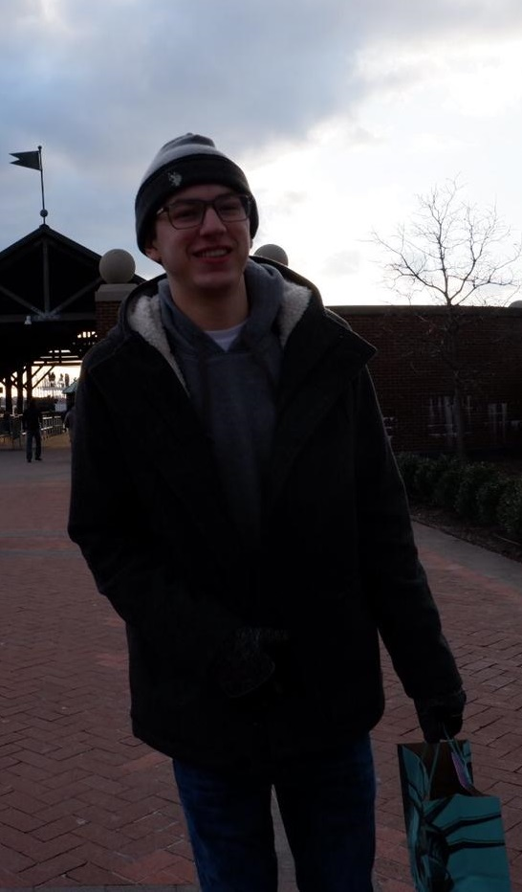

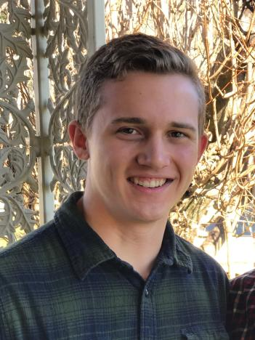
About Us
Bryan Hill
Hunter Hawkins
Ethan Little
Appalachian State University, Junior
Major: Computer Science
Minor: Mathematics
From Greensboro, NC
UNC Charlotte, Junior
Major: Computer Science, Japanese
From Greensboro, NC
Appalachian State University, Junior
Major: Computer Science
Minor: Mathematics

Slide 3
Problem Identified
Learning Loss Attributable to Covid as Well as Summer Recess.
Virtual Education & Reinforcement
Engagement to Big / Little Matching

Slide 4
Proposed Solution
To improve the challenge of learning loss and connecting bigs / littles, our team created a web application that supports messaging and a flash card studying system.
Bigs can create flashcards for the littles to study, or the littles can make flash card sets themselves to study.
The bigs and littles can communicate to each other through a messaging system implemented in the web app.

Slide 5
Demo

Slide 6
Challenges Faced and What We Learned
What we Learned:
React
Java Spring Boot
mySQL server
Competing Demand
Expected Availability
React Component Updates
Memory Leak

