Slide 1




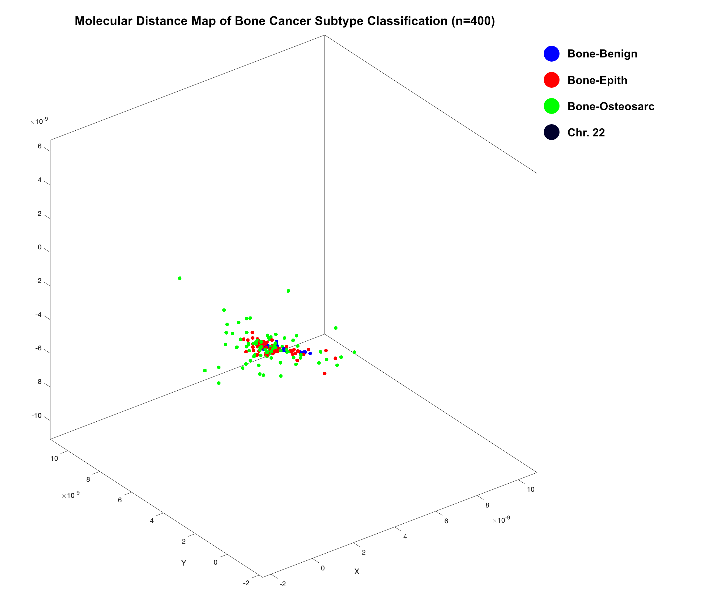
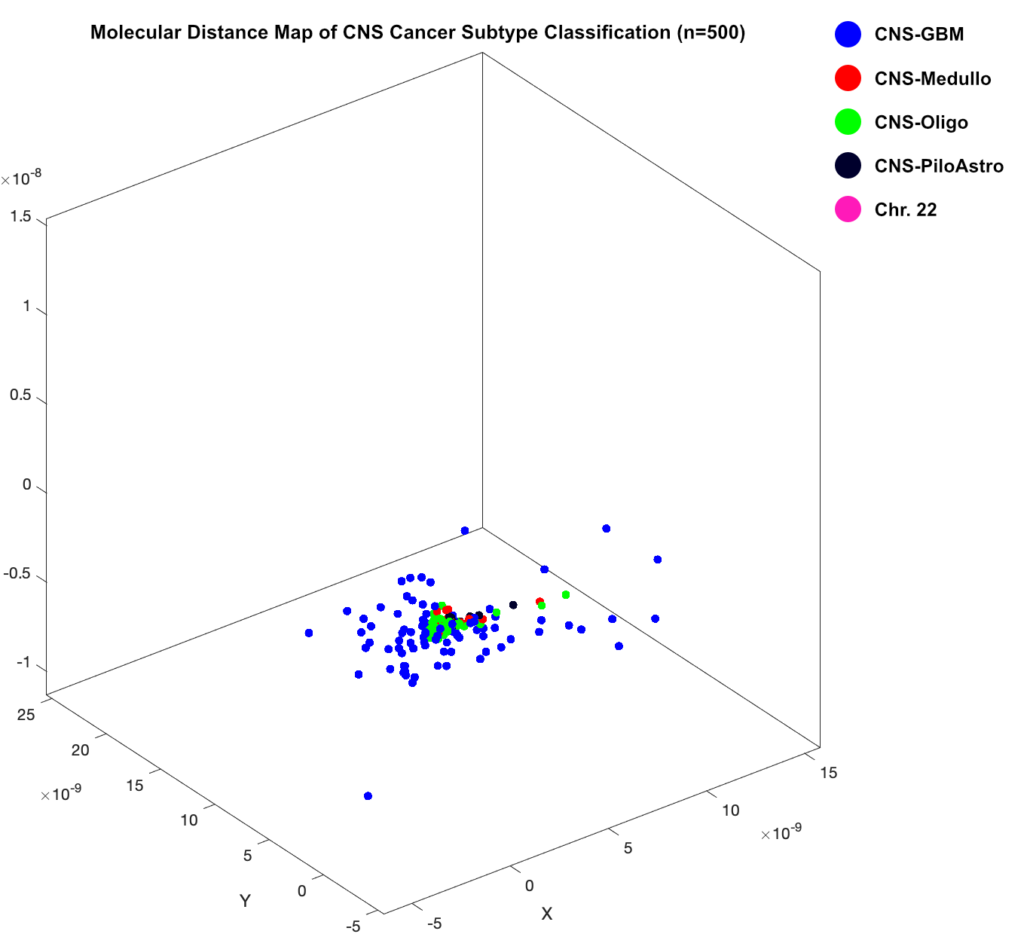
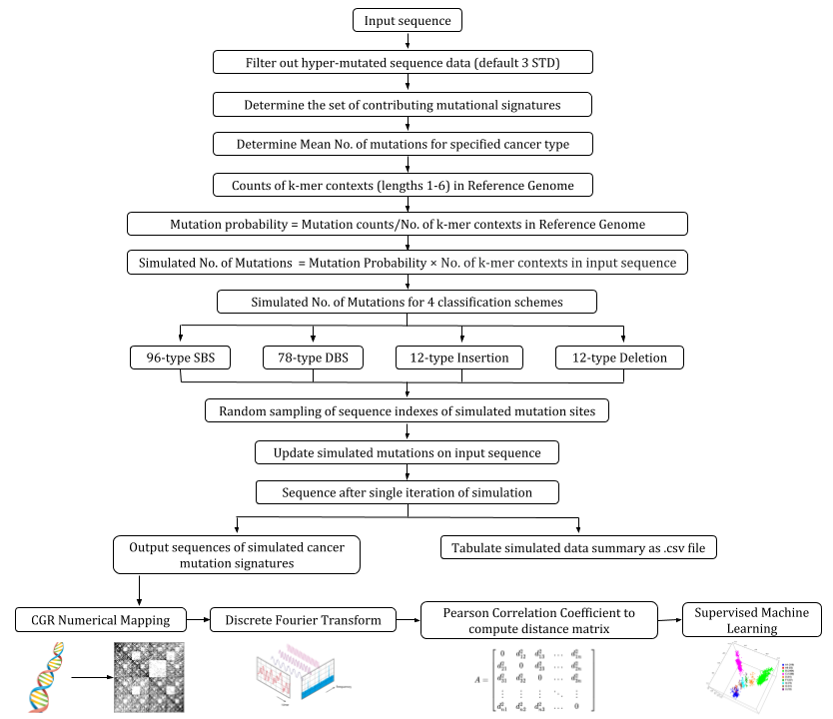


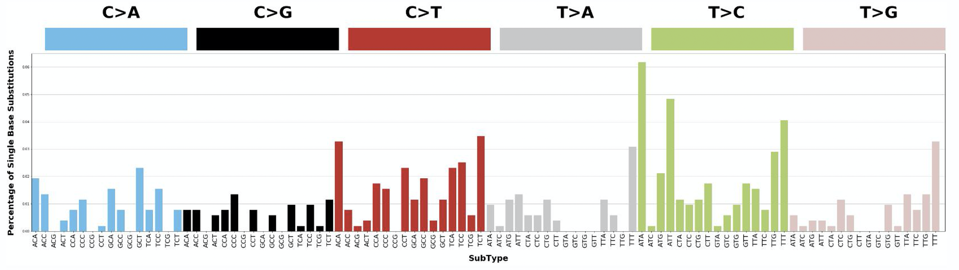
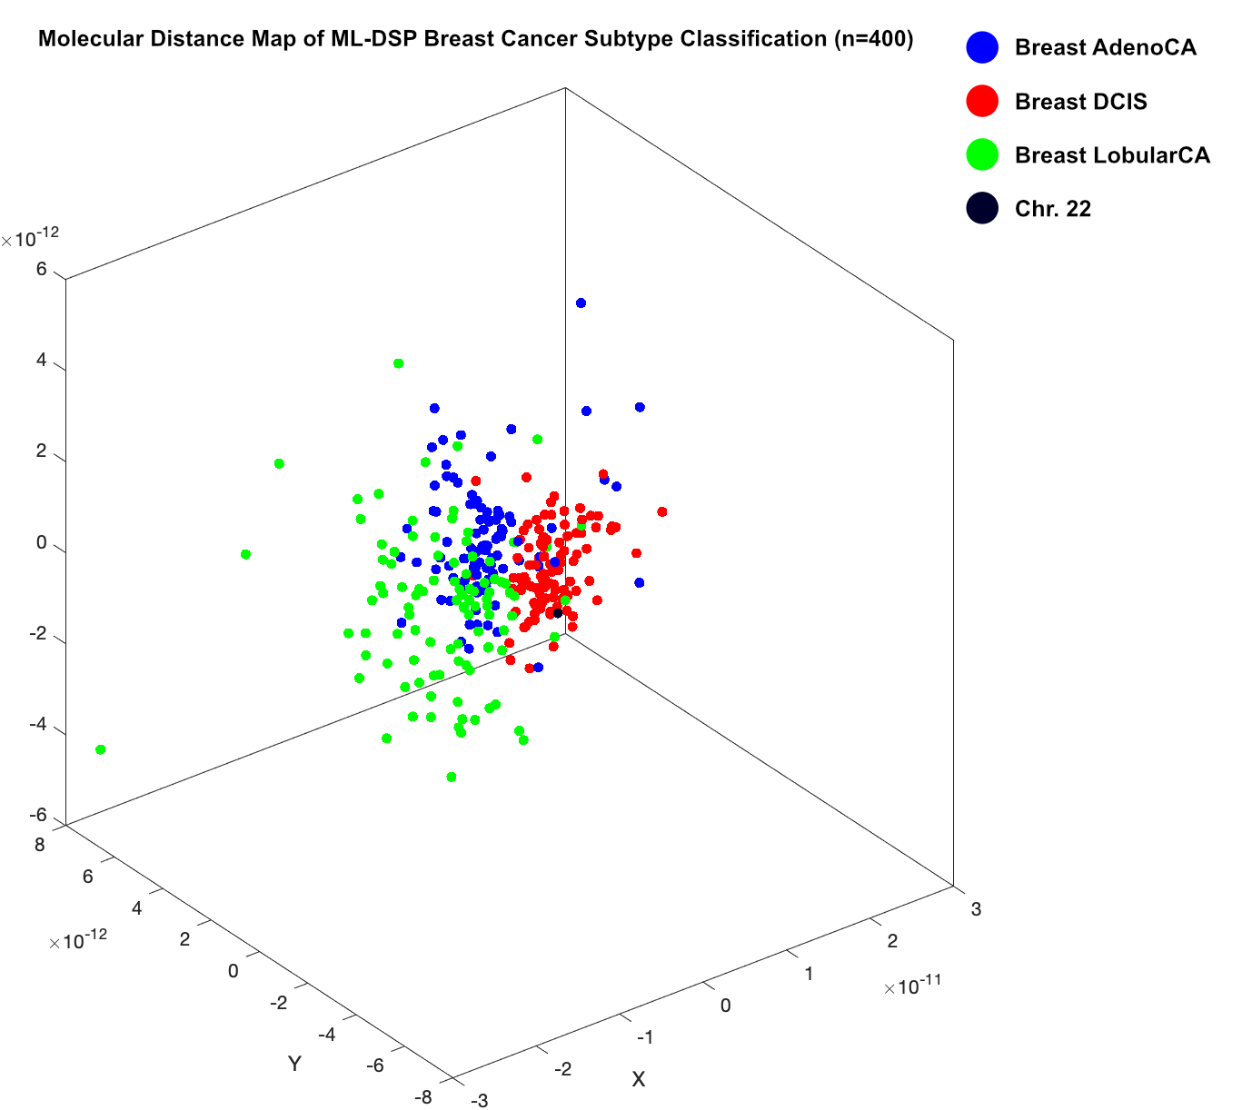
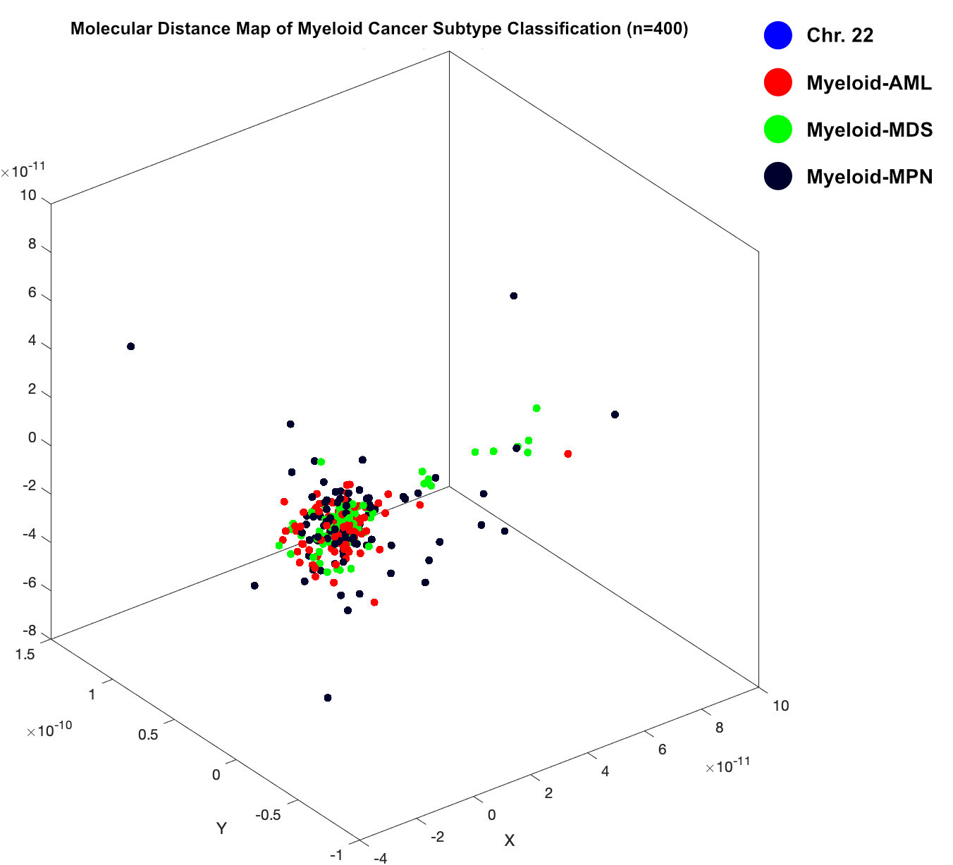
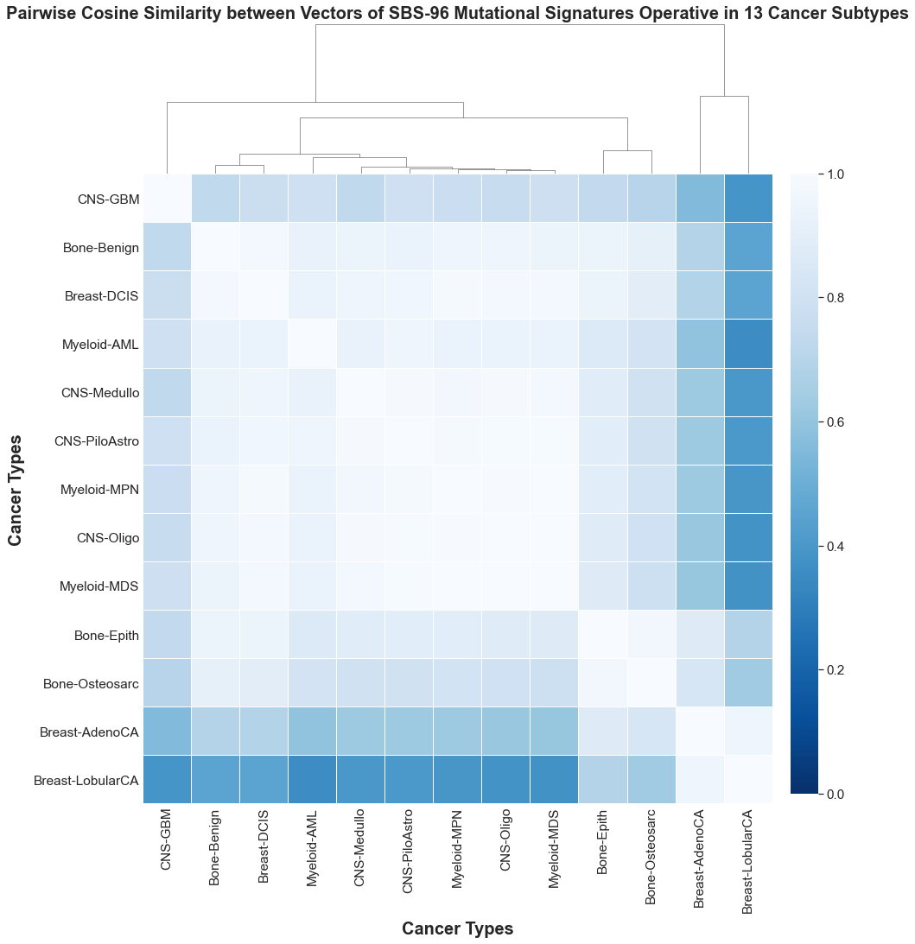
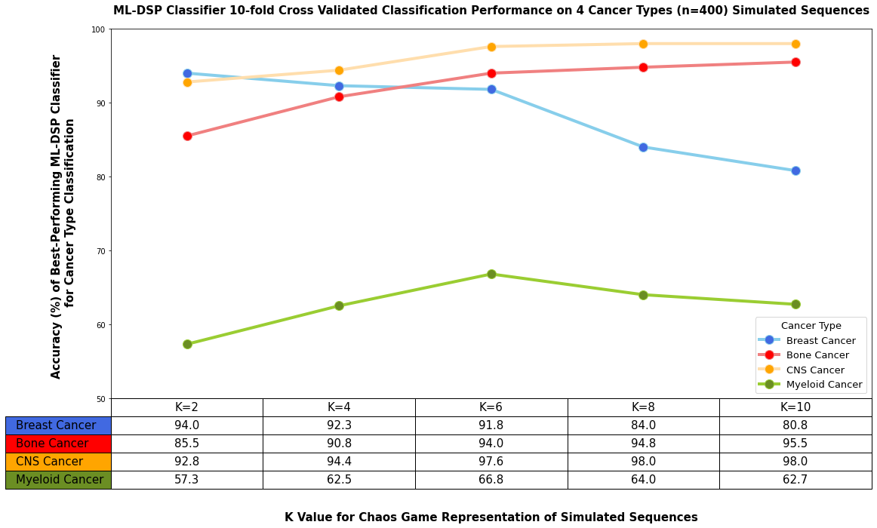
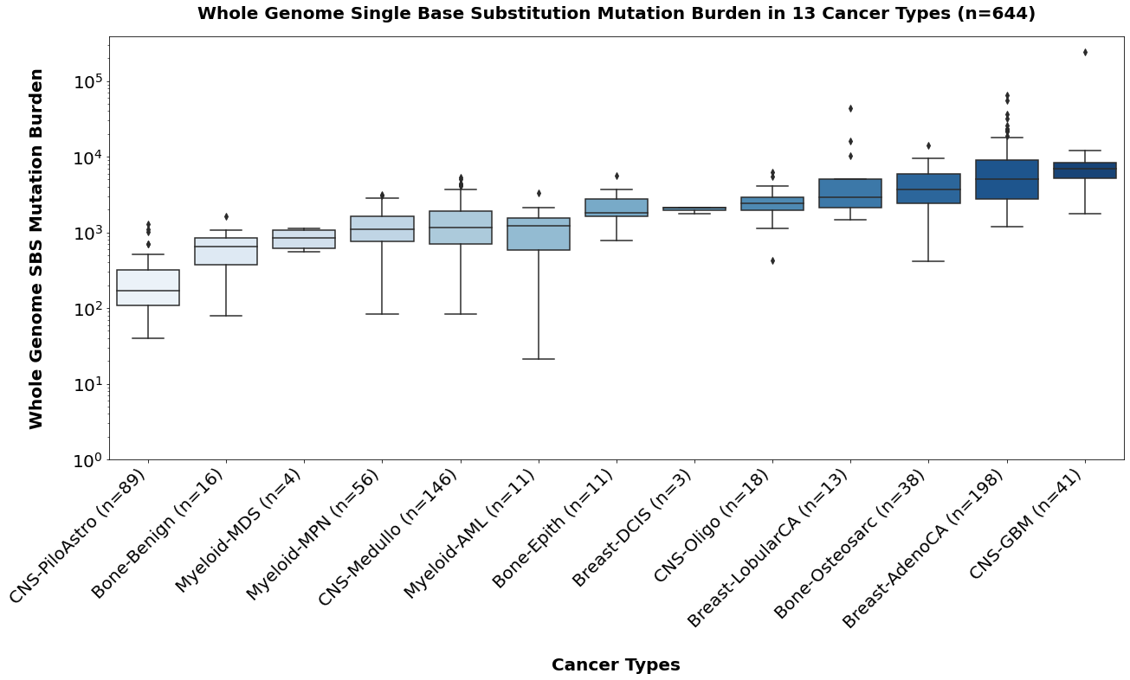
Simulated Cancer Mutational Signatures to classify cancer types using an
Alignment-free Machine Learning-based approach
David Chen¹, Gurjit S. Randhawa², Maximillian P. M. Soltysiak¹, Lila Kari², Shiva M. Singh¹, Kathleen A. Hill¹
¹ Department of Biology, University of Western Ontario
² School of Computer Science, University of Waterloo
Introduction
SomaticSiMu Simulation and ML-DSP Classification
Results
Somatic mutagenesis in cancer is a phenomenon that perturbs genome sequence organization given the mutational signatures that characterize global non-random biases in sequence composition arising from mutagen exposures, mutational mechanisms, and faulty DNA repair. Genomic signatures can be used for classification purposes with demonstrated sensitivity to the level of individual species. Early classification of cancer types using mutational signatures in cancer genomes is a novel intraspecific application of the ML-DSP, an ultra-fast, alignment-free, approach that uses Machine Learning with Digital Signal Processing (ML-DSP) for sequence dissimilarity analysis.
Biomarkers derived from specific components of mutation signatures can be used to characterize and delimit between cancer types. Thereby, the abstraction of useful biomarkers from the landscape of somatic mutations of mutation signatures can provide
insight into the evolutionary history of cancer and identify relevant mutational processes.
SomaticSimu simulates SBS, DBS, and single base indels simultaneously at non-overlapping, random indexes on a user supplied reference in silico. The program can simulate successive stages of simulated mutations using the COSMIC Mutational Signatures v3.0 catalogue as the reference dataset. SomaticSimu generated sequences with imposed mutational signatures were used as a training dataset to calibrate ML-DSP classification of the cancer subtypes. Four classification tests within 3-4 subtypes of Bone (n=400), CNS (n=500), Breast (n=400), and Myeloid (n=400) cancer was conducted at increasing k values of the Chaos Game Representation of the input sequences for ML-DSP.
Bone, Breast, and CNS simulated training datasets achieved above 94% 10-fold cross-validated accuracy using the Quadratic SVM classifier. The scaled 3-dimensional Molecular Distance Map visualizes more defined clusters for tests with high classification accuracy based on greater sequence dissimilarity. Myeloid cancer sequences achieved 64% 10-fold cross-validated accuracy and visualizes less clearly defined clusters in 3-dimensional space.
CGR k=10
CGR k=10
CGR k=2
CGR k=6
One biomarker that differentiates between cancer whole genomes is characteristic mutation types. A measure of similarity between the profiles of mutation types of different cancer types can be represented using the pairwise cosine similarity metric. The cosine similarity metric is defined between 0 and 1, where 1 suggests that the pairwise comparison of cancer mutation profiles are identical and 0 suggests that the pairwise comparison of cancer mutation profiles are independent.
Results
Discussion
Another unique biomarker between cancer whole genomes is whole genome mutation burden. The total mutation burden attributed to multiple operative mutation signatures in whole genome sequences represent the product of multiple accumulated mutational processes found in cancer. The frequency distribution of whole genome total SBS, DBS and indel mutation burden has shown variation by orders of magnitude across a spectrum of different cancer types.
The Quadratic SVM classifier of ML-DSP consistently performed with the highest accuracy among each of the four tests. This achieved up to 100% classification of cancer vs. noncancer genomic signatures. ML-DSP achieves high accuracy in classification within subtypes of Bone (94.8%), Breast (94%), Central Nervous System (98%), and Myeloid (66.8%) simulated cancer sequences.
Supervised machine learning classifiers are expected to show high accuracy in classification of classes with high sequence dissimilarity between cancer types and high mutation burden. Conversely, classifiers are expected to show low accuracy lower accuracy in classification of classes with low sequence dissimilarity between cancer types and low mutation burden. Our preliminary results are consistent with this hypothesis. In the tests using Bone and CNS cancer subtype sequences as the training dataset for ML-DSP classification, the Quadratic SVM classifier achieved above 95% accuracy using a k value of 10 for tests with high signature cosine similarity (>0.75) and high sequence mutation burden. In the tests using Breast cancer subtype sequences, the Quadratic SVM classifier achieved up to 4% accuracy using a k value of 2 for tests with low signature cosine similarity (<0.75) and high sequence mutation burden. In the tests using Myeloid cancer subtype sequences, the Quadratic SVM classifier achieved up to 66.8% accuracy using a k value of 6 for tests with higher signature cosine similarity (<0.75) and low sequence mutation burden. SomaticSiMu can be used to benchmark the alignment-free machine learning approach and identifies ML-DSP classifier parameters to achieve ultra-fast and highly accurate classification of cancer sequences based on cancer mutational signatures. Further research can be done to optimize ML-DSP classifier performance using alternative distance metrics to improve accuracy.
Conclusion
SomaticSiMu simulates cancer sequences with imposed mutational signatures in silico to benchmark Machine Learning with Digital Signal Processing classifier performance and facilitates identification of biomarkers within the landscape of cancer mutational signatures.

