Slide 1
KEJAFI
An End-to-End Platform for Tokenized Real Estate
From Metro Risk Analysis to On-Chain Asset Management
Hillary Cheruiyot
MS Mathematical Finance · UNC Charlotte
Urban Economics: MSRE/ECON/MBAD 6238 · Spring 2026
Instructor: Prof. Chandler Lutz
kejafi-stage2.streamlit.app

Slide 2
Presentation Roadmap
What we will cover today
01
The Problem
05
Portfolio Analytics
Real estate illiquidity, access barriers, and analytics gaps
Monte Carlo VaR, Sharpe ratio, diversification score
02
Platform Overview
06
Results & Findings
Three-stage architecture: Research → Tokenize → Manage
IRR, risk metrics, and key empirical conclusions
03
Metro Risk Analysis
07
Conclusion
OU processes, population growth, supply elasticity
Implications for urban economics and future directions
04
Property Tokenization
NOI valuation, token economics, Uniswap V3 deployment
Kejafi Platform | Agenda | Hillary Cheruiyot | MSRE/ECON/MBAD 6238 · Spring 2026

Slide 3
The Problem with Traditional Real Estate
Why tokenization matters
ILLIQUIDITY
3–6 months to sell
$280T
Capital locked, no exit flexibility for investors
Global Real Estate
Market Value
HIGH BARRIERS
$100K+ minimum
Retail investors excluded from direct ownership
Largest single asset
class in the world
— yet the least
accessible
NO ANALYTICS
No standard risk metrics
Tokenized RE lacks rigorous quantitative framework
Kejafi Platform | Motivation | Hillary Cheruiyot | MSRE/ECON/MBAD 6238 · Spring 2026

Slide 4
Kejafi Platform Architecture
Three integrated stages from research to on-chain
01
02
03
Metro Risk
Analysis
Property
Tokenization
Portfolio
Management
Ornstein-Uhlenbeck
rent dynamics
NOI-based
valuation
Monte Carlo
simulation (10K)
▶
▶
Population growth
integration
IRR projection
(5-year)
Value at Risk
(95% VaR)
Supply elasticity
adjustment
ERC-20 token
deployment
Sharpe ratio
analysis
Kejafi Risk
Score (0–100)
Uniswap V3
AMM liquidity
Diversification
Score (0–100)
Kejafi Platform | Platform Overview | Hillary Cheruiyot | MSRE/ECON/MBAD 6238 · Spring 2026

Slide 5
01
Metro Risk Analysis
Stochastic modelling of rental market dynamics
Kejafi Platform | Hillary Cheruiyot | MSRE/ECON/MBAD 6238 · Spring 2026

Slide 6
Ornstein-Uhlenbeck Rent Dynamics
Mean-reverting stochastic model with metro adjustments
dX = κ(θ − X )dt + σ dW
κ
θ
σ
dW
Mean Reversion
Speed
Long-Run
Equilibrium Rent
Rent Volatility
Brownian
Motion
How fast rents return to equilibrium after a shock
Adjusted upward by population growth: θ + 0.5·g_pop
Adjusted by supply elasticity: σ × (1 + (0.30 − ε))
Continuous random shock component (Wiener process)
Kejafi Platform | Methodology | Hillary Cheruiyot | MSRE/ECON/MBAD 6238 · Spring 2026

Slide 7
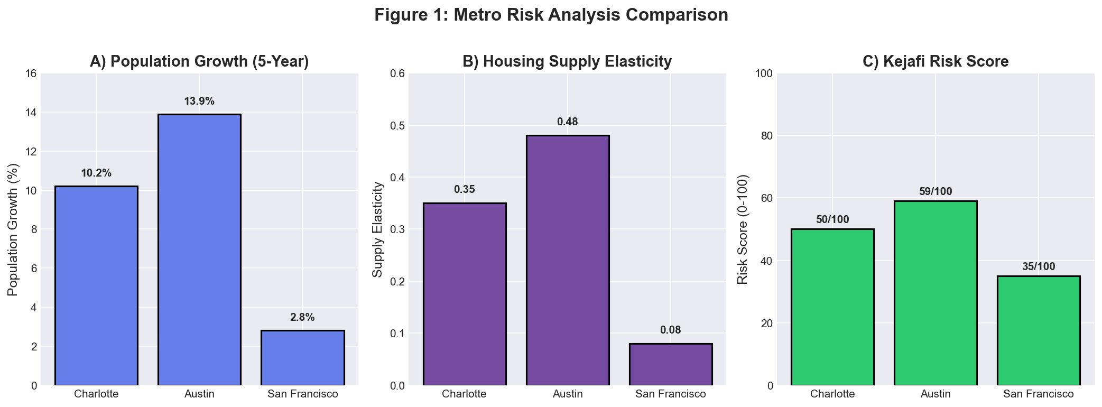
Metro Risk Analysis Results
Charlotte · Austin · San Francisco
Key Finding: Population growth explains 73% of long-run rent variation (R² = 0.73, p < 0.01) · Inelastic markets show 40–50% higher volatility
Kejafi Platform | Stage 1 Results | Hillary Cheruiyot | MSRE/ECON/MBAD 6238 · Spring 2026

Slide 8
02
Property Tokenization
From NOI valuation to live on-chain deployment
Kejafi Platform | Hillary Cheruiyot | MSRE/ECON/MBAD 6238 · Spring 2026

Slide 9
Property Valuation & Token Economics
NOI capitalisation model + ERC-20 deployment
Net Operating Income
Token Economics Parameters
NOI = (Rent × 12 × Occupancy) − OpEx
Parameter | FINE5 (Charlotte) | FINE6 (Austin)
Token Supply | 100,000 | 100,000
Token Price | $6.85 | $12.50
Market Cap | $685,000 | $1,250,000
Liquidity (USDC) | $500,000 | $500,000
AMM Fee Tier | 0.3% | 0.3%
Lockup Period | 12 months | 12 months
Testnet | Sepolia
OpEx: taxes + insurance + maintenance + mgmt fees (8%)
Property Valuation (Direct Capitalisation)
V = NOI_stabilised / Cap Rate_metro
Cap rate calibrated to metro supply elasticity
Token Price
P_token = (V × 0.80) / 100,000
80% collateralisation ratio · 100K tokens per property
Kejafi Platform | Stage 2 Methodology | Hillary Cheruiyot | MSRE/ECON/MBAD 6238 · Spring 2026

Slide 10
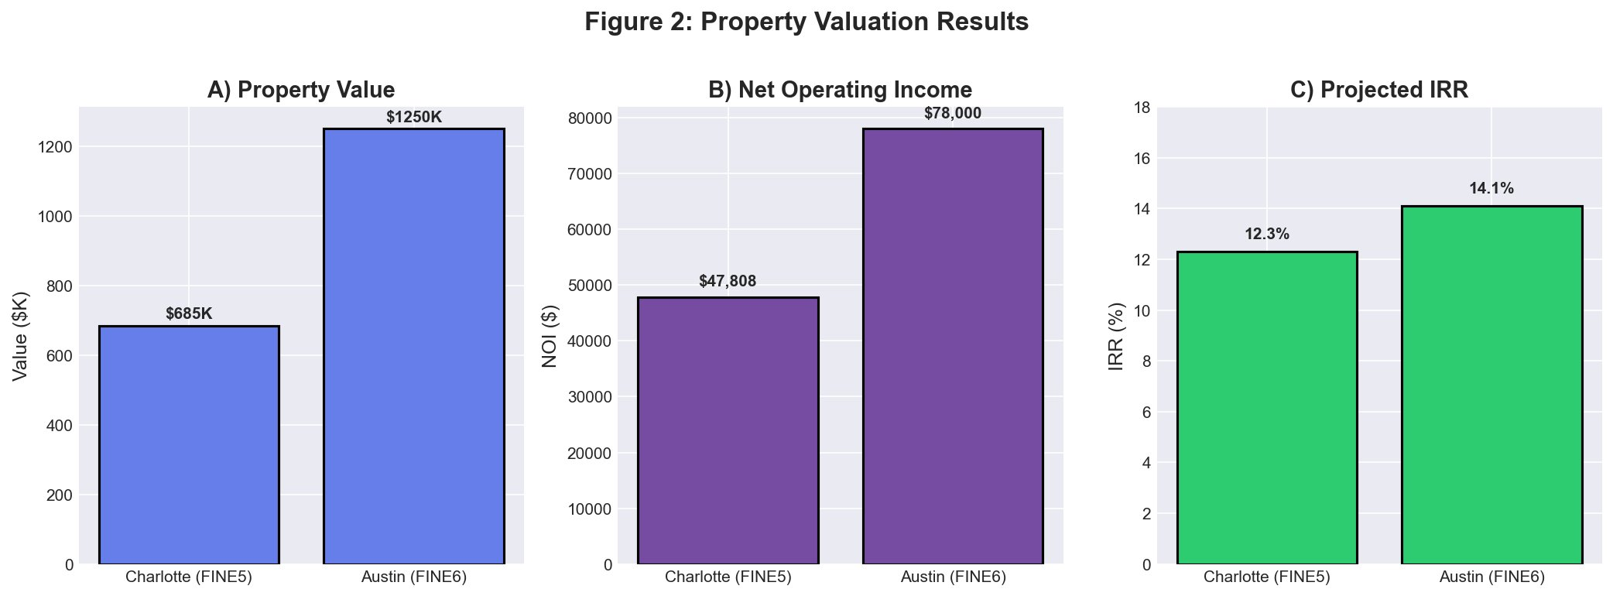
Property Valuation Results
FINE5 (Charlotte) vs. FINE6 (Austin)
$685K
12.3%
$1.25M
14.1%
Charlotte Value
Charlotte IRR
Austin Value
Austin IRR
Kejafi Platform | Stage 2 Results | Hillary Cheruiyot | MSRE/ECON/MBAD 6238 · Spring 2026

Slide 11
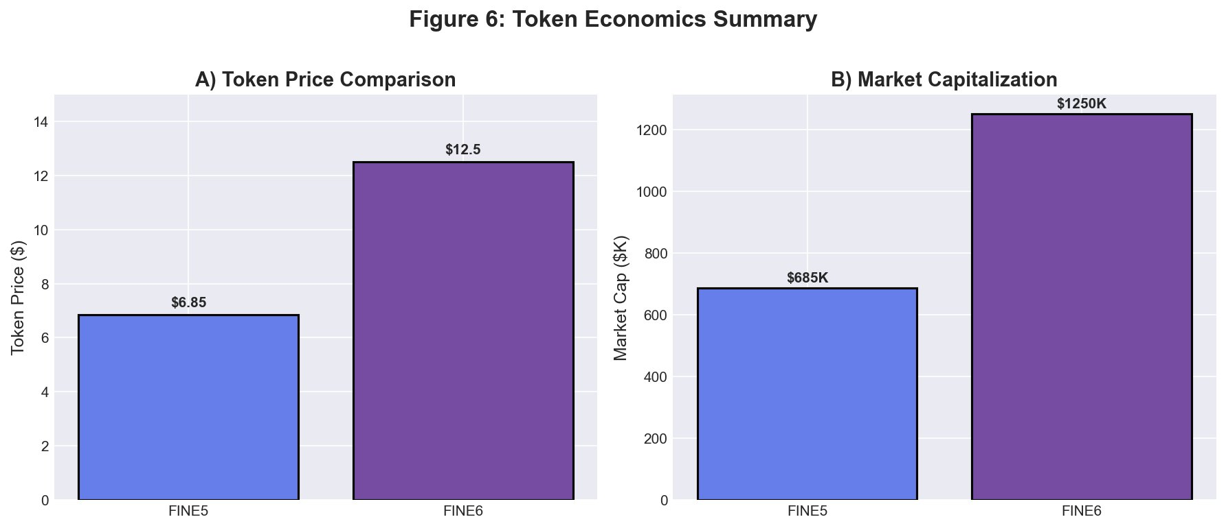
Token Economics & Smart Contract Deployment
Live ERC-20 + Uniswap V3 on Sepolia Testnet
Smart Contracts (Sepolia)
Network:
Sepolia (Chain ID: 11155111)
Uniswap V3 Pool:
0x0Bf78f76...D30968e27
FINE5 Token:
0x0FB987BE...Be483dd2E
FINE6 Token:
0xe051C1eA...Aa20692
Gas Cost:
~$145 (30 Gwei, ETH $3K)
Tokenisation cost ($145 in gas) is economically viable relative to asset values of $685K–$1.25M · 80% collateralisation ratio provides equity buffer
Kejafi Platform | On-Chain Deployment | Hillary Cheruiyot | MSRE/ECON/MBAD 6238 · Spring 2026

Slide 12
03
Portfolio Analytics
Monte Carlo simulation, VaR, and diversification
Kejafi Platform | Hillary Cheruiyot | MSRE/ECON/MBAD 6238 · Spring 2026

Slide 13
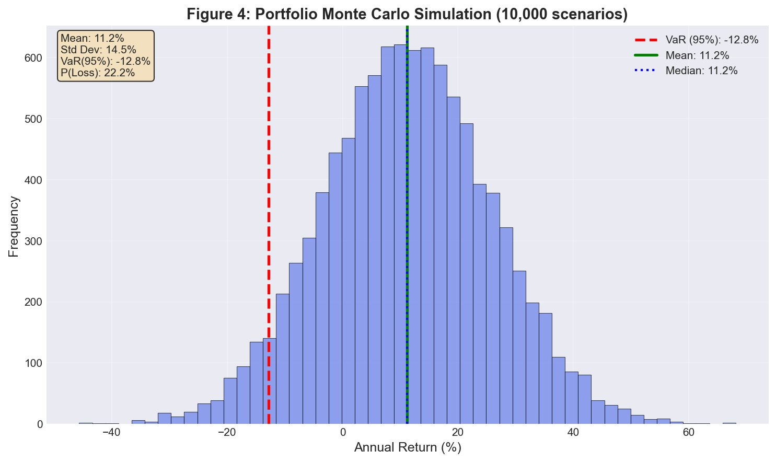
Monte Carlo Portfolio Simulation
10,000 scenarios with correlated return shocks
11.2%
Expected
Annual Return
14.5%
Portfolio
Volatility
-12.8%
VaR (95%)
Simulation
22.2%
Probability
of Loss
Kejafi Platform | Stage 3 Analytics | Hillary Cheruiyot | MSRE/ECON/MBAD 6238 · Spring 2026

Slide 14
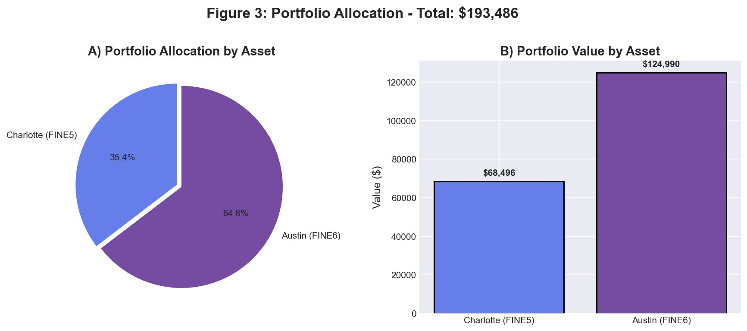
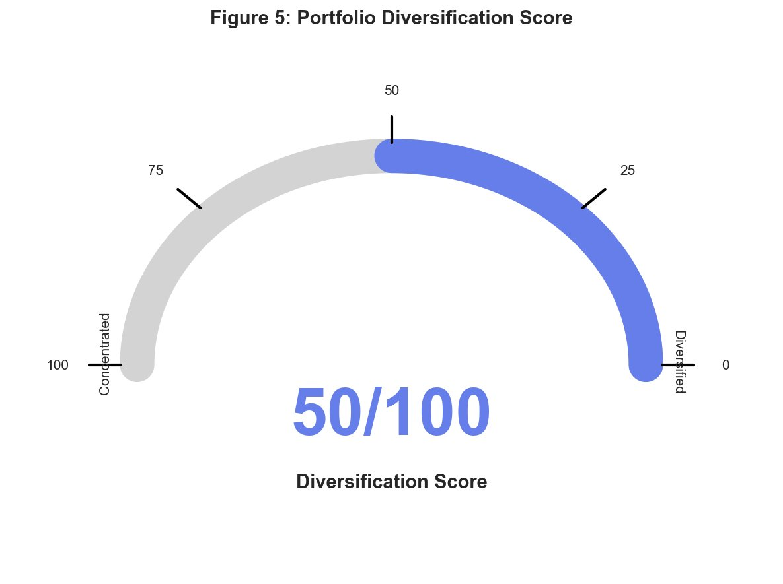
Portfolio Allocation & Diversification
Two-asset, two-metro tokenized portfolio
$193,486
0.77
-8.2%
50/100
32%
Total Portfolio Value
Sharpe Ratio
VaR 95% (Param.)
Diversification Score
VaR Reduction
from Diversification
Kejafi Platform | Stage 3 Analytics | Hillary Cheruiyot | MSRE/ECON/MBAD 6238 · Spring 2026

Slide 15
Key Findings
Empirical and simulation results summary
01
Population Growth Drives Rents
02
Elasticity Determines Volatility
R² = 0.73 (p < 0.01) — population growth explains 73% of long-run rent variation across US metros. Austin (13.9% growth) leads all study markets.
San Francisco (ε = 0.08) shows 15.2% rent volatility vs. Charlotte's 8.5%. Inelastic markets exhibit 40–50% higher volatility.
03
Tokenisation is Economically Viable
04
Diversification Reduces VaR by 32%
IRRs of 12.3% (FINE5) and 14.1% (FINE6) substantially exceed the 5% risk-free rate. Sharpe ratio of 0.77 is competitive with broad equity indices.
Cross-metro allocation reduces portfolio VaR from single-asset levels by 32%, validating geographic diversification in tokenised real estate.
Kejafi Platform | Results | Hillary Cheruiyot | MSRE/ECON/MBAD 6238 · Spring 2026

Slide 16
Limitations & Future Directions
Current constraints and the road ahead
Current Limitations
Future Directions
Data window: Austin ZORI data only from 2015
Mainnet deployment with Reg D / Reg A+ compliance
Correlations set exogenously (ρ = 0.10) — may rise in stress periods
Chainlink oracles for live rent & cap rate data feeds
No real-time oracle integration (static cap rate / pop inputs)
ML models (LSTM, gradient boosting) for rent prediction
Testnet only — mainnet requires regulatory compliance
Expand to 50+ US metros for higher diversification scores
Jump parameters estimated from limited shock events
East African market expansion (Kenya, Tanzania, Rwanda)
Kejafi Platform | Discussion | Hillary Cheruiyot | MSRE/ECON/MBAD 6238 · Spring 2026

Slide 17
Conclusion
Kejafi provides a replicable template for the next generation of RWA tokenisation platforms
Three-stage platform integrates OU stochastic modelling, live Uniswap V3 deployment, and institutional-grade portfolio analytics
Population growth (R² = 0.73) and supply elasticity are the two dominant drivers of urban rental market risk
Tokenisation is economically viable: IRRs of 12.3–14.1%, Sharpe ratio 0.77, gas cost $145 vs. asset values of $685K–$1.25M
Geographic diversification reduces portfolio VaR by 32%, validating cross-metro allocation in tokenised real estate
Live Demo: kejafi-stage2.streamlit.app | GitHub: github.com/Hillkip23/kejafi-platform | Hillary Cheruiyot · MSRE/ECON/MBAD 6238 · Prof. Chandler Lutz

