Slide 1
CSCoPilot
AI Decision Support untuk Customer Support
Client Kickoff · Internal Business Improvement
CSCoPilot · Client Kickoff · Confidential

Slide 2
WHY NOW
Knowledge is everywhere. Tapi susah dicari.
Knowledge tersebar
Answers live across docs, chats, dan pengalaman orang-orang.
Onboarding lambat
New agents masih bergantung pada pengalaman individual.
Jawaban tidak konsisten
Similar cases harus diinvestigate ulang setiap kali.
CSCoPilot
chaos → order
CSCoPilot · Client Kickoff · Confidential

Slide 3
PRODUCT PROMISE
Faster. Consistent. Human-approved.
01
02
03
Faster answers
Consistent replies
Human in control
Pencarian SOP, FAQ, Guide, atau template dalam 3 menit.
Draft dari company knowledge dan communication standard.
Review dan approve setiap draft sebelum disampaikan ke client.
CSCoPilot · Client Kickoff · Confidential

Slide 4
HOW IT WORKS
From Notion to human-approved reply
Notion
Knowledge Hub
AI Assistant
Human validation
Source of truth
Synced + searchable
Context-aware draft
Review · edit · kirim
Tidak auto-send.
CSCoPilot · Client Kickoff · Confidential

Slide 5
MVP SCOPE
What's in the box.
01
Authentication
02
Dashboard
03
Knowledge Hub
Secure login + protected routes.
Dashboard yang jelas ke core features.
Search, categories, dan detail.
04
AI Response Assistant
05
Database & Sync
Draft, edit, dan copy grounded replies.
Supabase/PostgreSQL + Notion sync.
Notion remains the single source of truth.
CSCoPilot · Client Kickoff · Confidential

Slide 6
EXPERIENCE PREVIEW
See it in action.
Knowledge Hub
AI Response Assistant
Cari keyword atau category
Client context
SOP Refund
Operasional
FAQ Reset Password
Akun
Generate draft
Template Keterlambatan Pengiriman
Template
Draft reply grounded in knowledge kamu…
Wajib di-review sebelum dipakai
Built with Next.js · TypeScript · shadcn/ui · Tailwind CSS
CSCoPilot · Client Kickoff · Confidential

Slide 7
GUARDRAILS
Safe by design
01
Notion tetap jadi source of truth
02
No auto-reply, ever
No second database, semua edit tetap di Notion.
AI tidak langsung send ke client atau ambil final decision.
03
Secrets tetap server-side
04
Full state coverage
API keys dan credentials tidak masuk browser.
Loading, empty, error, unauthorized, dan session expired.
CSCoPilot · Client Kickoff · Confidential

Slide 8
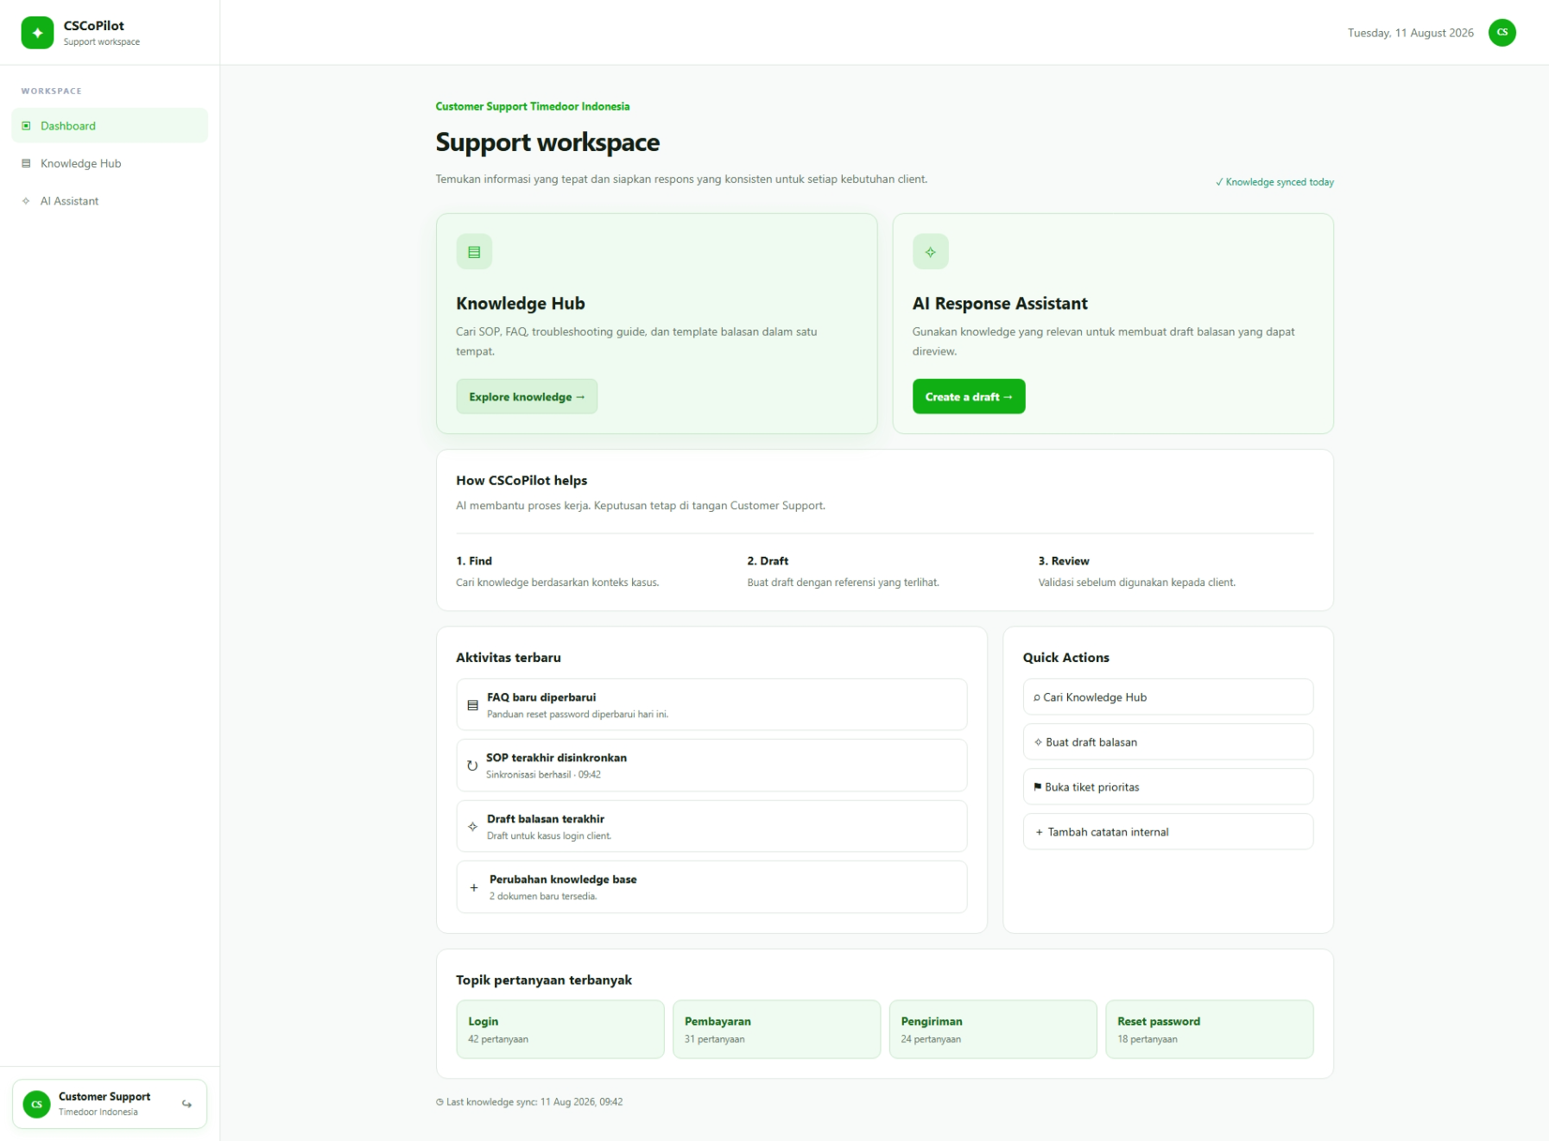
HOW IT WORKS
Wireframe preview
WIREFRAME
CSCoPilot · Client Kickoff · Confidential

Slide 9
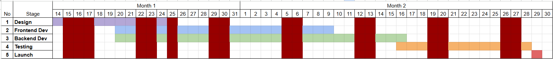
DELIVERY PLAN
Timeline
01
02
03
04
Foundation
Core build
Integration
QA & Release
Minggu 1 · Design + setup
Minggu 2 · Auth + Hub + sync
Minggu 3 · AI Assistant end-to-end
Minggu 4 · UAT + deployment
Plan
CSCoPilot · Client Kickoff · Confidential

Slide 10
EFFORT & PLANNING
Estimasi 49 mandays
Design
Frontend (Next.js)
Backend
QA
6 MD
14 MD
19 MD
10 MD
12% dari total effort
29% dari total effort
39% dari total effort
20% dari total effort
Recommended planning range
Critical path
54–57 MD
Backend 19 MD
Base 49 MD + contingency 10–15%.
Butuh tim paralel; 1 fullstack sekuensial tidak cukup 1 bulan.
CSCoPilot · Client Kickoff · Confidential

Slide 11
RISKS
Yang kami jaga sejak awal
01
Dokumentasi Notion belum rapi
02
Struktur Notion tidak konsisten
Mitigasi: audit dan rapikan knowledge sebelum UAT.
Mitigasi: tetapkan mapping kategori dan format data.
03
Scope melebar
04
Auth provider belum ditentukan
Mitigasi: out-of-scope list jadi batas delivery.
Mitigasi: konfirmasi config NextAuth sebelum sprint mulai.
CSCoPilot · Client Kickoff · Confidential

Slide 12
SCOPE BOUNDARY
Yang tidak masuk MVP
01
Tidak ada auto-reply ke client
02
Bukan pengganti Notion
Semua draft wajib direview manusia sebelum dipakai.
Notion tetap pusat dokumentasi; edit tetap di Notion.
03
Tanpa edit dokumen dari CSCoPilot
04
Belum ada halaman admin
Aplikasi membaca knowledge, tidak menulis balik.
Proses internal dulu; admin UI menyusul setelah MVP.
CSCoPilot · Client Kickoff · Confidential

Slide 13
TEAM & KICKOFF
Our Team
J
TO CONFIRM
Julia
Akses Notion + content taxonomy
PM · Design · Frontend
Auth provider config
Claude API · Supabase · hosting
H
Hilmi
UAT scenarios dari Customer Support
Backend · QA
CSCoPilot · Client Kickoff · Confidential

