Slide 1
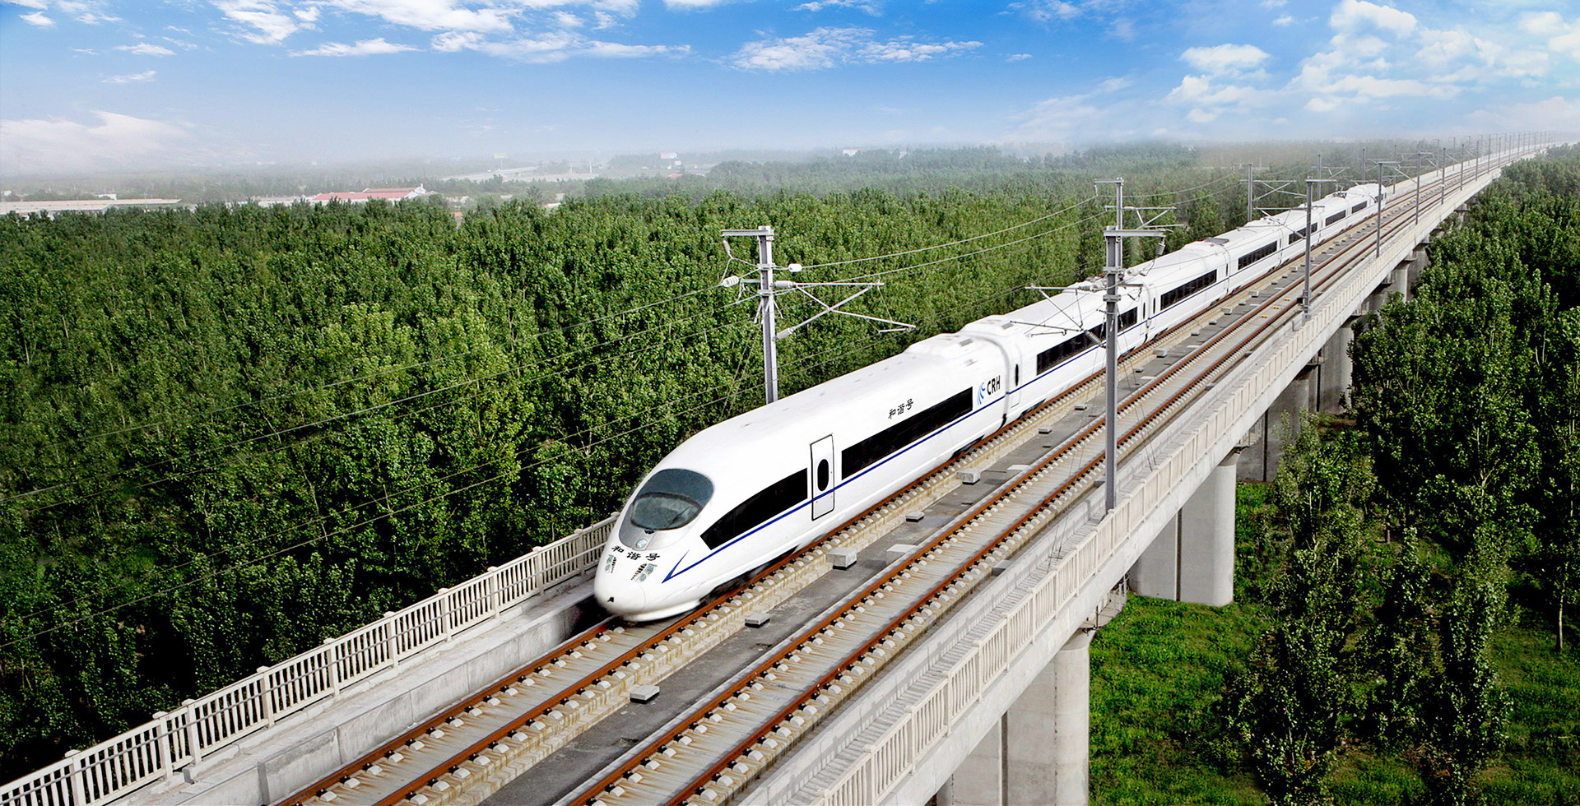

ADVANCED MATERIALS TECHNOLOGY
High-Performance Fiber-Reinforced Polyurethane Ties
for Bridges, Tunnel, Transit & Heavy Haul Applications
FFU Composite
Railroad Ties
Qingdao Hilywill Advanced Materials Technology Co., Ltd | hilywill.com | Hilywill Technologies LLC – 7763 N Haggerty Rd, Canton, MI 48187

Slide 2
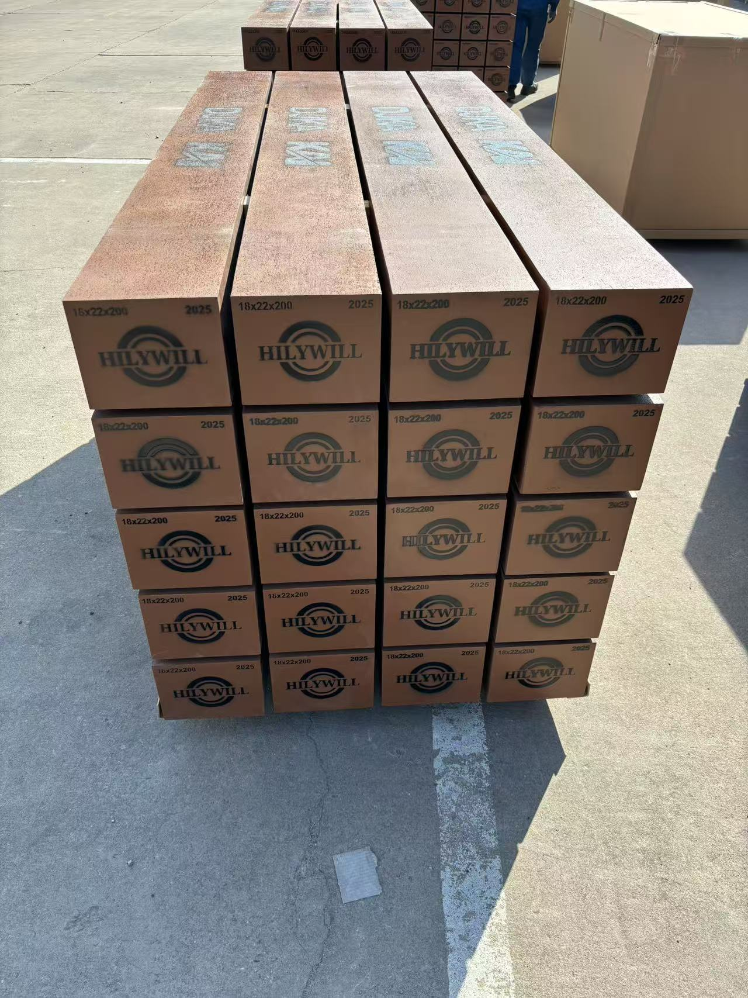
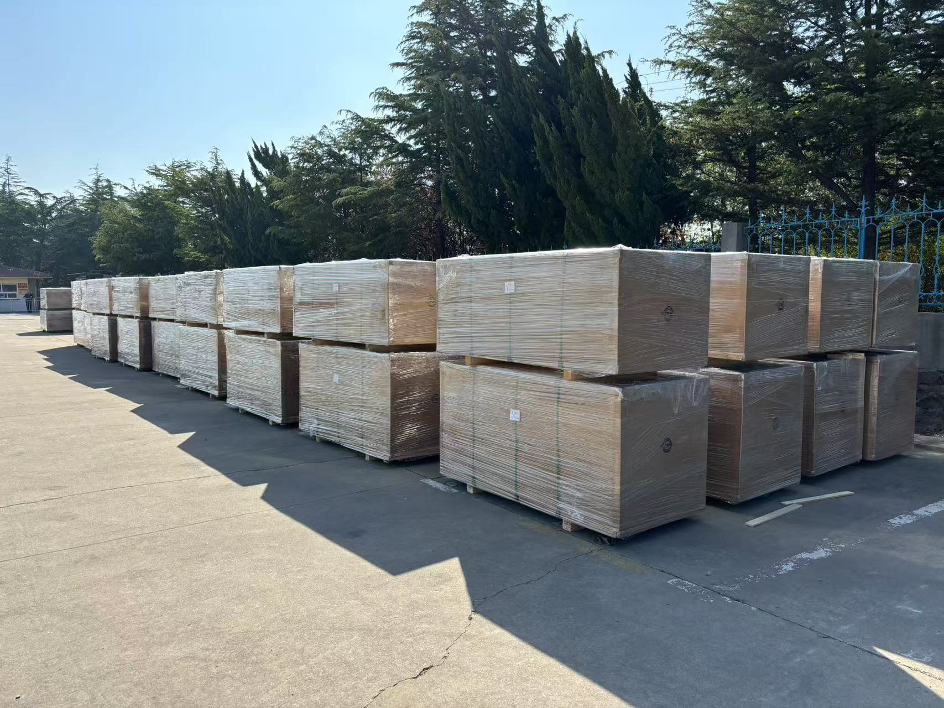
COMPANY OVERVIEW
About Hilywill
Qingdao Hilywill Advanced Materials Technology Co., Ltd is a leading high-tech enterprise specializing in the application of polymer new materials composed of rubber and plastics. Our primary focus is on the research, development, and production of rubber sealing products, vibration and noise reduction products, polyurethane products, composite material products, waterproof materials, and other polymer material products.
Hilywill products are widely used for sealing, shock absorption, and lightweighting in the automotive, locomotive, and railway industries, as well as for waterproofing and high-performance improvement in railway bridges and tunnel construction.
With operations in the United States through Hilywill Technologies LLC, we are committed to bringing world-class composite rail solutions to the North American market.
Hilywill Technologies LLC 7763 N Haggerty Rd, Canton, MI 48187 Sam Liu | Phone: +1 (313) 9306791 Email: samliu@hilywill.com
US CONTACT
CERTIFICATIONS & STANDARDS
ISO 9001:2015 Quality Management TB/GW161-2019 HFFP Bridge Tie Standard
CJ/T 399-2012 LFFP Transit Tie
JISE 1203:2007 Japanese Standard Compliant

Slide 3
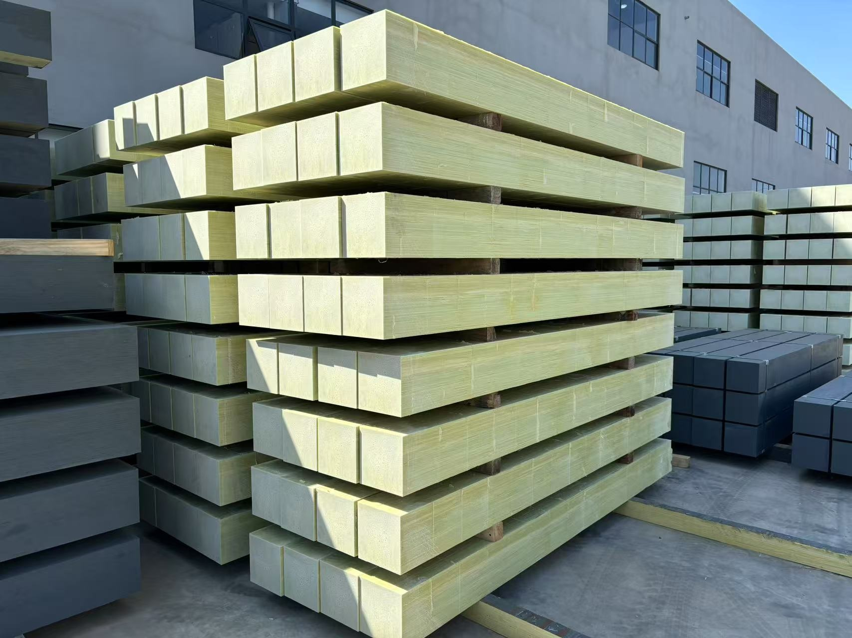
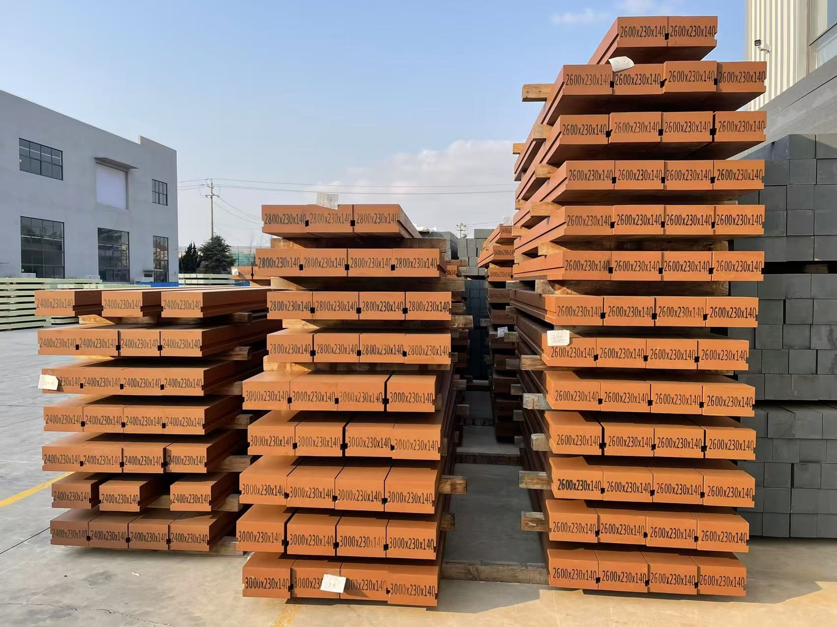
PRODUCT LINE
FFU Railroad Tie Product Line
Two density specifications engineered for specific track applications
HFFP TIE
75 lb/ft³
LFFP TIE
46 lb/ft³
High-Density Bridge Tie
Lightweight Synthetic Fiber-Foam Tie
(1,200 kg/m³)
(740 kg/m³)
Primary application: Steel bridge ties
Standard: TB/GW161-2019
Over 20,000 ties installed on Chinese rail lines
Proven 20+ year track record
Applications: Subway, light rail, urban transit
Standard: CJ/T 399-2012; JISE 1203:2007
Installed in 20+ cities: Shanghai, Guangzhou, Nanjing
Exported to multiple Southeast Asian countries

Slide 4
KEY FEATURES & ADVANTAGES
Why Choose Hilywill FFU Ties?
Exceptional Durability
Lightweight Construction
Weather-resistant, non-absorbent, and impervious to chemical media corrosion. Maintains full structural strength and dimensional precision over a service life exceeding 50 years — far outlasting traditional wood ties.
Low-density foam core gives these ties a weight similar to wood, making handling, transport, and installation straightforward with standard crew tools and equipment.
Superior Connection Strength
Excellent Electrical Insulation
Square and threaded rail anchors install securely with tensile strength substantially higher than wood ties. Connection strength is maintained after repeated removal and reinstallation cycles.
Non-conductive base material combined with a surface coating delivers high dielectric breakdown voltage and surface resistivity — ideal for signaling circuits and electrified transit systems.
Easy Machinability
Environmentally Responsible
Processed exactly like wood: can be slotted, drilled, ground, spiked, bonded, and painted. No special tooling required — existing MoW crews and equipment can handle installation.
Eliminates the need to harvest forest timber. End-of-life material can be ground and recycled or repurposed as structural components. Zero chemical treatment required (no creosote).

Slide 5
PERFORMANCE DATA
Technical Performance Specifications
All values shown in US/Imperial units. Metric equivalents in parentheses.
# | Test Parameter | Unit | HFFP Tie (Bridge) | LFFP Tie (Transit)
1 | Density | lb/ft³ | ≥75 (1,200 kg/m³) | ~46 (740 kg/m³)
2 | Bending Strength (MOR) | psi | ≥29,000 (≥200 MPa) | ≥10,150 (≥70 MPa)
3 | Bending Modulus (MOE) | × 10⁶ psi | ≥1.74 (≥12 GPa) | ≥0.87 (≥6 GPa)
4 | Compressive Strength | psi | ≥17,400 (≥120 MPa) | ≥5,800 (≥40 MPa)
5 | Shear Strength | psi | ≥2,610 (≥18 MPa) | ≥1,015 (≥7 MPa)
6 | Threaded Anchor Pull-Out Force | lbf | ≥13,500 (≥60 kN) | ≥8,990 (≥40 kN)
7 | Finished Product Bending Load | lbf | ≥224,800 (≥1,000 kN) | ≥38,220 (≥170 kN)
8 | Fatigue Cycles (Bending) | cycles | ≥2,000,000 | ≥100,000
9 | Strength Retention (1,000hr salt spray) | % | ≥95% | ≥95%
† Values detected after disassembly and reassembly ‡ No abnormalities observed after test completion

Slide 6
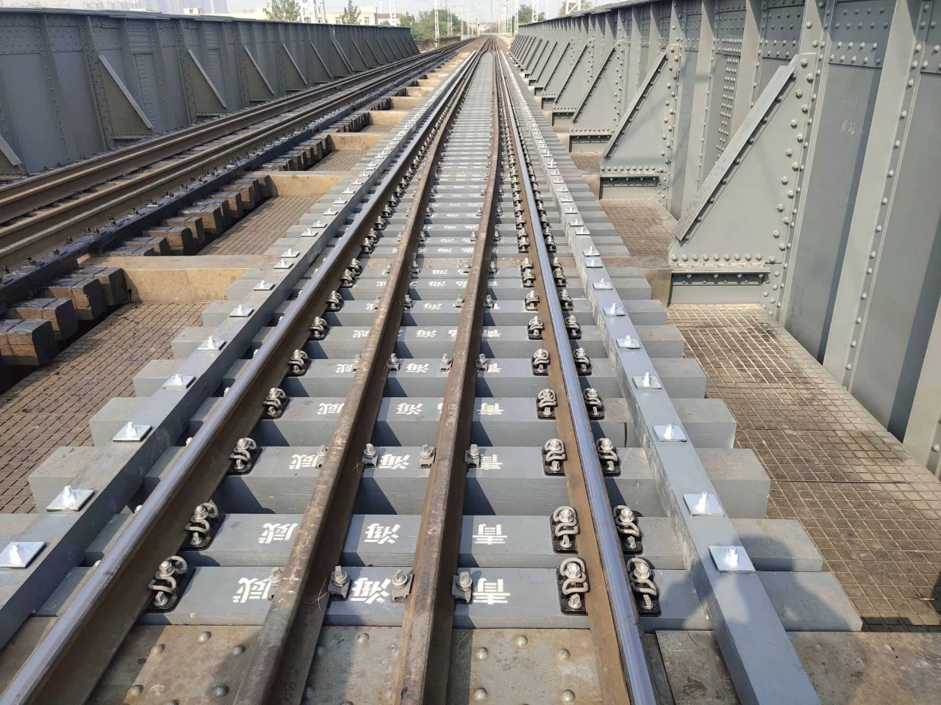
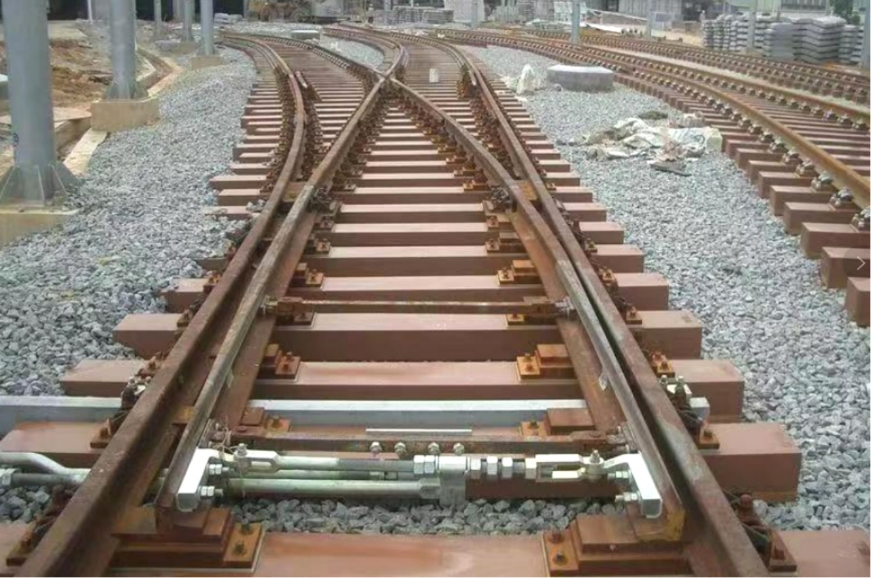
APPLICATIONS & INSTALLATION
Proven Performance Across Track Environments
Steel Railway Bridges
Subway & Light Rail
Switch & Turnout Zones
Heavy Haul Freight Rail
HFFP ties excel on steel truss bridges — reducing dead load while eliminating wood rot and tie replacement downtime.
LFFP ties prioritize low-vibration, high-insulation performance for urban transit systems including switch zones.
Installed as priority locations in turnout zones at subway and urban rail lines — cumulative volume over 35,310 ft³ (1,000 m³).
High compressive and bending strength handles demanding freight loads without creep or degradation over decades of use.

Slide 7
MANUFACTURING PROCESS
Continuous Pultrusion Manufacturing
STANDARD TIE DIMENSIONS (US)
Length | Width | Depth
94.5 in (2,400 mm) | 9.06 in (230 mm) | 5.51 in (140 mm)
98.4 in (2,500 mm) | 9.06 in (230 mm) | 5.51 in (140 mm)
102.4 in (2,600 mm) | 9.06 in (230 mm) | 5.51 in (140 mm)
110.2 in (2,800 mm) | 9.06 in (230 mm) | 5.51 in (140 mm)
118.1 in (3,000 mm) | 9.06 in (230 mm) | 5.51 in (140 mm)
1
Fiber Preparation
Continuous glass or carbon fibers are drawn from spools and aligned in the desired orientation for optimal structural properties.
2
Resin Infusion
Fibers pass through a resin bath containing polyurethane foam resin (ISO + POL components), ensuring full impregnation.
Custom lengths available per project specification.
All dimensions can be manufactured to order.
3
Mold & Cure
Impregnated fiber bundle passes through a heated precision mold, forming the final tie cross-section and curing the polymer matrix.
Both HFFP and LFFP ties are produced via continuous fiber-reinforced pultrusion using identical raw material types (glass fiber + polyurethane foam). The two product families are differentiated by raw material density grade, optimized for each application category. The raw material types are the same — different model numbers are specified to meet varying customer performance requirements.
RAW MATERIAL PROCESS
4
Pulling & Cutting
A precision puller draws the cured composite through the die at a controlled rate. A cut-off saw then cuts ties to specified lengths.

Slide 8
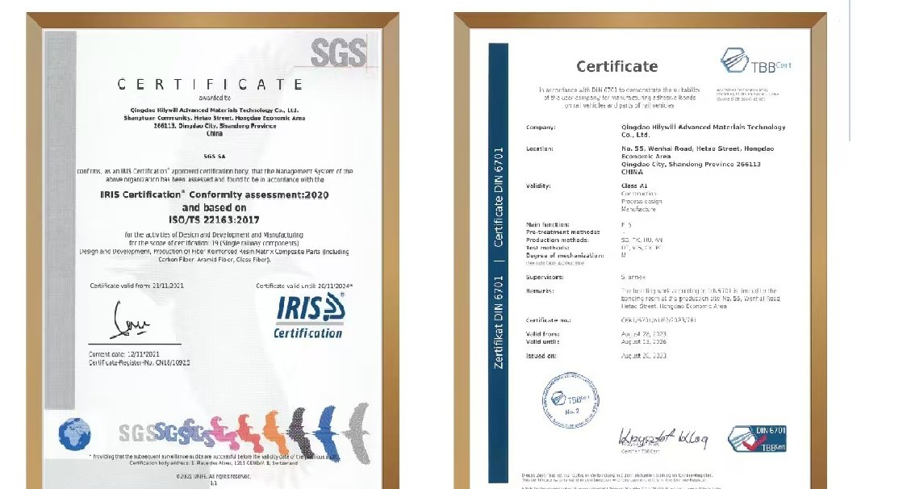
CERTIFICATIONS & STANDARDS
Quality Credentials & Technology Alignment
FFU COMPOSITE TIES TECHNOLOGY ALIGNMENT
Hilywill FFU composite railroad ties are manufactured using continuous fiber-reinforced polyurethane pultrusion technology and are designed to achieve performance characteristics comparable to leading industry FFU structural materials. Both product families share identical technology principles: continuous fiber-reinforced polyurethane foam pultrusion, comparable mechanical performance benchmarks, and equivalent service life expectations exceeding 50 years in revenue service.
CJ/T 399-2012 STANDARD TESTING
Hilywill LFFP ties are independently tested and certified to CJ/T 399-2012, the Chinese Urban Rail Transit standard governing synthetic fiber-reinforced polymer composite ties. This standard defines rigorous requirements for bending strength, modulus, fatigue life, electrical insulation, and dimensional stability — providing verifiable performance assurance for transit operators worldwide.
IRIS Certification
DIN 6701 (TBBCert)
CJ/T 399-2012
ENGINEERED FFU COMPOSITE SOLUTION
ISO/TS 22163:2017
Railway Component Mfg.
Adhesive Bonding for
Rail Vehicles — Class A1
Urban Rail Transit
Composite Tie Standard
FFU Technology &
Performance Benchmarks

Slide 9
Ready to Upgrade Your Track Infrastructure?
Contact our US team to discuss specifications, project quantities, and delivery schedules.
US Office
Sales Contact
Email
Hilywill Technologies LLC
7763 N Haggerty Rd, Canton, MI 48187
Sam Liu
Phone: +1 (313) 930-6791
samliu@hilywill.com
www.hilywill.com
The Leader and Wisdom Sharer in the Application of New Polymer Materials
© 2026 Qingdao Hilywill Advanced Materials Technology Co., Ltd | All rights reserved | Hilywill Technologies LLC – US Distribution/Manufacturing Plant

