Slide 2
Day 1: C Programming - Variables, Data Types & Arithmetic Expressions
By Himayoun

Slide 3
Previous.
Understand what programming and C are
-Compile and run basic programs
-Understand program structure
-Get familiar with an IDE

Slide 4
Hook for Lecture
Have you ever tried calculating your expenses, average marks, or simple interest manually?
What if I told you, you could make the computer do all that in milliseconds?
Today we will learn how to make a computer do calculations using C programming.

Slide 5
Understanding Pseudocode and Flowcharts
Pseudocode and Flowcharts are tools for algorithm design.
Use pseudocode for writing logic.
Use flowcharts for visualizing flow.
Both help in building better programs.

Slide 6
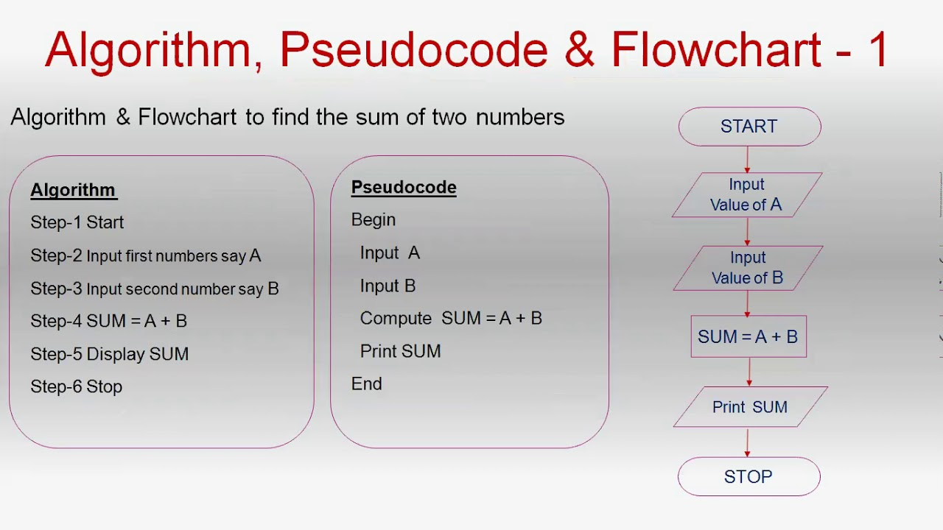

Slide 7
Topics for Today
Variables in C
Data Types: int, float, char
Type Conversion: Implicit vs Explicit
Arithmetic Operators: +, -, *, /, %

Slide 8
1. Variables in C
Variables are containers to store data values.
Syntax: dataType variableName = value;
Example: int age = 21;

Slide 9
2. Data Types
int: for integers (e.g., 10, -5)
float: for decimal values (e.g., 3.14)
char: for single characters (e.g., 'A')
Note: No 'bool' in traditional C

Slide 10
3. Arithmetic Operators
Addition: +
Subtraction: -
Multiplication: *
Division: /
Modulus: % (remainder)

Slide 11
4. Type Conversion
Implicit: Done automatically by compiler
Example: int + float → float
Explicit: Done manually using casting
Example: (int)3.14 → 3

Slide 12
Hands-on Practice: Code 1
Take 2 numbers from user and show sum, difference, and product:
#include<stdio.h>
int main() {
int a, b;
printf("Enter two numbers: ");
scanf("%d %d", &a, &b);
printf("Sum = %d\n", a + b);
printf("Difference = %d\n", a - b);
printf("Product = %d\n", a * b);
return 0;
}

Slide 13
Hands-on Practice: Code 2
Calculate Area of Circle:
#include<stdio.h>
#define PI 3.14
int main() {
float r;
printf("Enter radius: ");
scanf("%f", &r);
float area = PI * r * r;
printf("Area = %.2f\n", area);
return 0;
}

Slide 14
Hands-on Practice: Code 3
Simple Interest Calculation:
#include<stdio.h>
int main() {
float p, r, t;
printf("Enter principal, rate, time: ");
scanf("%f %f %f", &p, &r, &t);
float si = (p * r * t) / 100;
printf("Simple Interest = %.2f\n", si);
return 0;
}

Slide 15
Hands-on Practice: Code 4
Average of 3 numbers:
#include<stdio.h>
int main() {
float a, b, c;
printf("Enter 3 numbers: ");
scanf("%f %f %f", &a, &b, &c);
float avg = (a + b + c) / 3;
printf("Average = %.2f\n", avg);
return 0;
}

Slide 16
Type Casting Example
#include<stdio.h>
int main() {
float a = 5.9;
int b = (int)a;
printf("Value after casting = %d\n", b);
return 0;
}

Slide 17
Goal of the Day
Understand variable declaration and usage
Perform basic arithmetic using operators
Learn type conversions (implicit & explicit)
Practice basic input/output and problem-solving

