Slide 1
Day_02: Conditional Statements and Loops in C
Presented by: Himayoun

Slide 2
Topics Covered So Far
Introduction to C Programming
Pseudo Code and Flowcharts
Variables and Data Types
Arithmetic Expressions

Slide 3
TODAY'S Topics:
Conditional Statements (if, if-else, nested if, switch)
Loops (while, for, do-while)

Slide 4
Conditional Statements
Conditional statements are used to make decisions in a program.
Types:
1. if statement
2. if-else statement
3. nested if
4. switch-case
Example:
if (a > b) {
printf("A is greater");
}

Slide 5
if-else and nested if
if-else provides two paths of execution.
Example:
if (a > b) {
printf("A is greater");
} else {
printf("B is greater");
}
Nested if:
if (a > b) {
if (a > c) {
printf("A is the largest");
}
}

Slide 6
Switch-Case Statement
Used when there are multiple conditions based on a single variable.
Example:
switch(day) {
case 1: printf("Monday"); break;
case 2: printf("Tuesday"); break;
default: printf("Invalid day");
}

Slide 7
Introduction to Loops
Loops are used to repeat a block of code.
Types of Loops:
1. while loop
2. for loop
3. do-while loop

Slide 8
while and for Loops
while loop:
int i = 0;
while (i < 5) {
printf("%d ", i);
i++;
}
for loop:
for (int i = 0; i < 5; i++) {
printf("%d ", i);
}

Slide 9
do-while Loop
do-while loop runs the code at least once.
Example:
int i = 0;
do {
printf("%d ", i);
i++;
} while (i < 5);

Slide 10
Practice Problems
Practice 1: Find maximum of three numbers using nested if
Practice 2: Print even numbers from 1 to 100 using for loop
Practice 3: Sum of digits of a number using while loop
Practice 4: Display menu and take user choice using switch-case

Slide 11
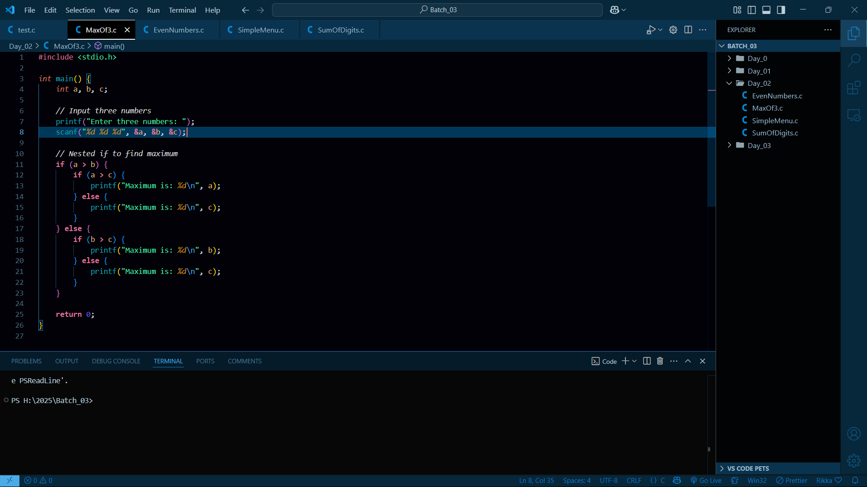

Slide 12
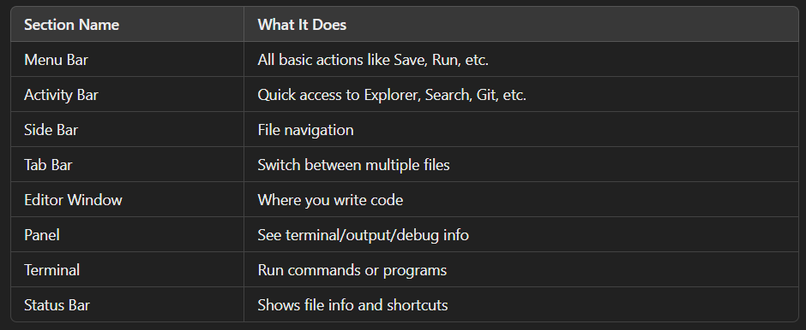


Slide 13
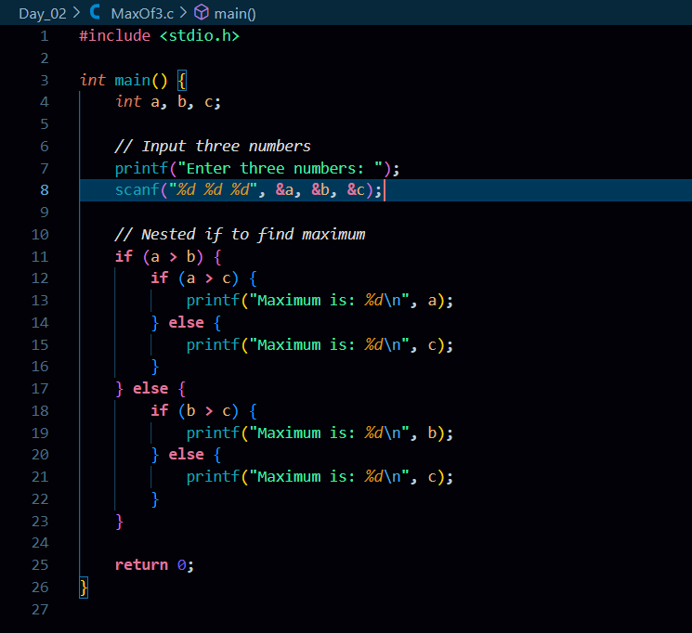

Slide 14
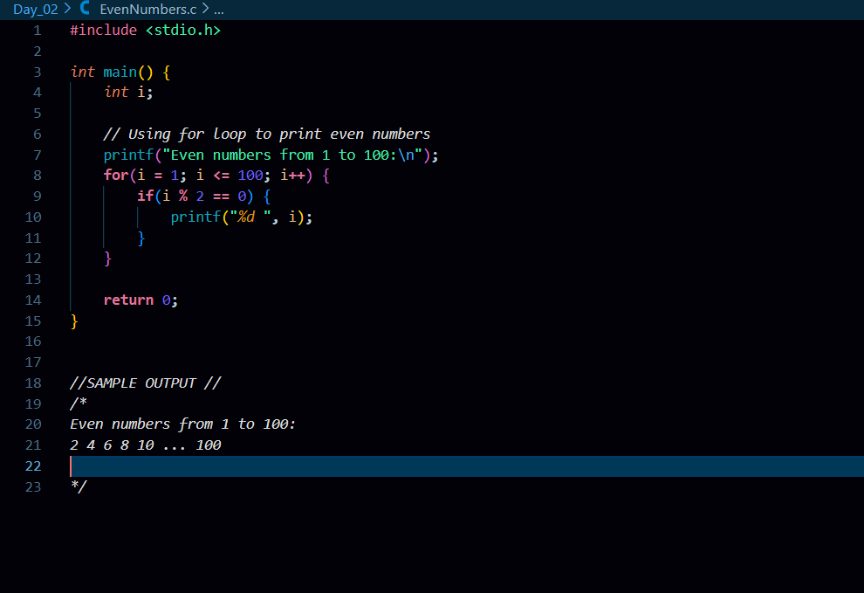

Slide 15
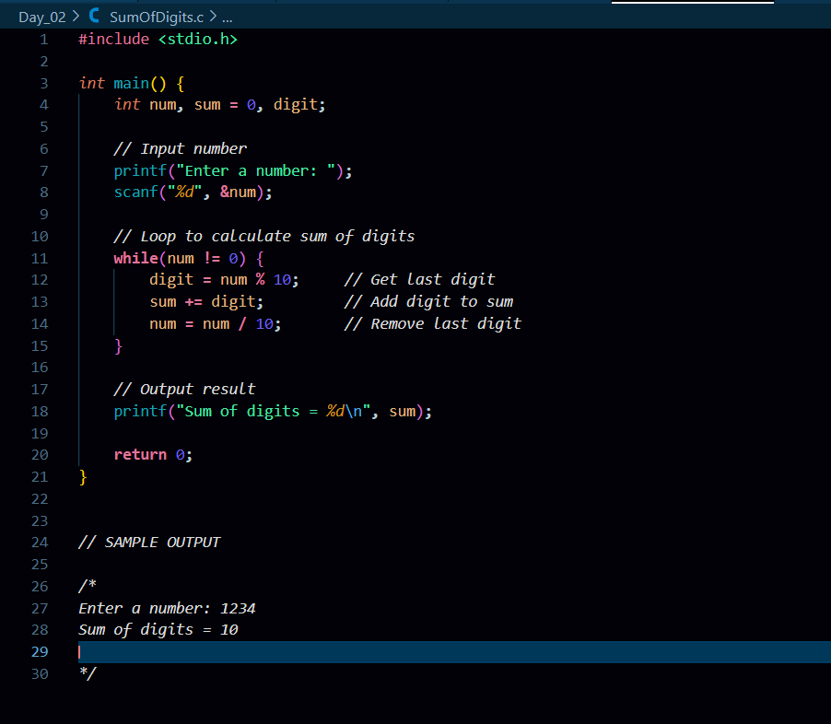

Slide 16
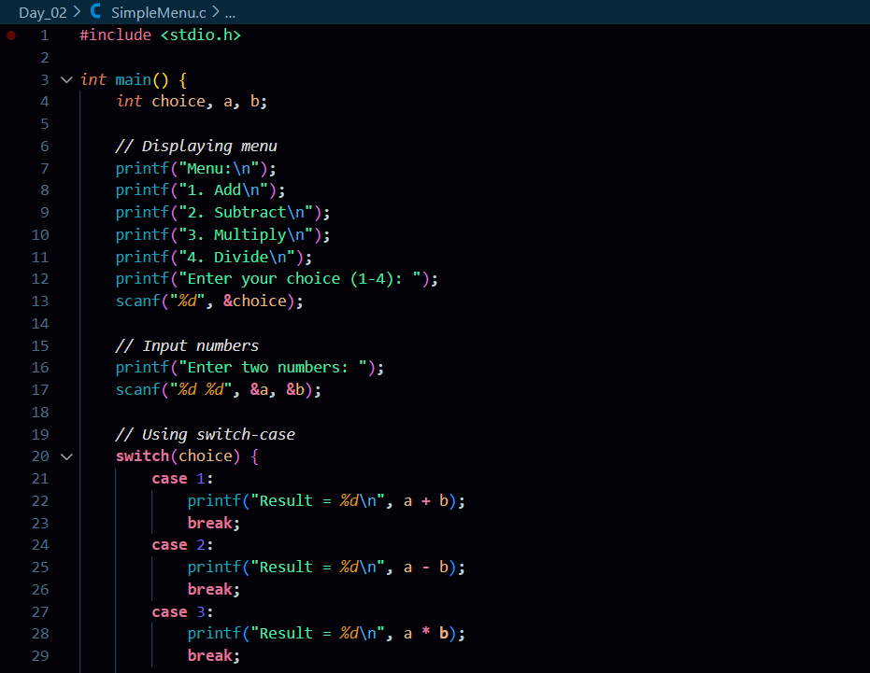

Slide 17
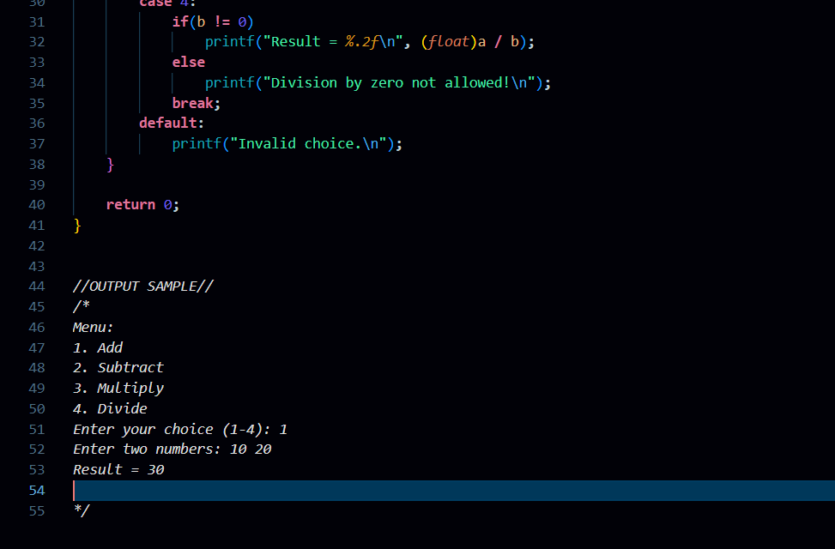

Slide 18
Goal of the Day
Understand:
Conditional Statements
Loops
Code Examples

